Slide 1

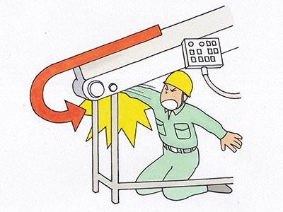
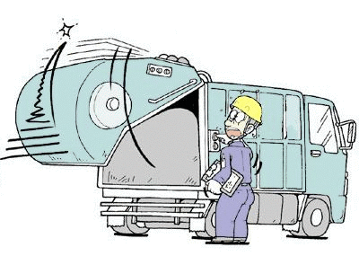
For People Working in the Industrial-waste Disposal Sector
For Your Safety and Health at Work

Slide 2
Procedures of Safety and Health Education for Inexperienced Workers
1. Help them understand various types of danger in the workplace.
2. Help them recognize danger of something that "may" take place.
3. Help them learn the basics of industrial accident prevention (1).
Help them learn various types of rules and activities.
(1) Safety in the workplace starts with being suitably dressed.
(2) Adhere to work procedures.
(3) Practice the 4S / 5S principles.
(4) Near-miss incidents analysis
(5) Risk prediction training
(6) Risk assessment
4. Help them learn the basics of accident prevention (2).
Work safely together to keep the workplace safe for all.
(1) Key points for accident prevention: Getting stuck or caught
(2) Key points for accident prevention: Falling
(3) Key points for accident prevention: Slipping / Stumbling
(4) Key points for accident prevention: Lower-back pain
(5) Key points for accident prevention: Collision
5. Help them learn the basics of accident prevention (3).
Help them learn what to do when any abnormality or accident should happen.
 What to do when any abnormality should happen.
 What to do when any accident should happen.

Slide 3
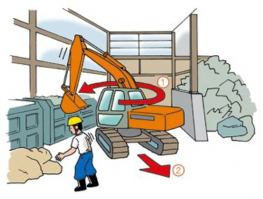
Key point 1: You are surrounded with various types of danger at work!
[Industrial accident: Case 1] A worker was run over by a power shovel and killed while sorting out industrial waste.
1. How did the accident occur?
(1) Victim C was sorting out metal waste in a yard.
(2) Worker A started to move a power shovel parked near the yard toward an approach for trucks.
(3) Rotating left and moving forward some 2 meters, the right crawler of the machine ran over Victim C.
  2. What was the cause of the accident?
Victim C
(1) No measures were taken to keep workers out of an operation path for power shovels.
(2) No one was designated as a guide.
(3) The operator failed to look around carefully and confirm safety before starting the machine.
(4) No work plan was prepared.
(5) No or little safety & health education had been provided for the workers concerned.
3. What should be done for safety in work.
(1) Designate any area as a no-go zone for workers when they may interfere with a power shovel there.
(2) Designate someone to guide a machine.
(3) Train operators for power shovels and other machines to look around carefully and confirm safety before starting a machine.
(4) Prepare a work plan specifying operation paths, no-go zones, designation of guides, communication, etc.
(5) Have a work plan, once prepared, fully recognized and understood by workers concerned.

Slide 4
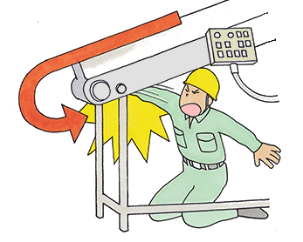
[Industrial accident: Case 2] While cleaning a roller of a conveyor before bringing it to a halt, a worker had his right arm caught and pulled in, almost to the shoulder.
1. How did the accident occur?
(1) He was working alone to rub off plaster from a roller of a conveyor set up for a crusher using a wire brush.
(2) He neglected to stop the conveyor. The brush was caught by the conveyor, between the brush and the belt, with his right arm pulled in together.
2. What was the cause of the accident?
(1) The machine had no cover, wall, block, or anything set up at the return roller
for preventing workers from getting caught.
(2) He was cleaning the roller before bringing the conveyor to a halt.
(3) He was cleaning the roller with leather gloves on; a type of gear with significant danger of getting caught.
(4) No emergency stop device had been installed within easy reach.
(5) He failed to adhere to the safety rules set for the plant (for instance, "Lock the power unit before starting repair work.").
3. What measures should be taken?
(1) Set up covers, walls, or blocks around any parts of a machine where workers may get caught.
(2) Never fail to stop a machine and lock the power unit before workers start cleaning or doing any other work that may otherwise expose them to danger.
(3) Replace return rollers with those designed to shed plaster.
(4) Train workers never to come close to rotating parts of a machine that they may get caught in.
(5) Prohibit workers from handling a rotating object with gloves on when there is any danger of having their hand caught in it.
(6) Develop safety management arrangements helpful to have rules fully implemented at the workplace once set for it.

Slide 5
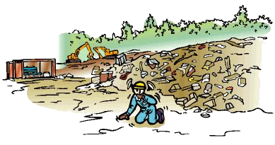
[Industrial accident: Case 3] A worker suffered heatstroke and died while working at an industrial waste site.
1. How did the accident occur?
(1) He started working around 8:00 a.m. to sort out construction debris.
(2) At noon, he had lunch there in a vacant drum can.
(3) A little after 3:00 p.m., he staggered, before collapsing.
(4) Saying "I feel sick," he tried to walk to an office, but clutched and stopped moving.
(5) A colleague came and called over to him. He made no response, and was unable to drink something offered.
(6) He was taken to an air-conditioned car, and showing no sign of recovery, was transferred to a hospital. He died of heatstroke at 11:00 p.m.
2. What was the cause of the accident?
(1) He continued working for a long time in severe heat, without taking enough water and salt.
(2) He failed to get suitably dressed when exposed to direct sunlight while working; he should have, for instance, wrapped a towel around his head before putting on a safety helmet.
(3) His physical condition was less than perfect. (No condition check was performed that day.)
3. What measures should be taken to prevent similar accidents?
(1) Offer workers an opportunity to learn about heatstroke.
(2) Take enough water and salt regularly before and while working.
(3) Dress suitably, such as putting on cotton work clothes and a wide-brimmed hat.
(4) Prepare a cool rest area; for instance, somewhere in the shade, to take brief breaks there. Offer access to a refrigerator, a shower, etc.
(5) Provide appropriate first aid.
(6) Perform appropriate health management on a day-to-day basis.

Slide 6
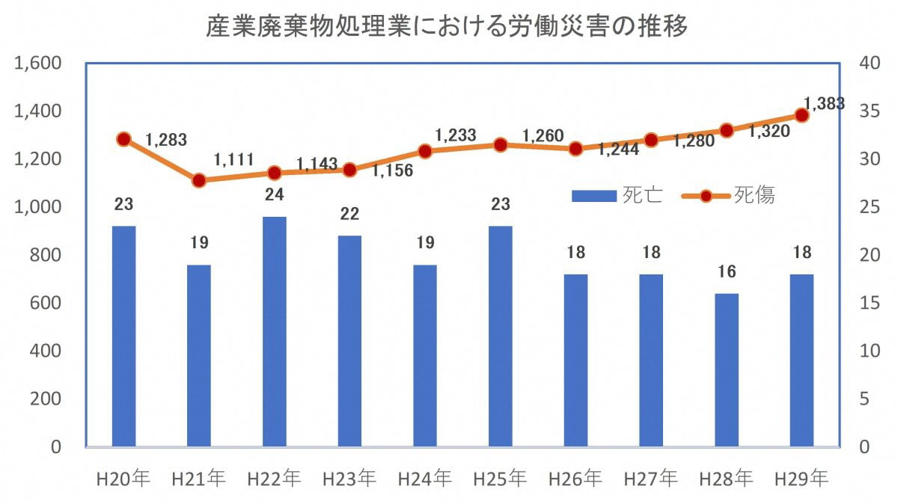


[Characteristics of Accidents in the Industrial-waste Disposal Sector]
1. Fatalities plus injuries in accidents are on an upward trend.
Fatalities by themselves are on a moderate downward trend.
2. Among the fatalities, "Getting stuck or caught" accounts for 50%, followed by "Collision" and "Traffic accident."
3. Among the fatalities plus injuries, "Falling" and "Getting stuck or caught" each account for 21%.
Accidents in the Industrial Waste Disposal Sector
Fatalities
Fatalities & Injuries
2008 | 2009 | 2010 | 2011 | 2012 | 2013 | 2014 | 2015 | 2016 | 2017
Contact with harmful substances
6%
Drowning
6%
Other
16%
Collapse
5%
Falling
21%
Falling
5%
Cut / Scratch
5%
2017
1,383 Fatalities & Injuries
2017
18 Fatalities
Getting stuck or caught
50%
Collision
6%
Traffic accident
11%
Hit by falling objects
9%
Getting stuck or caught
21%
Collision
17%
Reaction / Unreasonable action
10%
Slipping / Stumbling
12%

Slide 7
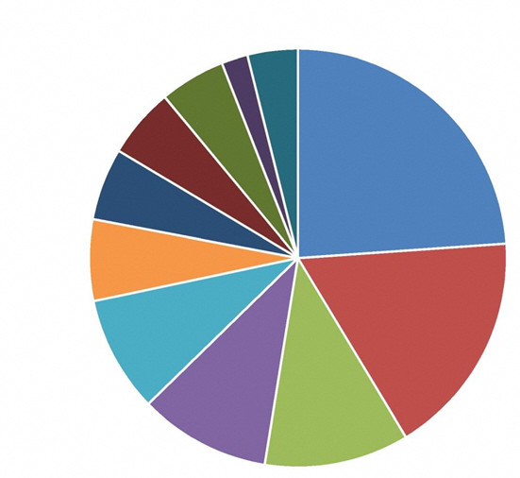
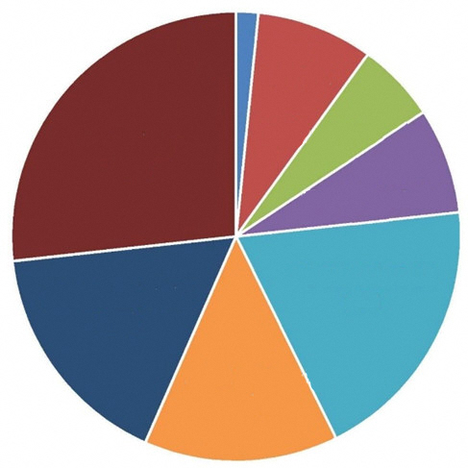
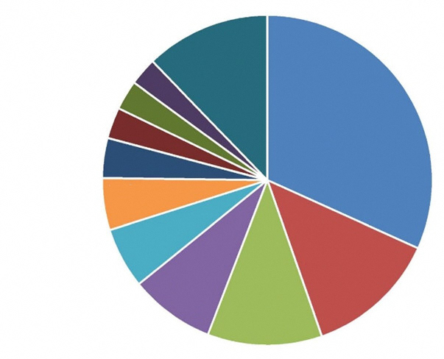
Among those involved in accidents, inexperienced workers account for more than 40%.
○ Among those involved in accidents in the industrial-waste disposal sector, classified into age groups, workers with experience of less than three years account for the largest share, 43%.
Puncture injury on the sole
2%
Traffic accident (road)
5%
Other
4%
Collision
5%
<1 month
1%
Cut / Scratch
6%
Getting stuck or caught
24%
1‒3 months
8%
3‒6 months
6%
Collision
6%
10 years ≤
27%
<1 year
23%
Falling
18%
6‒12 months
8%
Hit by falling objects
9%
Reaction / Unreasonable action
10%
Slipping / Stumbling
11%
1‒3 years
19%
5‒10 years
17%
3‒5 years
14%
Other facilities & equipment
3%
Other
12%
<3 year
43%
Man-powered machines & tools
3%
Power-driven transporting machine
32%
○ Among inexperienced workers involved in accidents, classified into accident types, those "Getting stuck or caught" account for the largest, 24%.
○ Among inexperienced workers involved in accidents, classified into types of equipment responsible, those using a "power-driven transporting machine," such as dump trucks and conveyors, account for the largest, 32%.
Vehicle
3%
General power-driven machines
4%
Equipment
5%
Construction machine, etc.
6%
Temporary facilities, building, structure, etc.
13%
Freight
8%
Raw materials
11%

Slide 8
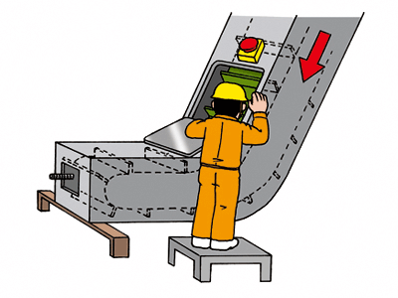
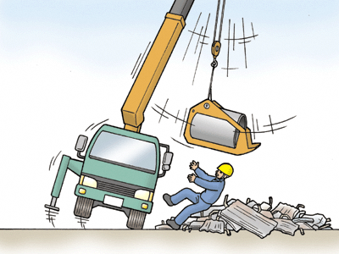
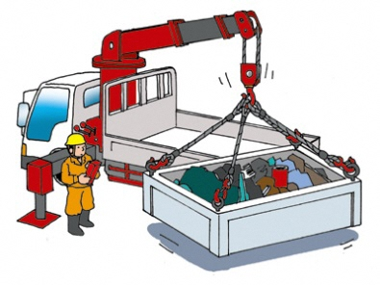
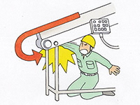
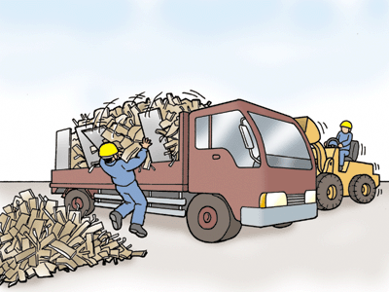
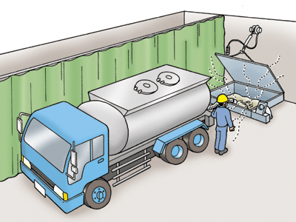
Key point 2: Recognize danger of something that "may" take place.
[Something "may" take place for persons.]
[Something "may" take place for things.]
A person ...
fall;
suffer lower-back pain;
stumble & fall down;
get stuck;
get caught;
collide;
be hit;
get burnt;
get an electric shock;
get gassed;
suffer oxygen deficiency; or
suffer from a harmful substance;
④
①
A thing ...
move;
rotate;
fly apart;
fall;
come off;
catch fire;
come down;
collapse;
explode; or
leak out;
May
⑤
②
③
⑥

Slide 9
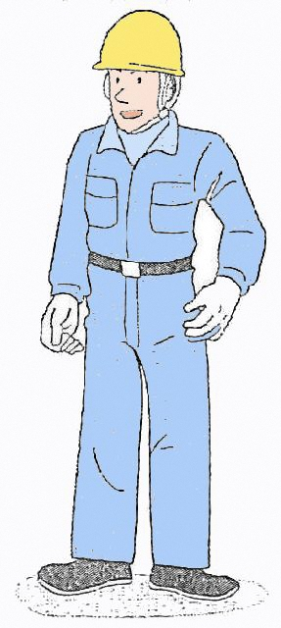
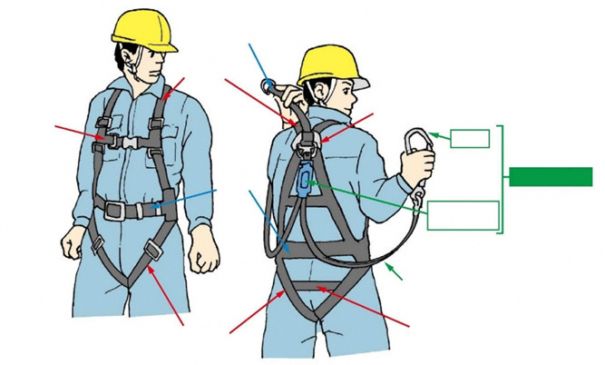
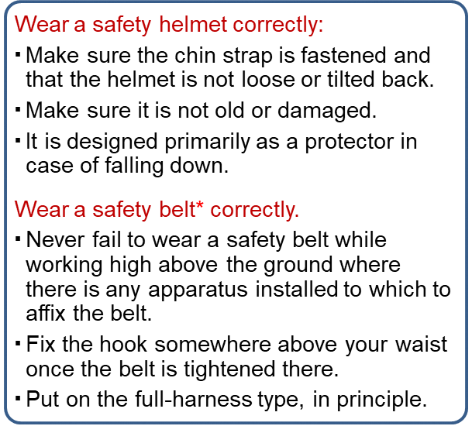
Key point 3: Safety in the workplace starts with getting suitably dressed.
Wear a safety helmet correctly:
$$ Make sure the chin strap is fastened and that the helmet is not loose or tilted back.
▪ Make sure it is not old or damaged.
▪ It is designed primarily as a protector in case of falling down.
Wear a safety belt* correctly.
▪ Never fail to wear a safety belt while working high above the ground where there is any apparatus installed to which to affix the belt.
▪ Fix the hook somewhere above your waist once the belt is tightened there.
▪ Put on the full-harness type, in principle.
▪ Have you put on a safety helmet and tightened the chin strap? (Never wear a towel or anything similar under it.)
▪ Did you leave a towel wrapped around the neck?
▪ Do your work clothes have any rip or tear?
▪ Have you fastened the cuffs?
▪ Have you put on a safety belt (while working at a high place, two meters or more above the ground)?
Removable connecting belt
Shoulder belt
▪ Have you put on safety shoes?
Chest belt
D-Ring
Hook
Body belt
Lanyard (double)
* With a revision of the law, "safety belt" has been renamed "fall-arrest system."
Shock absorber
Lanyard
Thigh belt
Pelvis belt

Slide 10

Key point 4: Adhere to work procedures once established.
 You may encounter various unexpected dangers in the workplace.
 Work procedures are set for safety, health, and efficiency at work.
 You can adhere to work procedures and protect yourself.
Work Procedures
 Adhere to work procedures (working standards) once established.
 Rehearse established work procedures repeatedly until completely mastering them.
 Fully understand what you should and should not do for safety.
 Never fail to consult a supervisor when you find anything you do not understand among the
work procedures.
 Be careful when you get accustomed to a procedure, as you often suffer injuries at that time. Careless or unreasonable actions must be avoided.
[Example: Work of Sorting]
○ While sorting out waste, workers must remove dangerous goods, such as spray cans and gas cartridges, sealed objects, and anything unidentifiable. They must be returned to those who brought them, when identified, and otherwise sent to specialists for disposal.
○ When workers sort out waste in a receiving yard or at any similar facility, some measures must be taken to prevent them from interfering with forklifts, trucks. or other vehicles. For instance, separate zones should be set for workers and vehicles, or someone should be designated as guide for vehicles.
○ Workers must put on necessary protection equipment, such as a safety helmet, protective goggles, dust mask, safety shoes, and leather gloves.
○ When it is feared that dust may fly up, wastes must be sprinkled with water, so that they will get suitably wet.
○ When workers handle heavy objects by hand for sorting or any other work, they must not carry anything heavier than a prescribed weight, and should work in a manner that places less burden on their lower back. When multiple employees work together, someone must be designated as the leader and the others must follow him/her.

Slide 11
Key point 5: Practice the 4S / 5S principles for safety.
Seiri (Classify) | Separate what you need from what you do not, to dispose of the latter. (Something unnecessary, just abandoned at the workplace, may make you stumble and fall and/or disturb the work flow.)
Seiton (Set in order) | Place everything you need where you can find it quickly. (Work efficiency falls when you waste much time to find something you need. A photo of the workplace, taken when everything is arranged properly, would help you keep it in good order.)
Seiketsu (Keep clean) | Remove dirt to keep everything clean. (The workplace must always be clean to keep machines working properly. When you deal with anything to be delivered to customers, the workplace must be kept clean to ship it with no dirt left on.)
Seiso (Clean up) | Remove any dirt and waste from machines, tools, and handling and storing yards. (The wet floor must be wiped up quickly lest anyone should slip and fall.)
Shitsuke (Establish discipline) | Follow rules strictly. Repeat proper procedures until they become a custom. (Seiri, Seiton, Seiketsu, and Seiso are of no use when merely understood. The principles must be established as a custom that you practice.)

Slide 12
 When the 5S principles are not fully practiced...
Problems, such as mentioned below, may arise. They must be meticulously practiced.
If you fail to fully practice 5S principles in the workplace ...
Occupational accidents and/or diseases occur.
 Workplace conditions deteriorate.
 An accident is caused by actions for work.
Productivity falls.
 Unreasonable and/or wasteful work impairs efficiency.
 Machines fail and/or troubles occur.
 Delay arises in shipment.
Failure to practice 5S
Confidence is lost.
 Customers are disappointed.
 Morale falls among workers.
Pollution is caused.
 Oil or other hazardous materials are leaked.
 Offensive smells are emitted.
Resources are wasted.
 Raw materials are wasted.

Slide 13
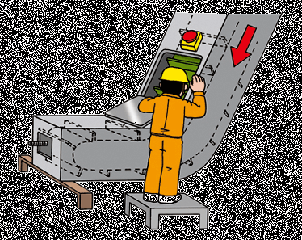
Key point 6: Work safely together to keep the workplace safe for all.
(1) Key points for accident prevention: Getting stuck or caught
Given industrial accidents that have ever observed in the manufacturing sector, below are key points of safety measures you must practice.
○ Workers must keep in mind safety at work.
A worker may have to visit a plant of customers to work there alone.
He/She must personally make sure to abide by safe work procedures
○ Stop a conveyor before removing objects stuck there or
carrying out an inspection or repair.
 Make sure to stop a conveyor before removing objects stuck
there or carrying out an inspection or repair.
 Never step over a conveyor.
○ Make sure to avoid interfering with a heavy machine or a forklift when walking in a plant.
 Walk in safety aisles.
 Never jump out from behind an object.
○ Heavy machine operators must make sure to avoid interfering with walkers.
 When finding a machine you have parked moving on its own, never try to get on or stop it.
 Never hang out of the driver's seat.
 Make sure to avoid interfering with walkers while operating a heavy machine carrying something.

Slide 14
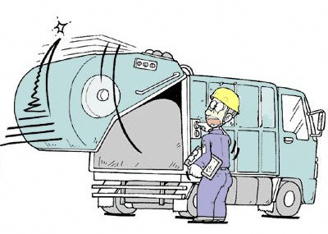
[Cases of accident: Getting stuck or caught]
○ Case 2-1: A worker was working to rub off plaster from a roller of a conveyor set up for a crusher, using a wire brush. He neglected to stop the machine. The brush was caught by the conveyor, between the roller and the belt, with his right arm pulled in together, almost to the shoulder.
○ Case 2-2: A worker left a conveyor running when examining tension of its chain. He was caught by a component of the moving machine.
○ Case 2-3: A worker was inspecting a garbage truck (packer). He was going to examine the joint between the body and the tailgate when lifting up the gate. The gate suddenly fell down and he was stuck. Struck by the car, he almost fell into the pit.

Slide 15
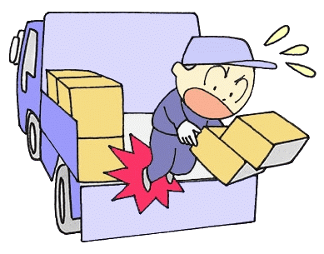
(2) Key points for accident prevention: Falling
Given industrial accidents that have ever observed in the manufacturing sector, below are key points of safety measures you must practice.
○ Workers must keep in mind safety at work.
You may have to visit a plant of customers to work there alone.
You personally must make sure to abide by safe work procedures.
○ Refrain from standing on a tailgate while working.
When working on a bed, you must set up a movable platform,
for instance, and avoid standing on a tailgate.
○ Use a platform to load a truck.
When working in a plant of a customer, you must ask them for permission to bring in a platform there.
(Photo 3)
○ Never fail to use a "fall-arrest system"* where there is any apparatus installed to which to affix the system.
While working high above the ground, such as on a heap of waste placed on a truck, you must always wear a "fall-arrest system" where there is any apparatus installed to which to affix the system. (Photos 1 & 2)
* With a revision of the law, "safety belt" has been renamed "fall-arrest system." (See Slide 9)

Slide 16
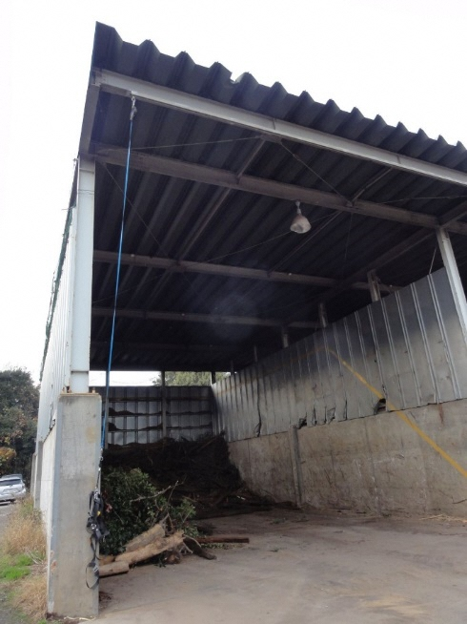
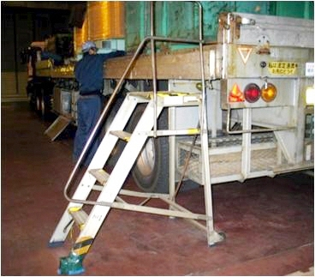
[Examples of measures for preventing accidents: Falling]
Given industrial accidents that have ever observed in the manufacturing sector, below are key points of safety measures you must practice.
Photo 1: Apparatus installed to get a fall-arrest system fixed to it
Photo 2: Apparatus installed to get a fall-arrest system fixed to it
Phot 3: Platform set beside a truck

Slide 17
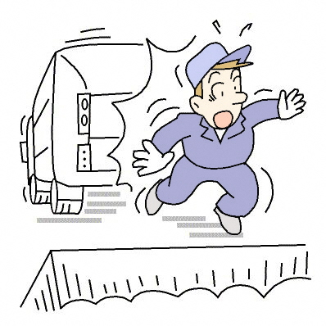
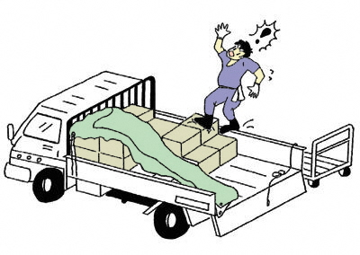
[Cases of near-miss incidents: Falling]
○ Case 1-1: A worker was guiding a garbage truck while it was going backwards to a waste pit. Having stepped back, he was hit by another truck, going backwards to the next pit, and almost fell down into it. he was hit by another truck, going backwards to the next pit, and almost fell down into it.
○ Case 1-2: A worker finished loading a truck with 25 cardboard boxes, each filled with 15 kg of documents to be disposed of. He then started covering the bed with a tarpaulin. He first fixed the tarp to the left side panel. To cover the entire load, he was walking between the boxes and the right side panel when he stumbled and almost fell down. he was hit by another truck, going backwards to the next pit, and almost fell down into it.

Slide 18
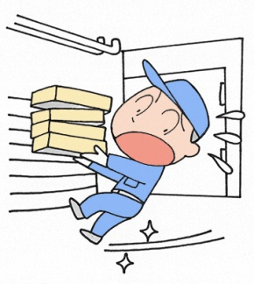
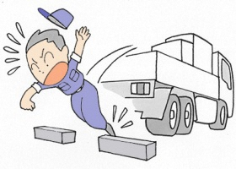
(3) Key points for accident prevention: Slipping / Stumbling
○ Carrying something in your hand is quite dangerous, as you may slip or stumble and fall.
 Carrying something in your hand, you have a greater risk of
slipping or stumbling and falling, as you cannot see where to
step and keep your balance.
 Never rush down the stairs with anything in your hand.
○ Keep the floor safe: Seiri, Seiton, Seiso, and Seiketsu.
 Wipe up the wet floor. (Be careful of the wet floor while cleaning.)
 Never leave anything unnecessary in the workplace. Someone may stumble on it and fall.
○ Carry anything large or heavy on a dolly.
When no dolly is available, you must ask a colleague to carry
things together or divide them into several sets to carry them.
○ Put on shoes in which you are less likely to slip and stumble.
Given industrial accidents that have ever observed in the manufacturing sector, below are key points of safety measures you must practice.

Slide 19

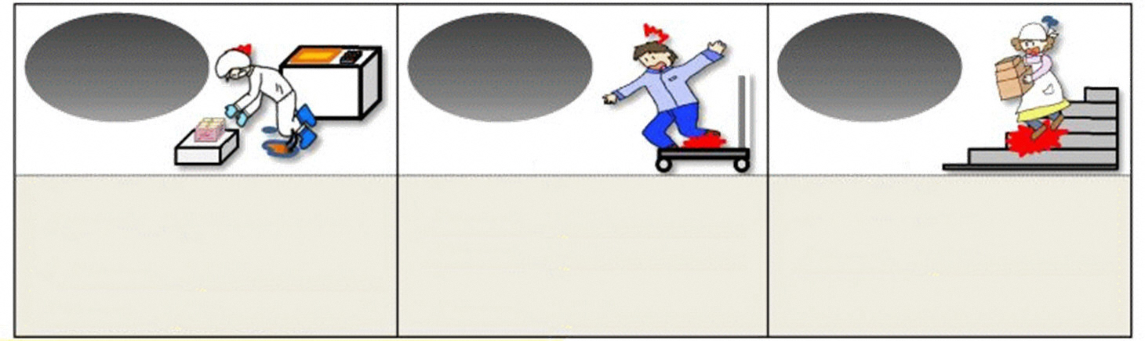
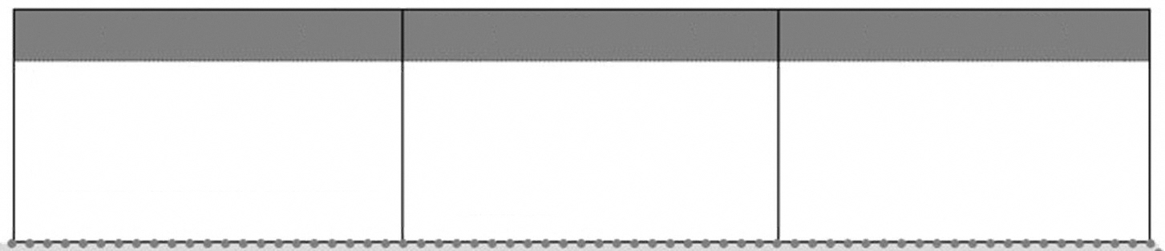
No Slip & Stumble Accident Project
<Major causes of falling>
Slipping
Stumbling
Misstep
<Major causes>
▪ The floor is covered with a slippery material.
▪ The floor has water or oil spread on it.
▪ The floor has pieces of vinyl, pieces of paper, or something slippery left on it.
▪ The road surface is frozen.
<Major causes>
▪ The floor is uneven or has steps on it.
▪ The floor has freight or goods left on it.
<Major causes>
▪ A worker cannot see where to step as, for instance, she is holding something large.
<Key points for accident prevention: Slipping / Stumbling>
4S (Seiri, Seiton, Seiso, & Seiketsu)
Work procedures helpful to prevent slipping & stumbling
Other solutions
▪ Leave nothing on a pathway.
▪ Remove dirt (water, oil, powder, etc.) on the floor.
▪ Eliminate unevenness, steps, etc. on the floor.
▪ Secure enough time for any action.
▪ When on a slippery surface, walk with short steps.
▪ Never start working when you cannot see where to step.
▪ Put on shoes suitable for walking & working.
▪ Prepare a hazard map of the workplace to share risk information.
▪ Place a sticker where someone may slip/stumble and fall for warning.

Slide 20
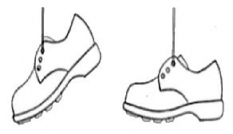
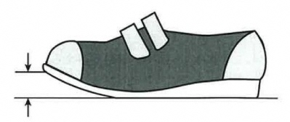
(Reference)
[How to choose appropriate shoes]
<Key points for choosing shoes helpful for avoiding slipping / stumbling>
Size
When wearing shoes that are too small or too large, you cannot avoid harm and easily lose your balance.
Flexibility
In inflexible shoes, your feet may slide, which may cause you to stumble.
×
○
Weight
In too heavy shoes, you cannot lift your legs easily, which may also cause you to stumble.
Weight balance
(toe & heel)
With a disproportionately heavy forefoot, you may walk with your toes down, another cause of stumbling.
Toe height
With too small a toe spring, you may easily stumble on the lowest step.
An appropriate level of slip resistance for the place and type of work is critical. For instance, when you work in shoes with less slippery soles on a less slippery floor, excessive friction between them may cause you to stumble.
Balance in slip resistance between sole and floor
(Toe spring)

Slide 21
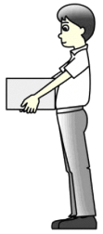
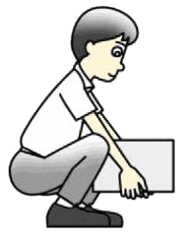
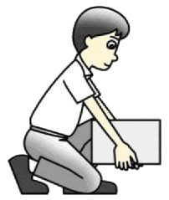
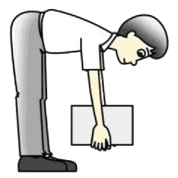
(4) Key points for accident prevention: Lower-back pain
○ Work positions and actions (when handling heavy objects)
Stand as near as possible to a heavy object and hold it with your center of balance kept lower.
[How to lift up a heavy object]
(1) Place one of your feet slightly forward and bend your knees, before fully squatting down to hold a heavy object.
(2) Stretch the knees, and lift it up.
(3) Before lifting up a heavy object, take a deep breath and tighten your stomach muscles.
[How to carry a heavy object]
Find the shortest possible route, and bypass the stairs when carrying something by hand.
Correct position
Incorrect position

Slide 22
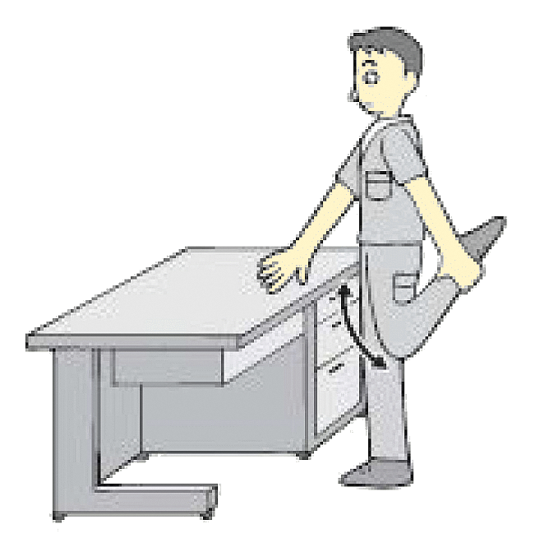
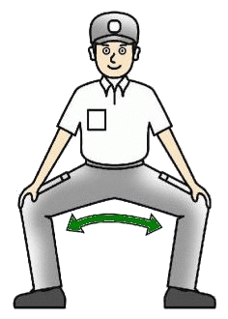
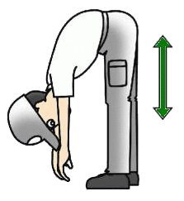
[Lower back pain exercises]
Do stretches for preventing lower back pain.
(Fig. 1) (Fig. 2) (Fig. 3)
[Effective stretching]
(1) Breathe out slowly, do not hold it, and stretch.
(2) Don't use reaction or gather momentum.
(3) Be aware which muscle you are stretching.
(4) Stop stretching when feel tension, before feeling pain.
(5) Hold a stretch for 20 to 30 seconds.
(6) Make sure to release the stretch gradually.
(7) Stretch up to three times.

Slide 23
(5) Key points for accident prevention: Collision
○ Never jump off from the bed or driver's seat of a truck.
 Never fail to use a platform, if any, when climbing up or down.
 Otherwise, maintain three-point contact.
○ Prevent a collision with a heavy machine.
In plants, heavy machinery and forklift operators must keep to the speed limit and pay attention to walkers.
 In plants, walkers must go in safety isles to avoid colliding with a heavy machine or a forklift. They must not jump out from behind an object, either.
Given industrial accidents that have ever observed in the manufacturing sector, below are key points of safety measures you must practice.

Slide 24

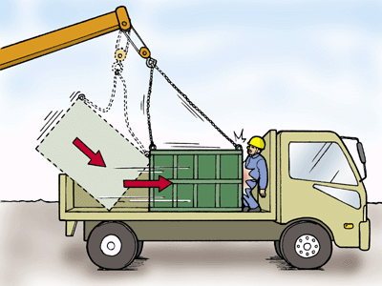
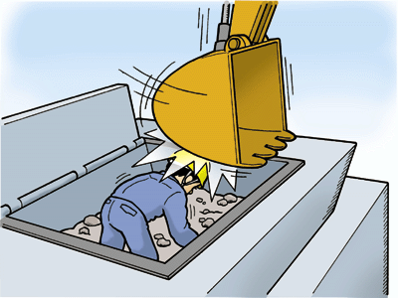
[Cases of accident: Collision]
○ Case 3-1: A worker was standing beside a mobile crane unloading an attachment for a construction machine used for demolition work when the load swung, hitting his leg.
○ Case 3-2: With a car-mounted crane, a worker was discharging industrial waste from a bucket to a truck when the bucket slid, hitting him. The bucket was placed on the tailgate at a side when two of the four wires holding it were released and it swung like a pendulum, colliding against him.
○ Case 3-3: At a recycling plant, an operator heard a crusher making strange sound. He stopped the crusher and got in its hopper for inspection. To remove foreign objects from the hopper, a backhoe operator, unaware that there was someone inspecting, put them in the bucket, which hit the crusher operator.

Slide 25
Key point 7: Actions to be taken when finding any abnormality or accident.
(1) When you find any "abnormality":
(1) First, make sure what is going on.
(2) Warn colleagues and supervisors around you in a loud voice.
(3) Push an emergency button to stop the machine, if necessary.
(4) Follow instructions of supervisors to work with colleagues and
take appropriate actions.
(5) Never act on your own authority.
[Let them know.]
Finding anything unusual or dangerous on a machine or the equipment, tell your supervisor or a representative of the customer immediately.
Principle:
Stop! Call out! and Wait!

Slide 26
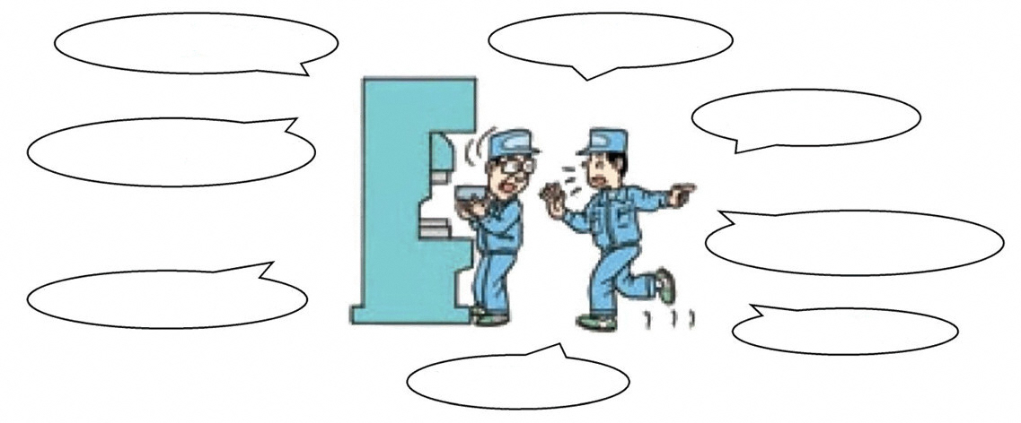
(2) Something is stuck on a belt conveyor. A crusher is making a strange sound and/or giving out an unusual smell.
(1) Stop the machine and turn off the main switch. Stop!
(2) Warn colleagues and supervisors around you of the abnormality in a loud voice. Call out!
(3) Follow instructions of supervisors. Wait!
→ Never act on your own authority.
(4) Before working with a machine, take some measures to prevent it from starting unexpectedly.
▪ Lock the main switch, so that it will not start.
▪ Place a sign on the machine to let others know that you are there to work, so that they will not start it up.
(5) When necessary, place "Work in Progress" signs around the site where you are working, as well.
The lever is loose.
I sense a strange smell.
Something is making a strange sound.
The red lamp is on.
The blue lamp is off.
The lamp is flashing.
The surface is hot.
X is missing.

Slide 27
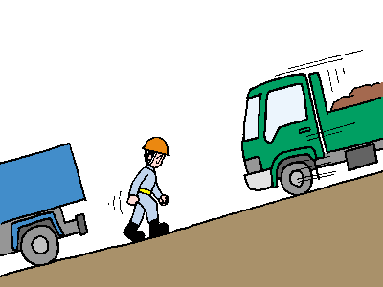
(3) When you find a truck, a heavy machine, or a forklift you have parked moving on its own ...
<A truck, a heavy machine, or a forklift starts moving.>
(1) Never try to stop it, and instead "Run away."
(2) Tell everyone around you in a loud voice to "Run away."
(3) Learn in day-to-day safety & health education to "Run away."
(None could stop it by hand.)
Run away!

Slide 28
(4) When an accident takes place ...
Even when you are reasonably confident of safety in the workplace, the risk of accident cannot be eliminated.
When an accident takes place, you must:
What to do when any accident occurs (Ex.)
Accident
First, keep calm.
▪ Never rush to the site, or you may suffer a secondary accident.
▪ Warn people around there in a loud voice.
Relieve victims.
Contact supervisors.
▪ Assist supervisors when instructed.
(Take victims to a hospital, etc.)
Action on
the site.

Slide 29

Thank you.

