Slide 1
Aerial work platform vehicle operation skill training auxiliary textbook
PowerPoint materials for training

Slide 2
Chapter 1 Basic knowledge about aerial work platforms vehicles

Slide 3
Definition of aerial work platform vehicles
The term " Aerial Work Platform Vehicle " Means a machine which is used for construction, inspection, repair, etc., at high altitude places, which consists of a work floor and a lifting device or other device, which has a facility for the work floor to be raised or lowered by the lifting device or other device, which is powered and can be self-propelled to an unspecified location. A machine that is powered and can be self-propelled to an unspecified location.
Furthermore, Fire engines such as ladder trucks and refractory ladder trucks used by fire-fighting organizations for fire-fighting activities are not included in aerial work platform vehicles.
※ Ministry of Health, Labor and Welfare, Labor Standards Bureau Director's Notice (September 26, 2002, Notice No. 583))
Textbook page 1 / Auxiliary textbook page 5

Slide 4
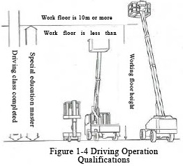
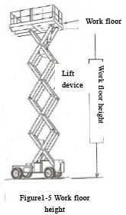
Qualification for driving aerial work platform vehicles
Table 1-1 Qualifications required to operate an aerial work platform vehicle
Qualification Classification | Persons who have completed technical training (Article 20, Paragraph 15 of the Safety and Health Ordinance) | Special education for those who have completed (Article 36, No.5 of No. 10 of the Code of Safety and Health)
Aerial work vehicles platform with a work floor height of 10m. or more | ○ | ×
Aerial work platform vehicles with a work floor height of less than 10m. | ○ | ○
※What is the work floor height?
The vertical height from the ground to the floor when the work floor (equipment for loading people and loads) is raised to its highest point.
Textbook page 3 / Auxiliary textbook page 5

Slide 5
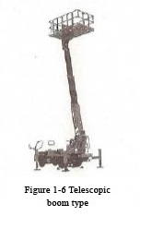
Types of aerial work platforms - working equipment (1)
① Telescopic boom type
The boom, on which the working floor is mounted, extends
and retracts to approach the working position in a straight line.
【Main features】
A. Positioning of the work floor is easy.
B. Good operability can take place if there are no obstacles
in the workplace.
C. Electrical and communication works, construction works,
shipyards etc. Have been widely use.
Textbook page 5 / Auxiliary textbook page 6

Slide 6
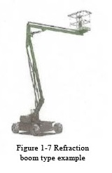
Types of aerial work platforms – working equipment (2)
② Telescopic boom type
The middle of the boom can be refracted.
【 Main Features 】
A. By deflecting the boom, it is possible to enter the work floor
deeply.
B. It is used for work that involves dodging obstacles along the way.
Textbook page 5 / Auxiliary textbook page 7

Slide 7
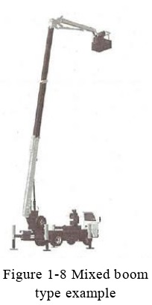
Types of aerial work platforms – working equipment (3)
③ Mixed boom type
The boom has both expansion and contraction and refracting functions.
【 Main Features 】
A. The reachable area of the work floor can be higher and wider.
B. It is often used for construction work and maintenance work that requires work in high places and in a wide range.
Textbook page 6 / Auxiliary textbook page 7

Slide 8
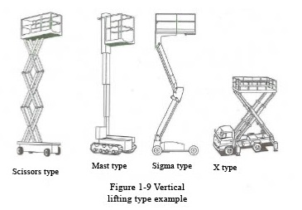
Types of aerial work platforms - working equipment (4)
④ Vertical lifting type
There are scissors type, mast type,
sigma type, and X type,
in which the working floor can be
raised and lowered vertically.
【Main Features】
A. The work area is limited to the
upper part of the traveling equipment.
B. It is often used for interior and
facility work in construction.
C. Many of them are relatively small.
Textbook page 6 / Auxiliary textbook page 7

Slide 9
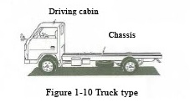
Types of aerial work platforms - Traveling Device (1)
① Truck type
It is a type attached to a truck and can travel on ordinary roads, making it highly mobile and easy to move to the work site. There are two types of trucks, one is an ordinary truck equipped with a work device and the other is a large crane trolley.
【 Major features 】
A. It is possible to drive on public roads.
B. It can be moved quickly to the work site and has good mobility.
C. It is often used for work on public roads, work of relatively short duration, maintenance and inspection work, etc.
Applications: Short construction period sites, electrical and communication work, signboard installation, maintenance of streetlights and traffic signals, pruning, etc.
A
Textbook page 7 / Auxiliary textbook page 8

Slide 10
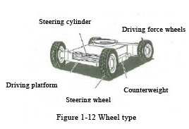
Types of aerial work platforms - Traveling Device (2)
② Self-propelled
The type that is not attached to a truck is called self-propelled and cannot be driven on public roads. Among the self-propelled types, there are wheeled and crawler types.
a) Wheel type
The wheel type generally has four tires, of which the front or rear two are the drive wheels.
The tires used are non-punk tires. Many of them use white rubber tires that do not leave running marks on the road surface.
The tires are driven by a hydraulic motor through a reduction gear.
【 Main Features 】
A. It is easy to work while moving around.
B. Traveling speed is slower than the truck type.
C. Compared to the crawler type (made of iron), there is less damage to the road surface during driving.
D. Often used for maintenance and inspection in factory facilities, finishing work in construction works, shipyards, etc.
Textbook page 8 / Auxiliary textbook page 8 to 9

Slide 11
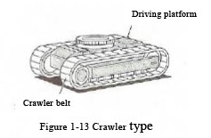
Types of aerial work platforms - Traveling Device (3)
② Self-propelled
The type that is not attached to a truck is called self-propelled and cannot be driven on public roads. Among the self-propelled types, there are wheeled and crawler types.
b) Crawler type
The crawler type also uses a hydraulic motor with a reduction gear to drive the crawler.
Some of the smaller ones use rubber crawlers and are used for indoor construction.
Many of them use white rubber crawlers that do not leave running marks on the road surface easily.
【 Major features 】
A. It is easy to work while moving around.
B. As with the wheeled type, the traveling speed is slow.
C. It is possible to run on relatively uneven ground.
D. It is possible to run on relatively soft ground.
E. Often used in construction and facility work.
Textbook page 8 / Auxiliary textbook page 9

Slide 12
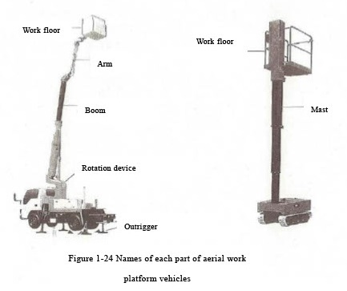
Terms related to aerial work platform vehicles (1)
It is important to understand the correct terminology and meaning of aerial work platform vehicles and operate them correctly and safely.
Textbook page 14 / Auxiliary textbook page 10

Slide 13
Terms related to aerial work platform vehicles (2)
It is important to understand the correct terminology and meaning of aerial work platform vehicles and operate them correctly and safely.
Work floor: the equipment on which people and loads are placed is called the work floor. 。
Leveling device: a device that keeps the working floor leveled at all times.
Operating device: a device that operates work equipment, traveling equipment, etc.
Boom device: a device that supports the work floor and can raise and lower, undulate, etc.
Swivel device: a device that swivels the work equipment.
Outrigger: a device that secures the stability of the machine with a jack.
Vertical Lifting Device: a device that raises and lowers the work floor vertically.
Load capacity: this is the maximum load that can be lifted with a person or load on the work floor.
If a load exceeding the load capacity is applied to the work floor, it may lead to a serious accident.
Textbook page 14 to 20 / Auxiliary textbook page 10 to 14

Slide 14
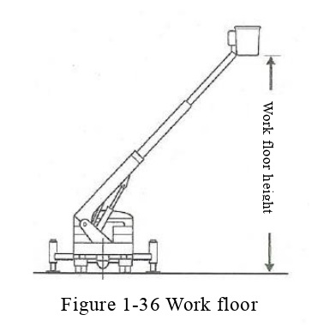
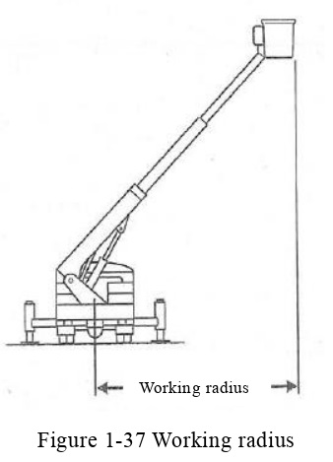
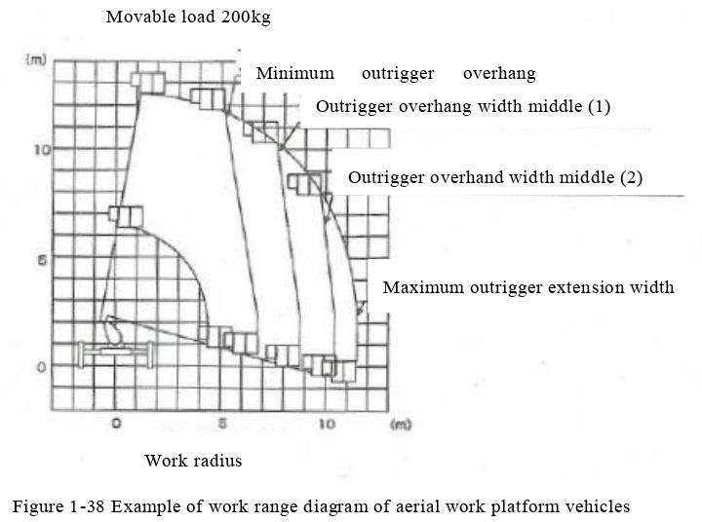
Terms related to aerial work platform vehicles (3)
You must understand the correct terminology and meaning of aerial work platform vehicles and strive to operate them correctly and safely.
Work floor height: the vertical height from the ground to the floor surface when the work floor is raised to its highest point.
Height above ground: the vertical height from the ground to the floor surface when the work floor is raised to an arbitrary height
Working radius: The horizontal distance from the swing center to the leading edge of the inner surface of the work floor.
Work range diagram: the working range varies depending on the capacity (load capacity, lifting capacity, boom length, working radius, outrigger overhang, etc.). That displays the range in which the aerial work platform vehicle can work safely.
Textbook page 20 to 21 / Auxiliary textbook page 15 to 16

Slide 15
Chapter 2 Structure and handling of work equipment, etc. for aerial work platform vehicles

Slide 16
Work equipment for boom-type aerial work platform vehicles (1)
Work equipment
Depending on the structure of the boom, there are three types of boom-type aerial work platform vehicles: telescopic boom type, articulating boom type, and mixed boom type.
The work equipment consists of boom devices, boom swinging devices, boom raising and lowering devices, work floor, work floor swinging devices, work floor leveling devices, etc.
Textbook page 25 / Auxiliary textbook page 17

Slide 17
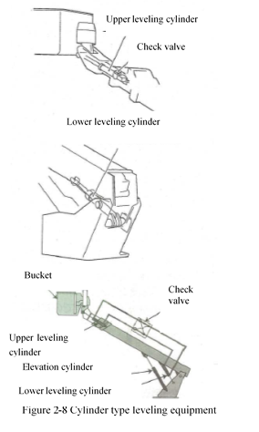
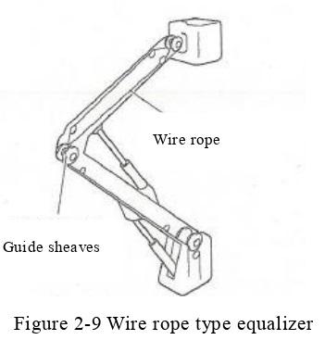
Work equipment for boom-type aerial work platform vehicles (2)
Work Floor Equalizer
If the work floor tilts when the boom is raised or lowered or refracted, there is a risk that the operator may fall from the work floor. In order to prevent this, this device always keeps the work floor leveled regardless of the boom's up-down or articulating operation. (This device is provided on all elevating work vehicles except the vertical elevating type.)
① Cylinder type leveling device
② Wire rope (chain) type equalizer
Textbook page 28 / Auxiliary textbook page 18

Slide 18
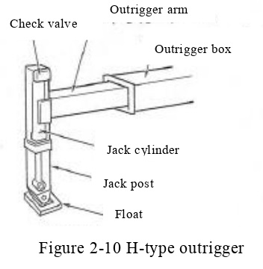
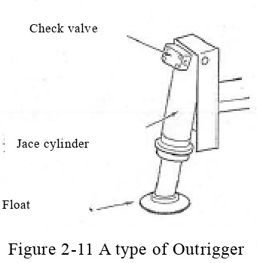
Work equipment for boom-type aerial work platform vehicles (3)
Outrigger structure and characteristics
The outriggers are the H-type, which sticks out horizontally and contacts the ground, and the A-type, which makes direct contact with the ground at an angle, both of which are devices that stabilize the work vehicle at height.
H-type outriggers are often used for relatively large elevating vehicles with a working floor height of 12 m or more, and A-type outriggers are often used for relatively small elevating vehicles with a working floor height of 12 m or less.
Further, the hydraulic cylinder for the jack is equipped with a check valve to prevent the cylinder from contracting when the hydraulic hose is damaged.
Textbook page 29 / Auxiliary textbook page 19

Slide 19
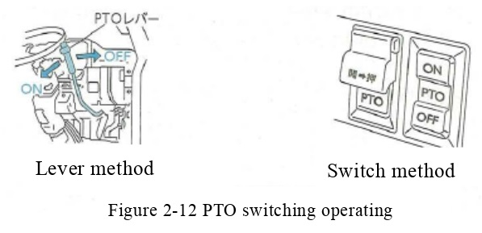
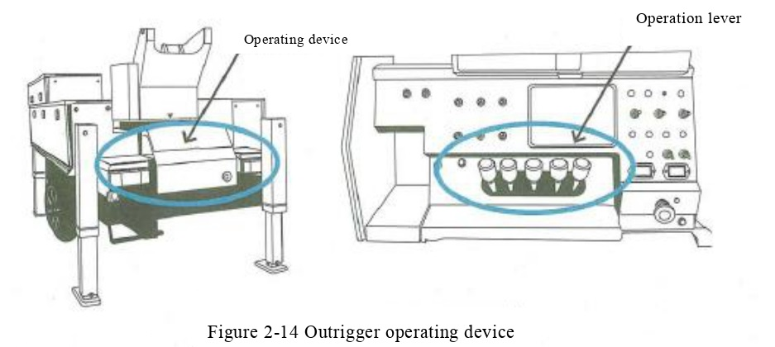
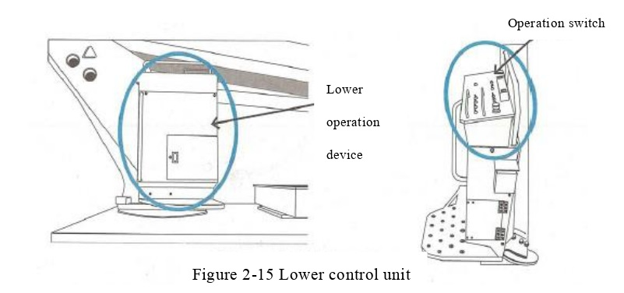
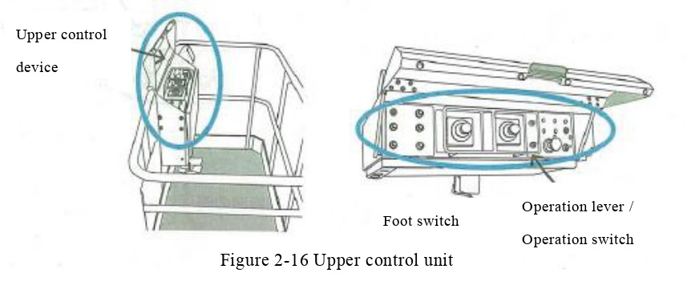
Work equipment for boom-type aerial work platform vehicles (4)
Structure and characteristics of the operating device
The operating devices include the PTO (Power Take Off) switching operating device (equipped only on track type) to operate the hydraulic pump, the outrigger operating device to operate the outrigger, and the lower and upper operating devices to operate the work equipment.
In addition, there are electric control (switch control), lever control, and electromagnetic proportional control systems in the operating system.
PTO lever
Textbook page 30 to 31 / Auxiliary textbook page 20 to 22

Slide 20
Work Equipment of Vertical Elevating Type Work Platforms
Vertical elevating type work trucks can be classified into the following 4 types according to the structure of the lift arm.
① Scissors type
② Mast type
③ Sigma type
④ X type
Textbook page 34 / Auxiliary textbook page 22

Slide 21
Safety device for aerial work platform vehicles (1)
Types of safety devices determined by law
Aerial work platform vehicles are equipped with a variety of safety devices to ensure safe and reliable work at high elevations. Some of these safety devices are specified in the Work Platforms Structure Standard, while others have been developed by the users and manufacturers of work platforms to make work safer.
As safety devices are changed or added over time, it is important to read the instruction manual carefully before use.
① Boom operation control device
② Emergency stop device
③ Emergency lowering device
④ Travel warning device
⑤ Vehicle body inclination angle control devic
⑥ Safety valve, check valve
⑦ Outrigger interlock devic
⑧ Indication of the front/rear direction of the vehicle body
⑨ Overload regulation device
Textbook page 36 to 41 / Auxiliary textbook page 23 to 30

Slide 22
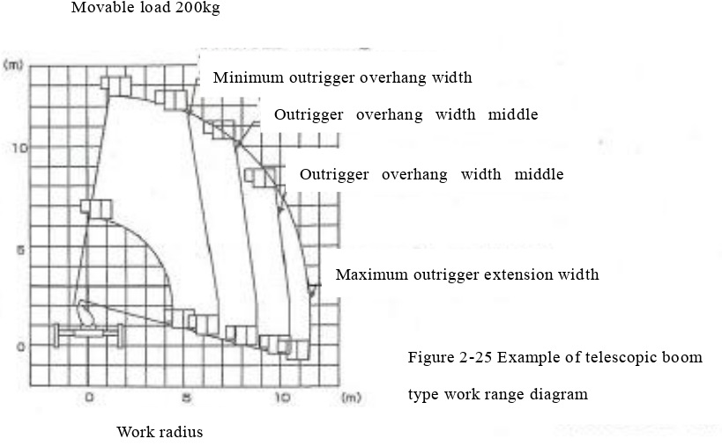
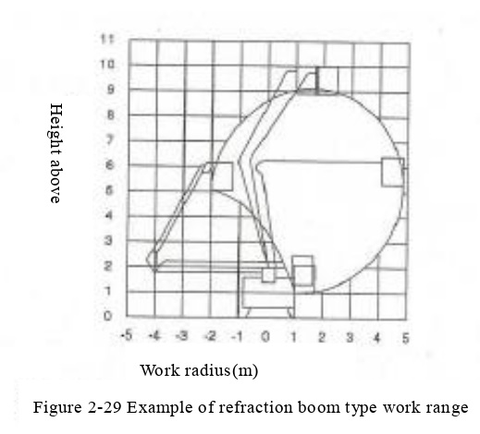
Safety device for aerial work platform vehicles (2) Boom operation control device
The boom operation regulator is a device that automatically regulates (stops or alerts) the operation of the boom when the working floor is about to exceed the set working range, preventing the aerial work platform vehicle from tipping over.
① Telescopic boom type
This system electrically detects the boom up/down angle and extension, as well as the turning angle and outrigger extension width, and stops the up/down, boom extension, and turning from the center of the vehicle when the working range is about to be exceeded.
For telescopic boom types there are 2 types of boom operation control devices.
(a) Detected increase or decrease of the load in the work floor.
(b) Those that do not detect an increase or decrease in the load in the work floor.
② Articulating boom type
The angle of the second boom to the horizontal of the vehicle is detected mechanically or electrically, and when the working range shown in Figure 2-29 is about to be exceeded, the elevation control and articulation are stopped.
Textbook page 36 to 37 / Auxiliary textbook page 23 to 25

Slide 23
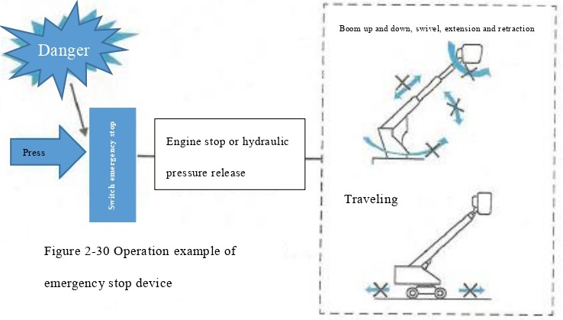
Safety device for aerial work platform vehicles (3) Emergency stop device
The emergency stop device immediately stops operation when the operator senses danger while the boom is operating or, in the case of self-propelled aerial work platform vehicles is running.
Textbook page 38 / Auxiliary textbook page 26

Slide 24
Safety device for aerial work platform vehicles (4) Emergency lowering device
An emergency lowering device is a device or apparatus that allows a worker on the work floor to descend to the ground in the event of an unforeseen event such as a machine stoppage.
※ As equipment, engine-powered aerial work vehicles are generally equipped with an emergency pump powered by a battery. Some vehicles equipped with a separate low-noise prime mover are not equipped with an emergency pump.
※ Vertical lift aerial work platforms are generally equipped with a descent valve.
Textbook page 39 / Auxiliary textbook page 27

Slide 25
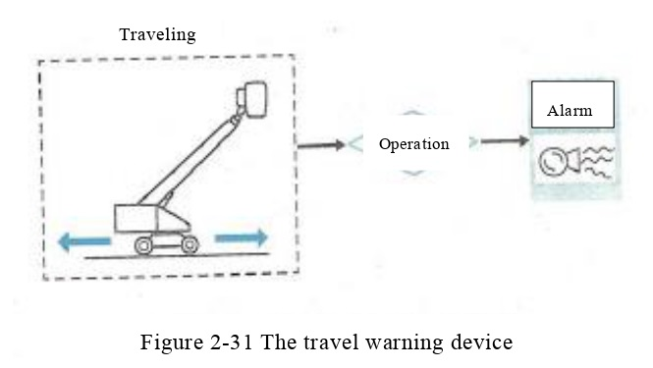
Safety device for aerial work platform vehicles (5) Travel warning device
Travel warning device is a device that automatically emits an alarm (buzzer) when traveling and is switched on in conjunction with the travel control lever.
※ It is attached to a self-propelled aerial work platform.
Textbook page 39 / Auxiliary textbook page 27

Slide 26
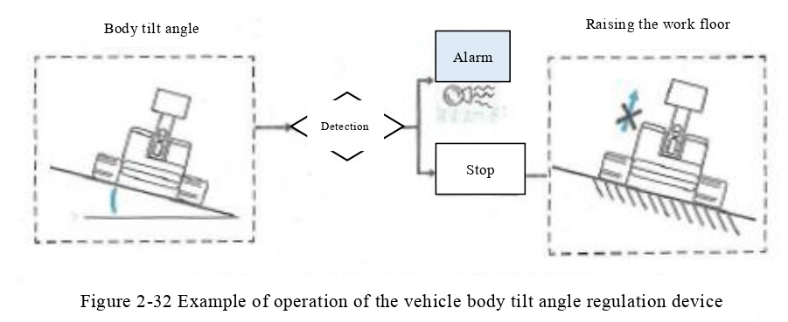
Safety device for aerial work platform vehicles (6) Safety device for aerial work platform vehicles (5)
There are two types of body inclination angle regulators: those that emit an alarm when an attempt is made to raise the work floor while the vehicle body is inclined, or when the allowable body inclination angle is exceeded while traveling, and those that automatically stop the work floor from being raised.
Textbook page 39 / Auxiliary textbook page 28

Slide 27
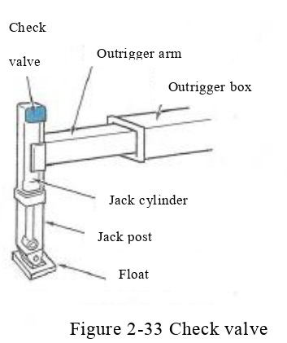
Safety device for aerial work platform vehicles (7) Safety valve, check valve
When an overload or shock load is applied during operation, an abnormally high pressure is generated in the hydraulic circuit, which may cause damage to the machine. In order to prevent this, the hydraulic system of an aerial work platform is equipped with a safety valve, and the pressure to be used is determined for each work truck, so that the pressure in the circuit does not rise above the set pressure at any time.
In addition, If the pipes and hoses are damaged or their connections are disconnected, the pressure in the cylinder drops abnormally, causing the work floor, etc. to drop rapidly. To prevent this, check valves are installed in each of the cylinders for jacking, raising, lowering, extending and retracting, leveling, artilulating and vertical lifting. In particular, double check valves are used for jacking, telescoping, and raising and lowering of the refracting boom type, since external force is applied in the direction of cylinder extension.
Textbook page 40 / Auxiliary textbook page 28

Slide 28
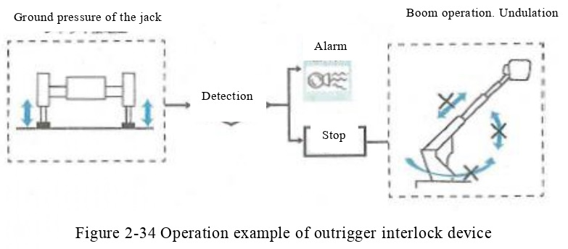
Safety device for aerial work platform vehicles (8)
Outrigger interlock device
The outrigger interlock device is an electrically controlled device that stops all boom operation when the jack is not under the specified load, in order to prevent the operator from forgetting to set the jack and operate the boom.
Textbook page 40 / Auxiliary textbook page 29

Slide 29
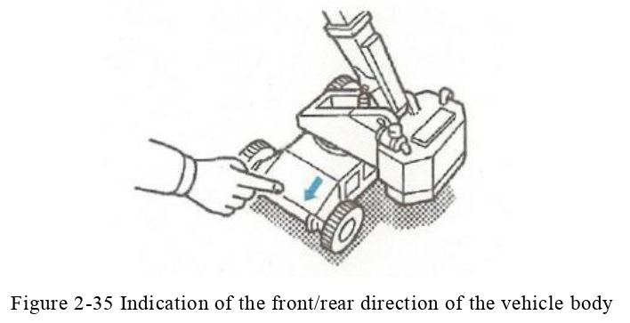
Safety device for aerial work platform vehicles (9) Indication of the front/rear direction of the vehicle body
The aerial work platform, which can be operated on the work floor and the work floor turns together with the swivel table, so that the front-rear direction (traveling direction) of the vehicle to be checked from the work floor.
※ It is mounted on a self-propelled, swiveling, aerial work platform.
Textbook page 41 / Auxiliary textbook page 29

Slide 30
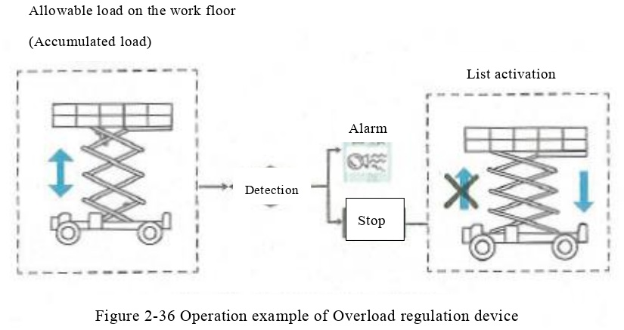
Safety device for aerial work platform vehicles (9) Overload regulation device
The overload control device is a device that detects the pressure in the hydraulic cylinder for the lift and stops the lift operation or issues an alarm when a load is placed on the work floor in excess of the allowable load (Accumulated load).
※It is attached to the vertical elevation
Textbook page 41 / Auxiliary textbook page 30

Slide 31
Outrigger installation procedures and precautions (1) Basic procedure
① Apply the parking brake.
② On flat ground, put a brake on the front and back of the rear wheel.
③ Maximize the outriggers. (For H-type outriggers)
④ In places with poor ground, cure with a floor board.
⑤ Make sure to set the jack. Float the tires and level the air frame.
Fig 2-41 Outrigger to maximum
Textbook page 49 / Auxiliary textbook page 31

Slide 32
Outrigger installation procedures and precautions (2) Slopes (1)
① Be sure to position the aerial work platform vehicle downward.
② Apply the parking brake.
③ Put a brake on the lower slope of all wheels to ensure that they are in contact with the tires.
④ Overhang outriggers. (For H-type outriggers)
⑤ Cure with a floor board.
(a) Use a large floor board.
(b) The maximum number of floor boards should be two on the front jack.
(c) The floor board should be within 20 cm in height and should be high enough to fit between the outrigger float and the ground in front of the jack set.
Parking brake
Within
2sheets
The base is unstable
Within 7 degree
The number of sheets is large and the base is small
Stopping each tire
Fig 2-42 Installation of aerial work platform vehicle on slopes
Fig 2-43 How to use the floorboard
Textbook page 49 / Auxiliary textbook page 31 to 32

Slide 33
Outrigger installation procedures and precautions (2) Slopes (2)
⑥ Overhang the outriggers in the following procedure.
(a) Be sure to do it in the order of the front jack and the back jack.
(b) The jack should be extended on the left and right at the same time.
(c) Make fine adjustments by operating each jack.
⑦ Float all the tires and level the airframe.
⑧ If the airframe cannot be leveled, strictly observe the following items.
(a) Be sure to work with the boom facing uphill.
(b) Make sure that the left and right directions of the aircraft are horizontal.
(c) If the turning work is going downhill, move the vehicle.
(d) In the case of the telescopic boom type, use it facing uphill and within 45 ° to the left and right.
(e) Even in the case of the articulating boom type, use it when the working position is on the slope above the turning center, and the turning range should be within 45 ° to the left and right.
Fig 2-44 Jack up from the front side
Hmm…
Only slightly diagonal！
Fig 2-45 The boom is always on the slope
Textbook page 50 to 51 / Auxiliary textbook page 32 to 33

Slide 34
Outrigger installation procedures and precautions (2) Slopes (2)
⑨ After the work is completed, store the outriggers according to the following procedure.
(a) Return the boom to the running position.
(b) Check the position of the brake.
(c) Be sure to put it back from the jack on the back side.
(d) Operate the jack at the same time on the left and right.
(e) Remove the break.
Fig 2-46 Jack can be stored from the rear side
Textbook page 51 / Auxiliary textbook page 33

Slide 35
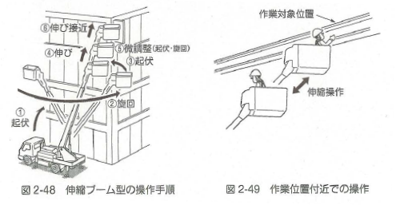
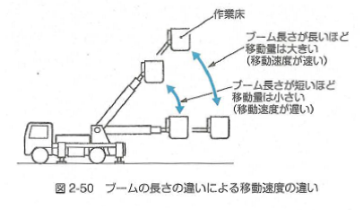
Telescopic boom type basic operation procedure and precautions
【Basic operating procedure】
① With the boom retracted, use the elevation system to separate the boom from the pedestal.
② Set the target position to some extent by turning.
③ Bring it closer to the target position to some extent by undulating.
④ Get closer to about 1m before the work position by expanding and contracting (extending).
⑤ Make fine adjustments to the left, right, up and down by undulating and turning.
⑥ Approach the work target position by stretching operation.
⑦ Adjust by swinging according to the situation of the
work place.
⑧ When moving away from the work position, first move away by the contraction operation.
Work target position
Stretching approach
Fine adjustment (Elevation
and turning)
Stretch
Elevation
Turning
Expansion and contraction operation
Elevation
Fig 2-48 Telescopic boom type operation procedure
Fig 2-49 Operation near the work position
Work platform
【Points to note】
When turning or undulating, be careful because the moving speed of the work floor differs depending on the length of the boom.
The longer the boom length, the larger the amount of movement (Faster the movement speed).
The shorter the boom length, the smaller the amount of movement (The slower the movement speed)
Fig 2-50 Difference in moving speed due to difference in boom length
Textbook page 53 / Auxiliary textbook page 34

Slide 36
Transfer of aerial work platform vehicle
Normally, truck-type aerial work platform vehicles are transferred to the work site by self-propelling, and self-propelled aerial work platform vehicle such as wheel-type and crawler-type are used. Since it is not possible to drive on public roads, it is often loaded on a transfer-only vehicle and transferred.
(1) For truck-type aerial work platform vehicle
When moving aerial work platforms, it is important to pay attention to the following
① Since the work floor is on the upper part and the position of the center of gravity (jyuushin) tends to be high, there is a risk of falling if the steering wheel is operated suddenly while driving.
② Since the lower vehicle is equipped with many weights and the vehicle weight is heavy in order to widen the work range and as a stability measure, it is desirable to start from the 1st speed when starting.
③ Since the vehicle weight is heavier than that of an ordinary cargo truck with no luggage loaded, the braking distance is longer. Therefore, it is important to keep a sufficient distance between vehicles.
④ Because the work equipment is higher than the driving cabin,
if you do not know the height of the vehicle and drive, there is a risk of collision under the guard.
(2) For self-propelled aerial work platform vehicle
Self-propelled aerial work platform vehicle such as wheel type and crawler type cannot run on public roads.
If it is unavoidable to travel on public roads, it is necessary to obtain the permission of the police chief in charge. Note the following points.
① Crawler-type aerial work platform vehicle may damage the pavement surface, so perform necessary curing.
② When driving, keep the boom to the shortest and keep the work platform below horizontal.
Textbook page 59 to 63 / Auxiliary textbook page 35

Slide 37
Inspection and maintenance of aerial work platform vehicle
It is very important not only to improve workability but also to prevent occupational accidents by properly carrying out daily inspections and maintenance and always maintaining the aerial work platform vehicle in the optimum condition.
In addition, the Occupational Safety and Health Regulations also require that aerial work platform vehicle be inspected and maintained, as shown in the following table.
It is important to carry out daily inspections and maintenance reliably so that the aerial work platform vehicle can always be used in the best condition.
Regulations regarding inspections and self-inspections
Item | Person / qualification to implement | Remarks
① Inspection before starting work (Article 194-27 of the Safety Regulations) | ・What the business operator designated (driver) | ・Checklist storage: It is desirable to store it while the machine is running.
② Regular self-inspection (Article 194-24 of the Safety Regulations) | What the business operator designated | ・Time: Once every month or less ・Retention period of inspection table: 3 years
③ Specific self-inspection (Article 194-23 of the Safety Regulations) (Article 194-26 of the Safety Regulations) | ・Persons with qualifications specified by the Ministry of Health, Labor and Welfare ・Inspection company | ・Time: Once every year or less ・Retention period of inspection table: 3 years ・Attaching the "mark" that has been inspected
If any abnormality is found in the self-inspection and inspection, it is necessary to immediately take
repairs and other necessary measures. (Article 194-28 of the Safety Regulations).
Textbook page 64 / Auxiliary textbook page 37

Slide 38
Safe work with aerial work platform vehicle (1)
Precautions when driving Truck type
Truck type general precautions
① Before driving, make sure that the outriggers are completely retracted.
② Make sure that the work platform is retracted, and then lower the worker from the work platform before running.
Textbook page 76 to 80 / Auxiliary textbook page 38

Slide 39
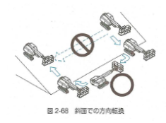
Safe work with aerial work platform vehicle (1)
Precautions when driving Self-propelled type (1)
Precautions for self-propelled climbing / descending, slopes, and steps
① Lock the swivel when climbing or descending a steep slope.
② It is dangerous to change direction or cross the slope in the middle of the slope because there is a risk of falling. Once get down to the flat ground then do the change.
③ Turn the counterweight toward the slope and climb up and down at a right angle to the slope.
④ Never perform the boom turning operation in the middle of the slope because there is a risk of tipping over.
Fig 2-68 Turn around on a slope
Textbook page 82 / Auxiliary textbook page 38

Slide 40
Safe work with aerial work platform vehicle (1)
Precautions when driving Self-propelled type (2)
Precautions for self-propelled climbing / descending, slopes, and steps
⑤ When climbing a step (slope), the angle of the aerial work platform vehicle may change suddenly at the top of the step (slope). Pay attention to the buildings on the upper and lower sides of the work platform.
⑥ When going down a step (slope), the angle of the aerial work platform vehicle may change suddenly at the top of the step (slope). Pay attention to the buildings on the upper and lower sides of the work platform.
Fig 2-69 When climbing a step
Fig 2-70 When going down a step
Textbook page 83 to 84 / Auxiliary textbook page39

Slide 41
Safe work with aerial work platform vehicle (1)
Precautions when driving Self-propelled type (3)
Precautions for self-propelled climbing / descending, slopes, and steps
⑦ Do not drive with the work platform raised (such as with the boom elevation angle raised), as there is a risk of tipping over if you enter a slight unevenness, step, or steep slope. From the tilt movement value of the lower traveling body, The tilt movement of the work platform is very large.
Fig 2-71 Moving with the work platform raised
Textbook page 84 / Auxiliary textbook page 40

Slide 42
Safe work with aerial work platform vehicle (2)
Precautions for work 1 Obey the rules of safety
  ① Workers should wear the necessary protective caps and fall prevention equipment.
  ② Immediately after boarding the work platform, hook the fall prevention equipment.
  ③ Never use it for other purposes such as lifting a load with a boom.
  ④ Strictly observe the load capacity of the work platform.
  ⑤ Do not transfer from the work platform to other structures.
  ⑥ FRP buckets are flammable, so do not use fire.
  ⑦ Do not get on (noruna)any place other than the work platform.
  ⑧ Do not climb the railing on the work platform to work.
  ⑨ Do not use ladders, stepladders, etc. on the work platform.
  ⑩ Be careful not to drop (otosuna) anything from the work platform.
  ⑪ The work platform should be lowered to 50 cm or less from the ground before getting on and off. (In the case of self-propelled type)
  ⑫ When getting on and off the aerial work platform vehicle, use the required route or step.
  ⑬ The parking brake of a truck-type aerial work platform vehicle has a structure that locks the propeller shaft and does not have a structure that stops the rotation of the wheels. Therefore, if you put your foot on the rear wheel with the outrigger stretched and the tire is floating, the wheel may rotate and fall, so never put your foot on the wheel and get on and off.
  ⑭ When using two or more aerial work platform vehicles in close proximity, work under the direction of the work commander, paying attention to the danger of accidents, disasters, etc. due to contact.
Textbook page 86 to 87 / Auxiliary textbook page 40 to 42

Slide 43
Safe work with aerial work platform vehicle (2)
Precautions for work 2 Thorough safety confirmation
① When working near an overhead power line, check the following items and take necessary measures before starting the work.
(a) How much is the voltage?
(b) Is the separation distance sufficient?
(c) Is power transmission stopped?
(d) Are measures to prevent electric shock sufficient?
(e) Do you have a watchman?
② Stop work in bad weather.
・Strong wind: Average wind speed of 10 m/s or more for 10 minutes
・Heavy rain: 50 mm or more for one rainfall
・Heavy snow： 25 cm or more of snowfall per time
③ Always pay attention to the surrounding structures when working.
④ When working in a place that is difficult for the driver to see, drive carefully according to the signal of the signaler.
⑤ Make sure that there are no obstacles in the direction of movement before moving.
⑥ When turning, check for obstacles within the turning range before turning carefully.
Textbook page 88 / Auxiliary textbook page 42 to 43

Slide 44
Safe work with aerial work platform vehicle (2)
Precautions for work 3 Dedicated to safe operation
(3) Dedicated to safe operation
① When driving or operating in the following situations, be sure to fully retract the boom and lower the work platform to below the horizontal level.
(a) When operating the steering
(b) When the road surface is sloping
(c) When there is a lot of unevenness on the road surface
(d) When the wind is strong
  ※（Never raise the work platform when the vehicle body tilt angle control device is activated and a warning sound is heard.）
  ② Take measures such as placing and fixing the materials so that the materials loaded on the work platform do not come into contact with the operation levers (sousa reba).
  ③ Do not operate the lever suddenly.
  ④ Never approach the work position with a self-propelled aerial work platform vehicle during driving operation.
  ⑤ When the operator is on board, operate the lower operation device in close contact with the passenger.
  ⑥ Bring the work floor close to a position where the worker does not need to work in an unreasonable posture.
Textbook page 88 to 89 / Auxiliary textbook page 43 to44

Slide 45
Safe work with aerial work platform vehicle (3)
Precautions at the end of work
① Return the work platform, etc. to the storage position.
② Take measures to prevent escape, such as applying the parking brake.
③ Do not jump off（tobioriruna） the work platform.
④ If it gets dirty due to painting work, clean it and store it.
⑤ Report necessary items such as defects during work to the vehicle manager.
⑥ Keep the key in the designated place.
Textbook page 90 / Auxiliary textbook page 45

Slide 46
Chapter 3 Knowledge of Motor

Slide 47
Types of Motor
A prime mover is a device that has the function of converting various energies into force, and typical ones are an internal combustion engine and an electric motor (the following referred to as "motor").
① Internal Combustion Engine
Internal combustion engines are divided into "diesel engines" and "gasoline engines" according to their ignition system.
② Motor (electric motor)
For aerial work platform vehicle that are often used indoors where it is necessary to consider engine noise and exhaust gas, a motor powered by a storage battery (the following referred to as "battery") is often used.
Textbook page 91 to 93 / Auxiliary textbook page 46

Slide 48
Internal combustion engine principle
Among internal combustion engines, we will explain the structure of diesel engines, which are often used for aerial work platform vehicle.
Diesel engines can be divided into "4-cycle engines" and "2-cycle engines" depending on their operating method.
Most of them are "4-cycle engines" except for large vessels that use "2-cycle engines" that rotate at extremely low speeds.
Operating principle of 4-cycle diesel engine
The four steps of a diesel engine are as follows:
Ⅰ Intake stroke: The stroke in which the piston is
lowered and only air is sucked into the cylinder.
Ⅱ Compression stroke: The stroke in which the
piston rises to top dead center and compresses only
air.
Ⅲ Combustion stroke: The stroke in which fuel is injected and burned into a high-pressure cylinder and the combustion gas pushes the piston down to the bottom dead center (explosion stroke).
Ⅳ Exhaust stroke: The stroke in which the piston rises due to inertia and pushes the combustion gas out of the cylinder.
Intake
Injection nozzle
Exhaust
Intake valve
Exhaust valve
Connecting rod
Crank shaft
Intake
Compression
Combustion
Exhaust
Fig 3-1 4-cycle of diesel engine (Directional injection type)
Textbook page 93 / Auxiliary textbook page 46 to 47

Slide 49
4-cycle diesel engine structure
① Lubrication device
Lubrication equipment has a piston that moves up and down thousands of times per minute. It is a device that supplies lubricating oil (engine oil) to reduce friction and wear of rotating parts due to the same metal soil in each part of the engine such as cylinders and crankshafts.
Engine oil has various functions as follows and its quality is important for maintaining the function of diesel engines.
  Lubrication of axle-bearings, piston rings, cylinders, etc.
  Engine cooling action
  Sealing action between the piston and cylinder.
  Cleaning action of impurities in the engine etc.
  Anti-rust effect inside the engine, etc.
It is necessary to use the engine oil of the standard specified in the instruction manual of the machine, constantly check the condition of the oil, and change it if necessary.
② Fuel system
The fuel system includes a fuel tank, an injection pump, an injection nozzle, a fuel filter, a governor and the like.
The fuel filter filters the fuel, removes foreign substances such as dust contained in the fuel and decomposes water.
Textbook page 99 to 100 / Auxiliary textbook page 47 to 48

Slide 50
Characteristic of electric motor
Electric motors are used as a power source for aerial work platform vehicle, which are often used in places where measures such as gas emitted from the engine and noise are required.
Batteries for industrial vehicles are used in self-propelled aerial work platform vehicle and not only DC motors but also AC motors are often used as electric motors.
The power transmission device for battery-powered aerial work platform vehicle is a replacement of the engine of the power transmission device for wheel-type and crawler-type aerial work platform vehicle with an electric motor powered by a battery. The power transmission device is almost the same as the wheel type and crawler type.
Textbook page 105 / Auxiliary textbook page 48

Slide 51
The characteristic of hydraulic system
Most of the work equipment of aerial work platform vehicle is operated by hydraulic equipment that utilizes hydraulic power. The hydraulic system has the following features.
【Strengths】
①Small and lightweight
②Easy to prevent overload
③Easy stepless shifting
④Less vibration
⑤Smooth operation is possible
⑥Easy remote control
【Weaknesses】
①Plumbing becomes complicated
②Hydraulic oil leaks
③Depending on the temperature of the hydraulic oil, the efficiency of the machine changes a little.
Textbook page 106 / Auxiliary textbook page 49

Slide 52
The principle of hydraulic system
The principle of the hydraulic system is an application of Pascal's principle that “the pressure applied to a part of a stationary liquid in a sealed container is transmitted to all parts of the liquid with the same pressure.”
For example, in the case of the container A and the container B connected by a pipe as shown in FIG. 3-12, a pressure of 10N/cm² is generated by a force of 10 N applied to the surface of the container A of 1 cm². Since the pressure is transmitted to all the pipes, the force (F) transmitted to the entire surface of the container B having a surface area of 10 cm² is as follows.
Force ＝ Pressure x Surface area
F ＝ 10N/cm² x 10 cm² = 100N
This is the principle of a hydraulic system that moves heavy objects with a small force. When the container A is pushed down by 50 cm, the liquid pushed down is 50 cm³, so that the container B is pushed up by 5 cm.
Container
A
Container
B
Fig. 3-12 Hydraulic system principle
Textbook page 106 / Auxiliary textbook page 49

Slide 53
Mechanism of hydraulic system
The hydraulic system is a device that operates the work device of the aerial work platform vehicle and is a device that converts the mechanical energy of the engine into fluid energy and further converts it into mechanical energy to perform work operation (work).
The hydraulic oil is pressurized by driving a hydraulic pump with the power of an engine or an electric motor and various hydraulic drive units (actuator) such as a hydraulic motor and a hydraulic cylinder are operated by the pressurized hydraulic oil.
The hydraulic oil whose pressure has dropped after being used in the hydraulic drive units returns to the hydraulic oil tank via the low pressure circuit is pressurized again by the hydraulic pump and is supplied to the hydraulic drive units. It is a mechanism that is used in a circulating manner. (See Figure 3-13）
High-pressure oil
Hydraulic oil control device (control pressure, flow rate, direction)
Processed oil
Hydraulic oil generator
(convert the mechanical energy into fluid energy)
Low-pressure oil
Relieve valve
Throttle
Hydraulic driving device
(change the oil pressure into mechanical energy)
Work
(Size, thickness direction)
Motor
Direction switch valve
Hydraulic cylinder
Hydraulic oil tank
Hydraulic motor
Low-pressure oil
Hydraulic oil, water cooling device (cooler)
Pipe, hose, joint, pressure gauge
Picture 3-13 Hydraulic system mechanism
Textbook page 107 / Auxiliary textbook page 50

Slide 54
Hydraulic system configuration
Hydraulic systems can be divided into devices with the following three functions and accessory devices.
① Hydraulic pressure generator (pump)
A device that sucks hydraulic oil from the hydraulic oil tank, applies pressure and sends it into the circuit.
② Hydraulic control unit (valve)
A device that controls the pressure, flow rate, and direction of hydraulic oil discharged from a hydraulic pump.
③ Hydraulic drive unit (actuator)
A device that converts the energy of high-pressure hydraulic oil into the force of rotary motion or linear motion
Main components of hydraulic systems
Name | Configuration equipment
Hydraulic pressure generator | ・Hydraulic pump
Hydraulic control unit | ・Directional control valve | ・Flow control valve | ・Pressure control valve
Hydraulic drive unit | ・Hydraulic motor | ・Hydraulic cylinder
Accessory device | ・Hydraulic oil tank | ・Filter | ・Air breather
 | ・Hose | ・Coupling joint | ・Rotating joint
 | ・Accumulator | ・Oil cooler | ・Pressure gauge, etc.
Textbook page 107 / Auxiliary textbook page 50 to 51

Slide 55
Hydraulic circuit of aerial work platform vehicle
As an example of the hydraulic circuit of the aerial work platform vehicle, the hydraulic circuit of wheel type aerial work platform is shown below.
Telescopic cylinder
Upper balancing cylinder
elevation cylinder
Basket swing motor
Lower balancing cylinder
Stop valve
Solenoid control valve
Return filter
Rear jack
Axle expansion
Emergency pump
Front jack
High low speed selector valve
Explosive valve for axle expansion
Engine
Rotary joint
Pump
Drive motor
Leveling steering
Drive motor
Solenoid control valve
Separation valve
Front jack cylinder
Axle expansion cylinder
Rear jack cylinder
Steering cylinder
Figure 3-14 Example of hydraulic circuit for wheel type aerial work platform vehicle
Textbook page 108 / Auxiliary textbook page 51

Slide 56
Hydraulic pressure generator
① Hydraulic pump
The hydraulic pump is driven by an engine or an electric motor, sucks hydraulic oil from the hydraulic oil tank and supplies it to the hydraulic drive unit (actuator) as high-pressure pressure oil.
Hydraulic pumps can be classified as follows from the structural point of view.
  Gear pump
  Piston pump (plunger pump)
  Vane pump
  Screw pump
  Others
Among the above pumps, the characteristics of the gear pump, which is often used as a hydraulic pump for work equipment such as expansion / contraction, elevation, and turning of the boom of aerial work platforms, will be described.
② Gear pump (cogwheel pump)
A gear pump is a pump that rotates two gears of the same type in a casing and pushes out hydraulic oil by engaging them.
【Gear pump characteristic】
  Compact and lightweight
  The structure is simple and durable
  There are few breakdowns
  Easy to maintain
Drive gear bracket
Case
(Drive gear)
Cover
High pressure
Low pressure
Suction side
Discharge side
Driven gear
Fig 3-15 Gear pump
Textbook page 109 / Auxiliary textbook page 52

Slide 57
Hydraulic drive unit
An actuator is a device that converts hydraulic oil sent from a hydraulic pump into mechanical motion (energy). Depending on the movement method, it can be divided into a hydraulic cylinder that moves linearly and a hydraulic motor that moves rotary.
From the hydraulic cylinder’s structure, the classification can be divided as below.
Single acting cylinder
Pressure cylinder
Double acting cylinder
Single rod cylinder
Double rod cylinder
Special type cylinder
Telescopic type
Textbook page 111 / Auxiliary textbook page 53

Slide 58
Hydraulic control unit
The hydraulic control device is a device that controls the flow direction, pressure, and flow rate of hydraulic oil to a hydraulic drive unit (actuator) such as a hydraulic motor or a hydraulic cylinder.
The hydraulic control unit can be classified as follows from the functional point of view.
Hydraulic control unit
Directional control valve
Directional switching valve
Directional control check valve (directional control check valve, check valve)
Pilot check valve
Flow control valve
Throttle valve
Flow control valve
Separation valve
Safety valve (relief valve)
Pressure control valve
Pressure reducing valve
Sequence valve
Counterbalance valve
Unload valve
Textbook page 113 / Auxiliary textbook page 54

Slide 59
Hydraulic oil deterioration
The hydraulic oil is pressurized to a high pressure by a hydraulic pump, moves the hydraulic drive device through the pipeline and repeatedly performs the work of moving the work device. For this reason, the hydraulic oil becomes hot and is in contact with metal or air and is vigorously agitated, so that deterioration (oxidation) of the hydraulic oil and contamination of foreign substances cannot be avoided.
Since the use of this deteriorated or contaminated hydraulic oil causes a failure of the hydraulic system, it is important to constantly inspect the hydraulic oil and manage it appropriately.
Deterioration (oxidation) is the deterioration of the components of hydraulic oil by causing a chemical reaction. The changes in properties and causes due to deterioration is shown below.
Changes in hydraulic oil properties and causes
Properties | Changes due to deterioration and pollution | Cause
Specific gravity | Increase | Deterioration of hydraulic oil, foreign matter contamination, dissimilar oil contamination
Moisture content | Increase | Intrusion of moisture from the outside
Precipitate content | Increase | Deterioration of hydraulic oil and contamination with foreign matter
Flash point | Deterioration | Deterioration of hydraulic oil and contamination with foreign matter
Hue | Transparency decreases | Deterioration of hydraulic oil, contamination with foreign substances, emulsification
Viscosity | Increase | Deterioration of hydraulic oil
Oxidation | Increase | Increased oil temperature and contamination with metal powder
Textbook page 121 / Auxiliary textbook page 55

Slide 60
Inspection and management of hydraulic oil
The air that goes in and out of the hydraulic oil tank brings in dust and moisture. In addition, the hydraulically operated device itself also generates metal powder little by little due to wear. Since these impurities are mixed in the hydraulic oil, it is necessary to replace the hydraulic oil regularly.
There are two methods for determining whether the usage limit has been reached due to deterioration of the hydraulic oil or contamination of foreign matter, such as a sensory test for visually determining the hydraulic oil and a property test by scientific analysis. Both are judged by comparing with unused hydraulic oil of the same type.
How to identify hydraulic oil and how to take measures
Appearance | Smell | Condition | Measure
Transparent and no color change | Good | Condition | Continue to use as it is
Transparent but pale in color | Good | Dissimilar oil mixed | Change hydraulic oil
It has changed to milky white | Good | Air bubbles and moisture are mixed | Change hydraulic oil
It has changed to dark brown | Stink | Deterioration | Change hydraulic oil
Transparent but with small sunspots | Good | Foreign matter mixed | Change hydraulic oil
Bubbling can be seen | － | Grease mixed | Change hydraulic oil
Textbook page 121 / Auxiliary textbook page 56

Slide 61
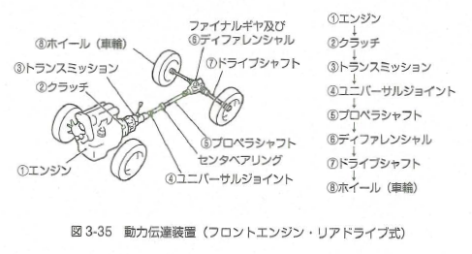
Transmission device of truck type lower part traveling body
Since the truck-type aerial work platform vehicle has a work device mounted on the upper part of the chassis of the truck, the traveling device and the operating device are the same as those of a general truck.
Therefore, when driving on a public road with a truck-type aerial work platform vehicle, it is necessary to have a driver's license corresponding to the vehicle and to comply with the Road Traffic Act.
The power transmission device for truck-type aerial work platform vehicle is generally a front engine / rear drive type and the rear wheels are driven by the engine at the front. The power of the engine is transmitted to the rear wheels which are the driving wheels
in the order shown in the right figure.
Final gear follows with
Engine
Wheel
Differential
Clutch
Transmission
Drive shaft
Transmission
Clutch
Universal Joint
Propeller shaft
Propeller shaft
Differential
Engine
Center bearing
Drive shaft
Universal joint
Wheel
Fig 3-35 Power transmission device (Front engine and Rear drive type)
Textbook page 124 / Auxiliary textbook page 57

Slide 62
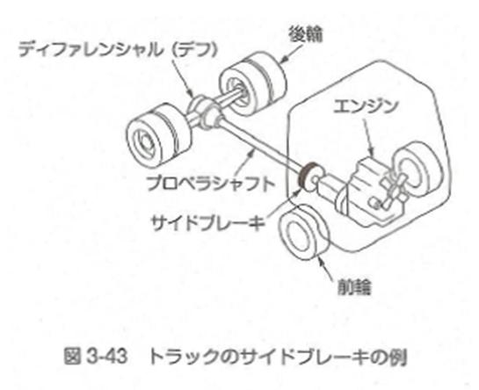
Braking device of truck type traveling body
The brakes include a foot brake for decelerating or stopping a moving vehicle and a parking brake used when parking and a friction type brake is generally used as the mechanism.
① Parking brake structure
The side brake of a passenger car has a structure that directly stops the rear wheels. However, in the case of trucks, it goes further through the differential (differential) instead of the tires. The structure is such that the propeller shaft is stopped by the side brake.
② Handling precautions
Due to the structure, even if the side brake is applied, if either of the rear wheels floats from the ground, the rear wheels will easily rotate and the parking brake will not work.
Differential (Diff)
Rear wheel
Engine
Propeller shaft
Side brake
Front wheel
Fig 3-43 Example of truck side brake
Textbook page 129 to 130 / Auxiliary textbook page 58

Slide 63
Power transmission device of wheel type and crawler type traveling body
① Power transmission device of wheel type’s traveling body
The lower traveling body of the wheel-type aerial work platform vehicle converts the mechanical energy generated by the engine into fluid energy (hydraulic pressure) with a hydraulic pump and transmits it. It is a structure that travels by rotating a traveling hydraulic motor with that hydraulic pressure.
The wheel type traveling body’s power transmission configuration
can be seen in the right picture.
② Power transmission device of crawler type’s traveling body
The power transmission device of the crawler type aerial work
platform vehicle is basically the same as that of the wheel type
aerial work platform vehicle. The difference from
the wheel type is that the left and right traveling devices
can be driven independently.
Coupling
Hydraulic pump
Engine
Engine
Hydraulic power
Operation valve
Coupling
Hydraulic pump
Turning force
Operation valve
Tire
Rotating joint
Rotating joint
Hydraulic drive motor
Hydraulic drive motor
Decelerator
Decelerator
Turning force
Wheel
Fig 3-44 Wheel-type vehicle mechanism and power transmission
Textbook page 131 to 135 / Auxiliary textbook page 59

Slide 64
Chapter 4 Knowledge of mechanics, electric shock, etc. required for driving

Slide 65
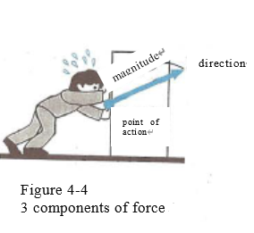
3 components of force
The figure on the right shows the state of force when a human is pushing an object.
"the place where the force acts" (point of action) 、
" the direction in which the force acts" (direction)、
"magnitude of force" (magnitude)
These can be represented by a straight line.
Force always has these three components,
which are called "three components of force".
Textbook page 142 / Auxiliary textbook page 60

Slide 66
Force composition and decomposition
① Composition of force
Composition of forces on a straight line
As shown in Fig. 4-7, the resultant force (R)
when two forces (F1 and F2) are acting on a straight line is the sum of
the forces when they are in the same direction. Moreover, when it is in
the opposite direction, it can be obtained by the difference.
(b) If the direction and size are different
As shown in Figure 4-8, the "resultant force (R)" when
two forces F1 and F2 with different force directions act on the O point is
obtained. Draw a parallelogram (OBDA) with F1 and F2 as two sides,
and the diagonal line is the "resultant force (R)".
This is called the "parallelogram of force"
② Decomposition of force
As shown in Fig. 4-10, the ship floating in the flowing river is
tied to the stakes (A, B) on both banks with a rope so that it
does not depend on the shore, and the force F that the ship is
swept away. Each forces that applied to the rope at that time are
Fa and Fb. The force applied to this rope can be obtained by
using the "parallelogram of force" as shown in figure. 4-10.
A parallelogram is drawn with the reaction force R of the force F
flowing by the ship as a diagonal line and each rope has two sides,
and the lengths Fa and Fb of the sides at that time are the forces applied to the rope.
Dividing one force into two or more forces in this way is called "force decomposition",
and the divided forces such as Fa and Fb are called "components of force“.
Figure 4-7 Composition of forces on a straight line
Figure 4-8 Law of parallelogram of forces
Component of force Fa
Resultant force R
(Counterforce of F)
Component of force Fb
Figure 4-10 Decomposition of forces
Textbook page 143 to 145 / Auxiliary textbook page 61 to 62

Slide 67
Moment of force（１） moment of force
The force that tries to rotate an object is called the "force moment", and the magnitude of this moment (M) is not only the magnitude of the force (F) but also, the center of the rotating axis and the force point of the force. The distance (arm length: L) is related and can be expressed as follows.
Moment（Ｍ）＝Force（Ｆ）×Distance（Ｌ）
Textbook page 146 / Auxiliary textbook page 62

Slide 68
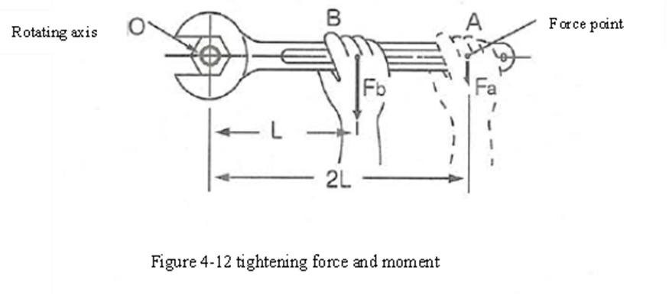
Moment of force（２） tightening force and moment
In the figure on the right, the forces acting on the force points A 2 L away from the rotation axis O and the force points B separated from L are referred to respectively as Fa and Fb.
Each moment (Ma, Mb) can be obtained as,
Ｍａ＝ Ｆａ×２Ｌ
Ｍｂ＝ Ｆｂ×Ｌ
If the force (moment) for tightening this nut is the same,
Ｍａ＝Ｍｂ will be,
Ｆａ×２Ｌ＝Ｆｂ×Ｌ
２Ｆａ＝Ｆｂ
Ｆａ＝Ｆｂ／２
If the force (moment) for tightening the nut is the same, the force Fa for tightening at the point A where the length of the arm is doubled is half the force Fb for tightening at the near point B.
However, in this case, the distance for moving the arm becomes long, and the amount of work is the same regarless of whether the arm is tightened with A or B.
Textbook page 146 / Auxiliary textbook page 62 to 63

Slide 69
Moment of Force（３） Fall and moment
The relationship between stability and moment against a fall during aerial work platform work will be explained as an example.
【formula】
Ｏ : Fall fulcrum (outrigger overhang position)
ＷＧ : Weight of aerial work platform (Mass of vehicle x g)
Ｗ：Total weight of load on the work floor (Loaded mass x g)
Ｌ : From the fulcrum O to the position of the center of gravity of the aerial work platform distance
ℓ ：From the fulcrum O to the center of gravity of the load horizontal distance
With the fulcrum O as the axis, the moment of the force that tries to overturn the aerial
work platform is the overturning moment (MW), and the moment that acts in
opposition to the moment that tries to overturn and tries to stabilize it (MG) is next.
It can be calculated by following formula.
Falling moment ＭＷ＝ Ｗ×ℓ
Stable moment ＭＧ＝ ＷＧ×Ｌ
If Ｍ_{Ｇ}＞Ｍ_{Ｗ}, the aerial work platform is stable against a fall, and if Ｍ_{Ｇ}＜Ｍ_{Ｗ},
the aerial work platform falls.
Even if the load is the same, by lowering or lengthening the boom, the distance (Ｑ)
to the center of gravity of the load becomes longer, the falling moment (Ｍ_{Ｗ})
increases, and the risk of falling increases.
Furthermore, the "boom operation regulation device", which is a safety device for
aerial work platforms, automatically detects this fall moment and stability moment
and issues an alarm or stops the operation.
The working range diagram in right figure shows the limit of operation of the boom.
Stable moment (Mg)
Fall moment (Mw)
Fall fulcrum ○
Figure 4-14 fall moment of aerial work platform
Outrigger maximum overhang
Ground clearance (m)
Operating radius (m)
Boom operation limit
Figure 4-15 work range diagram
Textbook page 148 / Auxiliary textbook page 64 to 65

Slide 70
Balance of Force
① Balance of force
When several forces are acting on one object, and the object does not move,
their forces are said "balanced".
For example, when a load is hung with a rope, the fact that the load is stationary
means that an upward force (F) having the same magnitude as
the gravity (W = mg) generated by the mass of the load acts on the rope,
and the force is applied. It means that they are in a balanced state.
② Balance of parallel forces
The force acting on the balance in right figure is standstill,
it means the counterclockwise moment (Ma) of the fulcrum,
and the clockwise moment (Mb) is equal.
It can be expressed by the following equation.
Ｍａ＝Ｍｂ
Ｍａ＝Ｗａ×ａ
Ｍｂ＝Ｗｂ×ｂ
In addition, on the shoulder of the person who supports this,
Wa＋Wb = The force of P is acting
Point of action
Quality (m)
Figure 4-16 Balance of parallel forces
A balance
Figure 4-18
Balance of parallel forces
Textbook page 149 / Auxiliary textbook page 65

Slide 71
Mass and center of gravity (shitsuryou & jyuushin)
① Mass (shitsuryou)
The mass of an object differs depending on the material even if the volume is the same. For example, lead is heavier than iron and wood is lighter than aluminum. This is due to the difference in "mass per unit volume" (d).
② Center of gravity (jyuushin)
The "center of gravity"(jyuushin) is "the point where the force acts when the gravity acting on each part of the object is put together", but simply put, it is the
"center" (chuushin) of the weight of the object.
A specific object has a center of gravity (jyuushin) peculiar to the
object, and if the object is not deformed, the position of the center
of gravity does not change even if the position or placement of
the object changes. Also, it is not always inside the object.
The position of this center of gravity is an important factor when
considering the position where an object is lifted and the overturning of a machine such as an aerial work platform.
Figure 4-19 Position of center of gravity
Textbook page 150 / Auxiliary textbook page 66

Slide 72
Center of gravity and stability（１）Object stability
The fact that the placed object is "stable" (suwari ga ii) means that it is stable without the risk of fall over. As shown in right figure, when the perpendicular line passing through the center of gravity (Jyuushin) of the object, if passes through the bottom surface supporting the object, the object sits well and is stable, but conversely, when the perpendicular line deviates from the bottom surface, It is unstable and falls.
This is the reason, objects tend to fall over when placed on a slope or at
incline angle.
Also, even if this vertical line passes through the bottom, an elongated object
with a high center of gravity (Jyuushin) may fall off the vertical line even if it is
tilted a little.
On the contrary, the flatter ones have less risk of falling.
Even if it is the same object as shown in (a) and (b) in right figure has a
larger bottom area than (a) just by changing the placement.
It is highly stable because the position of the center of gravity is low.
Furthermore, to keep the object stable, is important to place it in
low position and a large bottom area.
Figure 4-21 position of center gravity and stability.
Figure 4-22 bottom area and stability
Textbook page 153 / Auxiliary textbook page 66 to 67

Slide 73
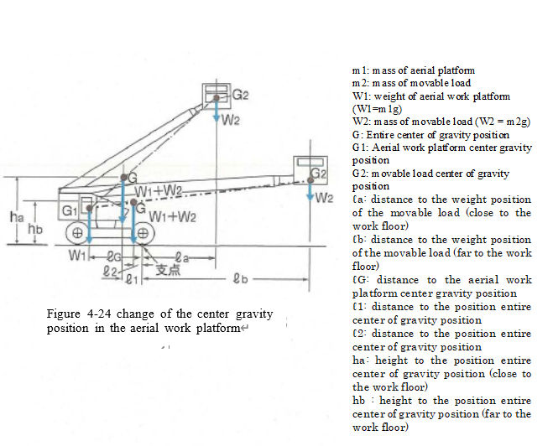
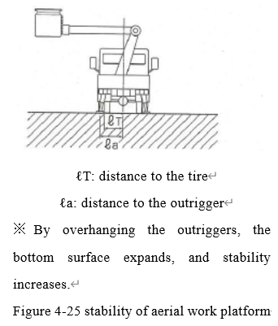
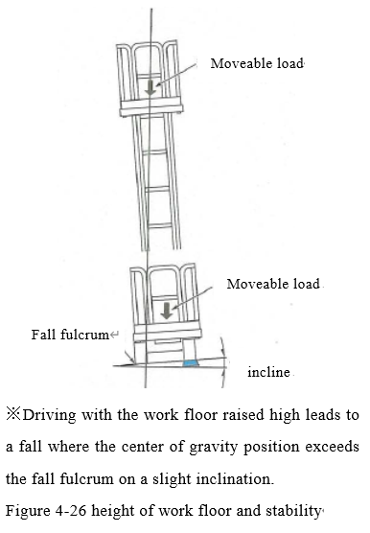
Center of gravity and stability （２）center of gravity and stability of two objects
In right figure, in example workers and materials
(mass ｍ_{２}, weight Ｗ_{２}＝ｍ_{２}ｇ, center of gravity position G2) were placed on the work floor of an aerial work platform
(mass ｍ_{１}, weight Ｗ_{１}＝ｍ_{１}ｇ, center of gravity position G1), the position of the center of gravity (jyuushin) (G) becomes higher (ｈ_{ｂ}→ｈ_{ａ}) as the work floor
becomes higher.
In addition, as the boom is extended and the work floor moves away from the center of the aerial work platform, the vertical line passing through G approaches the overturning fulcrum (wheels, crawlers, outriggers, etc.) that supports the aerial work platform (ℓ1 → ℓ2). It becomes an unstable state where it is easy to fall.
Therefore it is dangerous to load more than the specified
mass of material on the work floor and work without fully overhanging the outriggers.
For the same reason, it is important to install the aerial work platform as horizontally as possible because there is a risk of tipping over when using the aerial work platform on a slope or in an inclined state.
Textbook page 154 / Auxiliary textbook page 67 to 68

Slide 74
Inertia
An object has " the property of remaining at rest when it is at rest, and of continuing its motion when it is in motion ", unless an external force acts on it. Such a property is called "inertia", and the apparent force acting on an object due to inertia is called “inertia force”. The inertial force increases as the acceleration increases and the mass increases. When a person rides on the work floor of the aerial work platform vehicle and the vehicle is turning, if it stops suddenly, the person will try to jump out in the direction of rotation due to the “inertia”. Therefore, immediate operation is dangerous.
Applying a sudden brake
Figure 4-27 Inertial force
Textbook page 156 / Auxiliary textbook page 69

Slide 75
Friction and stability of the aerial work platform vehicle
When trying to park an aerial work platform vehicle on a slope . It is necessary to stop with a foot brake, apply a parking brake, further stop the work, and install an outrigger.
Considering the friction, the reason why the foot brake can decelerate, and stop is that the frictional force of the brake works. The parking brake is effective because of the frictional force. Furthermore, because the frictional force acts between the road surface and the tires, the aerial work platform can be kept stopped if the brakes are applied.
However, if the angle of the slope becomes large and the direction of the force changes as well as the frictional force acting between the tire and the road surface, the aerial work platform vehicle will start to run away.
This friction and the stability of the vehicle is one of the reasons why the aerial work platform vehicle must be installed and used within the specified tilt angle when attempting to work.
Figure 4-32
Stopped on a gentle slope
Figure 4-33
Stopped on a steep slope
Figure 4-34
Outrigger installation
Textbook page 160 / Auxiliary textbook page 69 to 70

Slide 76
Load
"Load" is the force received from the outside on all or part of an object such as a machine or structure.
① Classification of loads (forces) according to action state
・Static load ：The static load is a constant load in which the magnitude and direction of the force acting on the object are stationary regardless of the change in time.
・Dynamic load ：There are two types: repeating load and impact load.
・ Repeating load ：It is a load in which the direction of the load is the same, the magnitude of the load changes with time, and the load acts repeatedly.
・ Impact load ： It is a large load that acts instantaneously. For example, when the turning of the boom is suddenly stopped, the lateral load applied to the boom is the impact load. A large load acts on the boom, causing the machine to be destroyed momentarily.
Classification according to load distribution
It can be classified into the following two types according to the distribution state of the external force acting on the object.
・ Concentrated load ：It is a force acting on a point on the surface of an object. For example, it is the load exerted on the ground contact surface by the tires and outriggers of the aerial work platform vehicle.
・ Distributed load ：It is a force that acts with a distribution on the surface of an object.
For example, the load applied to the ground by the crawler surface of the aerial work platform. In particular, if the external force is the same on all surfaces, it is called as "uniformly distributed load".
Textbook page 163 to 165 / Auxiliary textbook page 71

Slide 77
Ground strength
In order to increase the efficiency of the work, the working floor can be raised, or the working radius can be increased by using a boom or a lifting device. Since the position of the center of gravity changes in the work floor, it is necessary to pay sufficient attention to the fall.
In addition, the strength of the ground on which the wheels, crawlers, outriggers, etc., which serve as fulcrums, are installed is an important factor in the measures against the fall of the aerial work platform vehicle.
Especially, when working by installing an aerial work platform vehicle on unpaved ground, there is a risk of tipping over due to the subsidence of the supporting ground, so it is important to check the bearing capacity of the ground in advance and use an iron plate to prevent the wheels and outriggers from sinking.
The aerial work platform vehicle is often used for a relatively short time in various places depending on the work content and situation. Therefore, it is difficult to confirm the strength of the ground on which the aerial work platform vehicle is installed each time, but it is possible to estimate the strength of the ground from the ground condition at the place where it is installed and the results of the geological survey at the nearby place.
Textbook page 168 / Auxiliary textbook page 72

Slide 78
Installation pressure when using outriggers
The strength of the ground as well as the magnitude of the load acting on the ground (ground pressure) is an important factor in the overturning of the aerial work platforms vehicle.
・ Ground pressure when using outriggers
Aerial work platform vehicle that have outriggers such as trucks, the ground pressure applied to the outrigger float changes greatly depending on the direction of the boom and the condition of elevation and expansion / contraction.
This sinking of the outrigger float during work, even if only slightly, is amplified and transmitted to the working floor at the top of the boom, where it can cause the work vehicle to tip over.
Therefore, when installing on unpaved ground, it is important to check the ground pressure applied to the outriggers and to cure them with an iron plate to disperse the ground pressure to prevent uneven subsidence.
Load value changes
due to boom operation
Total shrinkage
Middle extension
Full extension
Textbook page 169 to 171 / Auxiliary textbook page 72

Slide 79
Electric shock
Aerial work platform vehicles used for outdoor electrical / communication work, construction work, and work alongside electric wires, should always be operated with the prevention of accidents due to electric shock.
"Electric shock" refers to a disturbance caused by an electric current flowing through the human body, also known as an electric shock or electroshock.
The main causes of electric shock when using an aerial work platform vehicle are contact with power lines or distribution lines, and leakage of electricity due to improper use or poor maintenance of the aerial work platform vehicle.
The human body has low electrical resistance, and especially when it is wet with water, it is highly dangerous because current easily flows. Mild cases may cause only temporary pain and numbness, but severe cases often lead to electrocution.
In particular, when an electric current passes through the heart, it causes serious symptoms such as cardiac arrest, respiratory arrest, and shock, resulting in death by electric shock, and may cause burns and tissue necrosis in the place where the electric current is excessive.
Textbook page 172 to 173 / Auxiliary textbook page 73

Slide 80
Effect of electric current on the human body
① Factors that determine the risk of electric shock
The severity of the damage to the human body caused by electric shock depends on the situation at the time of electric shock, but the following are the main factors.
  Magnitude and frequency of current flow
  Duration of current flow
  Path of current flow (path of current through the human body)
  Type of power source (AC or DC), etc.
In general, it can be said that the greater the energizing current, the higher the risk, the more the current flows into an important part such as the heart of the human body, and the longer the current flows, the higher the risk.
② Effect of electric current on the human body
The magnitude of the electric current
About １ｍＡ | It feels tingling
About ５ｍＡ | It hurts considerably
About 10ｍＡ | It feels unbearably chattering.
About 20ｍＡ | The muscles are very stiff, breathing is difficult, and if it continues to flow, it will lead to death.
About 50ｍＡ | It is life-threatening even for a short time.
About 100ｍＡ | It can be fatal.
Human body reaction
Textbook page 174 / Auxiliary textbook page 73 to 74

Slide 81
Precautions when working near overhead power lines
In work using aerial work platform vehicle, many electric shock accidents have occurred due to contact with overhead power lines such as transmission and distribution lines.
Especially in the high-voltage power transmission lines, even if workers or the boom of aerial work platforms do not touch directly, there is a risk of electric shock just by approaching the power transmission line, so it is necessary not to approach within the specified distance (minimum separation distance). It is necessary to take protective measures and assign observers to carry out the work.
In addition, accidents due to electric shock are more common in summer, when the body is more exposed and wet with sweat.
When work such as construction, dismantling, inspection, repair, painting, etc. is performed using an aerial work platform vehicle in a place that closes to the charging electric wire of an overhead electric wire or an electric machine, it comes into contact with the charging electric circuit. Or, if there is a risk of electric shock due to approaching, it is necessary to take the following measures. (Article 349 of the Act on Safety and Health)
① Relocate the charging circuit.
② Enclose to prevent electric shock.
③ Attach insulating protective equipment to the charging circuit.
④ If the measures ① to ③ above are difficult, assign a supervisor to monitor the work.
Textbook page 174 / Auxiliary textbook page 74

Slide 82
Basics of electric shock prevention measures
The basic measures for electric shock prevention when working near transmission / distribution lines where there is a risk of electric shock are as follows.
【Basics of electric shock prevention measures】
① Consult with the electric power company in advance.
② Keep a safe distance (safe separation distance: see Table 4-8) with respect to power transmission lines.
③ Reassign the person in charge of monitoring.
④ Have a preliminary meeting with the work plan.
⑤ Ensure that all relevant workers are familiar with the work procedures.
⑥ Protect the charging circuit as needed.
When performing work such as inspection and repair of a low-voltage charging circuit, it is necessary to have the worker wear an insulating protective device or use a live-line working device. (Article 346 of the Safety Regulations)
In addition, when performing electrical work such as inspection, repair, painting, etc. of the electric circuit or the part supporting in a place close to the low-voltage charging electric circuit, it is necessary to take measures such as attaching insulating protective equipment to the electric circuit. Is. (Article 347 of the Safety Regulations)
※１Protective equipment for insulation: It is worn by workers to prevent electric shock hazard, such as electric safety cap, electric rubber glove, insulating rubber boots, electric rubber sleeve, etc.
※２ Insulating armor: It is used to protect the charging part from electric shock when handling the charging circuit or carrying out electrical work. This includes the insulation sheet, insulation cover, rubber insulation tube, etc.,
※３When working close to a high-voltage charging part such as construction work, in order to prevent the worker from getting an electric shock due to contact with the metal body for construction. The construction protective pipes and the construction protective sheets must be attached to the high-voltage charging section.
Textbook page 174 / Auxiliary textbook page 74 to 75

Slide 83
Safe separation distance from transmission / distribution lines
Safe separation distance from transmission / distribution lines
Electric circuit | Transmission pressure (V) | Minimum separation distance (m)
 |  | Ministry of Labour Notification※ | Power company target value
Distribution line | 100・200 or less | 1.0 or more | 1.0 or more
 | 6,600 | 1.2 or more | 2.0 or more
Power line | 22,000 | 2.0 or more | 3.0 or more
 | 66,000 | 2.2 or more | 4.0 or more
 | 154,000 | 4.0 or more | 5.0 or more
 | 275,000 | 6.4 or more | 7.0 or more
 | 500,000 | 10.8 or more | 11.0 or more
Textbook page 176 / Auxiliary textbook page 75

Slide 84
Chapter 5 Related Laws and Regulations

Slide 85
Related Laws and Regulations（１）
Matters to be observed by workers (related to Article 29 of the Safety and Health Regulations)
Workers must observe the following items regarding safety devices, etc.
① Do not remove the safety device nor lose its function
② If it is necessary to temporarily remove the safety device or lose its function, obtain permission from the business operator in advance.
③ If you have obtained the permission to remove the safety device or lose its function, restore it to the current state immediately after it is no longer necessary.
④ If it is found that the safety device, etc., has been removed or has lost its function, promptly notify the business operator.
Business requiring special education (related to Article 36 of the Safety and Health Regulations)
Special education must be provided when a business operator sends a worker to the next job.
⑩ -5 Driving an aerial work platform with work floor height of less than 10 meters.
㊶ Works related to operation performed using full harness type fall prevention equipment in places where it is difficult to provide a work floor at a height of 2 meters and above.
Textbook page 189 to 190 / Auxiliary textbook page 76

Slide 86
Related Laws and Regulations（２）
Qualifications for employment restrictions (related to Article 41 of the Safety and Health Regulations
(Safety Ordinance Article 20 No.15) The following persons can be engaged in the work of driving aerial work platforms with a work floor height of 10 meters or more (excluding driving on public road).
① Those who have completed the high-altitude work vehicle driving skill training.
② Persons specified by the Ministry of Health Labor and Welfare.
Reissuance of certificate of completion of skill training, etc. (related to Article 8)
① When the person who has been issued a skill training certificate, lost or damaged his/her skill training certificate, the
person must submit application (No.8) for reissuance of the skill training certificate to the registered training
institution that issued the skill training skill certificate.
② When the person who has been issued a skill training certificate changes his/her name, he/she must submit a skill
training certificate replacement application to the registered training institution that issued the skill training
certificate.
Textbook page 191 to 192 / Auxiliary textbook page 76 to 77

Slide 87
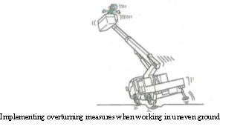
Related Laws and Regulations（３）
Matters to be managed when working with aerial work platforms.
（１）Work plan (related to Article 194-9)
① When working with an aerial work platform, the business operator shall determine in advance a work plan that adapts
to the situation of the place related to the work, the type and capacity of the aerial work platform, etc. and the work
plan must be performed.
② The work plan must show how to work with the aerial work platform.
③ When the business operator establishes a work plan, he/she must inform the workers concerned about the method of
working with aerial work platform.
（２）Work conductor (related to Article 194 –10)
・When carrying out work using an aerial work platform, the business operator must appoint a commander of the work
and have the person direct the work based on the work plan of (1).
（３）Prevention of fall, etc. (related to Article 194-11)
・When working with an aerial work platform, the business operator must take necessary measures such as the danger of
workers fall from the aerial work platform, overhanging outriggers, and prevent uneven subsidence of the ground and
prevent shoulder collapse.
（４）Signal (related to Article 194-12)
・When the business operator work using an aerial work platform and operates the work
floor in a place other than the work floor, to ensure the communication between workers
on the work floor and those who operate the work floor outside the work floor, necessary
measures such as setting a certain signal and pointing a person who gives the signal
needs to be taken.
Textbook page 194 / Auxiliary textbook page 77 to 78

Slide 88
Related Laws and Regulations（４）
Matters to be managed when driving aerial work platforms（part 1）
（１）Measures when moving away from the driving position (related to Article 194-13)
① The driver of the aerial work platform must take the following measures when leaving the driving position for travelling (except when the worker is on work or is about to work)
(a) Place the work floor in the lowest descent position.
(b) In order to prevent the work platform from running away, maintain the holding position by stopping the prime
mover and applying the brakes.
② As for driving the aerial work platform, the driver of the aerial work platform must take measures listed in (1) when
moving away from the driving position.
③ In the case where a worker rides on the work floor of an aerial work platform or is about to perform the work, the
business operator, must take measures such as applying the brakes to keep the aerial work platform stopped must be
perform when the driver leaves the driving position for travelling.
④ The driver of the aerial work platform must take the measures written on (3) when leaving the driving position for
travelling the aerial work platform.
（２）Boarding restrictions (related to Article 194-15)
・When working with aerial work platforms, the business operator must not put workers on any place other than the passenger seats and work floor.
（３）Restrictions on use (Article 194-16)
・For aerial work platform, the operator has a load capacity (meaning the maximum load that can be lifted by a person or load on the work floor, depending on the structure materials of the aerial work platform) and do not use beyond its capabilities.
Textbook page 195 to 197 / Auxiliary textbook page 78

Slide 89
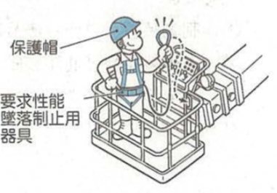
Related Laws and Regulations（５）
Matters to be managed when driving aerial work platforms（part 2）
（４）Restriction on use other than the main purpose (related to Article 194-17)
・The business operator shall not use the aerial work platform for any purpose other than the main purpose of the aerial work platform, such as lifting a load. However, this shall not apply when there is no risk of causing danger to workers.
（５）Required performance use of fall prevention equipment, etc. (related to Article 194-22 )
① When working with aerial work platforms (excluding those with a structure in which the safety hat work floor rises or
falls perpendicular to the ground area) The business operator of an aerial platform (the work floor safety hat rises or
falls only perpendicular to the ground), workers on the work floor equipment of the aerial work platform must be
made to use the required fall prevention equipment.
② Workers on the work floor equipment of aerial work platforms must use the required performance fall prevention equipment.
Safety helmet
The required performance fall prevention equipment
Textbook page 195 to 197 / Auxiliary textbook page 79

Slide 90
Related Laws and Regulations（６）
Matters concerning self-inspection of aerial work platforms （part 1）
（１）Periodic self-inspection (related to Article 194-23 and Article 194-24)
① The business operator must regularly conduct a self-inspection for aerial work platforms once every year. However,
this does not apply to the aerial work platform that is not used for a period of more than one year.
② The business operator must regularly inspect the following items once every month for aerial work platforms.
However, this does not apply to the aerial work platform that is not used for a period of more than one month.
(a) Presence and absence of abnormalities in the braking device, clutch and operating device.
(b) Presence and absence of abnormalities in work equipment and hydraulic equipment.
(c) Presence and absence of abnormality in the safety device.
③ The business operator must conduct a self-inspection on the matters listed in (2) when resuming the use of aerial
work platforms that will not be used for a period of more than one month.
（２）Record of regular self-inspection (related to Article 194-25)
When conducting a self-inspection, the business operator shall record the following items and keep them for 3 years.
① The date of the inspection
② Inspection method
③ Inspection point
④ Inspection result
⑤ The name of the person conducted the inspection
⑥ The details when repairs or other measures are taken based on the result of the inspection.
Textbook page 197 to 198 / Auxiliary textbook page 79 to 80

Slide 91
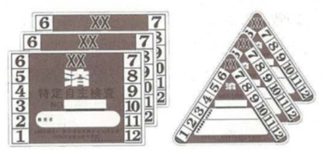
Related Laws and Regulations（７）
Matters concerning self-inspection of aerial work platforms（part 2）
（３）Specified voluntary inspection (related to Article 194-26)
① The specific self-inspection for aerial work platforms shall be the self-inspection listed in ① of (1).
② The provision of Article 151-24, paragraph 2 of the Occupational Safety and Health Regulations shall apply mutatis
mutandis to workers who are qualified as specified by the Ordinance of the Ministry of Health, Labor and Welfare,
Article 45, paragraph 2 of the Act on aerial work platforms. In this case, the term “forklift” in article 151-24, paragraph
2, item 1 of the Occupational Safety and Health Regulations shall be deemed to be replaced with “aerial work platform”
③ If the business operator inspects the aerial work platforms used for operation (limited to those subjected to Article 48,
paragraph 1 of the Road Transport Vehicle Law) based on the provisions of the same paragraph. It is not necessary to
carry out the self-inspection of ① of (1) for the part that has been inspected
④ Regarding the application of the provisions of the (2) when a specific voluntary inspection of aerial work platforms is
carried out by an inspection company, (2) The "name of the person who
conducted the inspection" in ⑤ is the "name of the inspector"
⑤ When a business operator conducts a self-inspection on an aerial work
platform, the business operator must attach an inspection mark that can
clarify the date of the specific voluntary inspection on an easily visible part
of the aerial work platform.
（４）Pre-work inspection (related to Article 194-27）
・When working with aerial work platforms, the employer must inspect the functions of the braking device, operating
device before starting the work of the day.
（５）Repairs, etc. (related to Article 194 -28）
・When the business operator finds an abnormality in the case of ① of (1) or (2) self-inspection or (4) inspection, he/she
must immediately take repairs and other necessary measures.
Textbook page 199 / Auxiliary textbook page 80 to 81

Slide 92
Related Laws and Regulations（８）
Matters concerning prevention of danger due to crashes, flying collapses（part 1）
(1) Installation of work floors, etc. (related to Article 518)
① When working at a height of 2 meters or more (excluding the edges of the work floor, openings, etc.), the business
operator may assemble scaffolding if there is a risk of danger to workers due to a crash. A work floor must be provided
by the method.
② When it is difficult to provide a work floor according to the provisions of (1), the business operator shall take measures
to prevent the danger of workers due to a fall, such as installing a net and having workers use the required
performance fall prevention equipment.
(2) Enclosures such as openings (related to Article 519)
① The business operators shall enclose handrails, cover, etc. at the edges of work floors with a height of 2 meters or
more, openings, etc. where there is a risk of danger to workers to a fall (hereinafter referred to as “enclosure”, etc.)
must be provided.
② According to the provisions of (1), when it is extremely difficult to provide an enclosure, etc., or when the enclosure,
etc. is temporarily removed due to work needs, the employer shall put up a net and have workers use the required
performance fall prevention equipment. Measures must be taken to prevent danger of workers due to crashes.
(3) Required performance use of fall prevention equipment, etc.(related to Article 520)
・Workers must use the required performance fall prevention equipment, etc. when ordered to use them in the cases of ① of (1) and ② of (2).
Textbook page 201 / Auxiliary textbook page 81

Slide 93
Related Laws and Regulations（９）
Matters concerning prevention of danger due to crashes, flying collapses（part 2）
(4) Required performance installation equipment for fall prevention equipment, etc. (related to Article 521)
① When the business operator works at a place where the height is 2 meters or more and the worker is required to use the performed fall prevention equipment, etc., the equipment for safety installing the required performance fall prevention equipment, etc., must be provided.
② When making workers use the required performance fall prevention equipment, etc., the employer shall inspect the required performance fall prevention equipment, etc., and their installation equipment for any abnormalities at any time.
(5)Prohibition of work in bad weather (related to Article 522)
・When the business operator works at a place with a height of 2 meters or more, due to bad weather such as strong winds, heavy rain, and heavy snow, workers shall not be engaged in the work when danger is expected in carrying out the work.
(6) Maintaining illuminance (related to Article 523
・When working at a height of 2 meters or more, the business operator must maintain the illuminance required to carry out the work safely.
Textbook page 202 / Auxiliary textbook page 81

Slide 94
Related Laws and Regulations（１０）
Matters concerning prevention of danger due to crashes, flying collapses（part 3）
(7)Installation of equipment for raising and lowering (related to Article 526)
① When working at a place where the height or depth exceeds 1.5 meters, the business operator shall install equipment for the workers engaged in the work to safely move up and down. However, this does not apply when it is extremely difficult to provide equipment for raising and lowering safely due to the nature of the work.
② Workers engaged in the work of ① must use the equipment, etc. for safely ascending and descending according to the provisions of the main clause of the same paragraph.
(8) No Trespassing (related to Article 530）
・The employer shall not allow workers other than authorized worker to enter the places where crash may cause danger to the workers.
(9)Prevention of danger due to dropping objects from high places(related to Article 536）
① When dropping an object from a height of 3 meters or more, the business operator must install appropriate dropping equipment and take measures to prevent danger by assigning a guard.
② Workers must not drop objects from a height of 3 meters or more, unless the measures prescribed in ① have been taken.
Textbook page 202 / Auxiliary textbook page 82 to 83

Slide 95
Related Laws and Regulations（１１）
Matters concerning prevention of danger due to crashes, flying collapses（part 4）
(10)Prevention of danger due to falling objects (related Article 537
・When there is risk of falling object to the workers, the business operator must take measures to prevent the risk by installing net protection and setting an entry area.
(11) Prevention of danger due to flying objects (related to Article 538)
・When there is risk of flying objects to the workers, the business operator must install equipment to prevent flying object and take measures to prevent danger by having workers wear protective equipment.
(12) Wearing safety helmet (related to Article 539
① The employer shall, when carrying out the work near a building berth, at a high-rise structure construction site, etc. over which other workers are carrying out other works, have the worker engaging the said work wear a safety helmet in order to prevent workers from dangers due to flying or falling objects.
② Worker engaged in work ① must wear a safety helmet.
Textbook page 203 / Auxiliary textbook page 83

