Slide 1
Shovel Loader Auxiliary Textbook for Driver Technical Training
PowerPoint for Training

Slide 2
Part 1 General Overview

Slide 3
Chapter 1 Shovel Loader Etc., Overview

Slide 4
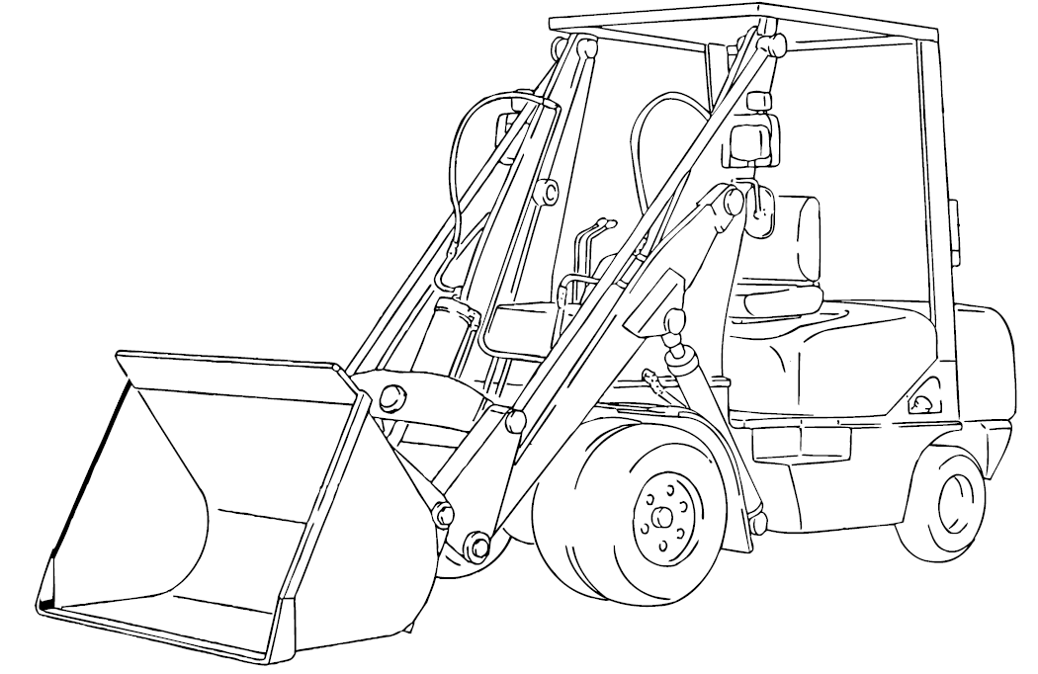
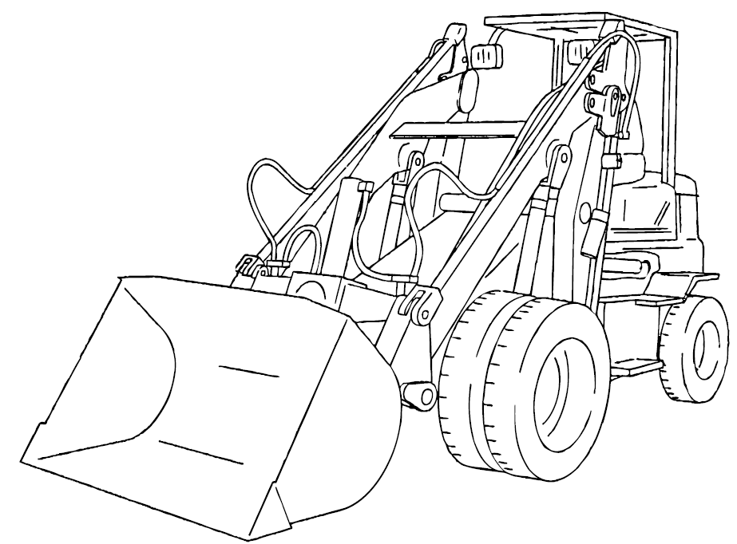
Shovel Loader Etc. Definitions and Characteristics
Figure 1-1 Shovel Loader (without reach mechanism)
Figure 1-2 Shovel Loader (with reach mechanism)
Textbookbook page 13 / Auxiliary Textbook page 4

Slide 5
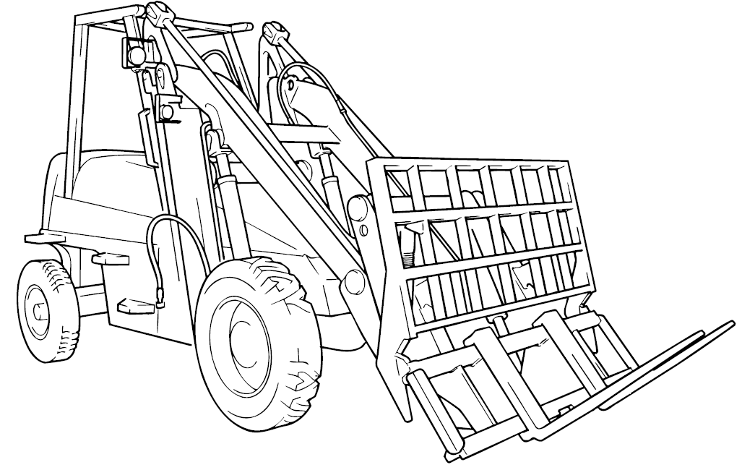
Shovel Loader Etc. Definitions and Characteristics
Figure 1-3 Fork Loader
Textbookbook page 14 / Auxiliary Textbook page 5

Slide 6
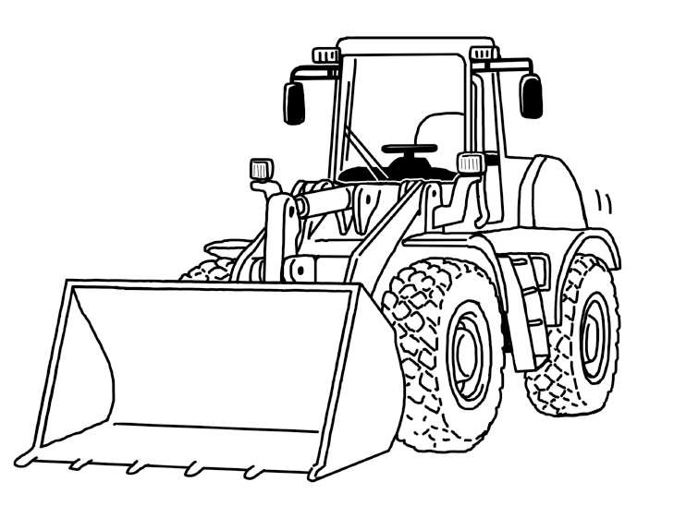
Shovel Loader Etc. Definitions and Characteristics
Reference Figure Wheel Loader
Textbookbook (there’s no page) / Auxiliary Textbook page 6

Slide 7
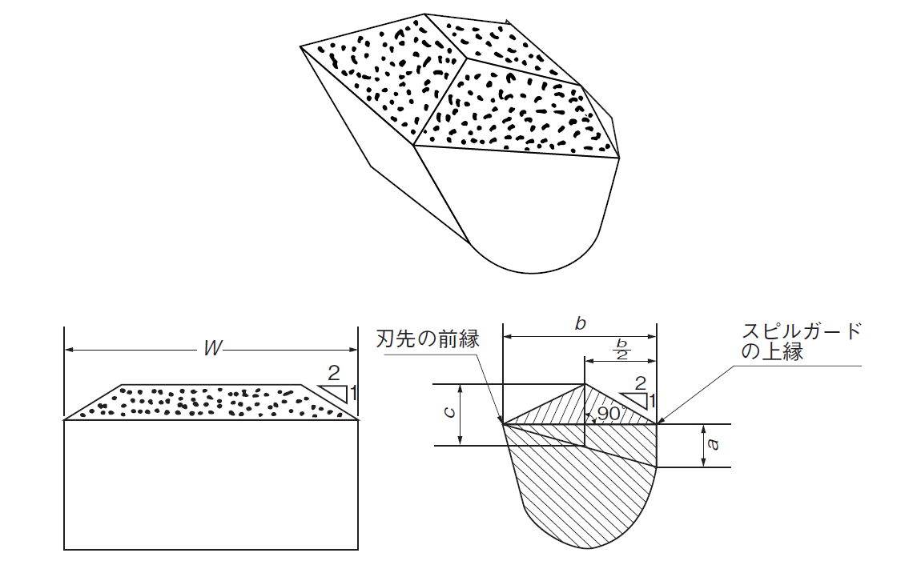
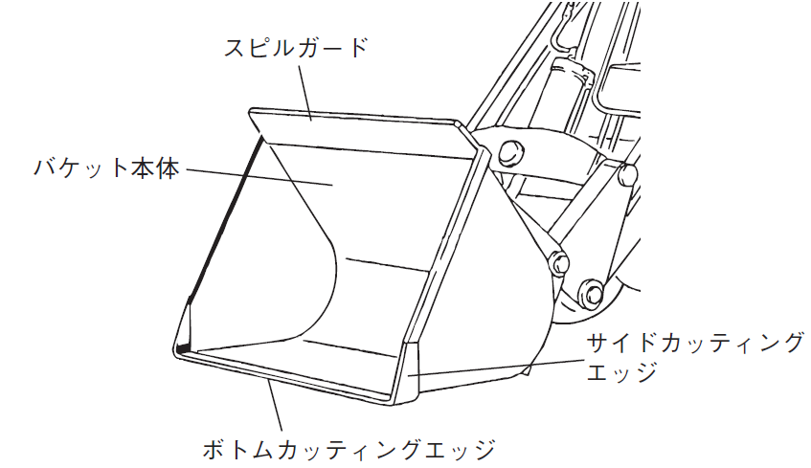
Main Specifications and Dimensions
Spill Guard
Bucket Body
Side Cutting Edge
Bottom Cutting Edge
Figure 1-4 Bucket
Figure 1-5 I Shape Bucket
図1－5 Ⅰ型バケット
Textbook page 16 / Auxiliary Textbook page 7

Slide 8
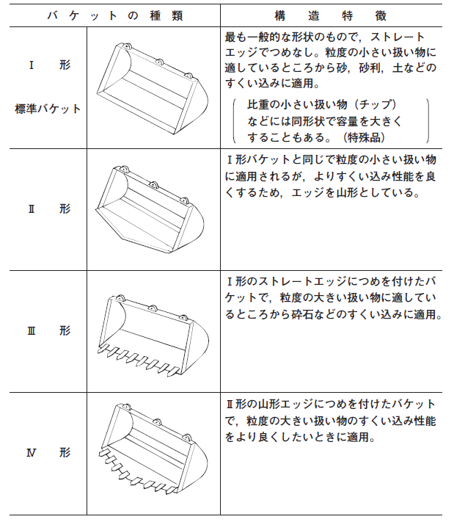
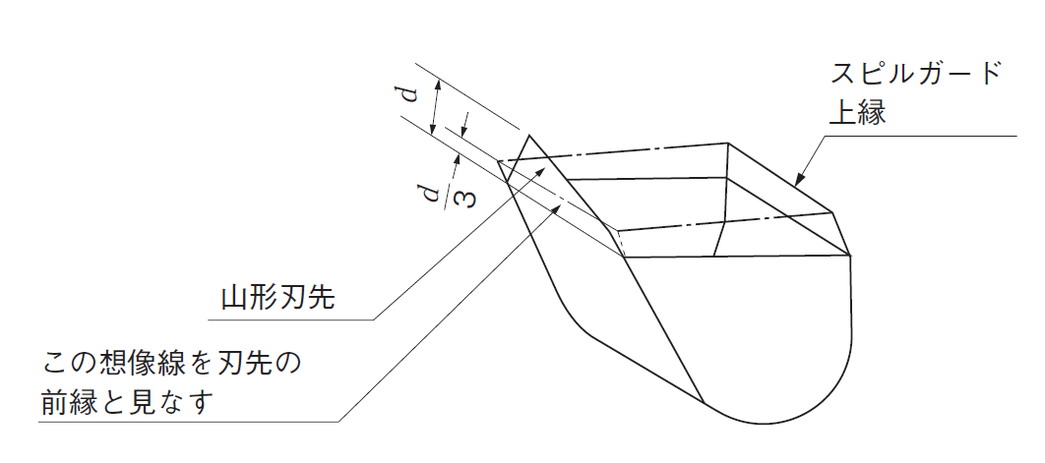
Main Specifications and Dimensions
Table 1－2 Bucket type and characteristics
Bucket type
Structure Characteristics
The most common shape bucket with straight edge and no claws. Suitable for handling small size object such as sand, gravel, soil, etc.
Ⅰ shape
Standard bucket
Spill Guard Top Edge
The capacity may be increased with the same shape for handling objects with a small relative density. (Specific objects)
Chevron shaped blade's tip
Similar to I shape bucket, this type is also suitable for handling small-sized objects. However, in order to increase the scooping ability, the edge is chevron- shaped.
Ⅱ shape
Consider this imaginary line as the blade's tip front edge
The I shape with straight edge is accentuated with claw and suitable for handling chips with bigger granularity such as crushed stone.
Ⅲ shape
Figure 1-6 II Shape Bucket
The II shape with chevron edge with claws and is used when need to handle chips with big granularity when improving scooping performance is wanted.
Ⅳ shape
Textbook page 18 / Auxiliary Textbook page 8 - 9

Slide 9
Part 2 Knowledge Related to Shovel Loader Drive Device Structure and Handling Method

Slide 10
Chapter 1 Structure

Slide 11
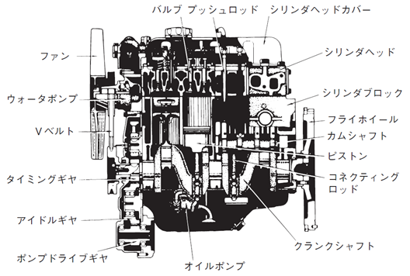
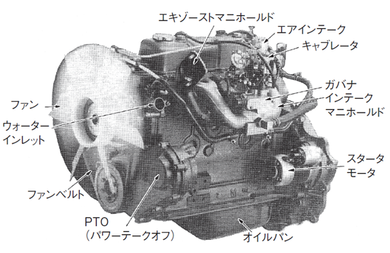
Prime Mover
Valve Push Rod
Cylinder Head Cover
Exhaust Manifold
Air Intake
Fan
Cylinder Head
Carburetor
Water Pump
Cylinder Block
Governor
V Belt
Flywheel
Fan
Intake Manifold
Cam Shaft
Water Inlet
Piston
Timing Gear
Connecting Rod
Starter
Motor
Idle Gear
Fan Belt
Crank Shaft
(Power Take Off)
Pump Drive Gear
Oil Pump
Oil Pan
Figure 2-1 Engine Structure
Figure 2-2 Gasoline Engine Exterior Appearance
Textbook page 31 / Auxiliary Textbook page 11 - 12

Slide 12
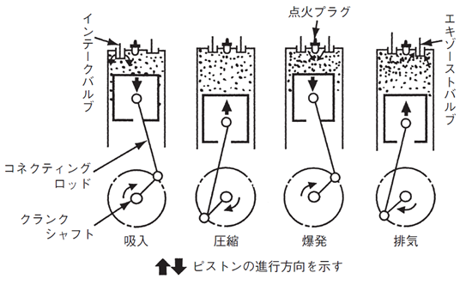
Prime Mover
Ignition Plug
Intake Valve
Exhaust Valve
Connecting Rod
Crankshaft
Intake
Compression
Combustion
Exhaust
Piston Movement Direction
Figure 2-3 Four-Stroke Engine Process Illustration
Textbook page 31 / Auxiliary Textbook page 12

Slide 13
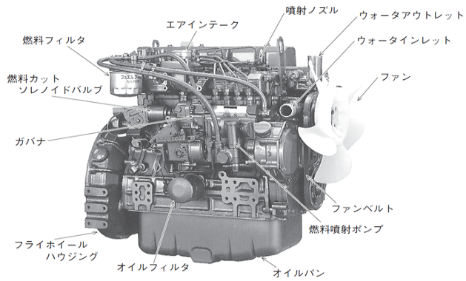
Prime Mover
Injection Nozzle
Water Outlet
Fuel Filter
Air Intake
Water Inlet
Fuel Cut Solenoid Valve
Fan
Governor
Fan Belt
Fuel Injection Pump
Flywheel Housing
Oil Filter
Oil Pan
Figure 2-4 Diesel Engine Exterior
Textbook page 34 / Auxiliary Textbook page 14

Slide 14
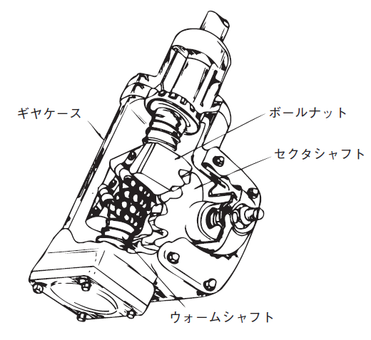
Maneuvering Gear
Gear Case
Ball Nut
Sector Shaft
Worm Shaft
Figure 2-24 Steering Gear
(Ball nut type)
Textbook page 52 / Auxiliary Textbook page 15

Slide 15
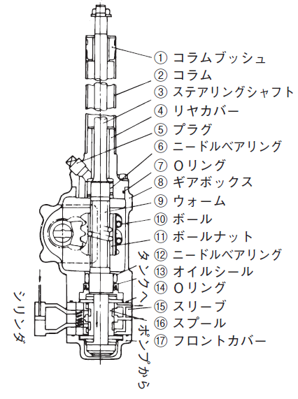
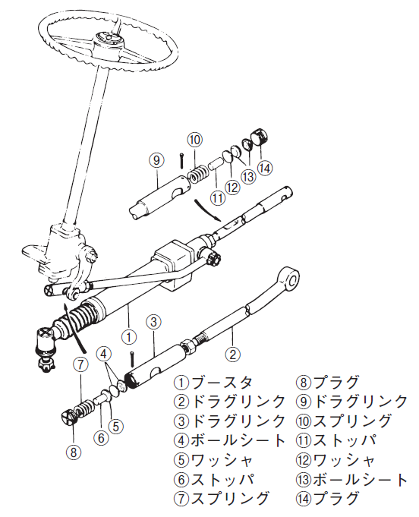
Maneuvering Gear
Column bush
Column
Steering shaft
Rear guard
Plug
Needle bearing
Oil tool
Gear box
Worm
Ball
Ball nut
Needle bearing
To tank
Oil tool
O ring
Sleeve
Cylinder
Spool
Booster
Plug
Front cover
Drag link
Drag link
From pump
Drag link
Spring
Ball sheet
Stopper
Washer
Washer
Figure 2-25 Semi Integral Type
Stopper
Ball Sheet
Spring
Plug
Figure 2-26 Linkage Type
Textbook page 53/ Auxiliary Textbook page 16 - 17

Slide 16
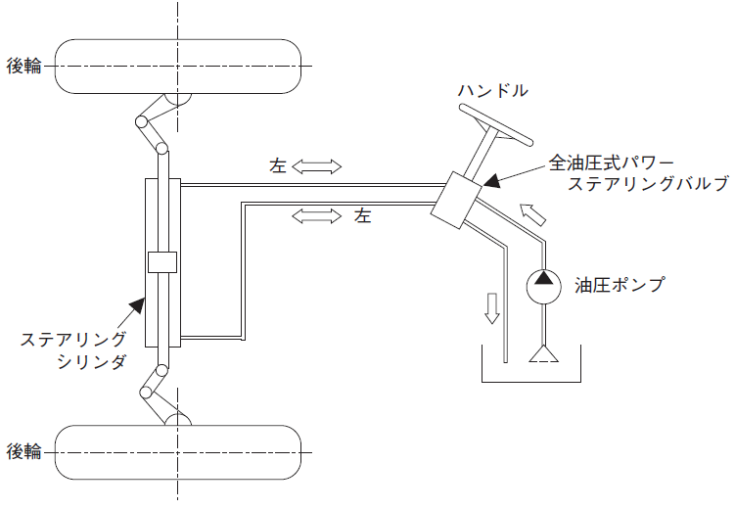
Maneuvering Gear
Rear axle
Handle
Left
Full hydraulic type power steering valve
Left
Hydraulic pressure pump
Steering cylinder
Rear axle
Figure 2-27 Full Hydraulic Pressure Type
Textbook page 54/ Auxiliary Textbook page 18

Slide 17
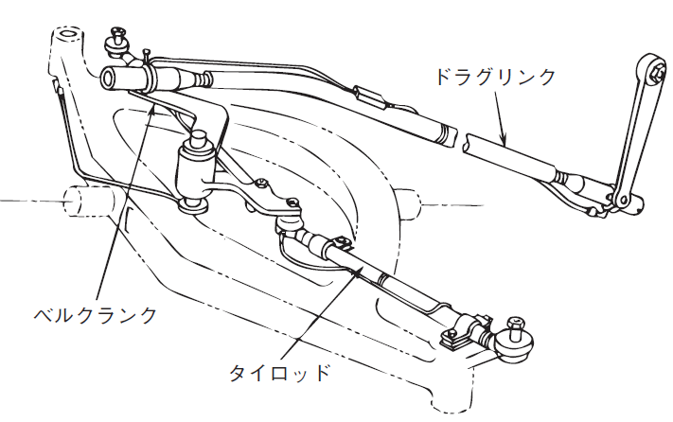
Maneuvering Gear
Drag link
Bell crank
Tie rod
Figure 2-28 Drag Link And Tie Rod
Textbook page 55/ Auxiliary Textbook page 19

Slide 18
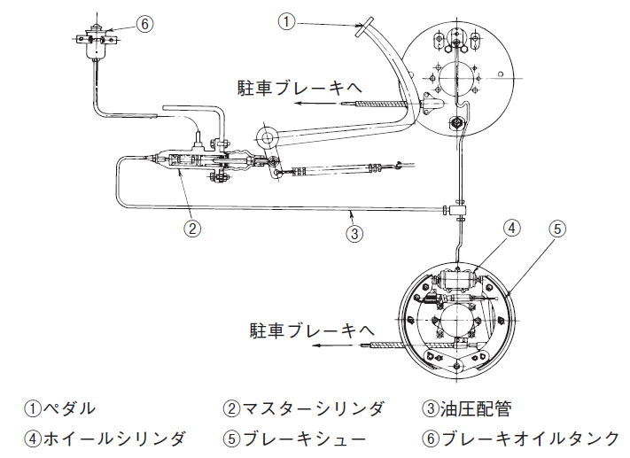
Braking Device
To the parking brake
To the parking brake
① Pedal ② Master cylinder ③ Hydraulic pipe④ Wheel cylinder ⑤ Brake shoes ⑥ Brake oil tank
Figure 2-29 Foot Brake (Example of drum type brake without servo)
Textbook page 56/ Auxiliary Textbook page 20

Slide 19
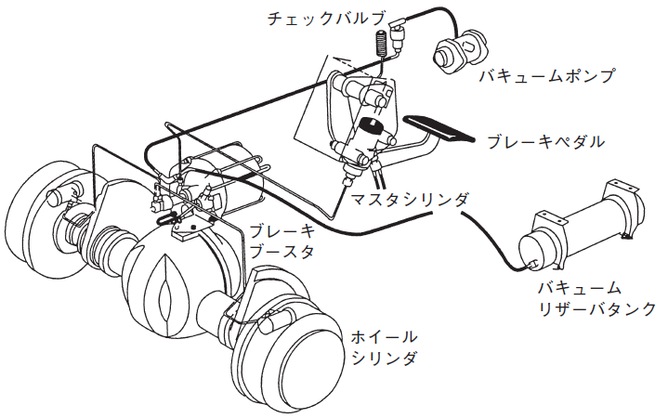
Braking Device
Check valve
Vacuum pump
Brake pedal
Master cylinder
Brake booster
Vacuum reserve tank
Wheel cylinder
Figure 2-30 Example of Brake Booster (vacuum servo type)
Textbook page 57/ Auxiliary Textbook page 21

Slide 20
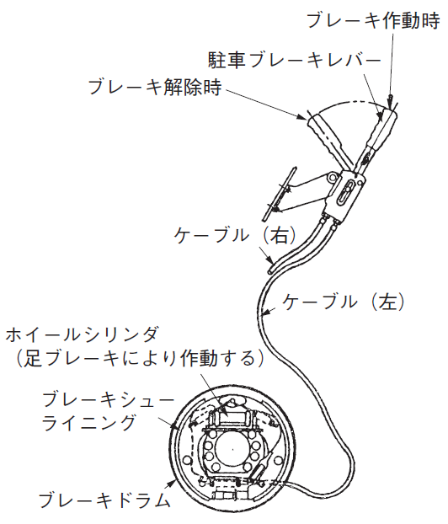
Braking Device
When the brake is operated
Parking brake lever
When the brake is released
Cable (right)
Cable (left)
Wheel cylinder
(Operated by the foot brake
Brake shoe lining
Brake drum
Figure 2-31 Internal Expanding Type Brake (double as parking brake too)
Textbook page 58/ Auxiliary Textbook page 22

Slide 21
Chapter 2 Handling Method

Slide 22
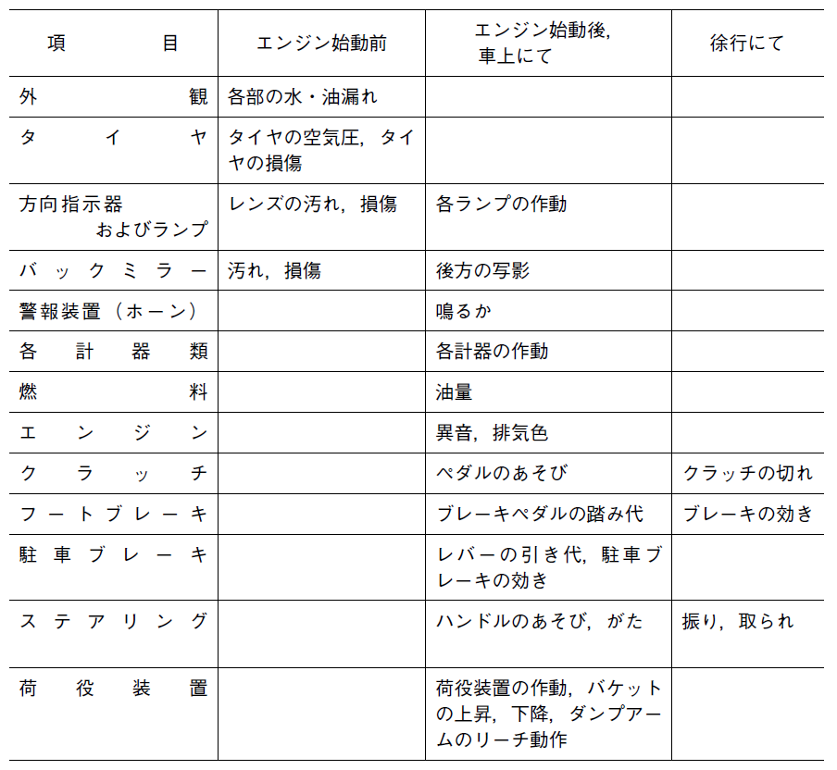
Instructions Before Starting Work
Table 2-1 Inspection list before starting work
Item | Before starting the engine | After starting the engine and in the car | When traveling at a slow speed
Exterior | Water or oil leakage
Tire | Tire's air pressure, tire damage
Turn signal and lamp | Stain or damage in the lens and lamp | Every lamp operation
Back mirror | Stain, damage | Rear reflection, view
Warning device (horn) |  | Is there any sound?
Each indicator |  | Each indicator operation
Fuel |  | Oil amounts
Engine |  | Abnormal sound, exhaust color
Clutch |  | Pedal clearance | Clutch disengagement
Foot brake |  | Brake pedal engagement | Brake effective
Parking brake |  | Lever travel, parking brake effectiveness
Steering |  | Handle play, looseness | Swing, control
Handling device |  | Handling device operation, bucket ascending and descending movement, dump arm reach operation
Textbook page 62/ Auxiliary Textbook page 24

Slide 23
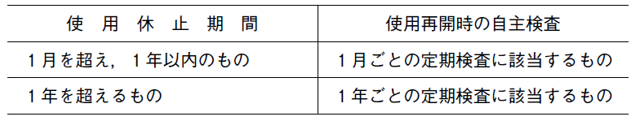
Periodic Inspections
Table 2-2 Inspection When Restarting Activities
Suspension period | Inspection when restarting activities
Over than 1 month, under one year | Corresponds with monthly inspection
Over than a year | Corresponds with annual inspection
Textbook page 63/ Auxiliary Textbook page 25

Slide 24
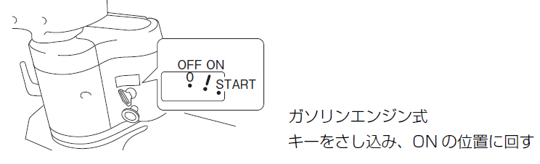
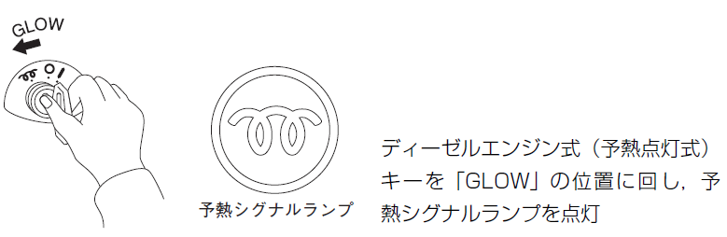
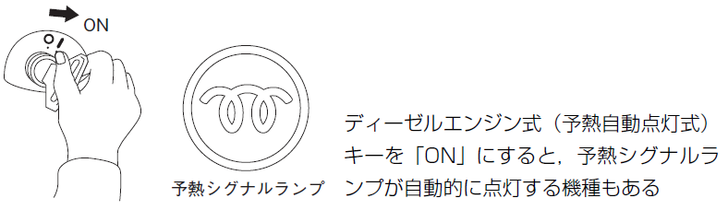
Guidelines When Starting Operation
For gasoline engine type, insert the key and turn it to ON position
Figure 2-33 Starting the gasoline engine type
For diesel engine type (preheat lamp type), turn the key to GLOW position, and turn the preheat signal lamp
Preheat Signal lamp
Figure 2-34 Starting diesel engine type (1)
For diesel engine type (automatic preheat lamp type), there is also a type where the lamp automatically light up if the key is turned to ON position
Preheat Signal lamp
Figure 2-35 Starting diesel engine type (2)
Textbook page 65/ Auxiliary Textbook page 27

Slide 25
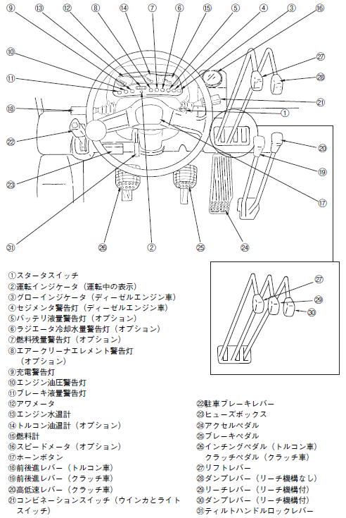
Guidelines for Starting and Driving
①Start switch
②Driving injector (displayed when driving)
③Glow injector (diesel engine type vehicle)
④Sedimenter warning light (diesel engine type vehicle)
⑤Battery liquid amount warning light (optional)
⑥Radiator cooling water quantity warning light
⑦Fuel remaining quantity warning light (optional)
⑧Air cleaner element warning light (optional)
⑨Charge warning light
⑩Engine hydraulic pressure warning light
⑪Brake liquid amount warning light
⑫Hour-meter
⑬Engine water temperature gauge
⑭Torque converter type oil temperature gauge (optional)
⑮Fuel meter
⑯Speedometer (optional)
⑰Horn button
⑱Forward-backward lever (torque converter type vehicle)
⑲Forward-backward lever (clutch type vehicle)
⑳High-low speed (speed switcher) lever (clutch type vehicle)
㉑Combination switch (winker and light switch)
㉒Parking brake lever
㉓Fuse box
㉔Accelerator/gas pedal
㉕Brake pedal
㉖Inching pedal (torque converter type vehicle)
Clutch pedal (clutch type vehicle)
㉗Lift lever
㉘Dump lever (without reach function)
㉙Reach lever (with reach function)
㉚Dump lever (with reach function)
㉛Tilt handle lock lever
Figure 2-36 Driver seat (clutch type, torque converter type)
Textbook page 67/ Auxiliary Textbook page 29

Slide 26
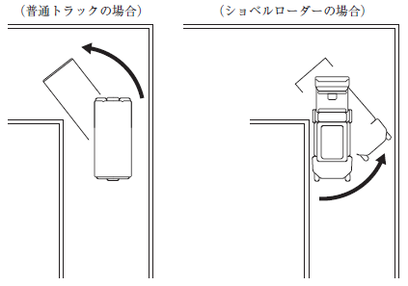
Guidelines for Starting and Driving
Normal truck
Shovel loader
Figure 2-37 Turning at the Corner
Textbook page 69/ Auxiliary Textbook page 30

Slide 27
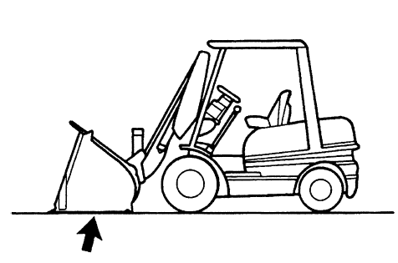
Guidelines for Stopping, Parking and After Driving
Figure 2-38 Parking Illustration
Textbook page 71/ Auxiliary Textbook page 32

Slide 28
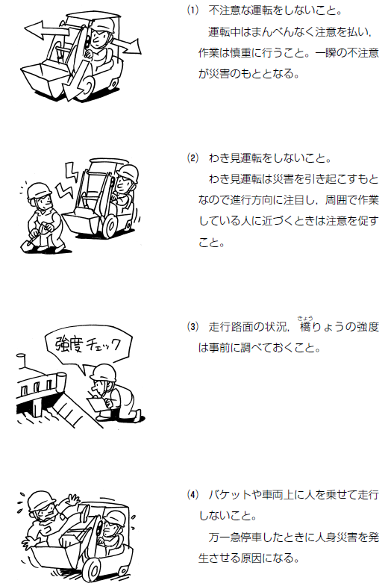
Operation Precautions
(1) Do not drive carelessly.
Pay close attention while driving
and work carefully. A moment of
carelessness can lead to an accident.
Textbook page 72 / Auxiliary Textbook page 34

Slide 29
Operation Precautions
(2) Do not take eyes off the road when driving. Looking aside while driving can cause a disaster, so pay attention to the direction of travel and pay attention when approaching people working around you.
Textbook page 72 / Auxiliary Textbook page 34

Slide 30
Operation Precautions
(3) Check the condition of the road
surface and the strength of the
bridge in advance.
Strength, check!
Textbook page 72 / Auxiliary Textbook page 34

Slide 31
Operation Precautions
(4) Do not drive with people on the
bucket or on the vehicle. It may
cause injury the person when it
suddenly stops.
Textbook page 72 / Auxiliary Textbook page 34

Slide 32
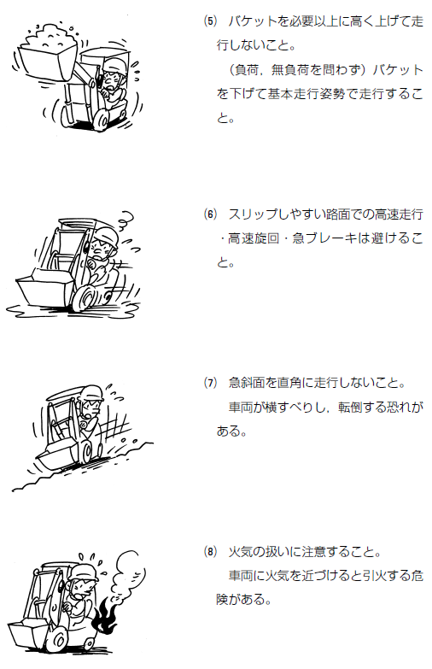
Operation Precautions
(5) Do not travel with a bucket raised
higher than necessary. (Regardless
of load or no load) lower the bucket
and travel in the basic driving position.
Textbook page 73 / Auxiliary Textbook page 35

Slide 33
Operation Precautions
(6) On a slippery road, avoid high-speed
driving, high-speed turning, and sudden
braking.
Textbook page 73 / Auxiliary Textbook page 35

Slide 34
Operation Precautions
(7) On steep slopes, do not drive at right
angle. The vehicle may slip and tip over.
Textbook page 73 / Auxiliary Textbook page 35

Slide 35
Operation Precautions
(8) Be careful when handling fire. When
bringing fire close to the vehicle, there
is a danger of fire.
Textbook page 73 / Auxiliary Textbook page 35

Slide 36
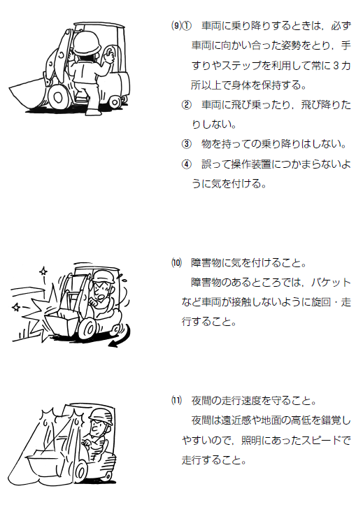
Operation Precautions
(9) ① Be sure to face the vehicle when getting on and off the vehicle. Always hold your body in three position or more by using the handrail and the steps.
② Do not jump on or jump off the vehicle
③ Do not get on or get off the vehicle while holding material.
④ Do not get caught in the operating
device accidentally.
Textbook page 74 / Auxiliary Textbook page 36

Slide 37
Operation Precautions
(10) Be careful of obstacles. When turning
and driving do not collide the vehicle
or the bucket with the obstacles.
Textbook page 74 / Auxiliary Textbook page 36

Slide 38
Operation Precautions
(11) Obey the running speed at night. At
night, it is easy to get an illusion of
perspective and ground height,
therefore, drive at a speed matches
the lighting.
Textbook page 74 / Auxiliary Textbook page 36

Slide 39
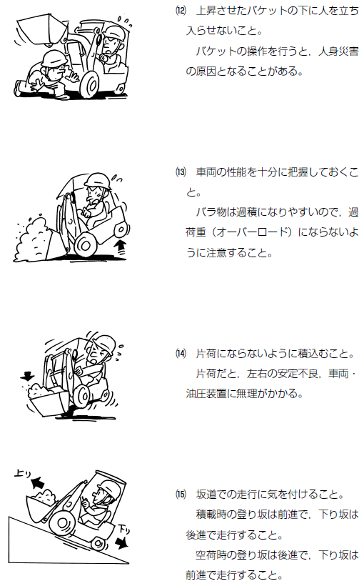
Operation Precautions
(12) Keep people out of the raised bucket.
Operating the bucket may cause injury.
Textbook page 75/ Auxiliary Textbook page 37

Slide 40
Operation Precautions
(13) Fully understand the performance of
the vehicle. Bulk materials are easy to
get overload, so be careful not to
overload.
Textbook page 75/ Auxiliary Textbook page 37

Slide 41
Operation Precautions
(14) Do not load on one side. If you load on
one side, the left and right sides will be
unstable, and the hydraulic system will
be undoable.
Textbook page 75/ Auxiliary Textbook page 37

Slide 42
Operation Precautions
Going
up
(15) Be careful when driving on slopes.
When the vehicle is loaded, drive forward on uphill slopes and backward on downhill slopes.
When the vehicle is empty, drive backward on uphill slopes and forward on downhill slopes.
Going
down
Textbook page 75/ Auxiliary Textbook page 37

Slide 43
Part 3 Knowledge of The Structure and Handling Method of Equipment Related to Cargo Handling Such as Shovel Loaders

Slide 44
Chapter 1 Structure

Slide 45
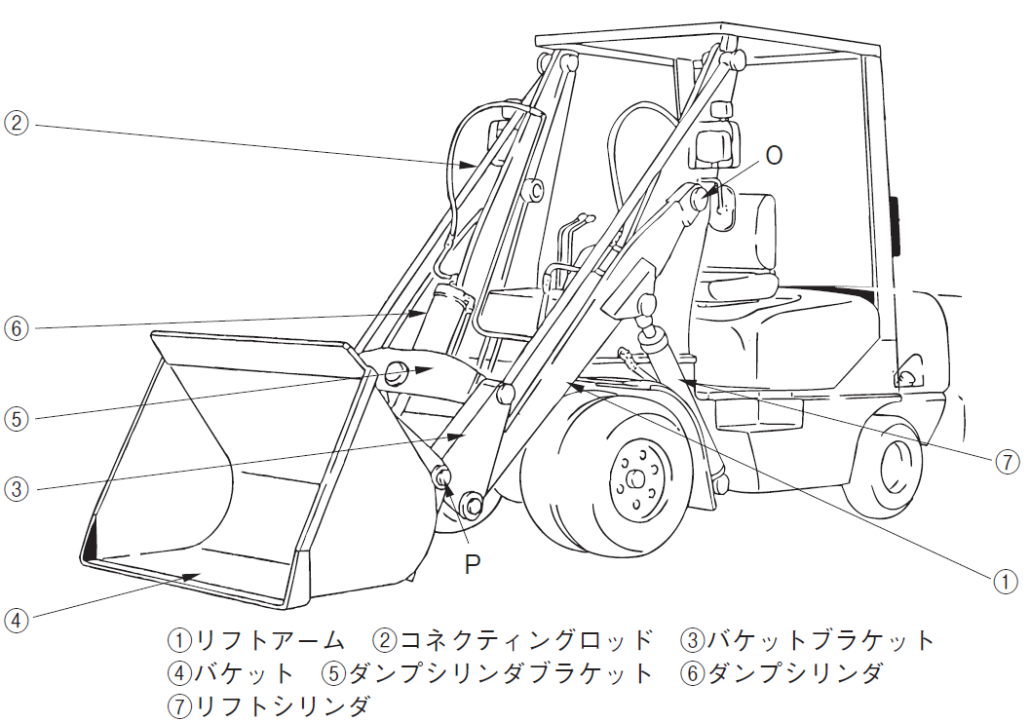
Cargo Handling Equipment
1 Lift arm 2 Connecting road 3 Bucket bracket
4 Bucket 5 Dump cylinder bracket 6 Dump cylinder
7 Lift cylinder
Figure 3-1 Shovel loader work equipment
Textbook page 79 / Auxiliary Textbook page 38

Slide 46
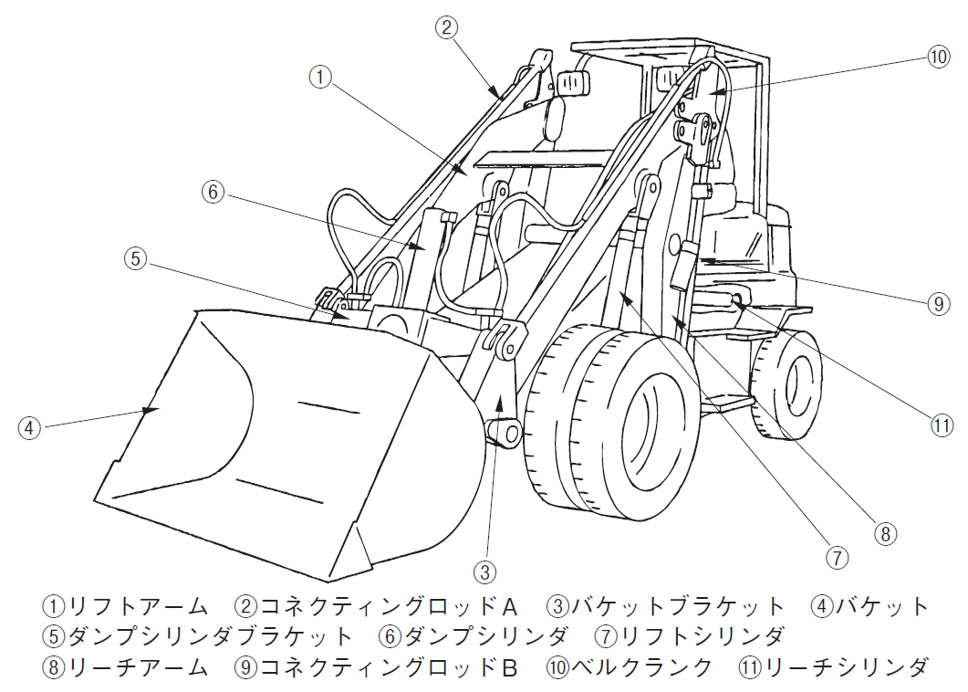
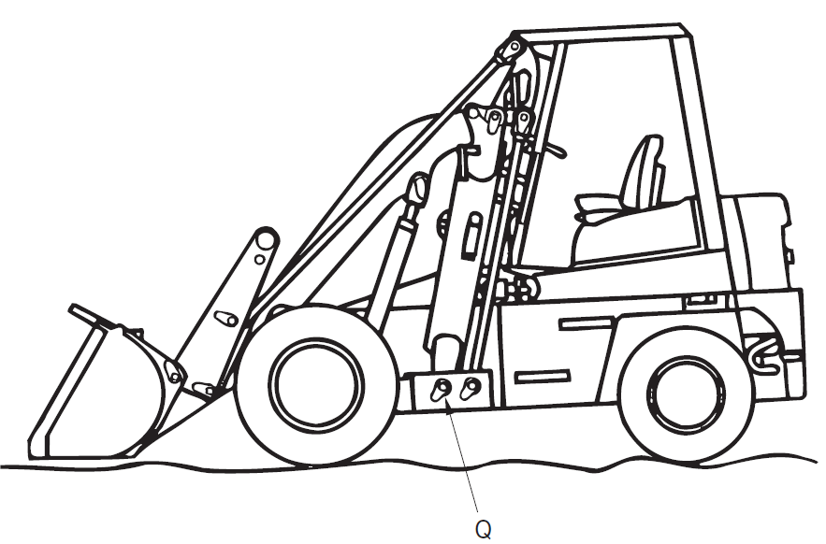
Cargo Handling Equipment
1 Lift arm 2 Connecting road 3 Bucket bracket 4 Bucket
5 Dump cylinder bracket 6 Dump cylinder 7 Lift cylinder
8 Reach arm 9 Connecting road B 10 Bell cranck 11 Reach cylinder
Figure 3-2 Shovel loader work equipment with reach mechanism
Textbook page 81 / Auxiliary Textbook page 39

Slide 47
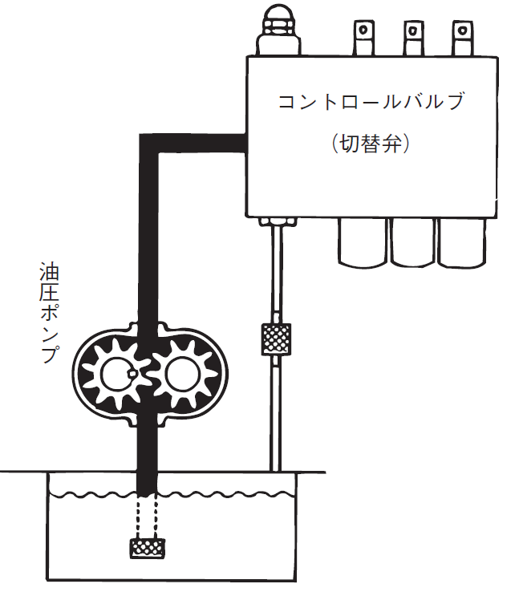
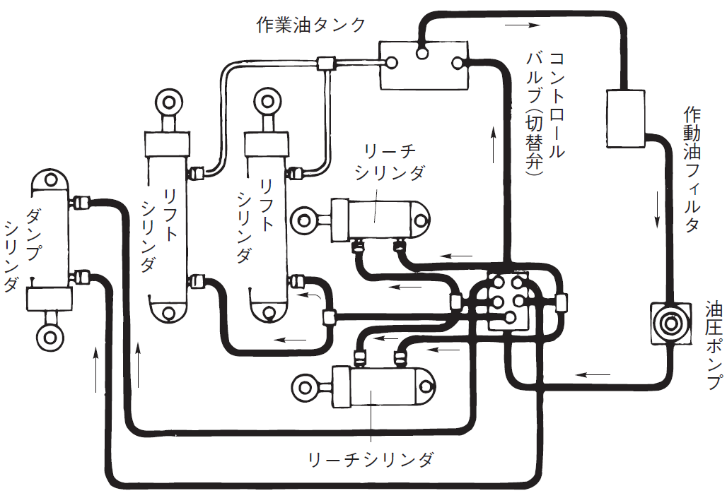
Hydraulic System
Fuel tank operation
Valve controller (Switching)
Valve controller (Switching)
Reach
cylinder
Operation oil filter
Dump cylinder
Lift cylinder
Lift Cylinder
Hydraulic pump
Hydraulic pump
Reach cylinder
Figure 3-3 Excavator loader system diagram
Figure 3-4 Hydraulic pump
Textbook page 82/ Auxiliary Textbook page 40 - 41

Slide 48
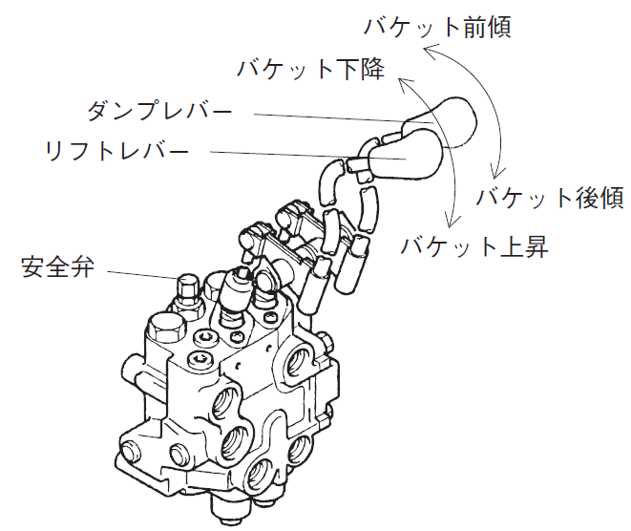
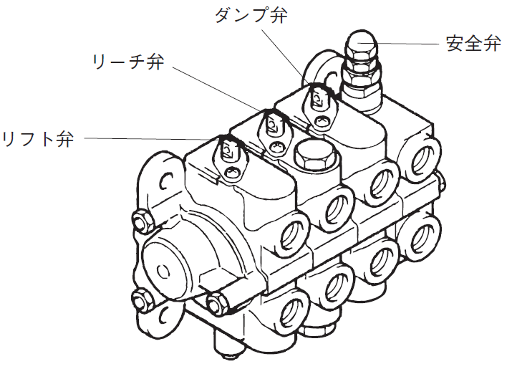
Hydraulic System
Bucket forward tilt
Bucket descent
Dump valve
Reach valve
Safety valve
Dump lever
Lift lever
Bucket backward tilt
Lift valve
Safety valve
Bucket rising
Figure 3-5 Control valve
(Double / Standard type)
Figure 3-6 Control valve
(Triple / Standard type)
Textbook page 84 / Auxiliary Textbook page 41 - 42

Slide 49
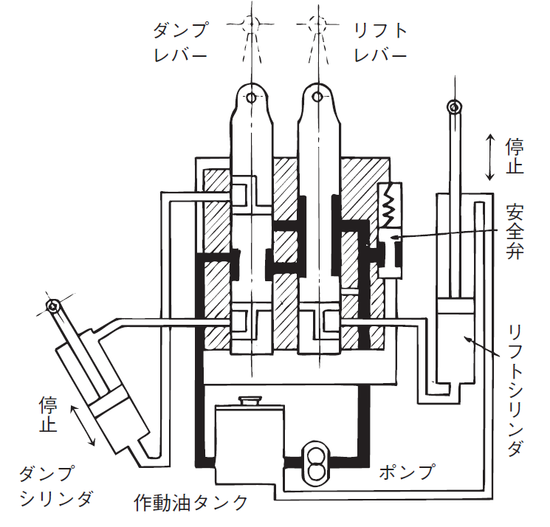
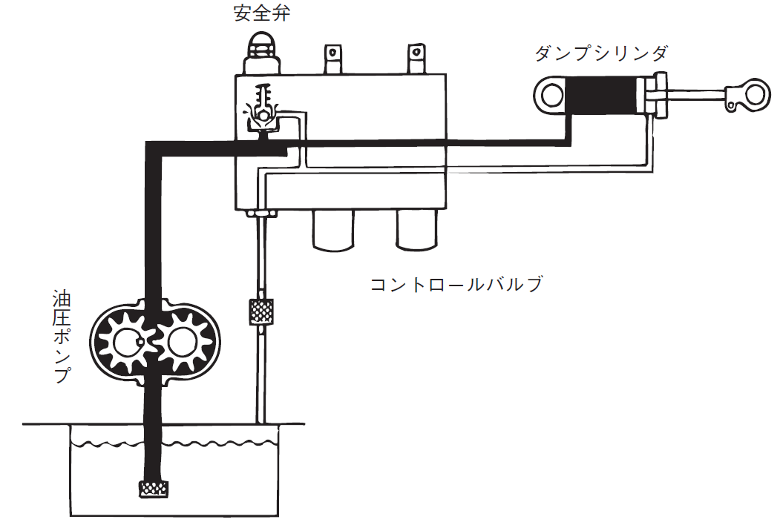
Hydraulic System
Dump lever
Lift lever
Safety valve
Dump cylinder
Suspension
Safety valve
Hydraulic pump
Control valve
Suspension
Lift cylinder
Dump cylinder
Pump
Hydraulic oil tank
Figure 3-7 Opreation of safety valve
Figure 3-8 Control valve operation diagram in neutral
Textbook page 85 / Auxiliary Textbook page 42 - 43

Slide 50
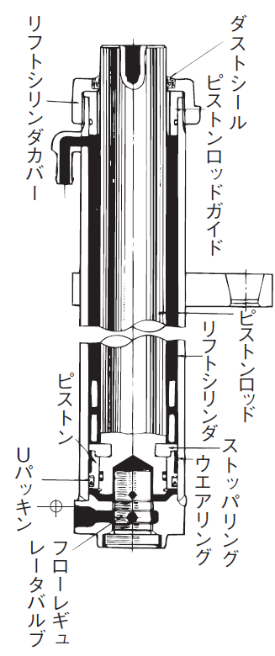
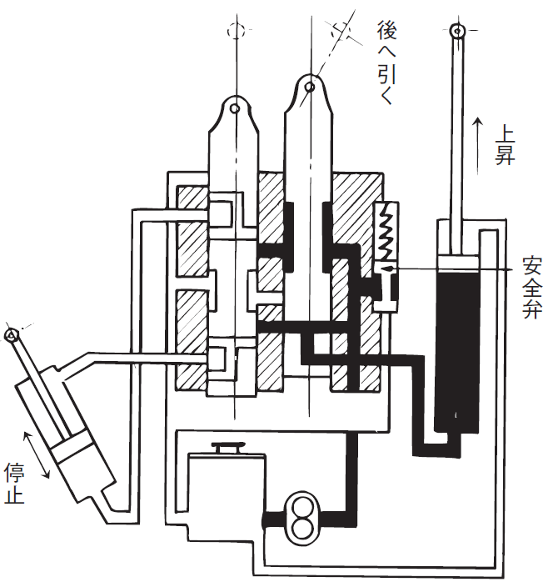
Hydraulic System
Dust seal
Lift cylinder cover
Pull back
Piston rod guide
Raising
Safety valve
Piston rod
Piston
Lift cylinder
Suspension
U seal
Stopper ring
Wear ring
Flow regulator valve
Figure 3- 9 Control valve operation diagram when the lift raise
Figure 3-10 Lift cylinder
Textbook page 86/ Auxiliary Textbook page 43 - 44

Slide 51
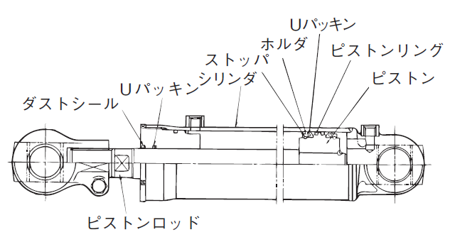
Hydraulic System
U seal
Holder
Piston ring
Stopper
U seal
Cylinder
Piston
Dust seal
Piston rod
Figure 3-11 Reach and Dump cylinder
Textbook page 87 / Auxiliary Textbook page 44

Slide 52
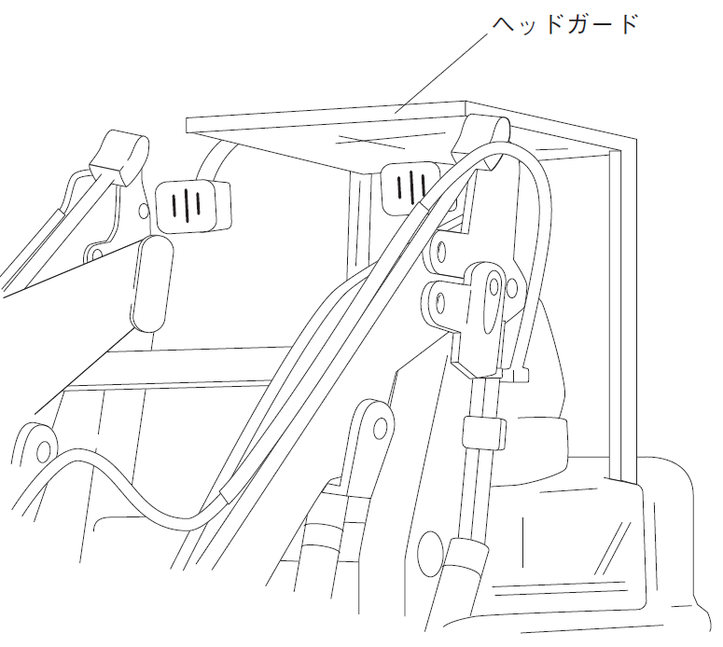
Head Guard
Head Guard
Figure 3-12 Head Guard
Textbook page 88/ Auxiliary Textbook page 45

Slide 53
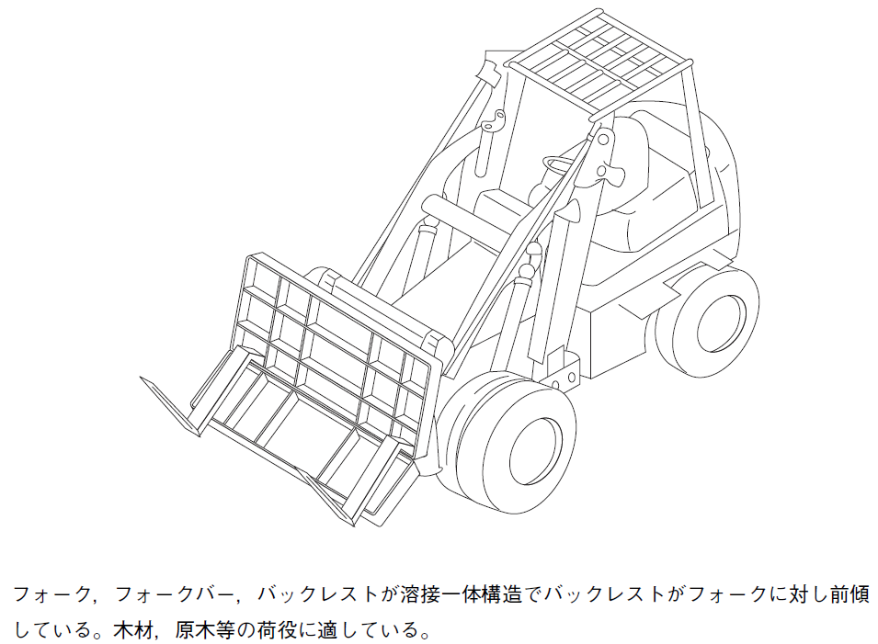
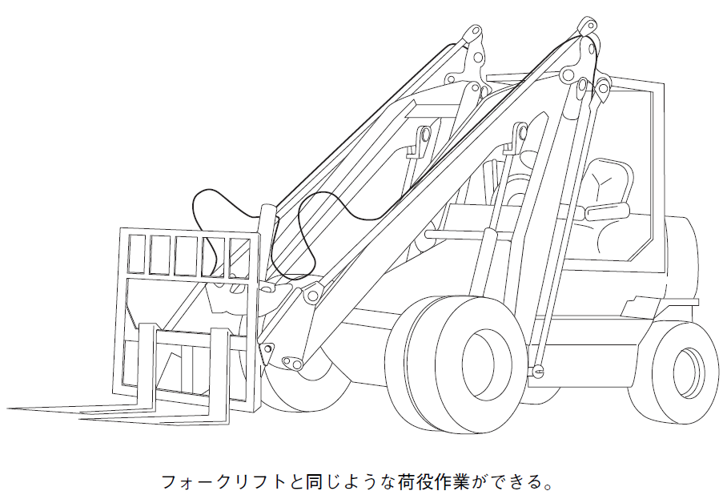
Fork Loader
Pallet forks can perform cargo handling operations the same as forklifts.
The fork, fork bars and backrest are welded together, and the backrest is tilted forward against the fork. It is suitable for the cargo handling work such as lumber, logs, etc.
Figure 3-13 Pallet Fork
Figure 3-14 Sharp Dumping Fork
Textbook page 89/ Auxiliary Textbook page 46

Slide 54
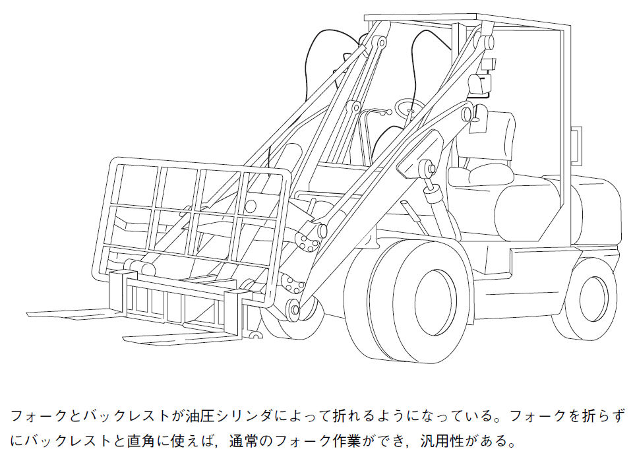
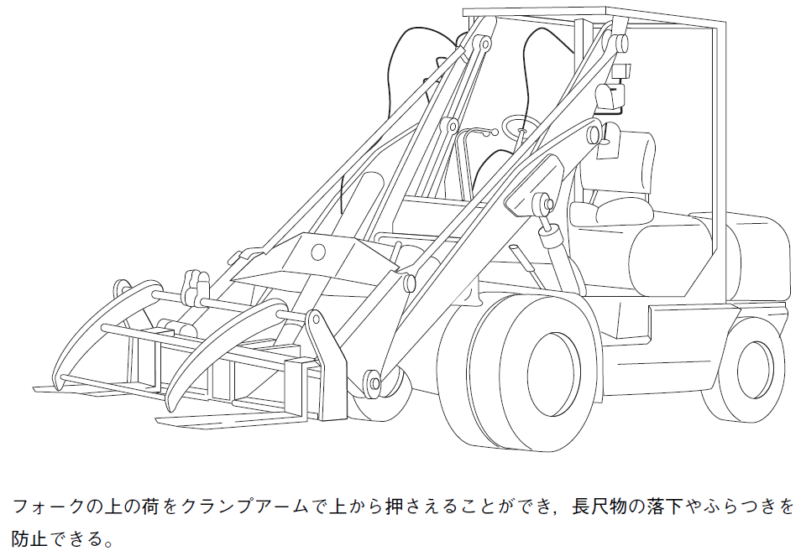
Fork Loader
The fork and backrest are designed to be folded by a hydraulic cylinder. If the fork is used at a right angle to the backrest without folding the fork, normal fork work can be performed making it versatile.
The load on fork can be hold on the forks from above with a clamp arm, preventing long objects from falling or wobbling.
Figure 3-15 Hinged fork
Figure 3-16 Log fork
Textbook page 90 / Auxiliary Textbook page 47

Slide 55
Chapter 2 Handling Method

Slide 56
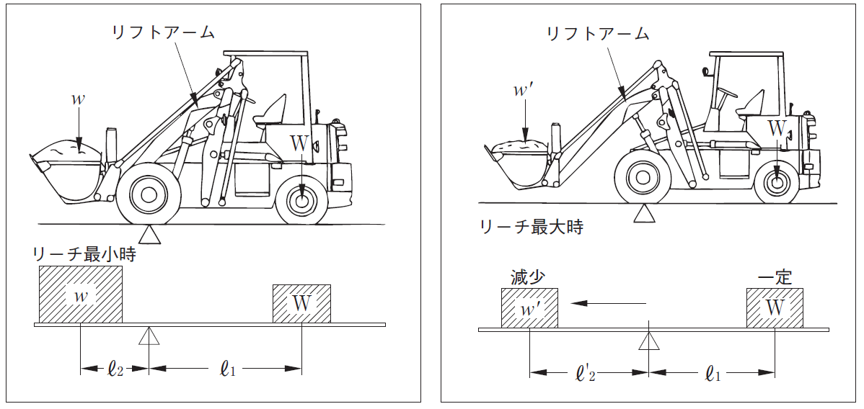
Load And Vehicle Stability
Lift arm
Lift arm
Minimum reach
Maximum reach
Decrease
Regular
Figure 3-25 Load and vehicle stability
Textbook page 98 / Auxiliary Textbook page 49

Slide 57


Load And Vehicle Stability
Figure 3-26 Left-right eccentricity
Figure 3-27 The center of gravity matches the center line
Textbook page 99 / Auxiliary Textbook page 50

Slide 58

Working Method
Figure 3-28 Uneven surface
Textbook page 100 / Auxiliary Textbook page 52

Slide 59

Working Method
Figure 3-29 Straight angle
Figure 3-30 Diagonally
Textbook page 101 / Auxiliary Textbook page 53

Slide 60

Working Method
Figure 3-31 Scooping
Textbook page 102 / Auxiliary Textbook page 54

Slide 61

Working Method
Figure 3-32 How to turn around corners
Textbook page 103 / Auxiliary Textbook page 55

Slide 62

Working Method
Figure 3-33 When dumping
Textbook page 104 / Auxiliary Textbook page 56

Slide 63

Working Method
Work target
Work target
Work target
Work target
Figure 3-34 Points when loading
Textbook page 105 / Auxiliary Textbook page 57

Slide 64

Working Method
Shovel loader with reach mechanism
Shovel loader without reach mechanism
Figure 3-35 Shovel loader with and without reach mechanism
Textbook page 106 / Auxiliary Textbook page 58

Slide 65
Part 4 Knowledge of Mechanics Necessary for Driving Shovel Loader Etc.

Slide 66
Chapter 1 Force

Slide 67


Moment of Force
Figure 4-8 Lever
Figure 4-9 Moment of force
Textbook page 115 / Auxiliary Textbook page 60

Slide 68

Moment of Force
Figure 4-10 Moment action on shovel loader
Textbook page 116 / Auxiliary Textbook page 61

Slide 69

Force Balance
Figure 4-12 Balance with a balance bar
Textbook page 118 / Auxiliary Textbook page 63

Slide 70
Chapter 2 Mass/Weight and Center of Gravity

Slide 71

Mass/Weight
Table 4-1 Unit volume mass table of various objects
Type | Mass per ㎥(t) | Type | Mass per ㎥(t) | Type | Mass per ㎥(t)
Lead | 11.4 | Concrete | 2.3 | Japanese evergreen oak | 0.9
Copper | 8.9 | Brick | 2.2 | Japanese zelkova | 0.7
Steel | 7.8 | Soil | 2.0 | Beech | 0.7
Tin | 7.3 | Pebble | 1.7 | Chestnut | 0.6
Cast iron | 7.2 | Sand | 1.8 | Japanese red pine | 0.5
Zinc | 7.1 | Coal lump | 0.8 | Larch | 0.5
Pig iron | 7.0 | Coal powder | 1.0 | Cedar | 0.4
Aluminum | 2.7 | Cork | 0.5 | Japanese cypress | 0.4
Clay | 2.6 | Water | 1.0 | Paulownia | 0.3
(Note) Wood mass is dry mass, coal and cork are appearance unit weight
Textbook page 121 / Auxiliary Textbook page 64

Slide 72


Mass/Weight
Table 4-2 Volume formula chat
Textbook page 122 / Auxiliary Textbook page 65

Slide 73

Center of Gravity
Figure 4-15 How to find center of gravity
Textbook page 124 / Auxiliary Textbook page 67

Slide 74


Stability of Objects
Figure 4-16 Object stability
Textbook page 125 / Auxiliary Textbook page 68

Slide 75
Chapter 3 Motion of Objects

Slide 76

Friction
Static frictional force
Maximum static
frictional force
Frictional of dynamic
Force applied to the object
The object is static
The object is moving
Figure 4－20 Maximum static frictional force and dynamic friction
Textbook page 133 / Auxiliary Textbook page 70

Slide 77
Part 5 Related Laws and Regulations

Slide 78
Related Laws and Regulations
Industrial Safety and Health Act
Law
Cabinet
order
Order for Enforcement of the Industrial Safety and Health Act
Ministerial order
Regulations for Enforcement of the Industrial Safety and Health Act
Structural standards for shovel loader, etc.
Public announcement Notification
Shovel loaders driving skill training rules
Safety and Health Special Education Regulations
Figure 5-1 Driving skills legal system for shovel loaders etc.
(Reference) Ministry of Health, Labor and Welfare Risk assessment manual in the building maintenance industry
Textbook page 145 / Auxiliary Textbook page 73

Slide 79
Part 6 Accident Cases

Slide 80

Case 1 Fall From Shoulder
Case 1 Fall from the shoulder
Textbook page 128 / Auxiliary Textbook page 91

Slide 81

Case 2 Fall From a Fork Loader Due to Vibration
Case 2 Fall from a fork loader due to vibration
Textbook page 220 / Auxiliary Textbook page 93

Slide 82

Case 3 While Checking the Condition of a Load, The Worker Was Run Over by a Fork
Case 3 While checking the condition of a load, the worker was run over by a fork
Textbook page 222 / Auxiliary Textbook page 95

Slide 83

Case 4 Run Over by a Shovel Loader During a Start-up Inspection
Case 4 Run over by a shovel loader during a start-up inspection
Textbook page 224 / Auxiliary Textbook page 97

Slide 84

Case 5 Shovel Loader Escapes and is Run Over
Accident situation map
Case 5 Shovel loader escapes and is run over
Textbook page 225 / Auxiliary Textbook page 99

Slide 85

Case 7 Trapped Between Driver’s Seat and Arm During Loading Of Round Steel
Case 7 Trapped between driver’s seat and arm during loading of round steel
Textbook page 229 / Auxiliary Textbook page 101

Slide 86

Case 8 Trapped Between the Machine And The Built-in Sheet Pile
Case 8 Trapped between the machine and the built-in sheet pile
Textbook page 231 / Auxiliary Textbook page 103

Slide 87


Case 9 Head Caught in the Arm of the Shovel Loader
Shovel
Shovel operation lever
Victim(A)
Driver's seat leg
Part cover plate
Lift arm
Driving seat
Shovel
Victim
Lift arm up and down
Operation lever
Iron
piece
Lift arm
Driver's seat leg cover plate
Accident situation map (side view)
Accident situation map (plan view)
Case 9 Head caught in the arm of the shovel loader
Textbook page 233 / Auxiliary Textbook page 106

Slide 88

Case 10 A Concrete Block Lifted by The Shovel Loader Falls and Was Damaged
Concrete block
Bucket
Situation diagram of lifting a block with a bucket
Case 10 A concrete block lifted by the shovel loader falls and was damaged
Textbook page 233 / Auxiliary Textbook page 108

