Slide 1
Sasakyang Makinaryang Pang-konstruksyon（Pang-demolisyon）
Driving Skill Training Auxiliary Text
Power Point Document para sa Skill Training Course

Slide 2
Kabanata 1:
Pangunahing Kaalaman Tungkol sa Sasakyang Makinaryang Pang-konstruksyon

Slide 3
Klasipikasyon ng Sasakyang Makinaryang Pang-konstruksyon (Industrial Safety and Health Act Enforcement Ordinance Appendix 7)
Makinarya para sa pag-patag, pag-transport, at pag-load) (bulldozer, tractor excavator (shoberu), atbp.)
Makinaryang pang-hukay (Drag Shovel (shoberu), atbp.)
Makinarya para sa pag-pondasyon（Piling machine, Pile-extractor machine, atbp.）
Compaction machine (Roller, atbp.)
Concrete Placement Machine (Concrete Pump Vehicle, atbp.)
Makinaryang pang-demolish (Breaker, Steel Frame Cutting Machine, Concrete Crusher, Demolition Gripping Tool)
Page 1 of textbook / Page 4 of auxiliary text

Slide 4
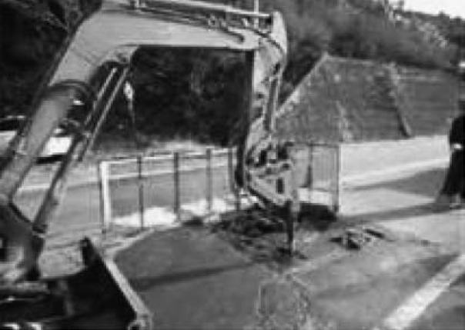
Uri at Gamit ng Dismantling Machines (Katangian)
(1) Breaker
Page 2 of textbook / Page 4 of auxiliary text

Slide 5
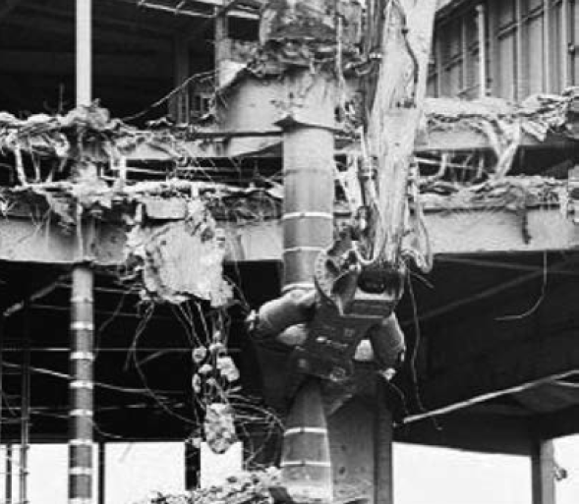
Uri at Gamit ng Dismantling Machines (Katangian)
(2) Steel Frame Cutting Machine
Page 3 of textbook / Page 5 of auxiliary text

Slide 6
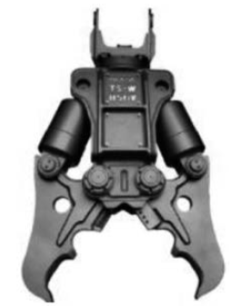
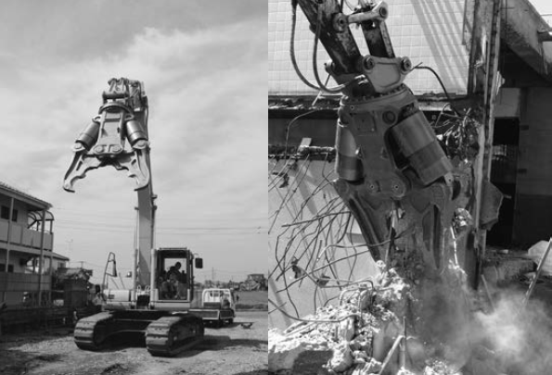
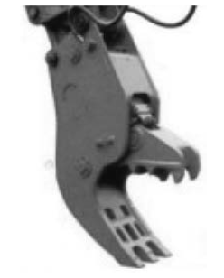
Uri at Gamit ng Dismantling Machines (Katangian)
(3) Concrete Crusher
Concrete rough crusher
Concrete crusher
Concrete fine crusher
Page 4 of textbook / Page 6 of auxiliary text

Slide 7
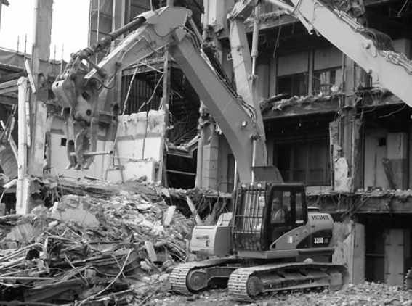
Uri at Gamit ng Dismantling Machines (Katangian)
(4) Demolition Gripping Machine
Page 4 of textbook / Page 7 of auxiliary text

Slide 8
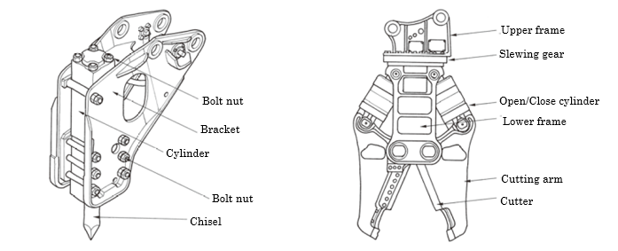
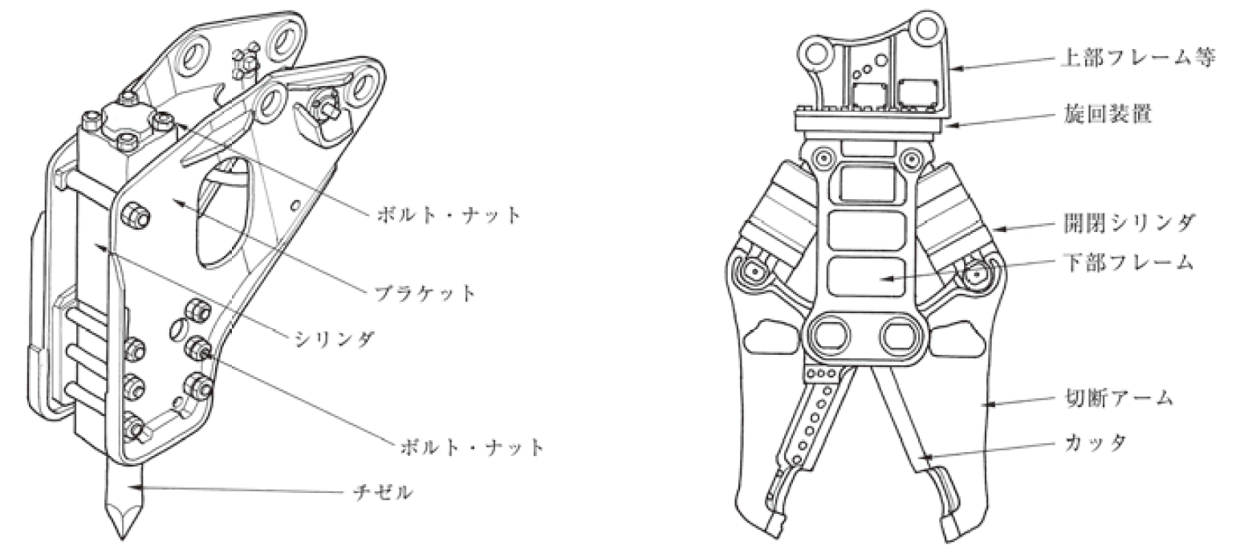
Uri ng Attachment para sa Makinaryang Pang Demolisyon
Upper frame, etc.
Slewing device
Bolts and nuts
Opening/closing cylinder
Lower frame
Bracket
Cylinder
Cutting arm
Bolts and nuts
Cutter
Chisel
Breaker Unit
Steel Frame Cutting Tool
Page 5 of textbook / Page 8 of auxiliary text

Slide 9
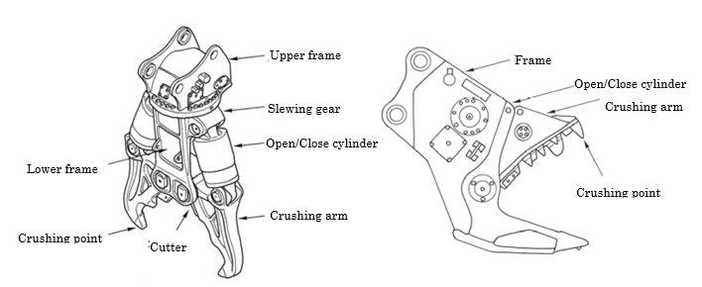
Uri ng Attachment para sa Makinaryang Pang Demolisyon
Rough Crusher
Fine Crusher
Page 5 of textbook / Page 8 of auxiliary text

Slide 10
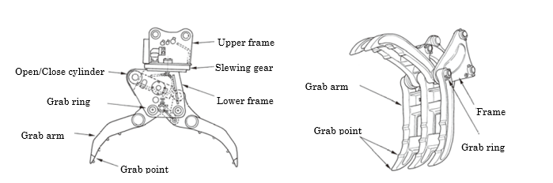
Uri ng Attachment para sa Makinaryang Pang Demolisyon
Grip Tool (Inner cylinder actuated type)
Grip Tool (Outer cylinder actuated type)
Page 5 of textbook / Page 8 of auxiliary text

Slide 11
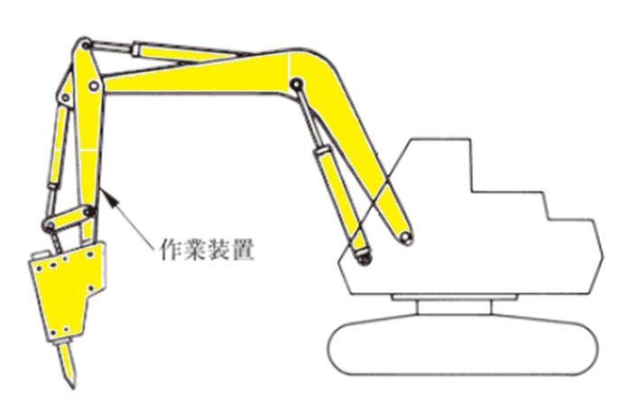
Base Machine ng Makinaryang Pang-demolisyon
(1) Working Device
Working device
Page 6 of textbook / Page 9 of auxiliary text

Slide 12
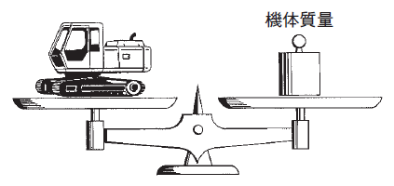
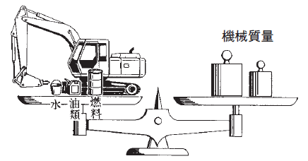
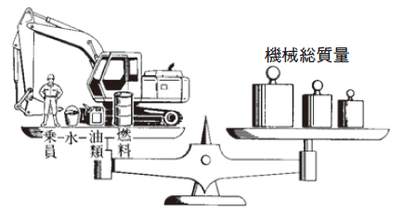
Base Machine ng Makinaryang Pang-demolisyon
(2) Base Machine Weight
(3) Machine Weight
(4) Kabuoang Mass ng Makinarya
Machine Body Weight
Base Machine Weight
Machine Weight
Total Mass of Machine
Oil
Fuel
Oil
Fuel
Water
Water
Crew
Machine Weight
Kabuoang Mass ng Makinarya
Page 6 of textbook / Page 9 of auxiliary text

Slide 13
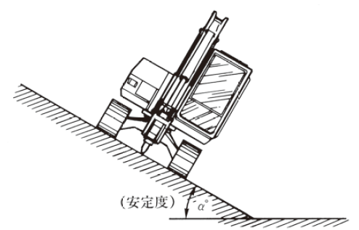
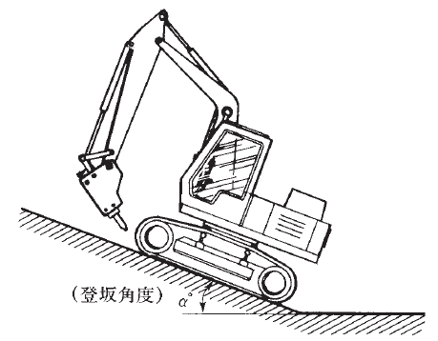
Base Machine ng Makinaryang Pang-demolisyon
(5) Stability (6) Gradeability
(Stability)
(Gradeability)
Stability
Gradeability
Page 7 of textbook / Page 10 of auxiliary text

Slide 14
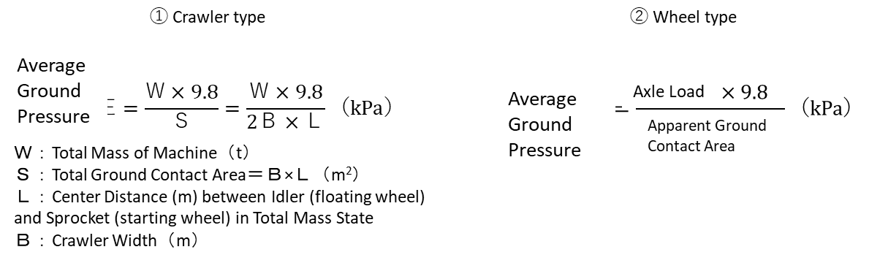
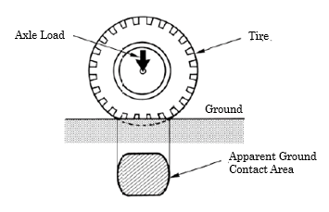
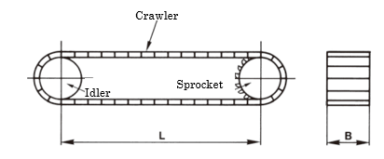
Base Machine ng Makinaryang Pang-demolisyon
(7) Average Contact Pressure
Page 8 of textbook / Page 11 of auxiliary text

Slide 15
Kabanata 2:
Prime Mover ng Makinaryang Pang Konstruksyon at Hydraulic System

Slide 16
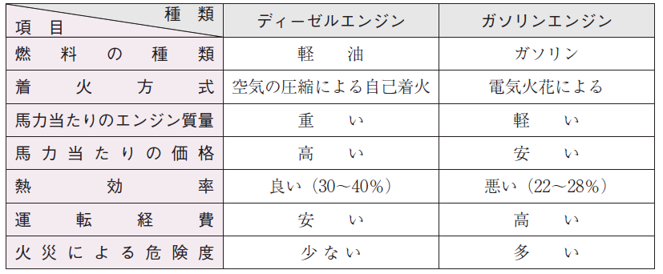
Prime Mover
Pagkompara sa diesel engine at engine na de-gasolina
ITEM
URI
  DIESEL ENGINE
  GASOLINE ENGINE
Fuel type
  Diesel fuel
  Gasolina
Type of ignition
Self-ignition by air compression
  By electric spark
Engine mass per horsepower
  Heavy
  Light
Price per horsepower
  Mahal
  Mura
Thermal efficiency
  Good (30～40)
  Bad (22～28%)
Operating cost
  Mababa
  Mataas
Fire danger level
  Mababa
  Mataas
Page 12 of text / Page 13 of auxiliary text

Slide 17
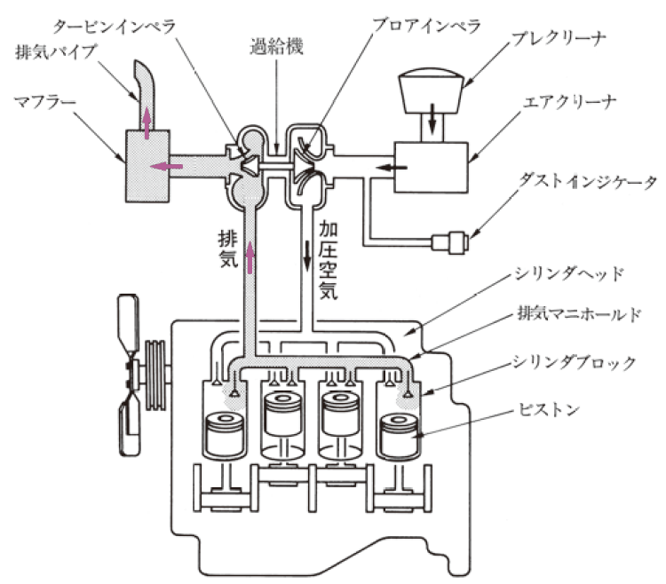
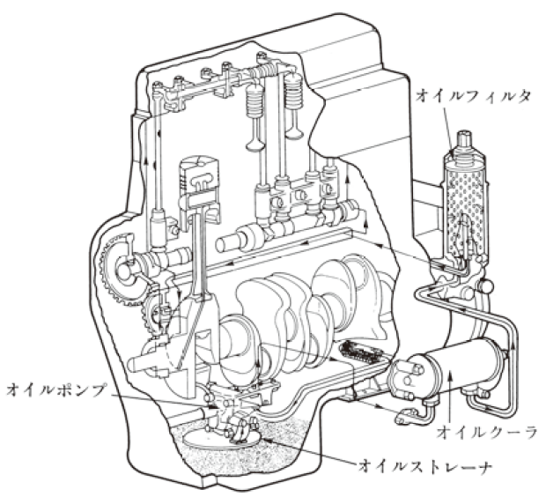
Istraktura ng Diesel Engine
Blower impeller
Turbine impeller
Supercharger
Pre-cleaner
Exhaust pipe
Muffler
Air cleaner
Oil filter
Dust indicator
Exhaust air
Pressurized air
Cylinder head
Exhaust manifold
Cylinder block
Piston
Oil pump
Oil cooler
Oil strainer
Halimbawa ng suctioning / exhaust device
Halimbawa ng Lubricating Device
Page 13 of textbook / Page 13 of auxiliary text

Slide 18
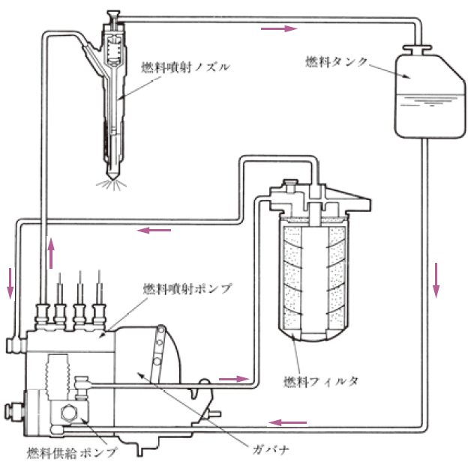
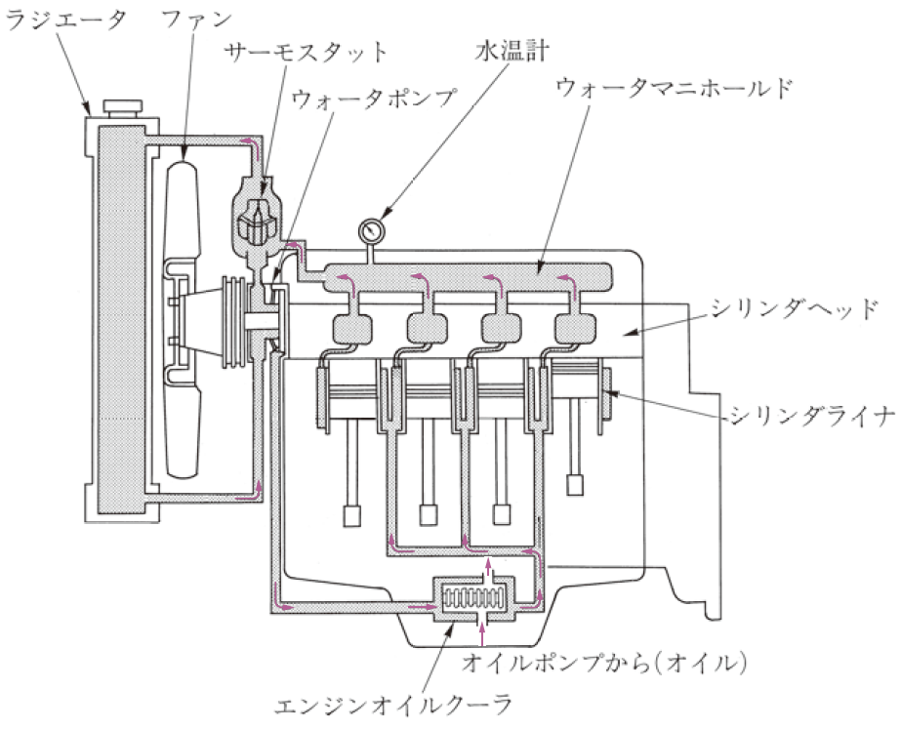
Istraktura ng Diesel Engine
Radiator
Fan
Water Thermometer
Fuel injection nozzle
Fuel tank
Thermostat
Water Pump
Water Manifold
Cylinder head
Fuel Injection Pump
Cylinder liner
Fuel filter
From the oil pump (oil)
Governor
Engine Oil Cooler
Fuel Feed Pump
Halimbawa ng fuel system device
Water Cooling Engine System Diagram
Page 15 of textbook / Page 14 of auxiliary text

Slide 19
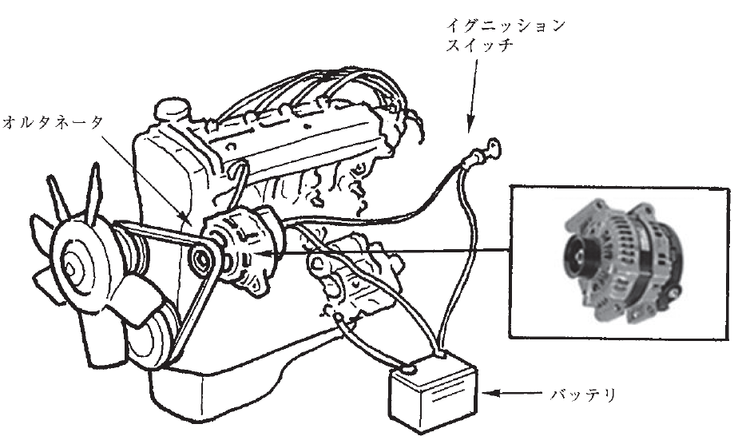
Istraktura ng Diesel Engine
Ignition switch
Alternator
Battery
Halimbawa ng Alternator
Page 17 of textbook / Page 15 of auxiliary text

Slide 20
Fuel/Engine Oil
Ang engine oil ay ginagamit para sa:
Lubrication
Cooling
Sealing
Cleaning
Anti-rust Prevention
Dahil may iba’t ibang tawag ang engine oil, gamitin lamang ang nakalahad sa user’s manual ng mga machine.
Page 18 of textbook / Page 15 of auxiliary text

Slide 21
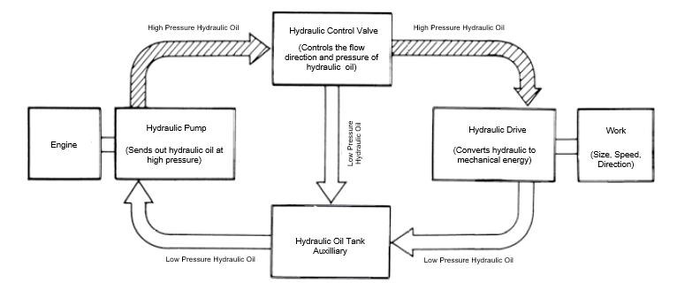
Hydraulic System
High Pressure Hydraulic Oil
Hydraulic Control Valve
(Controls the flow direction and pressure of hydraulic oil)
High Pressure Hydraulic Oil
Engine
Hydraulic Pump
(Sends out hydraulic oil at high pressure)
Hydraulic Drive
(Converts hydraulic to mechanical energy)
Work
(Size, Speed, Direction)
Low Pressure
Hydraulic Oil
Hydraulic Oil Tank Auxilliary
Low Pressure Hydraulic Oil
Low Pressure Hydraulic Oil
Pangkalahatang ideya ng mekanismo ng hydraulic system
Page 19 of textbook / Page 16 of auxiliary text

Slide 22
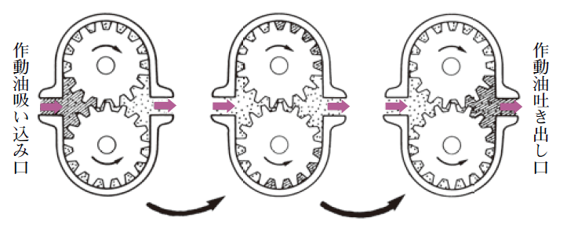
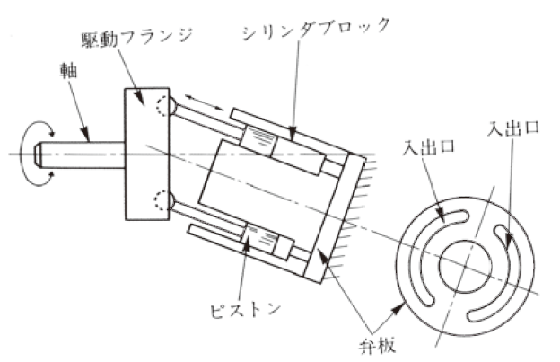
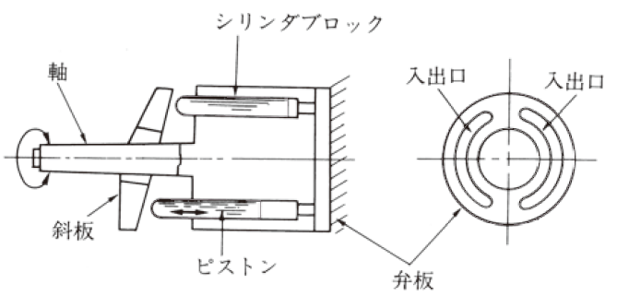
Hydraulic Pump ①Gear Pump ②Bent Axis Type and Swash Plate Type Piston Pump
Hydraulic oil IN
Hydraulic oil OUT
Gear Pump Operating Principle Outline
Entrance/exit
Driving flange
Cylinder block
Shaft
Cylinder block
In/out port
Shaft
In/out port
In/out port
In/out port
Swashplate
Piston
Piston
Valve plate
Valve plate
Halimbawa ng diagonal shaft type Halimbawa ng diagonal plate type
Page 20 of textbook / Page 16 of auxiliary text

Slide 23
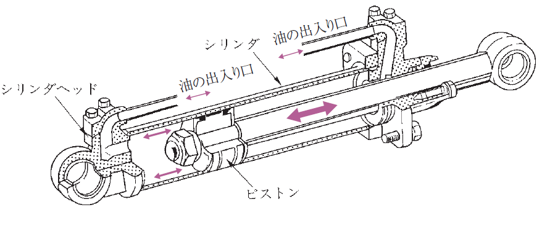
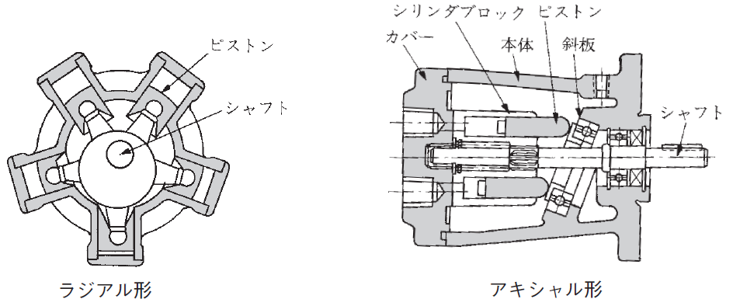
Hydraulic Drive Unit
① Hydraulic Cylinder ② Hydraulic Motor Piston Motor
Oil inlet/outlet
Cylinder
Oil inlet/outlet
Cylinder head
Piston
Halimbawa ng hydraulic cylinder
Cylinder block
Piston
Piston
Cover
Main body
Swash plate
Shaft
Shaft
Radial type
Axial type
Halimbawa ng piston motor
Page 23 of textbook / Page 17 of auxiliary text

Slide 24
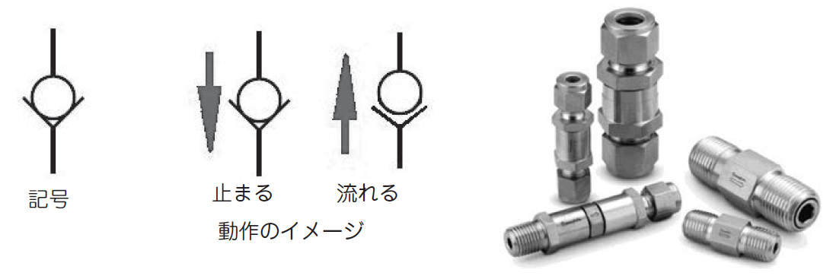
Check Valve
Symbol
Stop
Flow
Image of operation
Check valve operation
Example ng check valve
Page 24 of textbook / Page 18 of auxiliary text

Slide 25
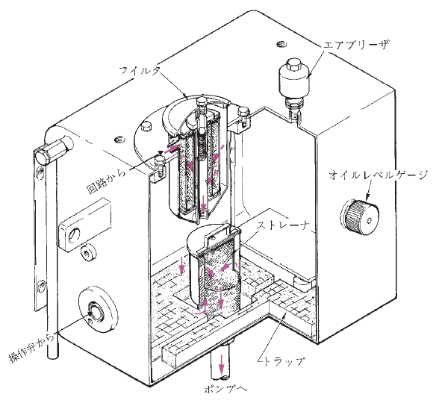
Hydraulic Oil Tank, Oil Filter
Air breather
Filter
Oil level gauge
From the Circuit
Strainer
Operation Valve
Trap
To the pump
Halimbawa ng hydraulic oil tank
Page 24 of textbook / Page 18 of auxiliary text

Slide 26
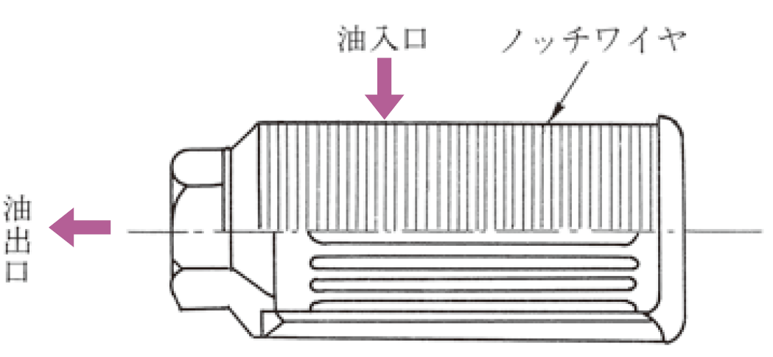
Oil filter
Oil inlet
Notch wire
Oil outlet
Halimbawa ng suction filter
Page 25 of textbook / Page 18 of auxiliary text

Slide 27
Kabanata 3:
Equipment Structure na may Kinalaman sa Pagpapatakbo ng Makinaryang Pang Demolisyon

Slide 28
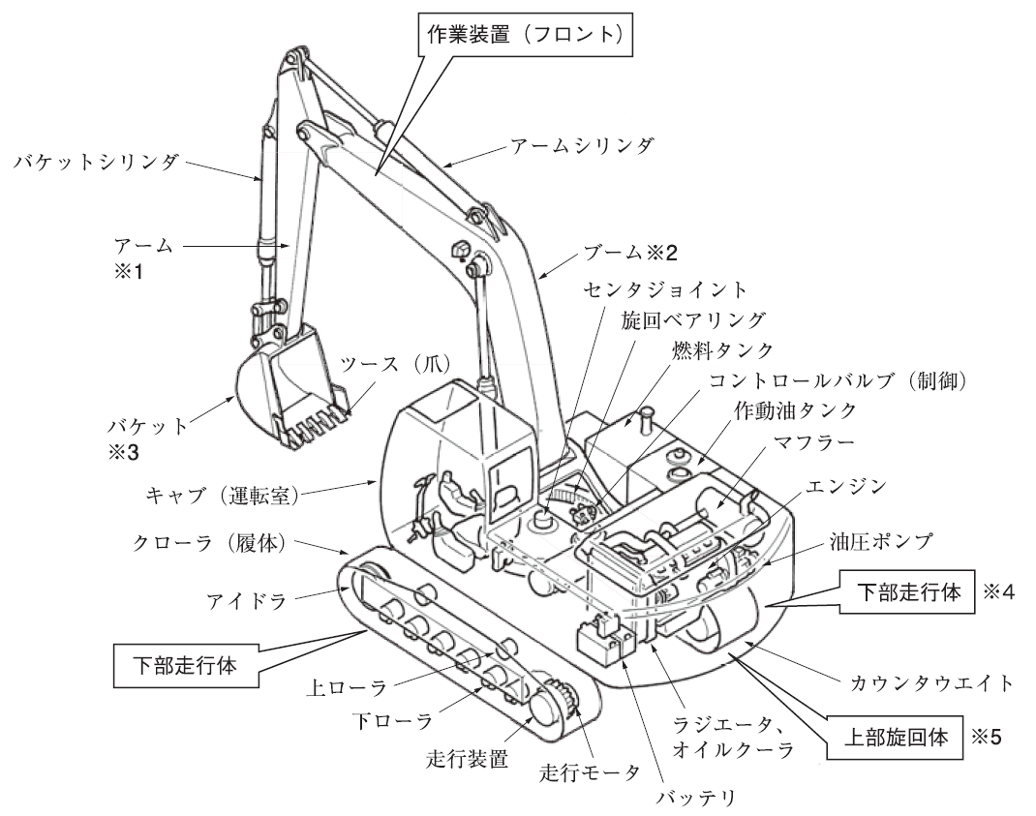
Istraktura ng Crawler Type na Makinaryang Pang-demolisyon
Work equipment (front)
Bucket cylinder
Arm cylinder
Arm
Boom
Center Joint
Tooth (nail)
Swing bearing
Fuel tank
Control Valve (control)
Bucket
Hydraulic Oil Tank
Muffler
Cab (driver's cab)
Engine
Crawler (Body)
Hydraulic pump
Lower Running Body
Idler
Lower Running Body
Upper roller
Counterweight
Lower roller
Radiator,
Oil cooler
Upper swivel
Traveling device
Traveling motor
Battery
Istraktura ng Hydraulic crawler
Page 28 of textbook / Page 19 of auxiliary text

Slide 29
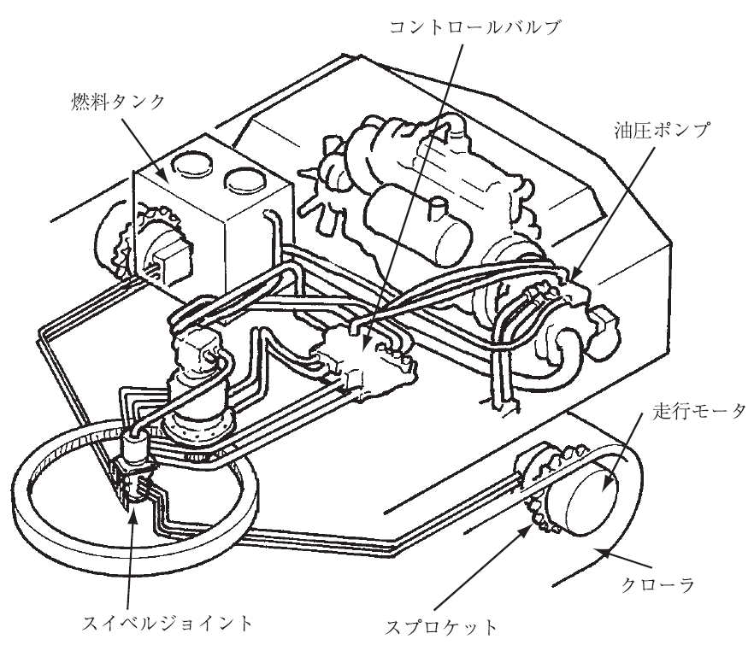
Power Transmission System Device
Control valve
エンジン
Engine
Fuel tank
Hydraulic pump
旋回モータ
Swing motor
Traveling motor
Crawler
Swivel joint
Sprocket
Halimbawa ng Power Transmission System Device
Page 29 of textbook / Page 19 of auxiliary text

Slide 30
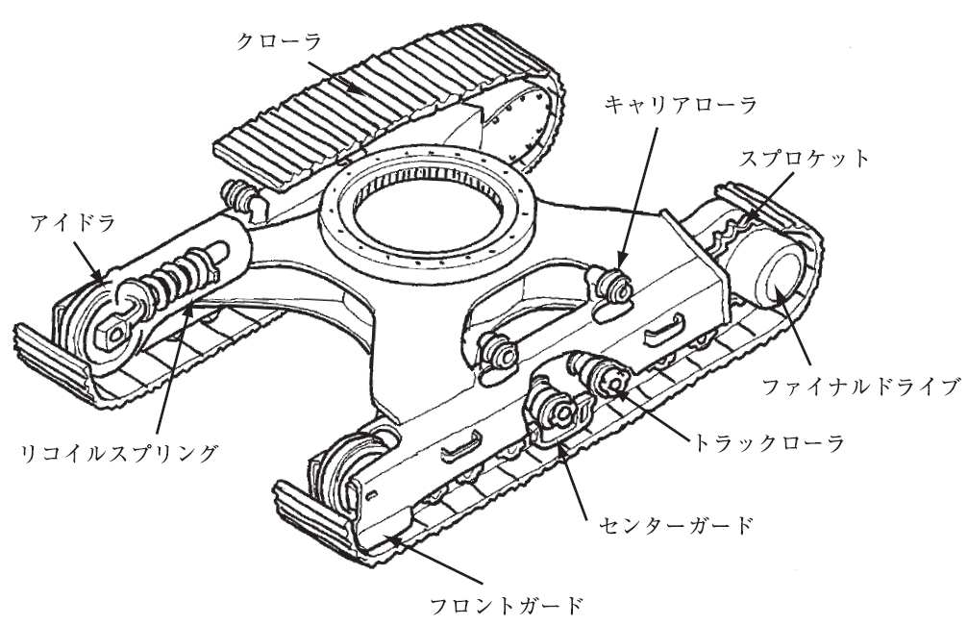
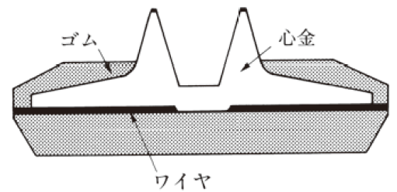
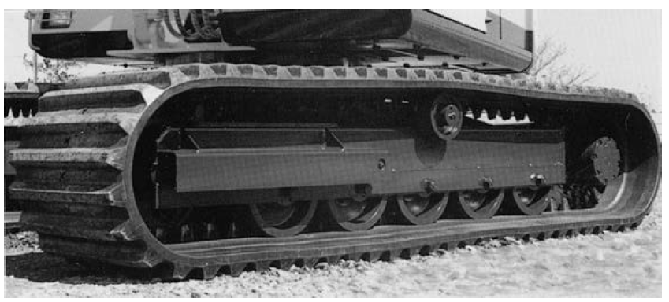
Undercarriage Device
Crawler
Carrier roller
Sprocket
Rubber
Mandrel
Idler
Final drive
Wire
Halimbawa ng cross section of rubber crawler
Recoil spring
Truck roller
Center guard
Front guard
足回り装置の例
Halimbawa ng undercarriage device
Halimbawa ng rubber crawler
Page 33 of textbook / Page 20 of auxiliary text

Slide 31
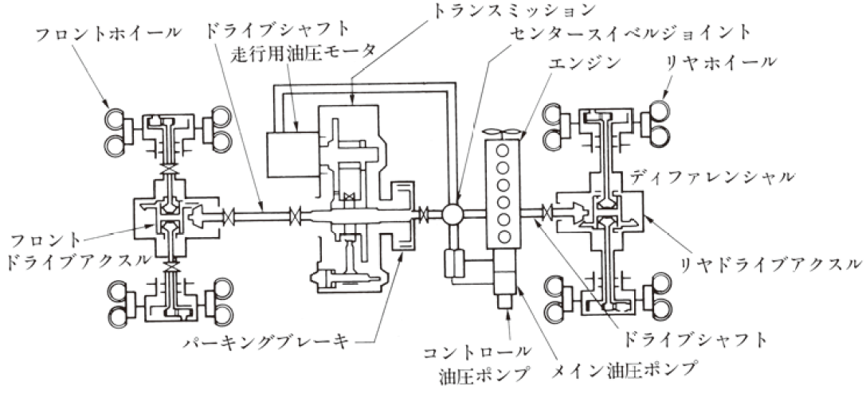
Istraktura ng Aparato ng Wheel Type na Makinaryang Pang Demolisyon
Transmission
Front wheel
Drive shaft
Traveling hydraulic motor
Center swivel joint
Engine
Rear wheel
Differential
Front
Drive axle
Rear drive axle
Parking brake
Control hydraulic pump
Drive shaft
Main hydraulic pump
Halimbawa ng Power Transmission Device
Page 36 of textbook / Page 21 of auxiliary text

Slide 32
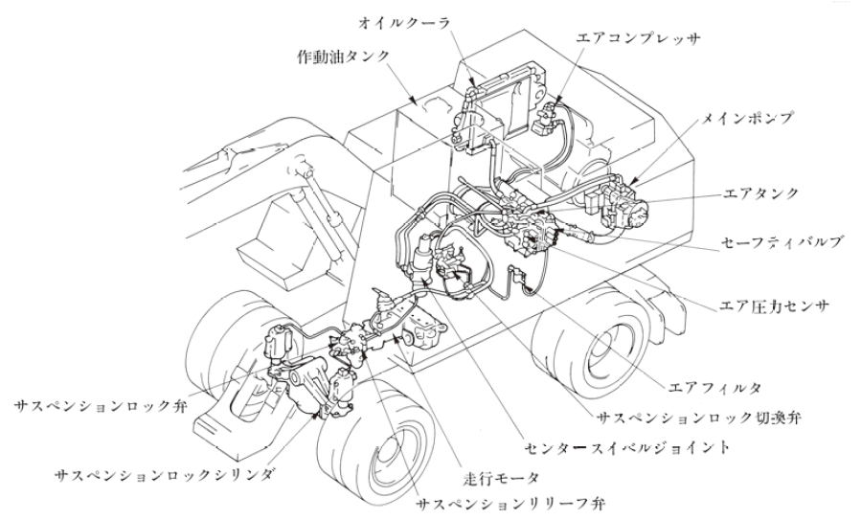
Undercarriage Device Base Frame
Oil cooler
Air compressor
Hydraulic oil tank
Main pump
Air tank
Safety valve
Air pressure sensor
Suspension lock valve
Air filter
Suspension lock switching valve
Lock center swivel joint
Suspension lock cylinder
Traveling motor
Suspension relief valve
Halimbawa ng Fixed Suspension Piping
Page 39 of textbook / Page 22 of auxiliary text

Slide 33
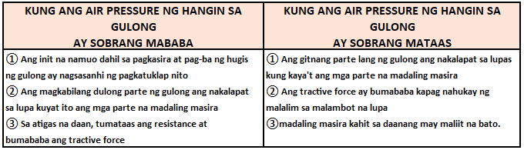
Air Pressure ng Gulong
Air Pressure ng Gulong
Page 40 of textbook / Page 22 of auxiliary text

Slide 34
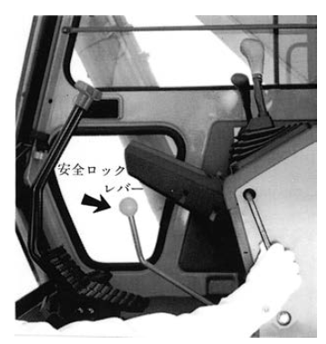
Safety Device ng Makinaryang Pang-Demolisyon
(1) Alarm Device (busina)
(2) Safety Lock Lever atbp.
Safety lock
lever
Halimbawa ng Safety Lock Lever
Page 41 of textbook / Page 23 of auxiliary text

Slide 35
Safety Device ng Makinaryang Pang-Demolisyon
(3) Monitoring system
Page 42 of textbook / Page 24 of auxiliary text

Slide 36
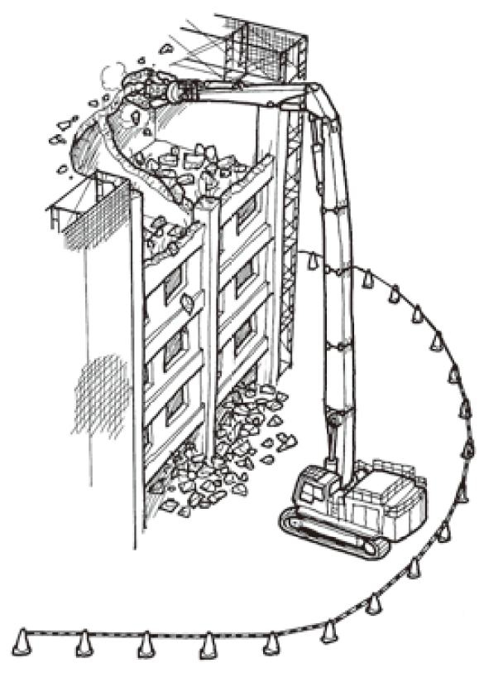
Safety Device ng Makinaryang Pang-Demolisyon
(4) Special na makinaryang pang-demolisyon (Special na makinaryang pang demolisyon na may kabuuang haba ng 12m o higit pa na boom at arm)
Page 42 of textbook / Page 25 of auxiliary text

Slide 37
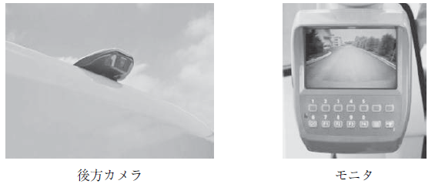
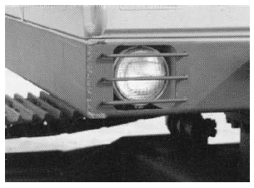
Safety Device ng Makinaryang Pang-Demolisyon
(5) Salamin, atbp.
(6) Mga Headlight, atbp.
Rear view camera
Monitor
Page 44 of textbook / Page 26 of auxiliary text

Slide 38
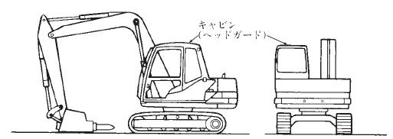
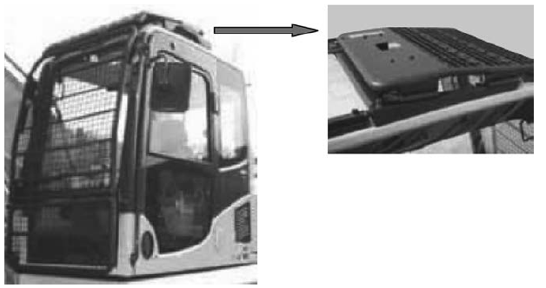
Safety Device ng Makinaryang Pang-Demolisyon
(7) Head guard
(8) Safety glass at protective equipment sa mga lumilipad ng bagay
Cabin
(Head guard)
Page 45 of textbook / Page 27 of auxiliary text

Slide 39
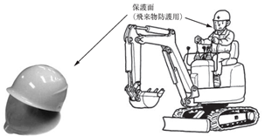
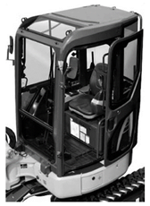

Safety Device ng Makinaryang Pang-Demolisyon
(9) Ang maliit na makinarya ng demolisyon na sasakyan na hindi nilagyan ng driver's cab o bubong
(10) Rollover protective structure (ROPS), Tip-Over Protective Structure (TOPS)
Protective Face Mask (proteksyon sa lumilipad na materyales
Seatbelt
Page 45 of textbook / Page 28 of auxiliary text

Slide 40
Kabanata 4:
Pag-gamit ng Kagamitan na Nauugnay sa Trabaho na may Attachment na Pang-Demolisyon

Slide 41

Istraktura ng Breaker, Uri at Operasyon, atbp.
Demolition Point
Flat End
Flat
(Applications)
・Concrete crushing
・Rock crushing
・Hard soil crushing
・Road construction
(Applications)
・Secondary crushing of crushed stone
・Peeling of slag, atbp
(Applications)
・Swing groove
・Cutting sprue, atbp
・Slope crushing
Halimba ng uri ng chisel (pait)
Page 47 of textbook / Page 29 of auxiliary text

Slide 42

Istraktura ng Breaker, Uri at Operasyon, atbp.
Pin
High pressure side piping
Low pressure side
Low pressure side piping
High pressure side
Breaker piping
Bracket
Breaker unit
Chisel
Hydraulic oil tank
Oil filter
  Impact Pedal
  Control valve
Oil pump
Hydraulic breaker
Page 48 of textbook / Page 30 of auxiliary text

Slide 43


Istraktura ng Breaker, Uri at Operasyon, atbp.
Accumulator
Hydraulic hose connection part
Valve box
Valve
Bracket
Chisel set pin
Cylinder
Chisel
Cylinder
Piston
Chisel
Pangalan ng bawat parte ng breaker unit
Accumulator
Operation valve
Stop valve
Pump
Relief valve
Breaker unit
Cooler
Stop valve
Tank
Secondary relief valve
Halimbawa ng hydraulic piping circuit
Page 49 of textbook / Page 30 of auxiliary text

Slide 44

Uri ng Breaker
Nitrogen gas Note*
Piston
Lower part pressure receiving surface
Replacement valve
Paalala: Huwag gumamit ng ibang uri
ng gas maliban sa nitrogen gas
Halimbawa ng diagram ng Repulsion type pressure accumulator
Page 50 of textbook / Page 31 of auxiliary text

Slide 45


Uri ng Breaker
Nitrogen gas *
High/low pressure switching
Nitrogen gas *
High/low voltage switching
Lower pressure receiving surface
Lower pressure receiving surface
Replacement valve
Replacement valve
Paalala: Huwag gumamit ng ibang uri ng gas maliban sa nitrogen gas
High voltage accumulator
Paalala: Huwag gumamit ng ibang uri ng gas maliban sa nitrogen gas
Halimba Direct-acting hydraulic system type
Operation diagram ng Direct-acting Hydraulic System Type gamit ang nitrogen gas at high-pressure accumulator
Page 51 of textbook / Page 32 of auxiliary text

Slide 46

Uri ng Breaker
Constant high pressure on the upper pressure receiving surface
High/low pressure switching
High pressure accumulator
Switching valve
Halimbawa ng operation diagram ng hydraulic direct drive type (b)
Page 51 of textbook / Page 33 of auxiliary text

Slide 47



Pangunahing Operasyon ng Breaker
Estado ng pag-demolish ng konkretong istraktura kagaya ng gusali
Estado ng pag-demolish ng mga kalsada
Estado ng pagdurog ng bato
Page 53 of textbook / Page 34 of auxiliary text

Slide 48


Pangunahing Operasyon ng Breaker
Itama at pukpokin ng pa right angle ang breaker
Huwag mag blank firing
Page 54 of textbook / Page 35 of auxiliary text

Slide 49


Pangunahing Operasyon ng Breaker
Huwag
i-pry(kojiru)
Huwag i-pry(kojiru) ang chisel
Larawan 4-16 Mula sa marupok na bahagi
Page 55 of textbook / Page 36 of auxiliary text

Slide 50


Pangunahing Operasyon ng Breaker
Huwag pampukpok nang nasa stroke end
Huwag mag sabit ng ano mang bagay sa breaker
Page 56 of textbook / Page 37 of auxiliary text

Slide 51


Pangunahing Operasyon ng Breaker
Bawal
pumasok
Bawal
pumasok
Bawal pumasok sa posibleng lumilipad na bagay.
Huwag gamitin sa ilalim ng tubig
Page 56 of textbook / Page 38 of auxiliary text

Slide 52


Pangunahing Operasyon ng Breaker
Mag-ingat sa landslides, rockfalls atbp.
Mag-ingat sa pag-tumba
Page 57 of textbook / Page 39 of auxiliary text

Slide 53

Pag-iingat Pagkatapos ng Trabaho
(1) Breaker Unit
(2) Base machine
Page 58 of textbook / Page 40 of auxiliary text

Slide 54

Istraktura, Uri at Operasyon ng Steel Frame Cutting Machine
Steel frame cutting tool
Page 59 of textbook / Page 41 of auxiliary text

Slide 55


Pangkalahatang Pamamaraan ng Pagtatrabaho ng Steel Frame Cutting Machine
Ang sitwasyon ng pag-aalis sa pamamagitan ng steel frame cutting machine
Pag-inject ng grasa
Page 60 of textbook / Page 42 of auxiliary text

Slide 56


Pangkalahatang Pamamaraan ng Pagtatrabaho ng Steel Frame Cutting Machine
Magtrabaho sa isang hindi panatag na lugar ay delikado
Suriin ang tibay ng daan
Mag-ingat kapag nagtatrabaho nang pahalang laban sa crawler belt
Mapanganib na magtrabaho kapag ang pangunahing bahagi ng makina ay lumulutang
Page 61of textbook / Page 43 of auxiliary text

Slide 57



Pangkalahatang Pamamaraan ng Pagtatrabaho ng Steel Frame Cutting Machine
Huwag puwersahin (kojiru)
Huwag ipukpok
Huwag paikutin ang boom ng pagilid
Page 62 of textbook / Page 43 of auxiliary text

Slide 58


Pangkalahatang Pamamaraan ng Pagtatrabaho ng Steel Frame Cutting Machine
Huwag kumagat sa stroke end
Huwag pumasok sa may bumabagsak at lumilipad
Page 63 of textbook / Page 44 of auxiliary text

Slide 59


Pangkalahatang Pamamaraan ng Pagtatrabaho ng Steel Frame Cutting Machine
Huwag paganahin ang arm, boom, pagpaandar ng sabay habang nagtatrabaho
Huwag mag-operate sa pamamagitan ng pagbubukas ng mga arm
Page 64 of textbook / Page 45 of auxiliary text

Slide 60


Pangkalahatang Pamamaraan ng Pagtatrabaho ng Steel Frame Cutting Machine
Huwag baguhin ang direksyon ng base machine sa pamamagitan ng pagtulak sa Steel Frame Cutting Tool laban sa lupa.
Huwag kagatin ang konkreto gamit ang talim
Page 64 of textbook / Page 46 of auxiliary text

Slide 61

Pag-iingat pagkatapos ng trabaho
(1) Steel frame cutting tool
(2) Base machine
Page 65 of textbook / Page 47 of auxiliary text

Slide 62




Istraktura, Uri, Operasyon, mga Pangalan at Pag-andar ng Bawat Bahagi ng Concrete Crusher
Malawakang demolisyon ng mga konkretong istruktura at gusali
Halimbawa ng Rough Crusher
Sitwasyon ng Pagdemolish ng Concrete Fine Crusher
Halimbawa ng Fine Crusher
Page 66 of text / Page 48 of auxiliary text

Slide 63

Karaniwang Pamamaraan ng Pagtatrabaho ng Concrete Crusher
Pag-iingat pagkatapos ng trabaho
(1) Concrete crusher
(2) Base machine
Page 69 of textbook / Page 52 of auxiliary text

Slide 64


Istraktura, Uri at Pagpapatakbo ng Demolition Gripping Machine atbp.
Upper frame
Hydraulic connection
Hydraulic motor
Swivel joint
Slewing gear
Lower frame
Cylinder pin
Open/close cylinder
Cylinder pin
Frame pin
Grabbing link
Link pin
Grabbing Arm
Sitwasyon ng Pagtatapon ng mga Debris
Grabbing point
Mga Pangalan ng Bawat Bahagi ng Gripping Tool (na may Slewing Gear, Internal Cylinder Operated Type)
Page 72 of textbook / Page 54 of auxiliary text

Slide 65


Istraktura, Uri at Pagpapatakbo ng Demolition Gripping Machine atbp.
Open/close cylinder
Open/close cylinder
Frame
Frame
Gripper link
Gripper link
Grabbing arm
Grabbing arm
Grabbing point
Grabbing point
Halimbawa ng Internal Cylinder Type Gripping Tool（Non-Swing Type）
Halimbawa ng External Cylinder Type Gripping Tool
Page 73 of textbook / Page 55 of auxiliary text

Slide 66



Pamamaraan para sa Pagpili at Pag-kabit ng Gripping Tool
Halimbawa ng Internal Cylinder Operated Type Gripping Tool na may swing device
Halimbawa ng Gripping Tool (Internal Cylinder Operated Type)
Halimbawa ng Grip (external operated type)
Page 74 of textbook / Page 57 of auxiliary text

Slide 67


Karaniwang Pamamaraan ng Pagtatrabaho ng Gripping Machine
Pag-demolish gamit ang gripping machine
Mag ingat kapag nag-ooperate malapit sa driver’s seat, dahil ang grip ay pwedeng makagambala sa driver's seat at ng boom cylinder. Mag-ingat na huwag matamaan ang driver's seat habang iikot na may dalang bagay.
Page 76 of textbook / Page 59 of auxiliary text

Slide 68




Karaniwang Pamamaraan ng Pagtatrabaho ng Gripping Machine
Huwag pa-diagonal ang pagkuha ng bagay gamit ang gripping machine.
Huwag basagin o baliin ang bagay sa pamamagitan ng pag-hampas nito sa lupa o pader habang naka-grip.
Para sa mahahabang bagay, sa gitna kapitan o sa sentro ng balanse.
Page 77 of textbook / Page 61 of auxiliary text

Slide 69

Pag-iingat pagkatapos ng trabaho
(1) Gripping tool
(2) Base machine
Page 78 of textbook / Page 63 of auxiliary text

Slide 70

Pag-tanggal ng attachment
Stop valve
Cap
Hydraulic hose
Pin
Hydraulic hose
Plug
Plug
Gamitin ang floor angle para maging stable
Postura kapag tinatanggal
Pag-tanggal ng breaker unit
Page 79 of textbook / Page 64 of auxiliary text

Slide 71

Pag-tanggal ng Attachment
Stop valve
Pin Stopper
Dust cap
Pin
Stop plug
Hydraulic hose
Prevent the rotating part from turning before work
Gumamit ng tabla para stable
Halimbawa ng pag-tanggal ng steel frame cutting tool
Page 80 of textbook / Page 65 of auxiliary text

Slide 72


Pag-tanggal ng Attachment
Stop valve
Stop valve
Dust plug
Dust cap
Lock pin
Dust cap
Hydraulic hose
Pin
Pin
Siguraduhing hindi umiikot
Gumamit ng tabla para stable
Dust plug
Hydraulic hose
Halimbawa ng pag-tanggal ng rough concrete crusher
Halimbawa ng pag-tanggal ng fine concrete crusher
Page 81 of textbook / Page 65 of auxiliary text

Slide 73



Pag-tanggal ng Attachment
Pin
Pin
Stop valve
Dust cap
Dust plug
Hydraulic hose
Pin
Halimbawa ng pag-alis ng gripping tool (internal cylinder operated type)
Halimbawa ng pag-alis ng gripping tool (external cylinder operated type)
Shovel arm
Bucket link
Arm link
Bucket
Halimbawa ng pag-alis ng bucket
Page 82 of textbook / Page 66 of auxiliary text

Slide 74



Pag-transport ng Makinaryang Pang-Demolisyon
Trailer Carriage
Covered with wood
Climbing Equipment
Claw to hang on the carriage
15° or less
Halimbawa ng claw climbing equipment
Halimbawa ng paggamit ng climbing equipment
Halimbawa ng ugnayan sa pagitan ng bigat ng loading machine at climbing equipment
Mass of loading machine (t)
Climbing equipment
Material
Number of material used
Shape and dimension
Length x Height x Width (mm)
Aluminium alloy
Aluminium alloy
Aluminium alloy
Page 83 of textbook / Page 68 of auxiliary text

Slide 75


Pag-transport ng Makinaryang Pang-Demolisyon
Vehicle Deck
Plane Figure
Foot stall
Climbing Equipment
Crawler
Vehicle Deck
Halimbawa ng paggamit ng foot stall
Brakes
Climbing Equipment
Crawler
Halimbawa ng ugnayan sa loading position
Page 84 of textbook / Page 70 of auxiliary text

Slide 76


Pag-transport ng Makinaryang Pang-Demolisyon
Drag
Wire Rope
Pad
(Yawara)
Lever Block
Joint Sleeper
Wire Rope
Para sa mga makinaryang pang-demolisyon, kapag dumadaan sa ilalim ng riles, kable, tulay, girders, atbp. Siguraduhin na ang distansya sa mga ito ay sapat at hindi sasabit ang boom.
Halimbawa ng fixing trailer para sa makinaryang pang-demolisyon
Page 86 of textbook / Page 71 of auxiliary text

Slide 77
Kabanata 5:
Pag-inspeksyon at Maintenance ng Sasakyang Makinaryang Pang Demolisyon

Slide 78


Applicable Laws and Regulations
Applicable laws and regulations
※Bagaman hindi itinakda ng batas, dapat ay nakalagay ang inspection table habang ang machine ay umaandar
Bawal pumasok ang hindi otorisado
Walang sinuman ang maaaring pumasok sa lugar ng trabaho, maliban sa taong may hawak ng trabaho para sa inspeksyon at maintenance.
Page 89 of textbook / Page 73 of auxiliary text

Slide 79



Pang-araw-araw na Pamamaraan ng Inspeksyon
Paraan ng pag-alam batay sa hitsura ng hydraulic oil
Boom
Arm
Halimbawa ng postura ng inspeksyon sa antas ng langis ng makinaryang pang-demolisyon
Kung nais simulant ang maintenance, alisin ang terminal na konektado sa (-)
Page 91 of textbook / Page 74 of auxiliary text

Slide 80



Pang-araw-araw na Pamamaraan ng Inspeksyon
Check for loose bolt
Push
Grease nipple
Abrasion Width
Abrasion width
Halimbawa ng paglalagay ng grasa gamit ang grease gun
Chisel
Halimbawa ng limitasyon sa pagkapudpod
Page 94 of textbook / Page 76 of auxiliary text

Slide 81
Pang-araw-araw na Pamamaraan ng Inspeksyon Bago Paandarin ang Makina
Pamamaraan ng diskriminasyon batay sa itsura ng hydraulic oil
Pang-araw-araw na Pamamaraan ng Inspeksyon Pagkatapos ng Trabaho
(1) Paglilinis ng Machine Body
(2) Pag-refuel
(3) Pagliligpit ng Makina
Page 96 of textbook / Page 77 of auxiliary text

Slide 82
Pamamaraan ng Inspeksyon Kapag may Natagpuang Isang Abnormalidad Habang Nagtatrabaho
Kung sa tingin mo ay wala sa kaayusan ang makinang ginagamit habang nagtatrabaho, kinakailangang ihinto kaagad ang makinaryang pang-konstruksyon at iparada ito sa isang patag na lugar, at kumontak sa namamahala tungkol sa sirang bahagi ng makina at ipaayos ito bago simulan ulit ang trabaho
Page 97 of textbook / Page 78 of auxiliary text

Slide 83
Kabanata 6:
Mga Kaugnay na Usapin Patungkol sa Trabahong Pang Demolisyon

Slide 84

Plano sa Trabaho
General flow ng demolition work
Page 99 of textbook / Page 79 of auxiliary text

Slide 85

Mga Tagubilin Para sa Ligtas na Pagmamaneho
engine key
Kung kinakailangan na itigil ang gawain ay siguraduhing ihinto muna ang makina at alisin ang susi, at ilagay sa lagayn..
Magsuot ng helmet at mga safety equipment, at magbihis ng damit bago magmaneho
Page 101 of textbook / Page 81 of auxiliary text

Slide 86


Mga Tagubilin Para sa Ligtas na Pagmamaneho
Siguraduhing i-check ang mga nakalubog na bagay habang ginagawa ang crushing operation sa urban na lugar.
Maging handa sa agad na paghinto sa mga biglaang pangyayari.
Page 101 of textbook / Page 82 of auxiliary text

Slide 87

Pamamaraan ng Signal at Paggabay
＜Whistle Signal＞ ＜Spoken Signal＞
• Safety：2 short whistles, repeat • Safety：”Allright, allright (Orai, orai)”
• Machine Stop：long whistle • Machine Stop：”Stop (sutoppu)”
Before starting work, the driver needs to discuss with the signaler or inductor in advance about the work position of other construction machines, the work position of the worker, the position of the dangerous place, and the signal method.
Ang guide person ay dapat magsuot ng damit na madaling makita ng driver at iba pang manggagawa. Nararapat na magbigay ng instruction ang driver sa guide person upang hindi maging blind spot ang posisyon ng driver.
Page 104 of textbook / Page 84 of auxiliary text

Slide 88
Kabanata 7:
Kaalaman sa Mechanics at Kuryente

Slide 89



Moment ng Force
Moment ng force
Blow reaction
Breaker for
tunnel
Moment ng force ①
Moment ng force ②
Page 110 of textbook / Page 85 of auxiliary text

Slide 90

Moment ng Force
Mga pag-iingat kapag nagtatrabaho sa partikular ng lugar ng isang dismantling machine
Page 112 of textbook / Page 86 of auxiliary text

Slide 91


Mass, Sentro ng Grabidad atbp.
Mass of object = volume x specific gravity
Approximate volume formula
Unit volume ng bigat ng object
Page 115 of textbook / Page 87 of auxiliary text

Slide 92


Mass, Sentro ng Grabidad atbp.
Paghahanap ng Sentro ng Gravity
[Stable]
(a)
[Medium]
(b)
[Unstable]
(c)
[Stable]
(b)
[Stable]
(e)
Stability ng mga Bagay
Page 117 of textbook / Page 89 of auxiliary text

Slide 93



Pag-galaw ng mga Bagay
Speed at acceleration
Centripetal force
Center
(hand)
Object A
Centrifugal force
Centrifugal force ・ centripetal force
Maximum static friction force
Page 118 of textbook / Page 90 of auxiliary text

Slide 94

Mga Kaalaman sa Kuryente
Reaksyon kapag ang current ay dumaloy sa katawan ng tao unit mA (milliampere)
Tandaan) Ang 1mA ay 1/1000 A(ampere).
Page 124 of textbook / Page 93 of auxiliary text

Slide 95


Mga Kaalaman sa Kuryente
Distansya ng layo o paghiwalay mula sa distribution line
(Tandaan) ※ Batayang Blg 759 sa petsang Disyembre 17, 1975
※※ Hindi ito nalalapat kung ang greenery ay protektado.
※※※ Ang【electric power company target value】ay tumutukoy sa TEPCO.
Naiiba ang kategoridad at target value depende sa electric power company.
Page 126 of textbook / Page 94 of auxiliary text

Slide 96

Mga Kaalaman sa Kuryente
Hydrometer
Electrolyte
Eye position
Rubber ball
Outer
cylinder
Water absorption pipe
Paraan ng pagtingin sa specific gravity meter
Page 127 of textbook / Page 95 of auxiliary text

Slide 97
Kabanata 8:
Uri ng Istraktura at ng Pagdemolisyon

Slide 98




Istrakturang Gawa sa Kahoy (W structure),
Istrukturang Gawa sa Bakal (S structure)
Halimba ng Istraktura ng frame na gawa sa kahoy
Halimbawa ng Istrukra ng frame ng dingding na gawa sa kahoy
Halimbawa ng steel frame na rahmen structure
Halimbawa ng steel frame ng truss structure
Page 129 of textbook / Page 96 of auxiliary text

Slide 99



Istrakturang Reinforced Concrete (RC structure),
Steel-framed reinforced Concrete Structure (SRC structure)
Halimbawa ng reinforced concrete na istrakturang rahmen.
Halimba ng reinforced concrete na Istraktura ng dingdin
Halimbawa ng steel-framed reinforced concrete rigid frame structure
Page 132 of textbook / Page 98 of auxiliary text

Slide 100

Paraan ng Pag-demolish ng Gusali
Advance preparation
measures
⑦ Dismantling of structure part and exterior material
① Destruction of building equipment
Temporary construction removal
(Leveling/ cleaning) After dismantling work is completed
② Removal of interior materials
Temporary installation work
③ Removal of inner ・outer fittings
⑤ Balcony removal.
etc.
Management dismantling work after completion
Work preparation
④ Removal of rooftop installation
⑥ Removal of roofing material
⑧ Dismantling of foundation, etc.
Demolition work completion inspection
Confirmation of residual good removal
On-site sorting
Sorted out
Manual work
Manual work or combined work with hand machines
Halimbawa ng manual n paraan ng pag-hihiwalay at pag-demolish.
Page 137 of textbook / Page 100 of auxiliary text

Slide 101

Paraan ng Pag-demolish ng Gusali
Temporary installation work
④ Removal of rooftop installation
⑧ Dismantling of structure part and exterior material
(Leveling/ cleaning) After dismantling work is completed
Management dismantling work after completion
① Destruction of building equipment
③ Removal of inner ・outer fittings
Advance preparation
measures
② Removal of interior materials
⑥ Removal of roofing material
Temporary construction removal
⑤ Balcony removal. etc.
⑦ Carrying/ installing heavy machines
⑨ Dismantling of foundation, etc.
Demolition work completion inspection
Work preparation
Carrying heavy machine out
Confirmation of residual good removal
On-site sorting
Sorted out
Manual work
Manual work or combined hand ・mechanical work
Halimbawa ng magkahiwalay na pamamaraan ng pag-demolish sa pamamagitan ng pinagsamang manual at mechanical method
Page 137 of textbook / Page 101 of auxiliary text

Slide 102

Paraan ng Pag-demolish ng Gusali
Advance preparation
measures
④ Removal of roofing material
⑥ Dismantling of structure part and exterior material
(Leveling/ cleaning) After dismantling work is completed
Management dismantling work after completion
Temporary installation work
③ Removal of inner ・outer fittings
① Destruction of building equipment
② Removal of interior materials
⑤ Carrying/ installing heavy machines
Temporary construction removal
⑦ Dismantling of foundation, etc.
Demolition work completion inspection
Work preparation
Carrying heavy machine out
Confirmation of residual good removal
On-site sorting
Sorted out
Manual work
Mechanical work
Halimbawa ng magkahiwalay na pag-demolish sa pamamagitan ng mechanical method
Page 138 of textbook / Page 102 of auxiliary text

Slide 103
Kabanata 9:
Batas at Regulasyon

Slide 104

Legal na Sistema para sa Kaligtasan at Kalusugan para sa mga Manggagawa
May ilang batas na kaugnay sa Kaligtasan at Kalusugan ng mga Manggagawa. Ang Industrial Safety and Health Law ay There are several laws related to Worker safety and health, including the Industrial Safety and Health Law. Ang batas na ito ay nagtatakda ng mga bagay na dapat sundin para matiyak ang kaligtasan at kausugan ng mga manggagawa at itaguyod ang pagbuo ng isang komportableng kapaligiran sa trabaho. Ang particular na bagay na nauugnay sa pagpapatupad ng batas ay ipinahiwatig sa mga ordenansa ng gobyerno, ordenansang pang-ministro, mga abiso, atbp.
Ang mga sumusunod ay mga legal na sistema para sa kaligtasan at kalusugan ng manggagawa:
Larawan 9-1 Legal na sistema para sa mga kasanayan sa pagmamaneho ng makinarya sa konstruksyon na nakabatay sa sasakyan (para sa demolisyon)
(Sanggunian) Ministro ng Kalusugan, Paggawa at Welfare Risk Welfare Manual para sa Building Maintenance Industry
Page 107 of auxiliary text

Slide 105
Industrial Safety and Health Act and Industrial Safety and Health Act Enforcement Ordinance (Excerpt) （１）
Chapter 1 General rules
Artikulo 3 <Mga responsibilidad ng kompanya >
Ang mga kumpanya ay hindi lamang dapat sumunod sa pinakamaliit na pamantayan para sa pag-iwas sa mga aksidente sa trabaho na itinakda ng batas na ito, ngunit dapat ding tiyakin ang kaligtasan at kalusugan ng mga manggagawa sa lugar ng trabaho sa pamamagitan ng pag-alam ng komportableng kapaligiran sa pagtatrabaho at pagpapabuti ng mga kondisyon sa pagtatrabaho. Bilang karagdagan, ang kumpanya ng kompanya ay dapat na makipagtulungan sa mga hakbangin ng pambansang pamahalaan upang maiwasan ang mga aksidente sa trabaho.
2. Ang taong nagdidisenyo, gumagawa, o nag-aangkat ng makinarya, kagamitan, atbp., taong gumagawa o nagaangkat ng mga raw materials, taong nagtatayo o nagdidisenyo ng isang gusali, Sa pagdidisenyo, paggawa, pag-angkat o pagbuo ng mga gamit na ito, ang mga pagsisikap ay dapat gawin upang mag-ambag sa pag-iwas sa mga aksidente sa trabaho na sanhi ng paggamit ng mga kagamitang ito.
3. Ang mga taong nagpapaubaya ng trabaho tulad ng pag-oorder ay dapat sundin ang paraan ng konstruksiyon, petsa ng konstruksiyon, atbp., upang hindi ilakip ang mga kondisyon na maaaring maging sanhi ng mahirap na pagpapatupad ng ligtas at hygienic na trabaho.
Artikulo 4 Dapat sumunod ang mga manggagawa sa mga mahahalagang bagay upang maiwasan ang mga aksidente sa trabaho at magsikap na makipagtulungan sa mga hakbang sa pag-iwas sa mga aksidente sa trabaho na ipinatupad ng mga negosyante at iba pang kaugnay na partido.
Page 149 of textbook / Page 108 of auxiliary text

Slide 106

Industrial Safety and Health Act and Industrial Safety and Health Act Enforcement Ordinance (Excerpt)（２）
Artikulo 5 Mga regulasyon sa makinarya at nakakapinsalang kagamitan
Artikulo 45 ＜Regular na Boluntaryong Inspeksyon＞
Ang tagapamahala ay kailangang magsagawa ng regular na inspeksyon ng boilers at iba pang makinarya ayon sa Cabinet Order at kailangang itala ang resulta nito alinsunod sa Ordinance of the Ministry of Health, Labor and Welfare.
2 Sa pagsasagawa ng self-inspection alinsunod sa Ordinance of the Ministry of Health, Labor and Welfare (“specified self-inspection”), ayon sa Cabinet Order batay sa naunang talata, ang manggagawang nakakuha ng kwalipikasyon ayon sa Artikulo 54-3 Talata 1 ang siyang magsasagawa ng inspeksyon sa makina.
3 Ang Ministy of Health, Labor and Welfare ay kailangang maglabas ng alituntunin sa inspeksyon upang maging maayos at mabisa ang pagsasagawa nito alinsunod sa mga probisyon sa Talata 1.
4 Abbreviation
Table 5-1 Related laws and regulations
Inspection classification | Article | Implementer / Qualification | Storage period of inspection check sheet
Operation before/after | Safety rules Article 170,171 | driver | During machine is in operation
Periodical self- inspection (once/month) | Safety rules Article 168,169,171 | Person who is selected by the safety manager | Inspection check sheet 3 years
Specified self- inspection (once/year)) | Safety rules Article 167,169, 169(2),171 | inspector | Inspection check sheet 3 years (posted inspected mark)
Page 154 of textbook / Page 108 of auxiliary text

Slide 107


Mga Hakbang sa Pagtatrabaho ng mga Manggagawa(Excerpt)（３）
Artikulo 6 Mga Hakbang sa Pagtatrabaho ng mga Manggagawa
Artikulo 61 ＜Mga Paghihigpit sa Trabaho>
Ang tagapamahala ay kailangang magpatakbo ng cranes at iba pang operasyon ayon sa Cabinet Order, na kung saan ang magsasagawa ng operasyon nito ay ang mga manggagawang may lisensya o rehistrado para sa gawain ng prefectural labor bureau director. Ang mga manggagawang nakatapos ng skill training at kwalipikado alinsunod sa Ordinance of the Ministry of Health, Labor and Welfare lamang ang siyang maaaring ilagay sa nasabing gawain.
2 Walang ibang manggagawa maliban sa mga kwalipikado ang dapat magsagawa ng nasabing gawain sa itaas na talata.
3 Ang mga manggagawang kwalipikado sa nasabing gawain sa talata 1 ay kailangang kumuha ng Lisensya sa pagmamaneho o iba pang dokumento na nagpapatunay ng kwalipikasyon sa nauugnay na trabaho.
4 Abbreviation
Kinakailangang Kwalipikasyon sa Nagmamaneho ng Makinarya Kinakailangang Kwalipikasyon ng Trabahante
Page 155 of textbook / Page 109 of auxiliary text

Slide 108

Mga Hakbang sa Pagtatrabaho ng mga Manggagawa(Excerpt)
Artikulo 20 ＜Trabaho na may kaugnayan sa employment restriction＞
Ang trabahong tinutukoy ng Cabinet Order sa ilalim ng Artikulo 61, Talata 1 ng Batas ay ang sumusunod.
1~11 Laktaw
Ang pagmamaneho ng machine na may bigat na 3 tonelada o higit pa na gumagamit ng lakas at self-propelled sa unspecified na lugar. (Hindi kasama ang pagmamaneho sa kalsada). Nakalista sa Table 7 No.1, 2, 3 o No. 6.
13 Omitted sa baba
Page 156 of textbook / Page 110 of auxiliary text

Slide 109
Mga Regulasyon sa Kaligtasan at Pangkalusugan sa Trabaho(Excerpt) (1)
Volume 1 Pangkalahatang panuntunan
Kabanata 7 Mga Lisensya, etc.
Seksyon 3 Teknikal na Pagsasanay
Artikulo 82 <Paglabas ulit ng sertipiko sa teknikal na pagsasanay sa pagkumpleto, etc>
Ang isang tao na naisyuhan ng isang sertipiko ng pagkumpleto ng isang teknikal na pagsasanay at kasalukuyang nakikibahagi o naglalayong kumuha ng trabaho na nauugnay sa teknikal na pagsasanay, kung nawala o nasira ito, maliban sa nakapaloob sa talata 3, ang aplikasyon para sa muling pagpapahayag ng sertipiko ng teknikal na pagsasanay (Form Artikulo 18) ay dapat na isumite sa nakarehistrong institusyon ng pagsasanay na nakatanggap ng sertipiko sa pagkumpleto ng tekinal na pagsasanay, at ang sertipiko ng pagkumpleto ng teknikal na pagsasanay ay dapat na muling ilabas.
2 Kapag ang taong tinutukoy sa naunang talata ay nagbago ng kanyang pangalan, maliban sa nakapaloob sa talata 3, ang rehistradong institusyon ng pagsasanay na nakatanggap ng aplikasyon sa pagpapalit ng sertipiko sa pagkumpleto ng teknikal na pagsasanay (Form Blg. 18). Dapat itong isumite at tanggaping isang muling pagsulat ng sertipiko sa tekninal na pagsasanay.
3 Omitted sa ibaba
Volume 2 Mga Pamantayang sa Kaligtasan
Kabanata 2 Makinaryang Pangkonstruksyon atbp.
Seksyon 1 Sasakyang makinaryang pang-konstruksyon
Subseksyon 1-2 Istruktura
Artikulo 152 ＜Pag-install ng Headlight＞
Ang mga kompanya ay kinakailangang mag-install ng headlight sa mga sasakyang makinaryang pang-konstruksyon Gayunpaman, ayos lang na hindi maglagay ng headlight para sa mga makinaryang pang-konstruksyon na ginagamit sa mga lugar kung saan may pinapatiling pag-iilaw na kinakailangan para makasagawa ng ligtas na trabaho.
Page 160 of textbook / Page 111 of auxiliary text

Slide 110
Mga Regulasyon sa Kaligtasan at Pangkalusugan sa Trabaho(Excerpt) (2)
Artikulo 153 <Head Guard o Helmet>
Kailangan maghanda ang kompanya o business ng head guard o helmet kung ang trabahante ay nasa lugar na mapanganib dahil sa posibilidad sa pagbagsak ng bato, atbp, ※1 at kapag nagmamaneho ng vehicle type construction machine (limitado sa bulldozer, tractor・shovel o excavator (shoberu)、muck loader, power・shovel、hydraulic excavator at machine para sa demolition). ※2
Tandaan 1) 「Lugar na mapanganib dahil sa posibilidad sa pagbagsak ng bato, atbp….」ay lugar na ginagawa ang magaan na paghuhukay, quarrying, gawaing konstruksyon tulad ng trail, atbp. gamit ang machine at ang paggamit nito ang magiging sanhi ng posibilidad na pagbagsak ng mga bato.
Tandaan 2) Ang pamantayan sa istraktura tungkol sa head guard o helmet ay ipinahiwatig ng Circular No. 559 ng Showa 9.26.
Subseksyon 2 Pag-iwas sa mga Panganib na Nauugnay sa Paggamit ng Vehicle Type Construction Machine
Artikulo 154 ＜Pagsusuri at Pagrerekord＞
Kapag nagsasagawa ng trabaho gamit ang vehicle type construction machine, upang maiwasan ang panganib ng mga trabahador dahil sa pagtumba ng mga ginagamit na vehicle type construction machine, pagkasira ng lupa atbp., ang kompanya ay dapat surihin ang topograpiya, kalagayan ng heograpiya atbp. ng mga lugar na may kinalaman sa trabaho bago maisagawa ang trabaho.
Artikulo 155 <Plano sa Pagtatrabaho>
Kapag nagsasagawa ng trabaho gamit ang vehicle type construction machine, ang kompanya ay dapat gumawa ng isang plano sa trabaho na nalalapat sa kung ano ang natutunan sa pamamagitan ng pagsisiyasat alinsunod sa mga probisyon ng naunang Artikulo, at isagawa ang gawain alinsunod sa plano ng trabaho.
2 Ang work plan sa naunang talata ay dapat magpahiwatig sa mga sumusunod.
1 Uri at kakayahan ng vehicle type construction machine na gagamitin.
2 Ruta ng pagmamaneho ng vehicle type construction machine
3 Pamamaraan sa pagtatrabaho gamit ang vehicle type construction machine
3 Kapag nagawa ng kompanya ang work plan na nakalagay sa talata 1, dapat ipaalam ng kompanya sa mga nauugnay na trabahante ang nakalagay sa mga item 2 at 3 ng naunang talata.
Page 163 of textbook / Page 111 of auxiliary text

Slide 111
Mga Regulasyon sa Kaligtasan at Pangkalusugan sa Trabaho(Excerpt) (3)
Artikulo 156 ＜Speed limit＞
Kapag magsasagawa ng trabaho nang gumagamit ng vehicle type construction machine (hindi kasama ang mga makinarya na maximum na tulin na 10 kilometro bawat oras o mas mababa pa), ang mga kompanya ay kinakailangang magtiyak ang naaangkop na speed limit ng vehicle type construction machine alinsunod sa topograpiya, kondisyon ng heograpiya atbp.※ bago magsagawa ng trabaho.
2 Ang drayber ng vehicle type construction machine na tinutukoy sa naunang talata, ay hindi dapat magmaneho nang vehicle type construction machine nang lumalagpas sa limit ng tulin na tinutukoy sa parehong talata.
Puna）Sa "atbp." ng "topograpiya, kondisyon ng heograpiya atbp.", kasama ang mga kaso kung saang may naka-install na ibang kagamitan para sa makinarya atbp.
Artikulo 157 <Pag-iwas sa pagkahulog, atbp>
Upang maiwasan ang panganib ng pagkabagsak o pagtaob ng vehicle type construction machine kapag nagtatrabaho gamit ang vehicle type construction machine, ang employer ay nararapat na iwasan pagkasira breakdown lane sa ruta na daraanan nito. Dapat din na iwasan ang paglubog ng lupa at panatilihin ang kinakailangan lapad nito atbp. ※1 Kailangang gawin ang mga kinakailangang hakbang.
2 Kapag magtatrabaho gamit ang vehicle type construction machine sa breakdown lane o sa slope atbp., na maaring magsanhi ng panganib ng pagbagsak o pagtaob sa laborer, ang employer ay nararapat ng magtala ng isang pinuno.※2, ang itatalang conductor ay nararapat na gumabay sa vehicle type construction machine.
3 Ang drayber ng makina sa konstruksyon na nakabatay sa sasakyan na nakalagay sa naunang talata ay dapat sundin ang patnubay na ibinigay ng conductor na nakasaad sa parehong talata.
Tandaan 1) Ang "atbp" sa "pagpapanatili ng kinakailangang lapad, atbp." ay kasama ang pag-install ng mga guardrail, pagtalaga ng mga palatandaan, at mga katulad nito.
Tandaan 2) Kung naka-install ang mga guardrail at itinakda nang maayos ang mga palatandaan upang walang peligro na tumaob o mahulog, hindi kinakailangan na maglagay ng condutor sa Talata 2.
Artikulo 157-2
Kapag ang vehicle type construction machine ay may panganib na tumaob o mahulog sa laborer sa breakdown lane o sa slope, ang employer ay panatilihin na hindi gumamit ng vehicle type construction machine kung walang fall protection structure at may nakalagay na seatbelt. Nararapat din na siguraduhin na ang drayber ay panitilihin ang pag gamit ng seatbelt.
Page 163 of textbook / Page 112 of auxiliary text

Slide 112
Mga Regulasyon sa Kaligtasan at Pangkalusugan sa Trabaho(Excerpt) (4)
Artikulo 158 <Pag-iwas sa Pagkabangga>
Kapag nagtatrabaho gamit ang vehicle type construction machine, ang employer ay hindi dapat payagan na pumasok sa mga lugar※ kung saan may panganib ng pagkabangga sa laborer habang nagmamaneho nito. Gayunpaman, hindi ito nalalapat kapag ang isang conductor ay itinalaga at ang tao ay ginagabayan sa vehicle type construction machine.
2 Ang driver ng vehicle type construction machine na nakalagay sa naunang talata ay dapat sundin ang patnubay na ibinigay ng conductor sa probiso ng parehong talata.
Tandaan) Ang "mga lokasyon kung saan maaaring mangyari ang panganib" ay nagsasama hindi lamang sa saklaw ng paglalakbay ng makina kundi pati na rin sa saklaw ng pagpapatakbo ng kagamitan sa trabaho tulad ng mga arm at boom.
Artikulo 159 <Pag-senyas>
Kapag ang isang employer ay nagtalaga ng isang conductor para sa pagpapatakbo ng vehicle type construction machine, dapat siyang magtakda ng isang tiyak na senyas at ang conductor ay dapat isagawa ang hudyat na ito.
2 Ang driver ng vehicle type construction machine na nakalagay sa naunang talata ay dapat sundin ang senyas na nakalagay sa parehong talata
Artikulo 160 <Mga hakbang kapag aalis mula sa posisyon sa pagmamaneho>
Kapag ang drayber ng isang Sasakyang Makinaryang Pang-konstruksyon
ay umalis sa posisyon ng pagmamaneho, ang operator ng negosyo ay
dapat mapasunod sa driver na gawin itong mga sumusunod na hakbang.
1 Ibaba ang kagamitan sa trabaho tulad ng mga bucket at jiper ※1 sa lupa.
2 Gumawa ng mga hakbang upang maiwasan ang paggalaw ng mga Sasakyang Makinaryang
Pang-konstruksyon, tulad ng pagtigil sa prime mover at pag-apply sa running brake ※2.
2 Ang drayber sa naunang talata ay dapat gumawa ng mga hakbang na nakalista
sa bawat item ng parehong talata kapag umalis siya sa posisyon ng pagmamaneho
ng Sasakyang Makinaryang Pang-konstruksyon.
Tandaan 1) Ang Excavators, soil removal boards, etc. ay kasama sa mga bucket, ziper, etc.
Tandaan 2) Ang pag-apply the running brake, etc. ay kasama ang pagtigil ng
isang kalso, isang stopper, o mga katulad nito.
Page 164 of textbook / Page 113 of auxiliary text

Slide 113
Mga Regulasyon sa Kaligtasan at Pangkalusugan sa Trabaho(Excerpt) (5)
Artikulo 161 <Paglipat ng vehicle type construction machine,>
Kapag ang employer ay nagsasagawa ng paglo-load at paga-unload ng mga cargo truck, atbp. ※1 gamit ang road board o embankment, upang maiwasan ang panganib sa pag gamit ng naturang mga bagay na ito, ang mga sumusunod na talalata ay nararapat na sundin.
1 Ang paglo-load at paga-unload ay dapat gawin sa patag at solidong lugar.
2 Kapag gumagamit ng isang road board, siguraduhin na gumamit ng isang road board na may sapat na haba※2, lapad at tibay, at ikabit ito nang ligtas sa isang naaangkop na gradient ito.※3.
3 Kapag gumagamit ng embankment, pansamantalang pedestal, atbp., Tiyakin ang sapat na lapad at tibay ng embankment※4 at siguraduhin na mayroong naaangkop na gradient ito.
Tandaan1) Sa “cargo truck, atbp.” ay nasasakop ang trailer truck sa “atbp.”
Tandaan2) Sa “Sapat na haba” ang “sapat” ay dapat matukoy alinsunod sa bigat at laki ng makina sa konstruksyon na nakabatay sa sasakyan para sa paglo-load at paga-unload.
Tandaan3) Ang "naaangkop na gradient" ay tumutukoy sa isang gradient sa loob ng isang ligtas na saklaw bilang pagsasaalang-alang sa pagtakbo ng makina tulad ng puwersa sa pag-akyat.
Tandaan4) Ang "tibay ng embankment" ay natitiyak sa pamamagitan ng paggawa ng mga hakbang tulad ng pagsusuri na mga troso na mahirap pilipitin at may sapat itong tigas.
Artikulo 162 <Limitasyon sa Boarding>
Kapag nagtatrabaho sa vehicle type construction machine, hindi dapat ilagay ng employer ang mga laborer sa anumang lugar maliban sa upuanng pampasahero ※.
Tandaan) Ang "upuang pampasahero" ay tumutukoy sa upuan ng pagmamaneho, upuan ng pasahero, at iba pang upuan para sa pagsakay.
Artikulo 163 <Limitasyon sa Paggamit>
Kapag nagtatrabaho gamit ang vehicle type construction machine, itinakda ng employer ang istraktura ng makinarya ng konstruksyon na nakabatay sa sasakyan upang maiwasan ang panganib ng mga manggagawa dahil sa pagbagsak at pagkasira ng kagamitan sa trabaho tulad ng booms at arm. ※ Katatagan, maximum load, atbp.
Tandaan) Ang "ito ay tinukoy sa istraktura" ay ipinahiwatig ng pamantayan ng istruktura ng makinarya ng konstruksyon na nakabatay sa sasakyan.
Page 165 of textbook / Page 114 of auxiliary text

Slide 114
Mga Regulasyon sa Kaligtasan at Pangkalusugan sa Trabaho (Excerpt) (6)
Artikulo 164 <Limitasyon sa Paggamit maliban sa pangunahing paggamit>
Ang vehicle type construction machine ay hindi dapat gamitin sa anumang layunin maliban sa pangunahing paggamit nito, tulad ng pag-aangat ng isang kargada gamit ang power shovel, o pag-aangat ng isang laborer gamit ang clamshell etc. ※1.
2 Ang mga probisyon ng naunang talata ay hindi naaangkop sa alinman sa mga sumusunod.
1 Load lifting work※2 kung gagawin man ito, ang mga sumusunod ay dapat naaangkop.
a. Kapag hindi maiiwasan dahil sa likas na katangian ng trabaho o kung kinakailangan upang maisagawa ang ligtas na trabaho ※3
b. Kapag gumagamit ng work device tulad ng mga arm, bucket etc., na may mga hook, shackle, etc., mga metal fittings at iba pang kagamitan sa pagaangat※4 na naaangkop sa alinman sa mga sumusunod.
(1) Kailangang mayroong sapat na tibay※5 alinsunod sa load na ilalapat.
(2) Kung walang panganib sa pagbagsak habang inaangat ang mga kagamitan gamit ang latch system
(3) Kung walang panganib na matanggal ang work device※6
2 Kapag nagsasagawa ng trabaho maliban sa pag-aangat ng kagamitan at walang banta ng panganib sa mga laborer.
Tandaan1) Ang “etc.” sa “pag-aangat ng isang laborer gamit ang clamshell etc.” ay maaring paggamit boom, arm etc. sa halip na trap.
Tandaan2) Kasama sa "load lifting work" ang paghihigpit ng boom, pagkarga at pagpapatakbo kasama ng load.
Tandaan3) Sa “kapag hindi maiiwasan dahil sa likas na katangian ng trabaho o kung kinakailangan upang maisagawa ang ligtas na trabaho”, Upang mabawasan ang panganib na pagbagsak ng sediment bilang bahagi ng excavation work gamit ang vehicle type construction machine, kapag pansamantalang binubuhat ang lagging, hume pipe, etc., ang espasyo na pagtatrabahuhan ay makitid, kaya't ginagamit ang isang mobile crane. Isaalang-alang na ang lugar ng trabaho ay maaaring mas maging kumplikado at mas magiging mapanganib.
Tandaan4) Ang ibig sabihin ng “kapag magkakabit ng lifting equipment sa work device”, ay ang pagkakabit ng hook, shackle, wire rope, hanging chain na hindi madaling makalas, at maaring gamitin ito sa load lifting work, maari din na kapag magkakabit ng wire rope sa bucket claw para sa pagaangat ng gamit, maari din na pagpulupot ng wire rope direkta sa boom at arm.
Tandaan5) Ang safety factor sa tibay ng lifting equipment, (Ang makukuha kapag i-divide ang value ng cutting load sa lifting equipment sa value ng load na nakapaloob sa talata 4-3) ay 5 o higit pa.
Tandaan6) Ang ibig sabihin ng “kung walang panganib na matanggal ang work device” ay, kung ang hook etc, ay nakakabit gamit ng hinang, dpat itong hinangin upang magkaroon ng sapat na pagdaloy, throat thickness, etc. ay makukuha, at ito ay dapat na mahinang sa buong paligid ng attachment part.
Tandaan) Ituro sa mga nakakumpleto ng pagsasanay sa sling work o ang mga nakakumpleto ng espesyal na edukasyon kaugnay ng sling work para isabit o tanggalin ang wire rope para sa sling
Page 165 of textbook / Page 115 of auxiliary text

Slide 115
Mga Regulasyon sa Kaligtasan at Pangkalusugan sa Trabaho (Excerpt) (7)
Artikulo 165 <Pag-ayos, etc.>
Kapag nag aayos ng vehicle type construction machine o nagkakabit o nagtatanggal, ang employer ay dapat magtala ng tao para mag-patnubay sa trabaho at ang taong ito ay dapat sudin ang mga sumusunod na alituntunin.
1 Siguraduhin ang mga hakbang sa trabaho at pangasiwaan ito.
2 Subaybayan ang katayuan ng kaligtasan ng mga safe column, safe block, etc. na nakasaad sa talata 1 ng sumusunod na artikulo at ang kalagayan sa pag-gamit ng frame na nakasaad sa Artikulo 166-2, Talata 1.
Artikulo 166 <Pag-iwas sa panganib sa pagbagsak ng boom, etc.>
Kapag ang employer ay itinaas ang boom, arm, etc... ng vehicle type construction machine at inayos, sinuri, etc. sa ilalim nito, ang employer ay nararapat na siguraduhin na maiwasan ang panganib sa mga laborer dala ng biglaang pagbagsak ng boom, arm, etc. Ang mga laborer na bahagi ng trabaho na ito ay nararapat na handa sap ag pag-gamit ng safe column, safe block, etc.
2 Ang mga laborer na bahagi ng trabaho na nakasaad sa naunang talata ay hindi dapat gumamit ng mga safe colum, safe block, etc.※ sa nasabing talata.
Tandaan) Ang “etc.” sa “safe block, etc.” ay kasama ang frame.
Artikulo 166-2 <Pag-iwas sa panganib dahi sa pagbagsak ng attachment>
Kapag nagkakabit o nagtatanggal ng attachments sa vehicle type construction machine, ang employer ay dapat ipahintulot na maging bahagi ang mga laborer sa trabaho at pag gamit ng frame upang maiwasan ang panganib dahil sa pagbagsak ng mga attachment.
2 Ang laborer na bahagi ng trabaho na nakasaad na naunang talata ay hindi dapat gumamit ng frame sa nasabing talata.
Artikulo 166-3 <Limitasyon sa pagkabit ng attachment>
Ang employer ay hindi dapat maglagay ng attachment sa vehicle type construction machine na hihigit sa timbang na tinutukoy sa istraktura.
Page 167 of textbook / Page 116 of auxiliary text

Slide 116
Mga Regulasyon sa Kaligtasan at Pangkalusugan sa Trabaho (Excerpt) (8)
Artikulo 166-4 <Display ng attachment weight, etc.>
Kapag ang employer ay pinalitan ang attachment ng vechicle type construction machine, ang timbang ng attachment (kapag ang buckt, zipper, etc. ay nakakabit, ang kapasidad o maximum load weight ng bucket, zipper, etc. ay nakalagay sa position na madaling makita ng driver. Ang mga sumusunod ay nalalapat sa Artikulo na ito.), o nararapat na mag lagay sa vehicle type construction machine ng dokumento para na madaling makumpirma ng driver ang timbang ng attachment.
Volume 8 section5 Pag-iwas sa peligro sa trabaho tulad ng pag-demolisyon ng mga konkreto.
Artikulo 517 ika-15 ＜Trabaho tulad ng pag-demolisyon ng mga konkreto＞。
Ang company o business ay dapat gumawa ng mga sumusunod na hakbang habang isinasagawa ang trabaho ng Artikulo 6-15-5 ng ordinansa.
1. Huwag payagan ang manggagawa kapag hindi otorisado.
2. Kung may panganib na maisakatuparan ang gawain dahil sa hindi magandang panahon tulad ng malakas na hangin, malakas na ulan, malakas na niyebe, atbp, itigil ang trabaho.
3 Gumamit ng mga loading rope o lubid at loading bucket/bag para sa pag-papababa ng mga equipment. atbp.
Artikulo 517 ika –16 ＜Mga senyas sa trabaho tulad ng pag-papababa＞
1.Kapag ang company o business ay magsasagawa ng trabahong pag-papababa ng Artikulo 6-15-5 ng ordinansa, dapat isagawa at ipaalam ang pagsenyas sa kasamahan habang isinasagawa ang trabaho.
2 Kapag isinasagawa ang gawain tulas ng naunang talata, ang operator ng companya ay bumababa sa isang manggagawa bukod sa manggagawa na nakikipagtulungan sa trabaho tulad ng paghila pababa (simula dito ay tinukoy bilang "ibang manggagawa" sa Artikulo na ito), atbp Kung mayroong panganib ng disgrasya dahil dito, kinakailangang ang manggagawa ay makisali sa gawain tulad ng paghila pababa na magbigay ng senyas ng parehong talata at kumpirmahing ang ibang mga manggagawa ay lumikas. Huwag payagan ang gawaing tulad bilang paghila pababa.
3 Kapag isinasagawa ang trabahong pag-papababa ng nasa unang talata, dapat magbigay ng isang senyas ng maaga at kumpirmahin ang ibang manggagawa na lumikas kapag may peligro na maging sanhi ng panganib sa naunag talata, huwag hilain o gumawa ng ibang gawain.
Page 167 of textbook / Page 116 of auxiliary text

Slide 117
Mga Regulasyon sa Kaligtasan at Pangkalusugan sa Trabaho (Excerpt) (9)
Artikulo 517 ika-17 ＜Pag-tagala ng pinuno ng trabahong tulad ng pag-demolish ng konkretong struktura＞
Para sa gawain ng Artikulo 6-15-5 ng ordinansa, ang company or buisness ay nag pinuno na mgatalaga ng mga maggagawa na nakapag-tapos ng skill traning na magsagawa ng pag-dismantel ng konkretong struktura.
Artikulo 517 ika-8 ＜Mga tungkulin ng mga pinuno ng trabahong tulad ng pag-dismantel ng konkretong istroktura.＞
Mga dapat isagawa ng pinuno ng isang company o business para sa trabahong pag-dismantel ng konkretong istruktura ayang mga sumusunod.
1 Pag-alam ng prosesong gagamitin at posisyong ng magsasagawa, at gagawa ng direktang utos..
2 Pag-suri ng mga equipment device tools, safety belts, helmet atbp, at tanggalin ang mga may sira.
3 Pagsubaybay ng pag-gamit ng mga safety belt at helmet.
Artikulo 517 ika-19 ＜Pag-suot ng helmet＞
1.Kapag isinasagawa ang trabaho ng Artikulo 6-15-5 ng ordinansa, ang companya or business ay pagsusuutin ang manggagawa ng helmet para sa proteksyon sa panganib mula sa nahuhulog na mga bagay.
2. Ang mga manggagawa na magsasagawa sa nabanggit na talata sa taas ay dapat magsuot ng helmet
Page 172 of textbook / Page 117 of auxiliary text

Slide 118
Mga Regulasyon sa Kaligtasan at Pangkalusugan sa Trabaho (Excerpt)(10)
Volume 4 Special Rules
Kabanata 2 Mga Espesyal na Panuntunan sa mga Machine Lessors, etc.
Artikulo 666 <Mga hakbang na dapat gawin ng mga machine lessors, etc.>
Ang provisioned person sa sa naunang talata (simula rito ay tinutukoy bilang “machine lessor, etc.) ay dapat magsagawa ng mga sumusunod na hakbang kapag magle-lend ng machine etc. sa ibang employer.
1 Suriin ang machine etc. beforehand※1 at kung mapagalaman na may anumang abnormalidad, magsagawa ng pag-aayos at iba pang kinakailangan na maintenance.
2 Mag-issue ng isang dokumento na nagsasaad ng mga sumusunod na bagay sa employer na nag-lend ng machine, etc.
イ Kapasidad Machine etc.※2
ロ Mga katangian ng makina, etc., at iba pang pag-iingat para sa paggamit nito ※3
2 Ang mga probisyon ng naunang talata ay ang lending ng mga machines, etc, at ang pag-lend ng mga machines, etc., na dapat gampanan ng may-ari ng mga machines, etc, tulad ng pagpili ng modelo sa oras ng pagbili ng mga machines, etc., maintenance pagkatapos ng pag-lend, atbp. (Kasama ang negosyo sa pagpapahiram ng kagamitan na isinasagawa ng mga prefectural lending institution na nakasaad sa Artikulo 2, Talata 6 ng Equipment Introduction Fund Subsidy Law for Small Businesses (Act No. 115 of 1958)) Hindi nalalapat sa ※4.
Tandaan1) Ang “beforehand” ay, hindi nangangahulugang na dapat suriin sa bawat pagpapahiram sa bawat oras, at pinapayagan na limitahan ito sa kinakailangang parts depende sa sitwasyon ng paggamit.
Tandaan2) Ang “kapasidad ng machine, etc.” para sa vehicle type construction machine, ang mga pangunahing item tulad ng stability at bucket capacity, na particular na kikakailangan sa paggamit ay sapat.
Tadaan3) Ang “iba pang pag-iingat para sa paggamit nito” ay tumutukoy sa mga bagay na dapat tandan sap ag gamit ng machine katulad ng nagamit na gasoline at paraan sap ag-adjust nito.
Tandaan4) Ang layunin ng talata 2 ay hindi ito nalalapat sa mga kumukuha ng paraan ng pagpapahiram bilang isang pampinansyal mula sa layunin ng artikulong ito.
Page 173 of textbook / Page 118 of auxiliary text

Slide 119
Pamantayan ng Istraktura ng Vehicle Type Construction Machine (Extract)
Chapter 1 ＜Intensity＞
Chapter 2 ＜Stability＞
Chapter 3（Stability ng Piling Machine at Pile Extractor）
Chapter 4（Rear Stability ng Excavator（maliban sa crawler track） at Demolition Machine（maliban sa crawler track）
Chapter 5 ＜Driving Brake＞
Chapter 6 ＜Work Device Brake＞
Chapte 7 ＜Pag-operate ng Driving Equipment＞
Chapter 8（Pagpapaandar, Mga Paraan, at Mga Kailangan Ingatan）
Chapter 9 ＜Ang Saklaw ng Paningin sa Pagmamaneho＞
Chapter 10 ＜Kagamitan sa Pag-angat＞
Chapter 11 ＜Danger Prevention Device para sa Pagtaas-baba ng Arm＞
Chapter 12 ＜Direction Signal Device＞
Chapter 13 ＜Alarm Device＞
Chapter 13 Part 2 ＜Automatic Stopping Device Kapag Lumagpas sa Lugar ng Trabaho＞
Chapter 14 ＜Safety Valve＞
Chapter 15 ＜Display＞
Chapter 16 ＜Espesyal na Istraktura ng Sasakyang makinaryang pang-konstruksyon＞
Chapter 17 ＜Mga hindi Naangkop＞
Page 177 of textbook / Page 119 of auxiliary text

Slide 120
Kabanata 10:
Halimbawa ng mga Sakuna

Slide 121

Halimbawa ng mga Sakuna
Sa larawan 10-1 ipinapakita ang mga nasawi o na pinsala/disgrasya nang mahigit apat na araw o pataas sa kensetsugyo (industriya ng konstruksyon)
Larawan 10-1 Nasawi o na pinsala/disgrasya nang mahigit apat na araw o pataas sa kensetsugyo (industriya ng konstruksyon)
(hindi kasama ang mga direktang na sanhi sa Great East Japan Earthquake)
Sa 2017 ang mga nasawi o na pinsala/disgrasya nang mahigit apat na araw o pataas sa kensetsugyo (industriya ng konstruksyon) ay binubuo nang 56% sa seichi(leveling)・unpan(pag-transport)・tsumikomi(loading)・kussaku(drill/paghukay), at 15% sa kaitai(demolition).
(Represensiya) Ministry of Health, Labour and Welfare
Occupational accident occurrence situation, workplace safety site:
Analysis of occupational accident cause factors
2017 Kensetsugyo (Industriya ng konstruksyon)
Number of occurrences (People)
Page 120 of auxiliary text

Slide 122



Case 1．Paghulog ng bato habang nagdudurog
Case 2. Nabangga sa isang nahuhulog na bagay habang ginagawa ang pag-demolisyon
Case 3. Pagtama ng bakal dahil sa pag pasok sa working area
Page 192 of textbook / Page 121 of auxiliary text

Slide 123



Case 4. Fracture dahil naipit sa gitna ng attachmentng makinaryang pang-demolisyon at belt
Case 5. Naipit ang paa habang pinapalitan ang attachiment
Case 6. Nawalan ng balance at nahulog dahil sa pag-swing
Page 195 of textbook / Page 124 of auxiliary text

