Slide 1
Operation of Vehicle-type Construction Machine for Demolition
Auxiliary Text for Technical Training
PowerPoint Document for Skill Training Course

Slide 2
Chapter 1: Basic Knowledge about Vehicle-type Construction Machine

Slide 3
Classification of Construction Machinery (Appended Table 7 of the Order for Enforcement of the Industrial Safety and Health Act)
(1) Machines for leveling, transporting and loading (bulldozers, tractor shovels, etc.)
(2) Excavation machinery (drag shovel, etc.)
(3) Machines for foundation work (pile-drivers, pile-extractors, etc.)
(4) Sand rammer machines (rollers, etc.)
(5) Concrete placing machinery (concrete pump truck, etc.)
(6) Demolition machines (breakers, steel frame cutting machines, concrete crushers, demolition grippers)
Page 1 of textbook / Page 4 of auxiliary text

Slide 4
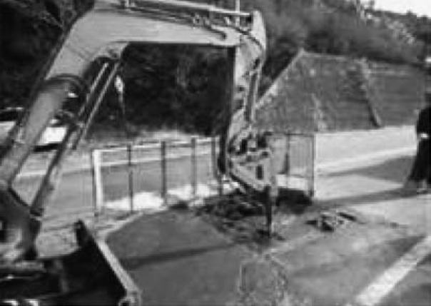
Types and applications (characteristics) of demolition machines
(1) Breaker
Page 2 of textbook / Page 4 of auxiliary text

Slide 5
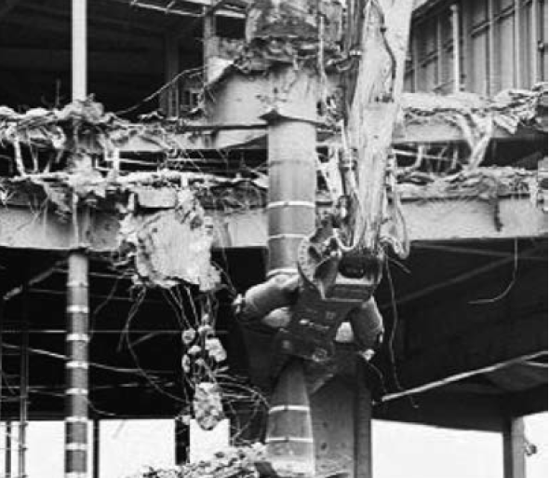
Types and applications (characteristics) of demolition machines
(2) Steel frame cutting machine
Page 3 of textbook / Page 5 of auxiliary text

Slide 6
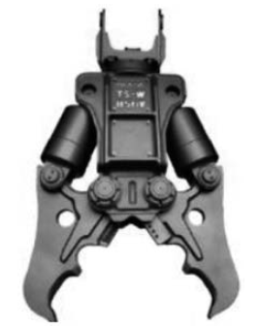
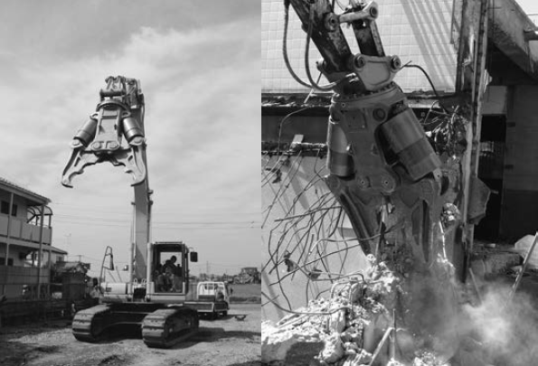
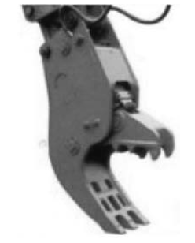
Types and applications (characteristics) of demolition machines
(3) Concrete crushers
Concrete rough crusher
Concrete crusher
Concrete fine crusher
Page 4 of textbook / Page 6 of auxiliary text

Slide 7
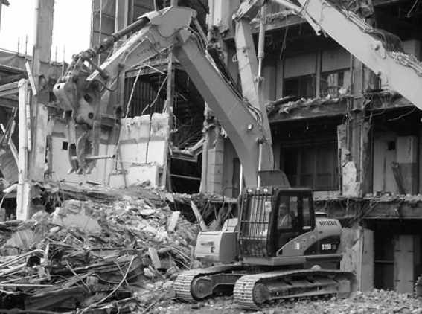
Types and applications (characteristics) of demolition machines (4) Demolition grippers
Page 4 of textbook / Page 7 of auxiliary text

Slide 8
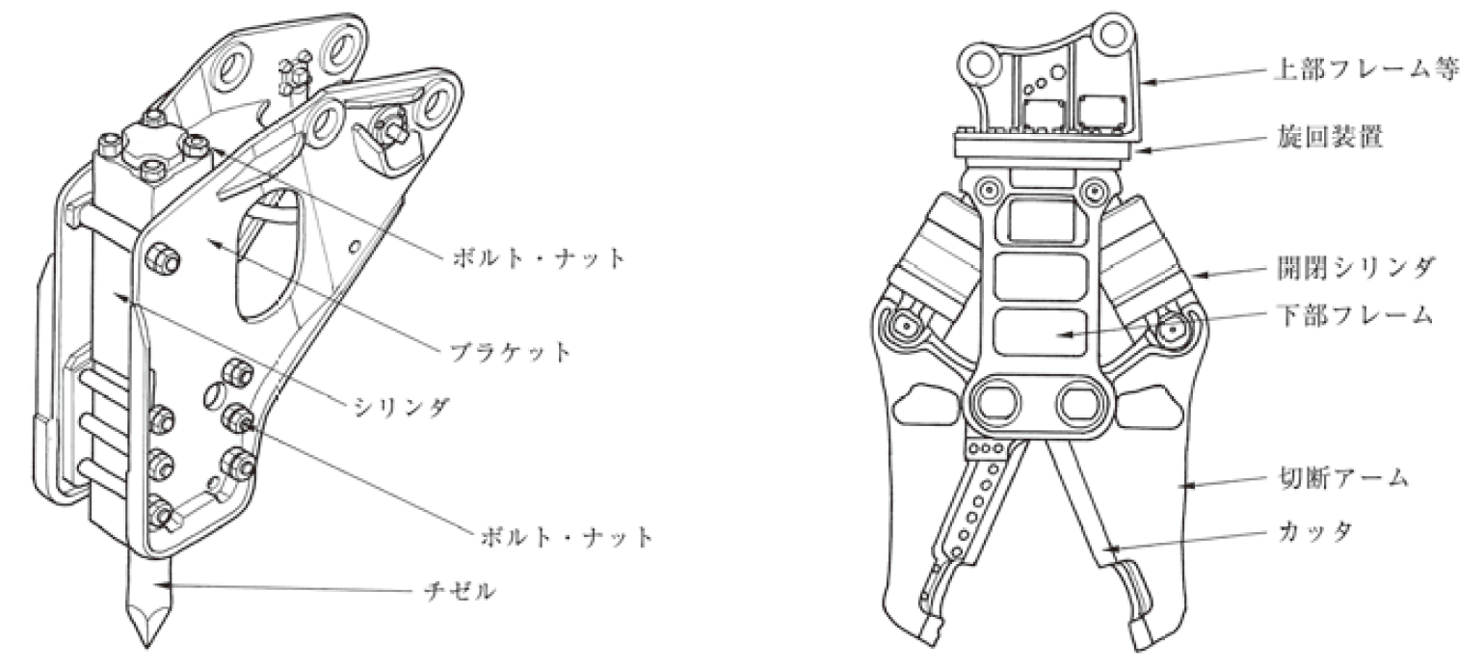
Types of Attachmentsfor Demolition machines
Upper frame, etc.
Slewing device
Bolts and nuts
Opening/closing cylinder
Lower frame
Bracket
Cylinder
Cutting arm
Bolts and nuts
Cutter
Chisel
Breaker unit
Steel frame cutting tool
Page 5 of textbook / Page 8 of auxiliary text

Slide 9
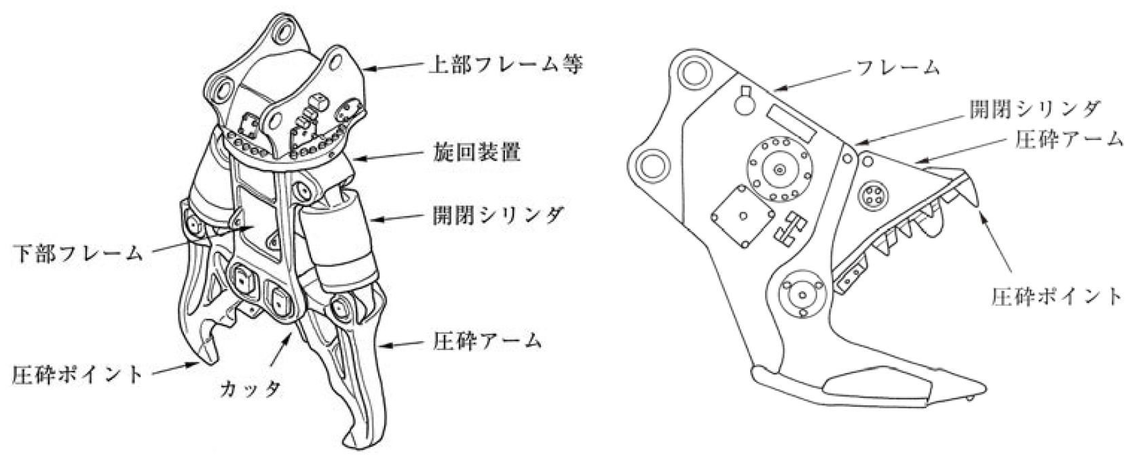
Types of attachments for Demolition (kaitai) machines
Upper frame, etc.
Frame
Opening/closing cylinder
Slewing device
Crushing arm
Opening/closing cylinder
Lower frame
Crushing point
Crushing arm (assai amu)
Crushing point
Cutter
Concrete rough crusher
Concrete fine crusher
Page 5 of textbook / Page 8 of auxiliary text

Slide 10
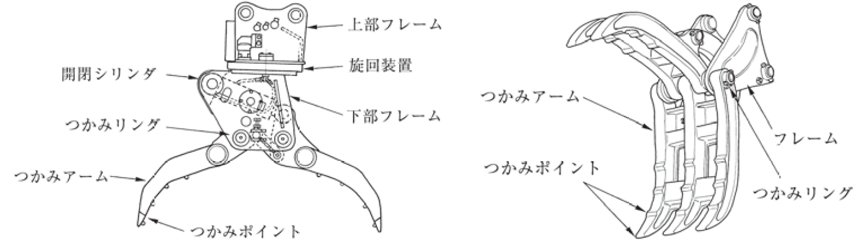
Types of attachment for Demolition machines
Upper frame
Opening/closing
cylinder
Slewing device
Gripping arm
Gripping ring
Lower frame
Frame
Gripping
arm
Gripping point
Gripping ring
Gripping point
Gripper (internal cylinder operated type)
Gripper (external cylinder operated type)
Page 5 of textbook / Page 8 of auxiliary text

Slide 11
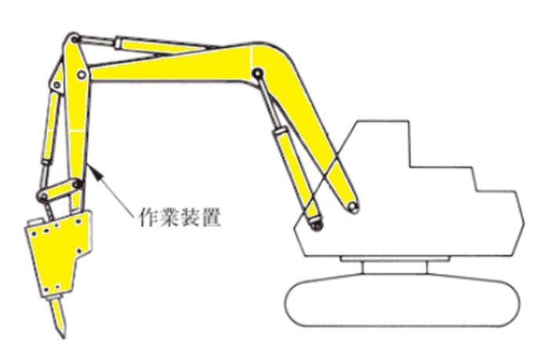
Base machine for Demolition (1) Work device
Work device
Page 6 of textbook / Page 9 of auxiliary text

Slide 12
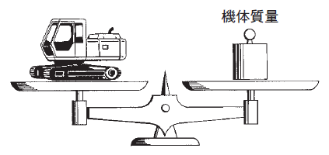
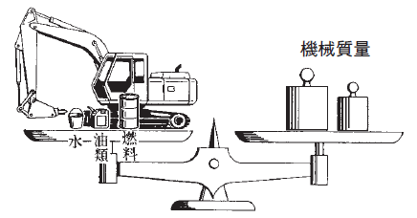
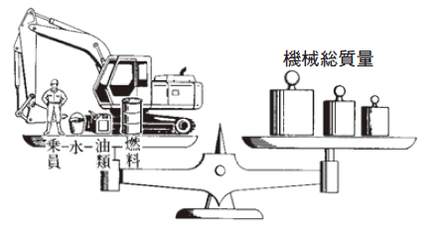
Base machine for Demolition
(2) Machinery body mass
(3) Machine mass
(4) Gross vehicle mass
Machine body mass
Machine body mass
Machine mass
Gross vehicle mass
Oil
Fuel
Crew
Oil
Fuel
Water
Water
Machine mass
Gross vehicle mass
Page 6 of textbook / Page 9 of auxiliary text

Slide 13
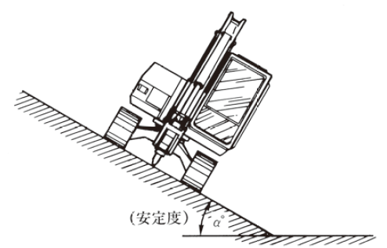
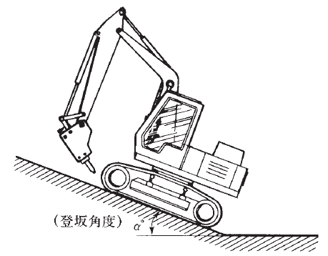
Base machine for Demolition (5) Stability (6)Gradeability
(Stability)
(Climbing angle)
Stability
Gradeability
Page 7 of textbook / Page 10 of auxiliary text

Slide 14
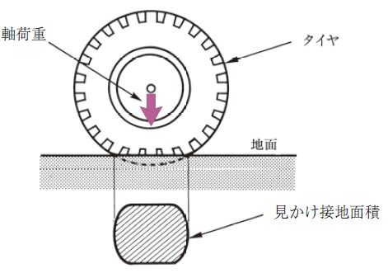
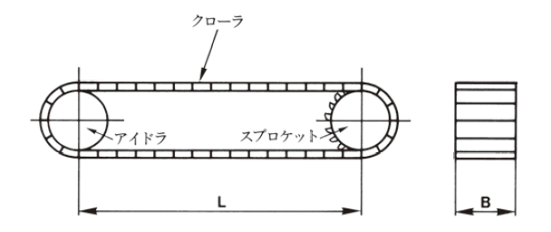


Base machine for Demolition (7) Average contact pressure
①Crawler type
② Wheeltype
$$平均接地圧=\frac{軸荷重×9.8}{見かけ接地面積}（kPa）$$
$$平均接地圧=\frac{Ｗ×9.8}{Ｓ}=\frac{Ｗ×9.8}{2Ｂ×Ｌ}（kPa）$$
Axial load
Average contact pressure
Average contact pressure
Apparent ground contact area
W: Gross vehicle mass (t)
S: Total ground contact area= 2B x L （m²）
L: Center distance (m) between idler (idle wheel) and sprocket (sprocket wheel) under total loaded mass condition
B: Width of crawler (m)
Crawler
Axial load
Tire
Idler
Sprocket
Ground
Apparent ground contact area
Page 8 of textbook / Page 11 of auxiliary text

Slide 15
Chapter 2 Prime Mover and Hydraulic System of Vehicle Type Construction Machines

Slide 16
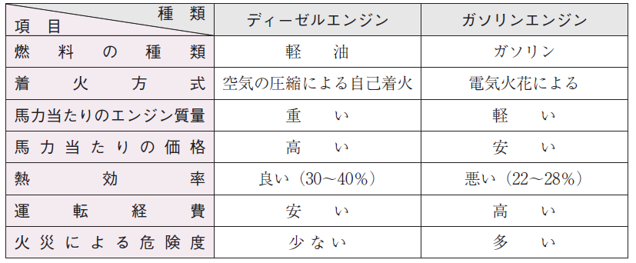
Prime mover (Gendoki)
Comparison between diesel engine and gasoline engine
Item
Type
  Diesel engine
  Gasoline engine
Fuel type
  Diesel fuel (keiyu)
  Gasoline
Type of ignition
Self-ignition by air compression
  By electric spark
Engine mass per horsepower
  Heavy
  Light
Price per horsepower
  High
  Cheap
Thermal efficiency
  Good (30～40)
  Bad (22～28%)
Operating cost
  Low
  High
Fire danger level
  Low
  High
Page 12 of text / Page 13 of auxiliary text

Slide 17
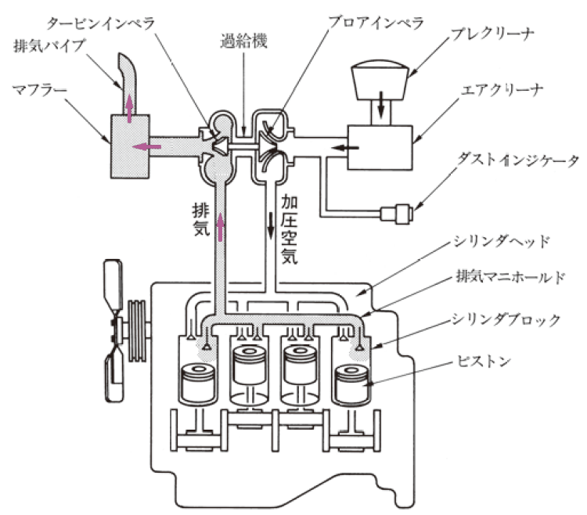
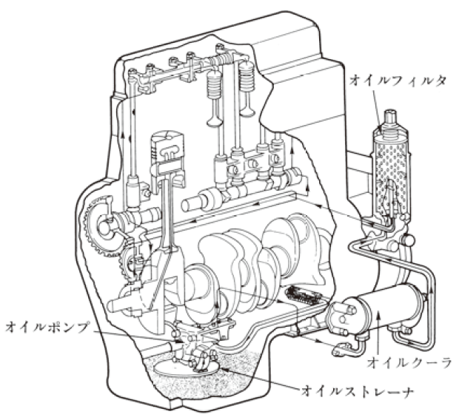
Structure of a diesel engine
Blower impeller
Turbine impeller
Supercharger
Pre-cleaner
Exhaust pipe
Muffler
Air cleaner
Oil filter
Dust indicator
Exhaust air
Pressurized air
Cylinder head
Exhaust manifold
Cylinder block
Piston
Oil pump
Oil cooler
Oil strainer
Example of air intake and exhaust system
Example of lubrication equipment system
Page 13 of textbook / Page 13 of auxiliary text

Slide 18
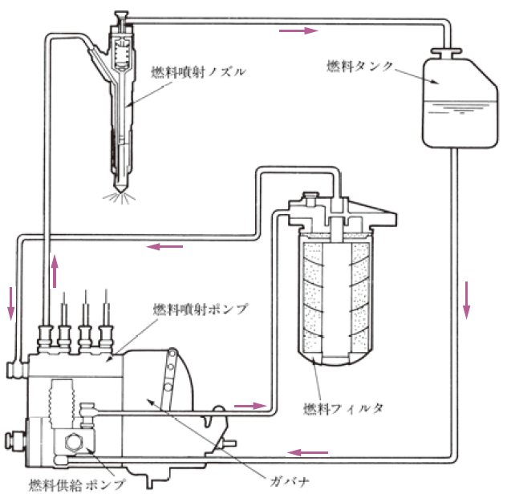
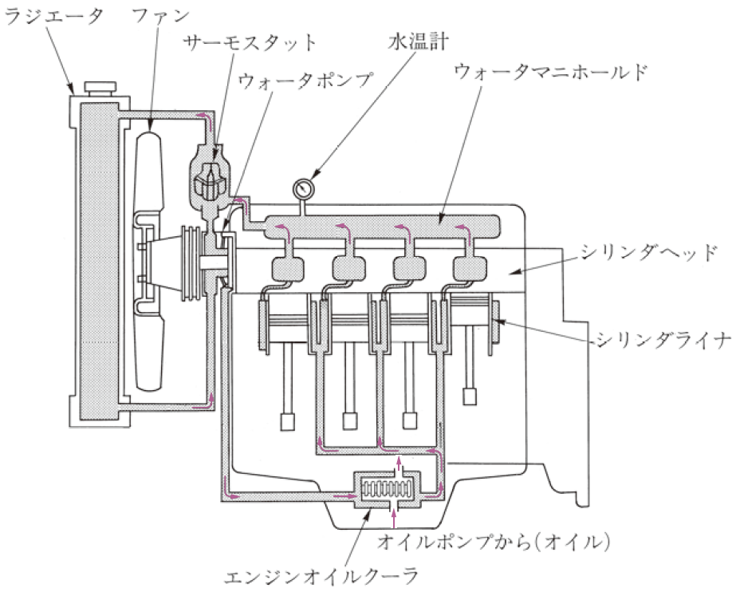
Structure of a diesel engine
Fuel tank
Radiator
Fan
Thermostat
Water Thermometer
Fuel injection nozzle
Water pump
Water manifold
Cylinder head
Cylinder liner
Fuel injection pump
Fuel filter
From the oil pump (oil)
Fuel feed pump
Governor
Engine oil cooler
Diagram of a cooling device for water-cooled engine system
Example of a fuel system
Page 15 of textbook / Page 14 of auxiliary text

Slide 19
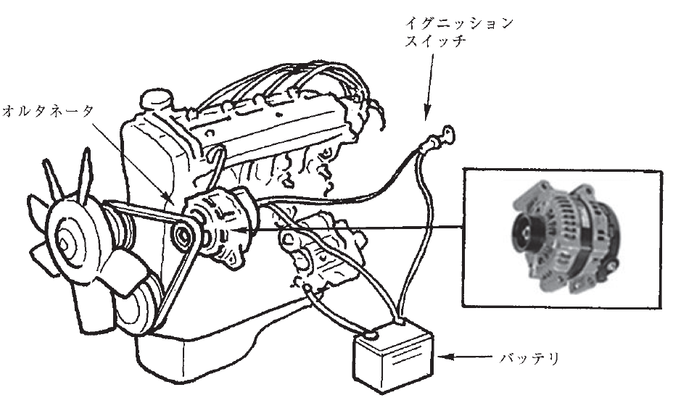
Structure of a diesel engine
Ignition switch
Alternator
Battery
Example of alternator
Page 17 of textbook / Page 15 of auxiliary text

Slide 20
Fuel and engine oil
Engine oil has the following functions.
① Lubricating
② Cooling
③ Sealing
④ Cleaning
⑤ Rust prevention
Although there are many different brands for engine oil, it is necessary to use the standard brand specified in the instruction manual of the construction machine.
Page 18 of textbook / Page 15 of auxiliary text

Slide 21
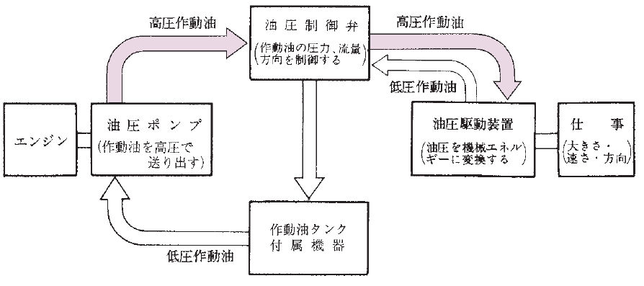
Hydraulic system
High pressure hydraulic oil
High pressure hydraulic oil
Hydraulic control valve
(controls the pressure, flow rate, and direction of hydraulic fluid)
Low pressure hydraulic oil
Oil hydraulic pump
(Hydraulic oil is pumped out at high pressure)
Hydraulic drive unit
(Exchange hydraulic pressure for mechanical energy)
Engine
Task
(size, speed, direction)
Alternator
Hydraulic oil tank
Attached equipment
Low pressure hydraulic oil
Page 19 of textbook / Page 16 of auxiliary text

Slide 22
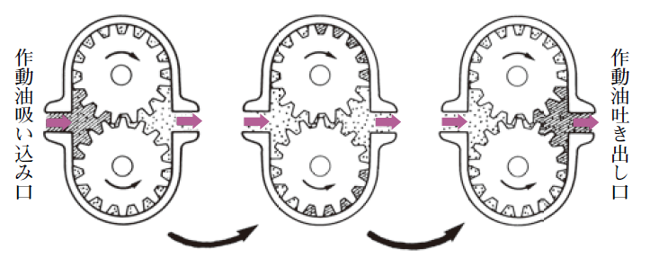
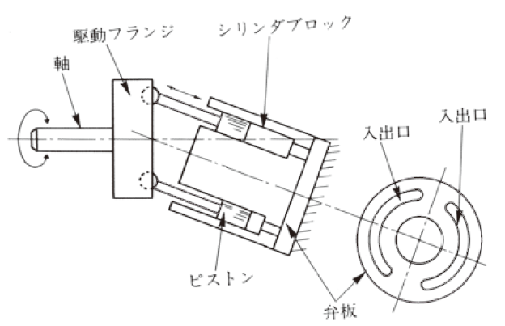
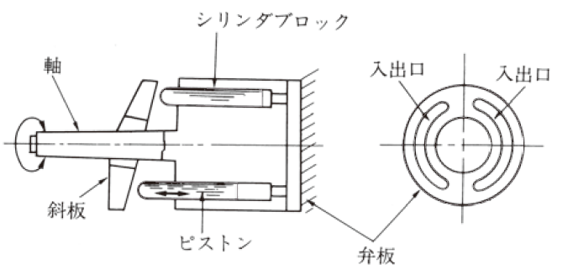
Hydraulic pump ①Gear pump ②Bent axis type and swash plate type piston pump
Hydraulic oil inlet
Hydraulic oil outlet
Gear pump
Entrance/exit
Driving flange
Cylinder block
Shaft
Cylinder block
In/out port
Shaft
In/out port
In/out port
In/out port
Swashplate
Piston
Piston
Valve plate
Valve plate
Bent axis type piston pump Swash plate type piston pump
Page 20 of textbook / Page 16 of auxiliary text

Slide 23
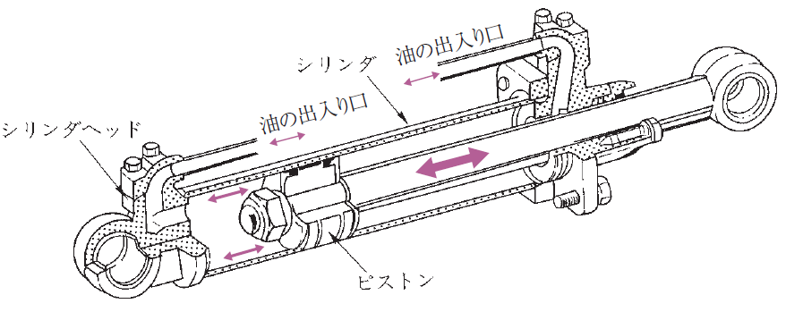
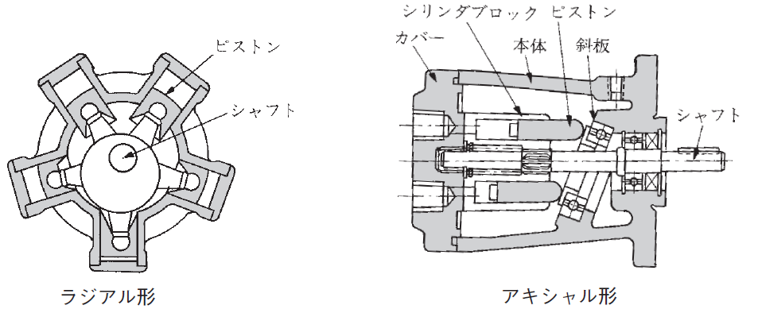
Hydraulic drive unit ① Hydraulic cylinder ② Hydraulic motor Piston motor
Oil inlet/outlet
Cylinder
Oil inlet/outlet
Cylinder head
Piston
Hydraulic cylinder
Cylinder block
Piston
Piston
Cover
Main body
Swash plate
Shaft
Shaft
Radial type
Axial type
Hydraulic motor Piston motor
Page 23 of textbook / Page 17 of auxiliary text

Slide 24
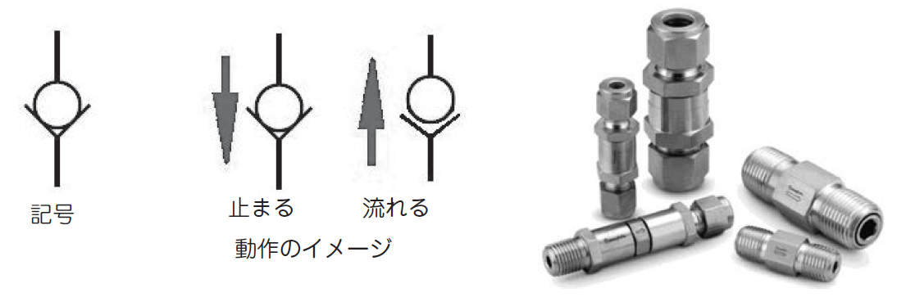
Non-return valve
Symbol
Stop
Flow
Image of operation
Non-return valve
Page 24 of textbook / Page 18 of auxiliary text

Slide 25
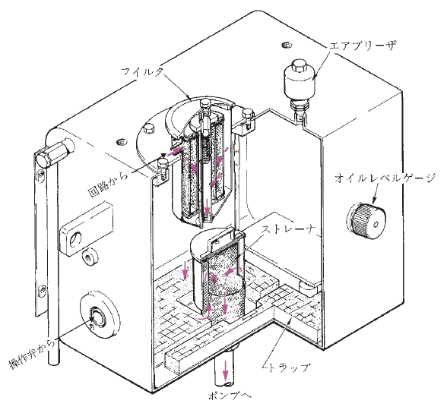
Hydraulic oil tank, oil filter
Air breather
Filter
Oil level gauge
From the circuit
Strainer
Operation valve
Trap
To the pump
Hydraulic oil tank
Page 24 of textbook / Page 18 of auxiliary text

Slide 26
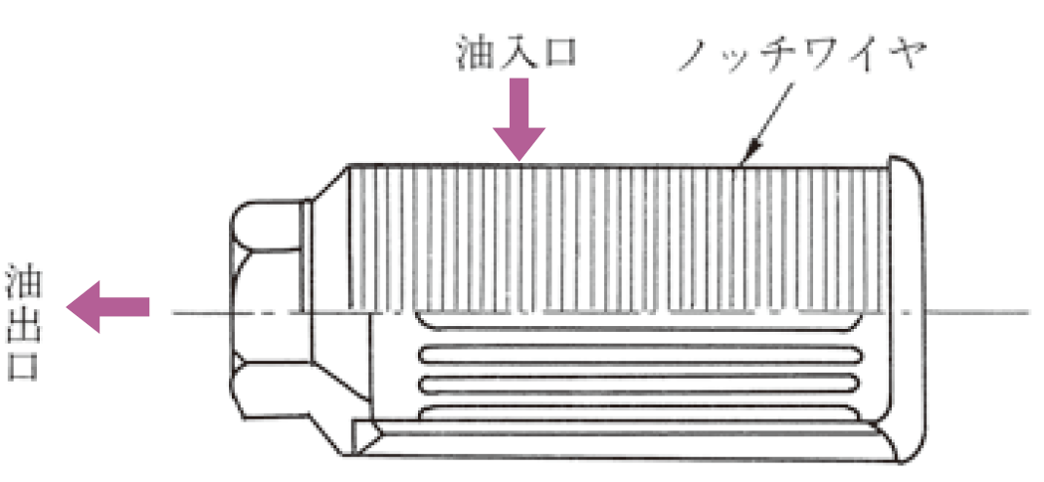
Oil filter
Oil inlet
Notch wire
Oil outlet
Oil filter
Page 25 of textbook / Page 18 of auxiliary text

Slide 27
Chapter 3: Equipment’s Structure related to the running of demolition machines

Slide 28
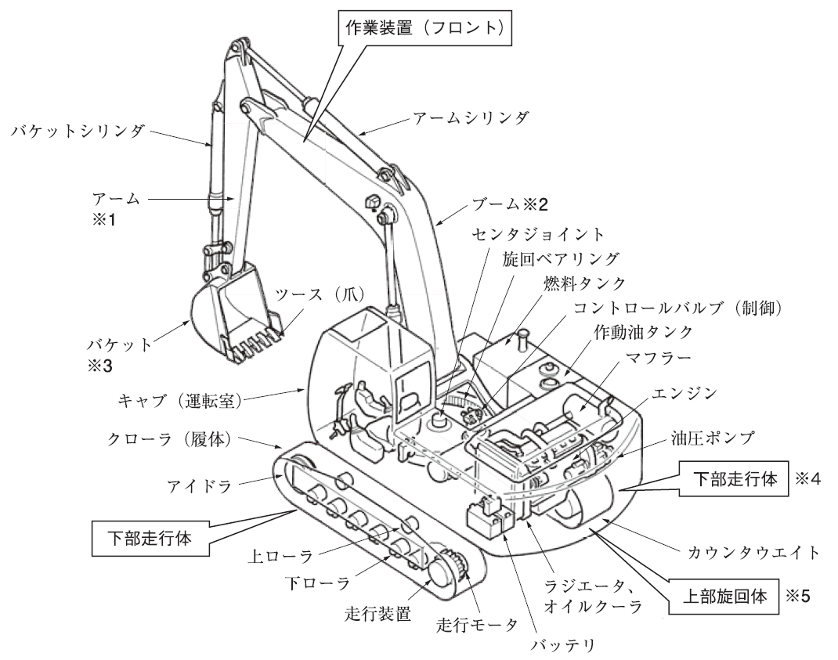
Traveling device structure of crawler type dismantling machine
Work equipment (front)
Bucket cylinder
Arm cylinder
Arm
Arm
Center joint
Swing bearing
Tooth (nail)
Fuel tank
Control valve (control)
Bucket
Hydraulic oil tank
Muffler
Cab (driver's cab)
Engine
Crawler (Body)
Hydraulic pump
Idler
Lower running body
Lower running body
Upper roller
Counterweight
Lower roller
Radiator,
Oil cooler
Upper swivel
Traveling device
Traveling motor
Battery
Page 28 of textbook / Page 19 of auxiliary text

Slide 29
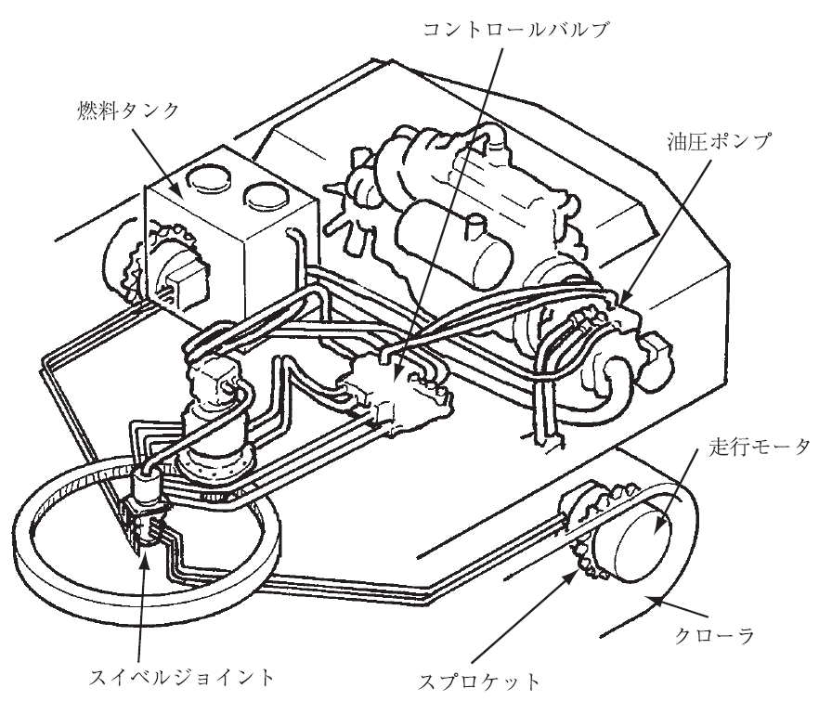
Power transmission system device
Control valve
エンジン
Engine
Fuel tank
Hydraulic pump
旋回モータ
Swing motor
Traveling motor
Crawler
Swivel joint
Sprocket
Example of power transmission system device
Page 29 of textbook / Page 19 of auxiliary text

Slide 30
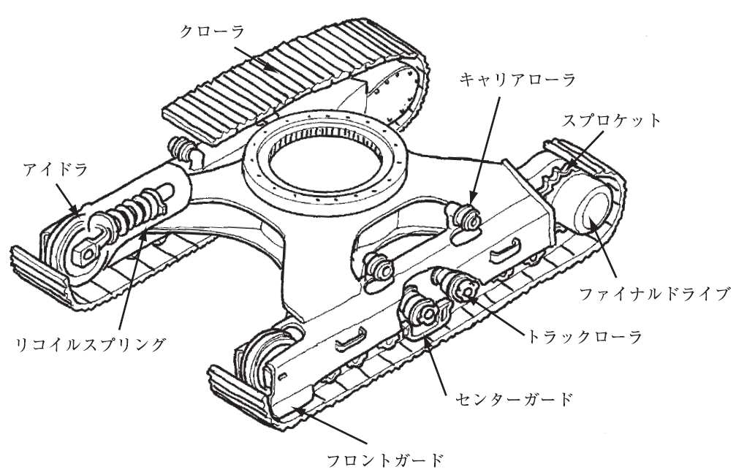
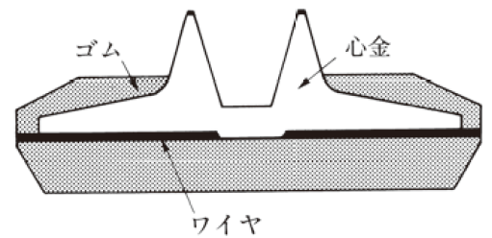
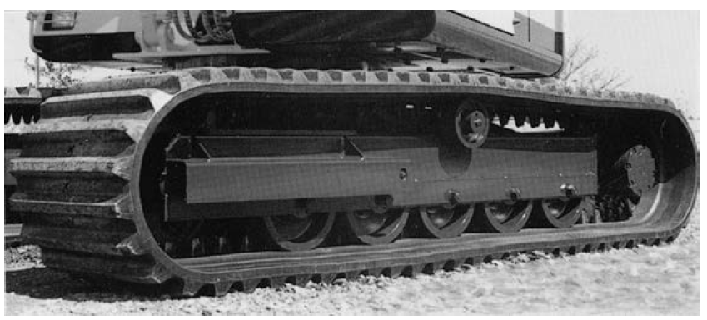
Suspension device
Crawler
Carrier roller
Sprocket
Rubber
Mandrel
Idler
Final drive
Wire
Example of cross section of rubber crawler
Recoil spring
Truck roller
Center guard
Front guard
足回り装置の例
Example of suspension device
Example of rubber crawler
Page 33 of textbook / Page 20 of auxiliary text

Slide 31
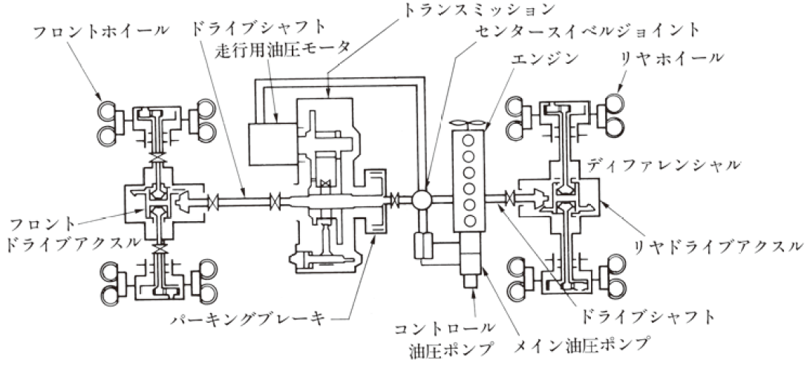
Traveling device structure of the wheel type machines for demolition power transmission system device
Transmission
Front wheel
Drive shaft
Traveling hydraulic motor
Center swivel joint
Engine
Rear wheel
Differential
Front
Drive axle
Rear drive axle
Parking brake
Control hydraulic pump
Drive shaft
Main hydraulic pump
Example of power trasmission system device
Page 36 of textbook / Page 21 of auxiliary text

Slide 32
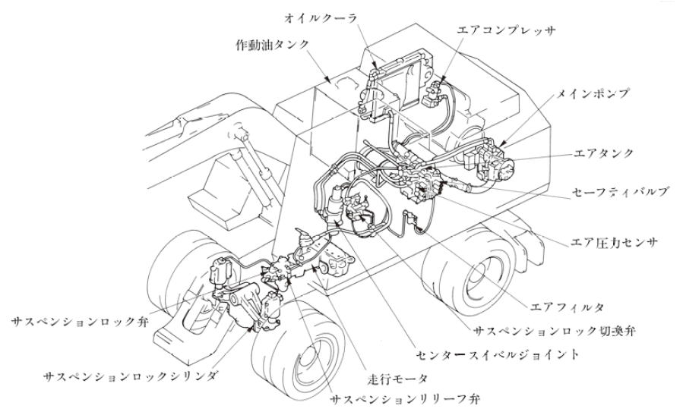
Suspension device Lower frame
Oil cooler
Air compressor
Hydraulic oil tank
Main pump
Air tank
Safety valve
Air pressure sensor
Suspension lock valve
Air filter
Suspension lock switching valve
Lock center swivel joint
Suspension lock cylinder
Traveling motor
Suspension relief valve
Example of suspension fixed piping
Page 39 of textbook / Page 22 of auxiliary text

Slide 33
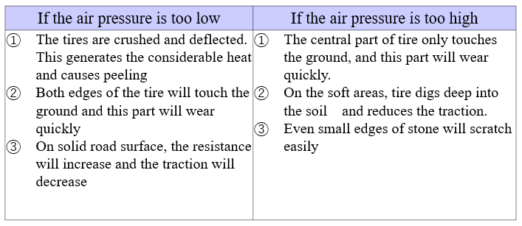
Suspension device Tire
Tire air pressure
Page 40 of textbook / Page 22 of auxiliary text

Slide 34
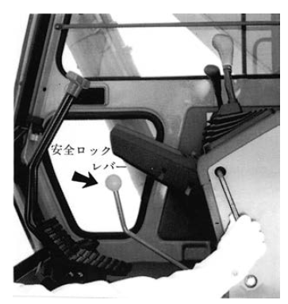
Safety devices for dismantling machines, etc.
(1) Alarm equipment (horn)
(2) Safety lock lever , etc
Safety lock
lever
Page 41 of textbook / Page 23 of auxiliary text

Slide 35
Safety devices for dismantling machines, etc.
(3) Monitoring system
Page 42 of textbook / Page 24 of auxiliary text

Slide 36
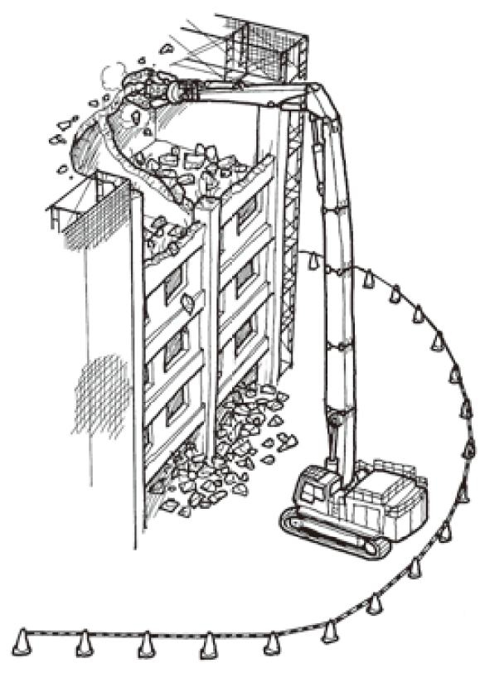
Safety devices for dismantling machines, etc.
(4) Specified dismantling machine demolition machine with the total length of boom and arm that is more than 12 m
Page 42 of textbook / Page 25 of auxiliary text

Slide 37
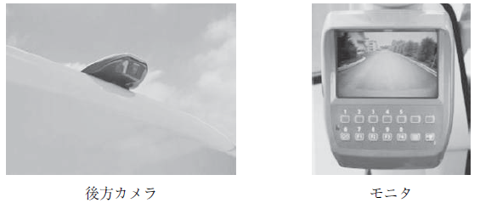
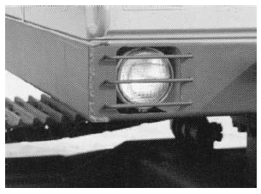
Safety devices for dismantling machines, etc.
(5) Mirror etc.
(6) Headlights, etc.
Rear camera
Monitor
Page 44 of textbook / Page 26 of auxiliary text

Slide 38
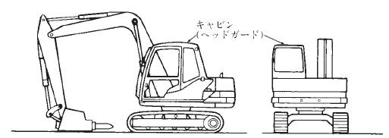
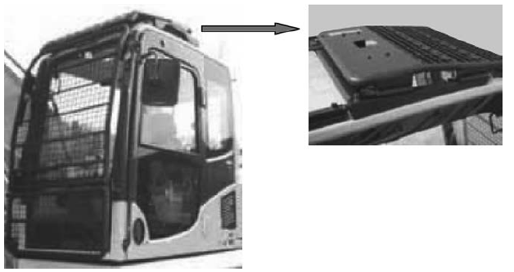
Safety devices for dismantling machines, etc.
(7) Head guard
(8) Safety glass and flying object protective device
Cabin
(Head guard)
Page 45 of textbook / Page 27 of auxiliary text

Slide 39
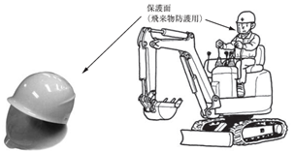
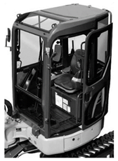
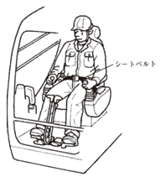
Safety devices for dismantling machines, etc.
(9) Machines for dismantling small vehicles without a cab
(10) Rollover protective structure (ROPS), Tip-over protective structure (TOPS)
Face Shield
(For protecting from flying objects)
Seatbelt
Page 45 of textbook / Page 28 of auxiliary text

Slide 40
Chapter 4 Handling of equipment regarding operation with demolition attachments, etc.

Slide 41
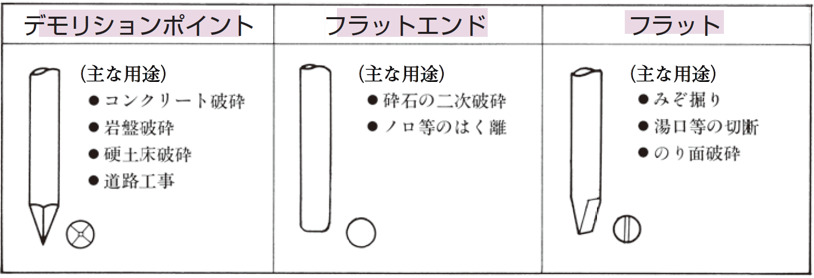
Selection and installation of breakers, characteristics, names and functions of each part
Demolition point
Flat end
Flat
(Main applications)
・Concrete crushing
・Bedrock crushing
・Hard bed soil crushing
・Road construction
(Main applications)
・Secondary crushing of crushed stone
・Delamination from cement paste
(Main applications)
・Ditch excavation
・Cutting of sprues
・Slope crushing
Example of chisel types
Page 47 of textbook / Page 29 of auxiliary text

Slide 42

Selection and installation of breakers, characteristics, names and functions of each part
Pin
High pressure side piping
Low pressure side
Low pressure side piping
High pressure side
Breaker piping
Bracket
Breaker unit
Chisel
Hydraulic oil tank
Oil filter
  Impact Pedal
  Control valve
Oil pump
Hydraulic Breaker
Page 48 of textbook / Page 30 of auxiliary text

Slide 43


Selection and installation of breakers, characteristics, names and functions of each part
Accumulator
Hydraulic hose connection part
Valve box
Valve
Bracket
Chisel set pin
Cylinder
Chisel
Cylinder
Piston
Chisel
Example of breaker unit part names
Accumulator
Operation valve
Stop valve
Pump
Relief valve
Breaker unit
Cooler
Stop valve
Tank
Secondary relief valve
Example of hydraulic piping circuit
Page 49 of textbook / Page 30 of auxiliary text

Slide 44

Type of breakers
Nitrogen gas Note*
Piston
Lower part pressure receiving surface
Switching valve
Note: Do not use any gas other than nitrogen gas.
① Pressure accumulation repulsion type
Page 50 of textbook / Page 31 of auxiliary text

Slide 45


Types of breakers
Nitrogen gas *
Nitrogen gas *
High/low pressure switching
High/low pressure switching
Constant high pressure on the lower pressure receiving surface
Constantly high pressure on the lower pressure receiving surface
Switching valve
Switching valve
Note: Do not use any gas other than nitrogen gas.
High pressure accumulator
Note: Do not use any gas other than nitrogen gas.
② Hydraulic direct acting type
(a) Piston upper surface high/low pressure switchable type
② Hydraulic direct acting type
(a) Piston upper surface high/low pressure
Use of nitrogen gas and high-pressure accumulator
Page 51 of textbook / Page 32 of auxiliary text

Slide 46

Types of breakers
Constant high pressure on the upper pressure receiving surface
High/low pressure switching
High pressure accumulator
Switching valve
② Direct-acting hydraulic system type (b) High/low pressure switchable underside piston type
Page 51 of textbook / Page 33 of auxiliary text

Slide 47



General work methods for breakers
Demolition of concrete structures in buildings, etc.
Demolition of road paving panel
Rock crushing
Page 53 of textbook / Page 34 of auxiliary text

Slide 48


General work methods for breakers
Press the breaker unit at a right angle and hit
Do not blank fire
Page 54 of textbook / Page 35 of auxiliary text

Slide 49


General work methods for breakers
Do not pry (kojiru)
Do not pry (kojiru) with the chisel.
Start with the part that is easy to break
Page 55 of textbook / Page 36 of auxiliary text

Slide 50


General work methods for breakers
Do not hit with the stroke end
Don't use breakers to hang things
Page 56 of textbook / Page 37 of auxiliary text

Slide 51


General work methods for breakers
No entry
No entry
Prohibited entry to areas with flying fragments
Do not work underwater
Page 56 of textbook / Page 38 of auxiliary text

Slide 52


General work methods for breakers
Be cautious of landslides, falling rocks, etc.
Be careful not to fall down
Page 57 of textbook / Page 39 of auxiliary text

Slide 53

Precautions after finishing work
(1) Breaker unit
(2) Base machine
Page 58 of textbook / Page 40 of auxiliary text

Slide 54

Characteristics of steel frame cutting machines, names and functions of each part, types, selection and installation, operation, etc.
Steel frame cutting tool
Page 59 of textbook / Page 41 of auxiliary text

Slide 55


General work method for steel frame cutting machines
Dismantling by Steel frame cutting machine
Grease injection
Page 60 of textbook / Page 42 of auxiliary text

Slide 56


General work method for steel frame cutting machines
Operating in an unstable place is dangerous Check the strength of the floor surface
Be careful when working horizontally against the crawler belt
It is dangerous to work when the main part of the machine is floating
Page 61of textbook / Page 43 of auxiliary text

Slide 57



General work method for steel frame cutting machines
Do not pry (kojiru)
Do not hit
Side sweeping is forbidden
Page 62 of textbook / Page 43 of auxiliary text

Slide 58


General work method for steel frame cutting machines
Do not bite in a stroke end situation
No entry within flying and falling material area
Page 63 of textbook / Page 44 of auxiliary text

Slide 59


General work method for steel frame cutting machines
Do not operate arm, boom or drive at the same time when working.
Do not perform the operation by opening the arms
Page 64 of textbook / Page 45 of auxiliary text

Slide 60


General work method for steel frame cutting machines
Do not change the direction of the base machine by pushing the Steel frame cutting tool against the ground.
Do not bite concrete with the Cutter Blade (buredo)
Page 64 of textbook / Page 46 of auxiliary text

Slide 61

Precautions after finishing work
（１）Steel frame cutting tool
（２）base machine
Page 65 of textbook / Page 47 of auxiliary text

Slide 62




Concrete crushers characteristics, name, and function of each part, types, selection and installation, operation, etc.
Demolition of rough parts of concrete structures and buildings
Example of a crusher for rough parts
Demolition of fine parts of concrete
Example of a crusher for fine parts
Page 66 of text / Page 48 of auxiliary text

Slide 63

General working method for Concrete crushers
Precautions after finishing work
(1) Concrete crusher
(2) base machine
Page 69 of textbook / Page 52 of auxiliary text

Slide 64


Demolition grippers characteristics, names and functions of each part, and types
Upper frame
Hydraulic pressure connection
Hydraulic motor
Swivel joint
Slewing device
Lower frame
Cylinder pin
Open/close cylinder
Cylinder pin
Frame pin
Gripper link
Link pin
gripper arms
Clearing of rubble
Gripping point
Name of each part of a gripping tool (with slewing device, internal cylinder operated type)
Page 72 of textbook / Page 54 of auxiliary text

Slide 65


Demolition grippers characteristics, names and functions of each part, and types
Open/close cylinder
Open/close cylinder
Frame
Frame
gripper link
gripper link
gripper arm
gripper arm
Gripping point
Gripping point
(Non-slewing type) Example of internal cylinder type gripping tool
Example of an external cylinder type gripping tool
Page 73 of textbook / Page 55 of auxiliary text

Slide 66



Selection, installation and operation of demolition grippers
Example of internal cylinder operated type gripping tool with slewing device
Example of gripping tool (internal cylinder operated type)
Example of gripping tool (external cylinder operated type)
Page 74 of textbook / Page 57 of auxiliary text

Slide 67


General work method for demolition grippers
Demolition carried out by a demolition grippers
When rotating while grabbing a long object be very careful not to hit the driver's seat
Page 76 of textbook / Page 59 of auxiliary text

Slide 68



General work method for demolition grippers
Change the angle before grabbing
Do not grasp objects at an obliquely with the gripper
Change the angle before grabbing
Do not hit an object against the ground or a wall and do not perform breaking or bending operations while still grabbing the object
When grabbing long objects, grab the middle part or the center of gravity.
Page 77 of textbook / Page 61 of auxiliary text

Slide 69

Precautions after finishing work
(1) Gripping tool
(2) base machine
Page 78 of textbook / Page 63 of auxiliary text

Slide 70

Removal of attachments
Stop valve
Cap
Hydraulic hose
Pin
Hydraulic hose
Plug
Plug
Use square timbers to stabilize it.
(Position during removal)
Dismantling example of a Breaker unit
Page 79 of textbook / Page 64 of auxiliary text

Slide 71

Removal of attachments
Stop valve
Lock pin
Dust cap
Pin
Dust plug
Hydraulic hose
Ensure that the rotating part does not rotate before operation
Use square timbers to stabilize it
Dismantling example of a steel frame cutting tool
Page 80 of textbook / Page 65 of auxiliary text

Slide 72


Removal of attachments
Stop valve
Stop valve
Dust plug
Dust cap
Lock pin
Dust cap
Hydraulic hose
Pin
Pin
Ensure that the rotating part does not rotate
Use square timbers to stabilize it
Dust plug
Hydraulic hose
Dismantling example of Concrete rough crusher
Dismantling example of Concrete fine crusher
Page 81 of textbook / Page 65 of auxiliary text

Slide 73



Removal of attachments
Pin
Stop valve
Pin
Dust cap
Dust plug
Hydraulic hose
Pin
Dismantling example of gripping tool (internal cylinder operated type)
Dismantling example of gripping tool (external cylinder operated type)
Shovel arm
Bucket link
Bucket
Arm link
Dismantling example of bucket
Page 82 of textbook / Page 66 of auxiliary text

Slide 74



Transportation of demolition machinery
Trailer carriage
Covered with wood
Climbing equipment
Claw to hang on the carriage
15° or less
Example of claw climbing equipment
Example of climbing equipment
Example of relationship between mass of loading machine and climbing equipment
Mass of loading machine (t)
Climbing equipment
Material
Number of material used
Shape and dimension
Length x Height x Width (mm)
Aluminium alloy
Aluminium alloy
Aluminium alloy
Page 83 of textbook / Page 68 of auxiliary text

Slide 75


Demolition machine transport
Vehicle deck
Plane figure
Foot stall
Climbing equipment
Crawler
Vehicle deck
Example of foot stall use
Brakes
Climbing equipment
Crawler
Example of loading position
Page 84 of textbook / Page 70 of auxiliary text

Slide 76


Demolition machine transport
Wire
rope
Pad
Wire
rope
Lever block
Sleeper
Gear
In the case transport it by driving the vehicle, when passing under railway trolley wire, electric wires, and bridge girders, etc.,
make sure that the separated distance is sufficient so that the boom's tip does not touch them.
The example of fixing trailer for Demolition machine
Page 86 of textbook / Page 71 of auxiliary text

Slide 77
Chapter 5 Inspection and maintenance of construction machine for demolition

Slide 78

Related laws and general precaution
Related laws
Inspection classification | Article | Implementer / Qualification | Storage period of inspection check sheet
Operation before/after | Safety rules Article 170,171 | driver | During machine is in operation
Periodical self- inspection (once/month) | Safety rules Article 168,169,171 | Person who is selected by the safety manager | Inspection check sheet 3 years
Specified self- inspection (once/year)) | Safety rules Article 167,169, 169(2),171 | inspector | Inspection check sheet 3 years (posted inspected mark)
※However; even though it is not stipulated by law, it is better to keep the inspection results when the machine is in use.
AUTHORIZED PERSONNEL ONLY
Entering the place for inspection and maintenance is authorized personnel only
Page 89 of textbook / Page 73 of auxiliary text

Slide 79


Daily inspection procedure Before engine starts
Discrimination method based on the appearance of hydraulic oil
Appearance | Smell | Cause
Changed to milky white | good | Water is mixed
Changed to dark brown | bad | deteriorated
Small dark spot is appearing | good | contaminated
Bubbling up | - | Grease is mixed
Boom
Arm
The example of oil inspection position of demolition machine
Before mentaining the electrical system, remove the battery (-) terminal.
Page 91 of textbook / Page 74 of auxiliary text

Slide 80



Daily inspection procedure Before engine starts
Check for loose bolt
push
Grease nipple
Abrasion width
Abrasion width
The example of grease up by grease gun
chisel
The example of wear limit
Page 94 of textbook / Page 77 of auxiliary text

Slide 81
Daily inspection procedure Before engine starts
The criiteria of exhaust gas color
The color of echaust gas | The criteria
black | The fuel-air mixture is thick, incomplete combustion
Light yellow | The fuel-air mixture is thin
whit・blue | Oil combustion
grey | The fuel-air mixture is thick, and oil combustion
colorless | The fuel-air mixture is appropriate, complete combustion
Daily inspection procedure After operation is completed
(1) Clearning a machine body
(2) Supplying fuel
(3) Housing a machine body
Page 96 of textbook / Page 77 of auxiliary text

Slide 82
In the case of noticed abnormalities during work
When you notice a Demolition machine has some trouble, stop it on a flat place immediately and report defective parts to person in charge, then it is necessary to start work again after repairing.
Page 97 of textbook / Page 78 of auxiliary text

Slide 83
Chapter 6: Matters related to the demolition work

Slide 84

Construction plan
General flow of demolition work
Page 99 of textbook / Page 79 of auxiliary text

Slide 85

Safe driving rules
When the driver leaves the driver's seat during working , etc., the driver stop the engine, take the key out and store it.
The driver wears a protective cap and safety equipments, dresses up and then drive.
Page 101 of textbook / Page 81 of auxiliary text

Slide 86


Safe driving rules
During driving, keep in mind to stop immediately in case of an unexpected situation
Always check for buried objects when fracturing in urban areas.
Page 101 of textbook / Page 82 of auxiliary text

Slide 87

Signals and guidance procedure
＜Signaled by whistle＞ ＜Signaled by spoken ＞
• Safety：2 short whistle voices, repeat • Safety：All right (orai), all right (orai)
• Stop：long whistle • Stop：stop (sutoppu)
Before starting work, the driver needs to discuss with the signaler or inductor in advance about the work position of other construction machines, the work position of the worker, the position of the dangerous place, and the signal method.
Page 104 of textbook / Page 84 of auxiliary text

Slide 88
Chapter 7: Knowledge of force and electricity

Slide 89



Moment of force
Moment of force
Blow reaction
Breaker for
tunnel
Moment of force ①
Moment of force ②
Page 110 of textbook / Page 85 of auxiliary text

Slide 90

Moment of force
The area of fall risk
Maximum working radius
Work area
Warning area
Precautions when working with a specificed dismantling machine
Page 112 of textbook / Page 86 of auxiliary text

Slide 91


Mass, specific gravity and center of gravity
Mass of object = volume x specific gravity
Approximate volume formula
Unit volume mass of an object
Page 115 of textbook / Page 87 of auxiliary text

Slide 92


Mass, specific gravity and center of gravity
How to find the center of gravity
[Stable]
(a)
[Medium]
(b)
[Unstable]
(c)
[Stable]
(b)
[Stable]
(e)
Object Stability
Page 117 of textbook / Page 89 of auxiliary text

Slide 93



Motion of an object
Non-fast motion
Fast motion
Speed and acceleration
Centripetal force
Center
(hand)
Object A
Centrifugal force
Centrifugal force ・ centripetal force
Maximum static friction force
Page 118 of textbook / Page 90 of auxiliary text

Slide 94

Knowledge of electricity
Reaction of a unit mA (milliampere) when an electric current flows through the human body
NOTE) 1 mA is 1 / 1000A (ampere)
Page 124 of textbook / Page 93 of auxiliary text

Slide 95


Knowledge of electricity
Distance from the transmission / distribution line
(NOTE) No. 759 dated December 17, 1975
** This does not apply if the insulation is protected
***[Target valueof electric power company] indicates the case of TEPCO. This category and target values differ for each electric power company.
Page 126 of textbook / Page 94 of auxiliary text

Slide 96

Knowledge of electricity
Hydrometer
Electrolyte
Eye position
Rubber ball
External
cylinder
Water absorption pipe
How to read the hydrometer
Page 127 of textbook / Page 95 of auxiliary text

Slide 97
Chapter 8 Structure types and Demolition methods

Slide 98




Wooden structure (moku kozo) (W structure) (W zo), Steel structure (tekkotsu kozo) (S structure) (S zo)
Example of wooden frame structure
Example of wooden frame wall structure
Example of steel frame structure
Example of steel truss structure
Page 129 of textbook / Page 96 of auxiliary text

Slide 99



Reinforced concrete structure (tekkin konkurito kozo) (RC structure) (RC ZO),
Steel-framed reinforced concrete structure (tekkotsu tekkin kozo) (SRC structure) (SRC zo)
Example of reinforced concrete frame structure
Example of reinforced concrete wall structure
Examples of steel-frame reinforced concrete rigid frame structure
Page 132 of textbook / Page 98 of auxiliary text

Slide 100

Building Demolition method
① Destruction of building equipment
⑦ Dismantling of structure part and exterior material
(Leveling/ cleaning) After dismantling work is completed
Advance preparation
measures
② Removal of interior materials
Temporary installation work
③ Removal of inner ・outer fittings
⑤ Balcony removal.
etc.
Temporary construction removal
Work preparation
④ Removal of rooftop installation
⑥ Removal of roofing material
⑧ Dismantling of foundation, etc.
Demolition work completion inspection
Management dismantling work after completion
Confirmation of residual good removal
On-site sorting
Sorted out
Manual work
Manual work or combined work with hand machines
Example of manual separation and dismantling method
Page 137 of textbook / Page 100 of auxiliary text

Slide 101

Building demolition method
Temporary installation work
④ Removal of rooftop installation
⑧ Dismantling of structure part and exterior material
(Leveling/ cleaning) After dismantling work is completed
① Destruction of building equipment
③ Removal of inner ・outer fittings
Advance preparation
measures
② Removal of interior materials
⑥ Removal of roofing material
Temporary construction removal
⑦ Carrying/ installing heavy machines
⑨ Dismantling of foundation, etc.
Demolition work completion inspection
Work preparation
⑤ Balcony removal. etc.
Carrying heavy machine out
Management dismantling work after completion
Confirmation of residual good removal
On-site sorting
Sorted out
Manual work
Manual work or combined hand ・mechanical work
Example of separate dismantling method by combined manual and mechanical work
Page 137 of textbook / Page 101 of auxiliary text

Slide 102

Building Demolition method
Advance preparation
measures
④ Removal of roofing material
⑥ Dismantling of structure part and exterior material
(Leveling/ cleaning) After dismantling work is completed
Temporary installation work
③ Removal of inner ・outer fittings
① Destruction of building equipment
② Removal of interior materials
⑤ Carrying/ installing heavy machines
Temporary construction removal
⑦ Dismantling of foundation, etc.
Demolition work completion inspection
Work preparation
Carrying heavy machine out
Management dismantling work after completion
Confirmation of residual good removal
On-site sorting
Sorted out
Manual work
Mechanical work
Example of separate dismantling method by mechanical work
Page 138 of textbook / Page 102 of auxiliary text

Slide 103
Chapter 9 Related laws and regulations

Slide 104
Legal system for safety and health for workers
There are several laws related safety and health for worker including industrial safety and health law. Especially industrial safety and health law, items that you need to observe are regulated for the purpose of promoting establishment of the comfortable working environment and ensuring the safety and health of workers. The specific items that associated with enforcement of the law are indicated in government, ministry ordinance and notifications etc. The legal system for safety and health for workers is as follows.
Industrial safety and health law
Law
Industrial Safety and Health Law Enforcement Ordinance
Government
ordinance
Ministerial
ordinance
The regulation of Industrial Safety and Health Law Enforcement Ordinance
Vehicle-based construction machine structural standards
Public notice
・
Nnotification
Driving skills training for Vehicle-based construction machine (demolotion) regulations
Safety and Health Special Education regulations
Picture 9-1 the legal system for driving skills for vehicle-based construction machine (for Demolition)
(Reference) Ministry of Health, Labor and Welfare The risk assessment manual for ministry of building maintenance industry.
Page 107 of auxiliary text

Slide 105
Industrial safety and health law（selection）(1)
Chapter 1 General rules
Article 3 <Responsibilities of businesses, etc>
Businesses need not only simply preserve minimum standards for prevention of occupational accidents stipulated by this law but ensure the safety and health of workers in workplace by creating comfortable working environments and improving working conditions.
And businesses need to cooperate the policy preventing occupational accidents enforcing by government.
2 The person who designs machines and other equipment and manufactures or imports and the person who manufactures raw material or imports or builds or designs a building, regarding designing, manufacturing, importing or constructing these items, make efforts to prevent occupational accidents caused by the use of these materials.
3 The person who undertake works such as contractors for construction needs to care not impair conditions for safety and sanitary work in construction method and construction period, etc.
Article 4 workers make efforts to follow the necessity for preventing occupational accident and cooperate with measures to prevent occupational accidents implemented by businesses and other related persons
Page 149 of textbook / Page 108 of auxiliary text

Slide 106

Industrial safety and health law（selection）(2)
Chapter 5 Regulations on machines, etc and deleterious material
Article 45 <Periodical self-inspection>
According to the Ordinance of the Ministry of Health, Labor and Welfare, businesses regularly need to check self-inspection of boiler and other machines that specified by government ordinance and compiles the result.
2 When businesses conduct the self-inspection which is specified government ordinance about the preceding paragraph of machines, etc by the ordinance of the ministry of Health, Labor and Welfare, it is needed to enforce by workers who use them and have the qualifications specified by the ordinance of the ministry of Health, Labor and Welfare or who are received registration specified in article 54-3 paragraph 1 and conduct specific voluntary inspection of machines requested by others.
3 The minister of Health, Labor and Welfare publishes the policy of self-inspection which is necessary for the appropriate and effective implementation according to regulation paragraph 1.
4 Abbreviation
Tbale 5-1 Related laws and regulations
Inspection classification | Article | Implementer / Qualification | Storage period of inspection check sheet
Operation before/after | Safety rules Article 170,171 | driver | During machine is in operation
Periodical self- inspection (once/month) | Safety rules Article 168,169,171 | Person who is selected by the safety manager | Inspection check sheet 3 years
Specified self- inspection (once/year)) | Safety rules Article 167,169, 169(2),171 | inspector | Inspection check sheet 3 years (posted inspected mark)
Page 154 of textbook / Page 108 of auxiliary text

Slide 107


Industrial safety and health law（selection）(3)
Chapter 6 The measure for workers’ employment
Article 61 <Working restrictions>
In crane and other operations specified government ordinance, businesses must not let the person engage in the relevant operations without obtained a license for them by prefectural labor director, completed skill-training related them by person who is registered by it and having certification specified by the ordinance of the ministry of Health, Labor and Welfare.
2 No one excepting person who can engage in the relevant operations according to the regulation preceding paragraph can conduct this operation.
3 Person who can engage in the relevant operations according to the regulation paragraph 1 need to carry the license or certification for operations.
4 Abbreviation.
The necessity certification for driving machines
The necessity certification for operator
Page 155 of textbook / Page 109 of auxiliary text

Slide 108


Industrial Safety and Health Law Enforcement Ordinance（selection）
Article 20 <Operation related to working restriction>
The business specified by government ordinance of article 61, paragraph 1, is below.
1~11 Abbreviation
12 The operation of machines with a 3-tons weight or more which can drive self-propelly (except driving on the road) in unspecific places and use power in appendix list 1,2,3 and 6.
13 The rest is abbreviated.
Page 156 of textbook / Page 110 of auxiliary text

Slide 109
Industrial Safety and Health Law Regulations（selection）（１）
Part 1 General Rules
Chapter 7 licenses, etc
Section 3 skill-training
Article 82 <Reissuance of certification of skill-training completion, etc>
When person issued a certification of skill-training completion and work related it or will work lost or damages a certification, excepting regulation 3, person need to submit application for reissuing certification of skill-training completion (Form article 18) to the institution that you received that certification and reissue it.
2 When person, regulated preceding paragraph, change name, excepting regulation 3, person need to submit application for rewriting certification of skill-training completion (Form article 18) to the institution that you received that certification and rewrite it.
3 The rest is abbreviated.
Part 2 Safety Standards
Chapter 2 Constriction machines, etc
Section 1 Vehicle-based construction machines
Subsection 1-2 Structure
Article 152 <Establishing headlights>
Businesses need to equip the headlights in vehicle-based construction machines. However; it is not applied that vehicle-based construction machines is used in the place that maintained illuminance for safe-operation.
Page 160 of textbook / Page 111 of auxiliary text

Slide 110
Industrial Safety and Health Law Regulations（selection）（２）
Article 153 <Head Guard>
When businesses operate vehicle-based construction machine ※1(only bulldozers, tractor excavators, stackers, power excavators, drag excavators and Demolition machines) in the place where there is risks for worker falling rocks, etc, solid head guard ※2 need to be equipped on vehicle-based construction machines.
Note 1) The phrase “the place where …..falling rocks” means light excavation work, quarrying
excavation work and constructing road work using machines, and the pace where rocks may
be fallen causing operating machines.
Note 2) Regarding head guard, the structural standard is indicated by No 559 Sep 26,1975.
Subsection 2 Prevention of dangers related to the use of vehicle-based construction machine.
Article 154 <Survey and Record>
Businesses need to investigate the topography, geological condition, etc of places related to operate and record the result in advance when start operation using vehicle-based construction machine to prevent the danger of workers due to fallen its machines and demolished ground, etc.
Article 155 <Operation plans>
When you operate vehicle-based condition machines, businesses need to establish operation plan adapting investigation preceding article in advance and operate following that plan.
2 Operation plans in the preceding paragraph need to indicate the following items.
1 Types and capabilities of vehicle-based construction machine
2 Operation route of vehicle-based construction machine
3 Operation method for vehicle-based construction machine
3 Businesses need to publish to the relevant worker about the preceding paragraph items 2 and 3 when person has established the operation plan.
Page 163 of textbook / Page 111 of auxiliary text

Slide 111
Industrial Safety and Health Law Regulations（selection）（３）
Article 156 <Speed limit>
When businesses operate using vehicle-based construction machines (excepting maximum
speed is less than 10km), in advance you need to operate specified appropriate speed limit for it
according to the topography, geological condition, etc ※ of places related to operate.
2 The driver of vehicle-based construction machines preceding paragraph must not drive it over the speed limit in the same paragraph.
Note) “etc” in the phrase “the topography, geological condition, etc” is including the cases where other machines is established.
Article 157 <Prevention of falling, etc>
When businesses operate using vehicle-based construction machines, you need to take necessary measures and maintain the required width ※1 to prevent the danger of workers due to fall or vehicle-based construction machines is fallen, collapse of shoulders for operation route and uneven settlement of ground.
2 When business operate using vehicle-based constructure machines on shoulders, slopes, etc, if there is a risk of danger to worker due to the fall or vehicle-based construction machines is fallen, you need to assigned a guide ※2 and let him/her guide vehicle-based construction machines.
3 the driver of vehicle-based construction machines preceding paragraph needs to follow the guidance given by inductor of the same paragraph.
Note 1) “etc” in “necessary measures and maintain the required width” includes establish guardrails and setting signs.
Note 2) In case of establishing guardrails and setting signs not to falling, assigning inductor in paragraph 2 is not needed.
Article 157-2
At the place where there is a risk for driver falling or vehicle-based constructure machines at shoulders, slopes, etc, businesses make driver use seat belts and machines with fall protection structure not using machines without equipped seat belts.
Page 163 of textbook / Page 112 of auxiliary text

Slide 112
Industrial Safety and Health Law Regulations（selection）（４）
Article 158 <Privation of contact>
When businesses operate using vehicle-based construction machines, you must not be allowed to enter the place where there is a risk of danger ※ contacting that machines driving.
However, it is not applied if inductor is assigned and guide vehicle-based construction machines.
2 The driver of vehicle-based construction machines preceding paragraph needs to follow the guidance given by inductor of the same paragraph.
Note) “the place where there is a risk of danger” is including places within operating range of equipment such as arms and booms as well as traveling range of machines.
Article <Signal>
When businesses assign inductor for driving vehicle-based construction machines, you need to decide certain signals and make inductor use them.
2 Driver of vehicle-based construction machines preceding paragraph need to follow the signal of the same paragraph.
Article 160 <The measure in case of being away from driving position>
When driver for vehicle-based construction machines is away from driving position, businesses need to lecture as following measure.
1 Operation equipment such as buckets and jippers, etc※1 set down on the ground.
2 Take measures to prevent overrun of vehicle-based construction machines such as apply running brake, etc※2 and stop engine, etc.
2 When driver for vehicle-based construction machines is away from driving position, he/she needs to make the listed measure as the same paragraph.
Note 1) “etc” in “such as buckets and jippers, etc” is including shovels (shoberu) and soil removal boards.
Note 2) “etc” in “apply running brake, etc” is including stopping with wedge, stopper.
Page 164 of textbook / Page 113 of auxiliary text

Slide 113
Industrial Safety and Health Law Regulations（selection）（５）
Article 161 <Transferring vehicle-based construction machine>
When businesses operate loading and unloading freight vehicles, etc※1 due to transferring vehicle-based construction machine at road boards, embankments (morido), etc, you need to park it as bellow due to prevent dangers from falling or tipping over.
1 Operate loading and unloading in flat and slid places.
2 When you use road board, make sure the road board is enough※2 length, width and strength, and fit appropriate gradient※3.
3 when you use embankments (morido) and temporary stands, ensure enough width and strength※4 and appropriate slop.
Note 1) “etc” in “freight vehicles, etc” is including trailers.
Note 2) “enough” in “enough length” is determined according weight and size of vehicle-based construction machine for loading and unloading.
Note 3) “appropriate gradient” is within safe range in consideration of machines such as climbing ability.
Note 4) “strength of embankment (morido)” is ensured by striking logs in embankment (morido) and make it enough harden.
Article 162 <Restrictions on ride>
When businesses operate using vehicle-based construction machines, you must not ride anyone on the any other passenger seats※.
Note) “passenger seats” is for driver, assistant driver and for other passengers.
Article 163 <Restriction for using>
When businesses operate using vehicle-based construction machines, due to prevent dangers of workers from falling and demolishing working equipment such as booms and arms, the structurally defined※ stability maximum working load, etc for that machines must be observed.
Note) “structurally defined” is indicated by the structural standard of vehicle-based construction machines.
Page 165 of textbook / Page 114 of auxiliary text

Slide 114
Industrial Safety and Health Law Regulations（selection）（６）
Article 164＜Restring usage for other than main purpose＞
Businesses must not use vehicle-based construction machines for other than its main purpose of such as lifting a load by a power shovel, raising and lowering workers by a clamshell, etc. ※1 The regulations of the preceding paragraph do not apply to the following cases:
1 The case of load lifting operation※2 and meets the following all.
a. When it is unavoidable due to the nature of operation or necessary due to the safe operation. ※3
b. When metal parts of hooks and shackles or any other lifting parts falling under all following conditions are fitted to operate equipment such as arms and buckets.※4
(1) To have enough strength ※5 corresponding to the load to be burdened.
(2) To be unlikely to cause danger of the load falling from the parts due to the use of a latch, etc.
(3) To be unlikely to cause coming off from the operate equipment. ※6
2 To be unlikely to cause dangers to workers in the case operating other than lifting a load.
Note 1) "etc." of "raising and lowering workers by a clamshell, etc." is including the use of booms, arms instead of traps.
Note 2) "Load lifting operation" is including turning booms with the load and running with the load.
Note 3) In this phrase " When it is unavoidable due to the nature of operation or necessary due to the safe operation.“, it is considered that the workplace becomes more complicated and the danger is increased by using portable cranes because of narrow working area in the case of temporarily lifting ground for hume pipes,etc and retaining sheet to reducing the risk of mass failure as part of excavation operation using vehicle-based construction machines.
Note 4) “When metal parts of lifting parts are fitted to operate equipment “ means that the hook, shackle, wire rope, hanging chain, etc. are attached to the operating equipment so that they will not be off easily and can be used to lift the load. And it does not include the case that wire rope is hung on the claws of buckets to lift the load, and case that wire rope is turned directly on the boom or arm to lift the load.
Note 5) The strength of the lifting equipment should have a safety factor more than 5 (The value obtained by dividing the value of the cutting load of the lifting equipment by the value of the load in paragraph 3, No.4)
Note 6) “To be unlikely to cause coming off from the operate equipment" means those with hooks attached by welding, which are enough penetration, throat thickness, and it is welded the entire circumference of this attachment parts.
Page 165 of textbook / Page 115 of auxiliary text

Slide 115
Industrial Safety and Health Law Regulations（selection）（７）
Article 165 <Repair, etc>
When you repair vehicle-based construction machines and remove their attachments, businesses need to select inductor of this operation and lecture as following measure.
1 To decide operate procedure and command operation.
2 To monitor the usage of stand, safety prop and safety block, etc regulated by paragraph 1 of the next article.
Article 166 <Prevention of danger lowering of booms, etc>
Businesses make workers engaging in this operation use a safety prop, a safety block, etc in order to prevent workers from dangers due to unexpected descending of the boom or the arm, etc when you operate repairing, checking, etc., under the raised booms or arms, etc., of vehicle-based construction machines.
2 Workers engaging in the operation in the preceding paragraph need to use a safety prop, a safety block, etc.※, mentioned in the same paragraph.
Note ) "etc." of the "safety block, etc." is including stands, etc.
Article 166-2 <Prevention of dangers due to collapsed attachments, etc>
Businesses make workers engaging in this operation use stand in order to prevent workers from dangers due to collapsed attachments, etc when you operate attaching or removing attachments of vehicle-based construction machines.
2 Workers engaging in the operation in the preceding paragraph must use stand mentioned the same paragraph.
Article 166 - 3＜Restrictions on attachment＞
Business must not attach attachments to vehicle-based construction machines exceeding the structurally specified weight.
Page 167 of textbook / Page 116 of auxiliary text

Slide 116
Industrial Safety and Health Law Regulations（selection）（８）
Article 166-4 <Display of attachment weight, etc>
Businesses must display the weight of attachment at the position where driver can see it easily (When buckets and zippers, etc. are equipped, the capacity or maximum load weight of buckets and zippers, etc are included. Hereinafter it is the same in this article below) and keep document which drivers can easily check attachment weight on vehicle-based construction machine when attachments of vehicle-based construction machines are replaced.
Chapter 8-5 Prevention of danger in operation such as demolishing concrete workpieces, etc.
Article 517-15 <Operation of demolishing concrete workpieces, etc.>
Businesses need to take the following measures when operation in ordinance article 6-15-5 is done.
1 Do not allow workers excepting related workers to enter the operate area.
2 Stop the operation if there is a risk of dangers due to bad weather such as strong wind, heavy rain and snow, etc.
3 Make workers use fishing ropes or bags, etc when raising or lowering equipment and tools, etc.
Article 517-16 <Signal of pulling down operation>
Businesses, due to operation in ordinance article 6-15-5, need to decide certain signals for pulling down and publish to the relevant workers about it when you operate pulling down outer walls and pillars, etc.
2 Businesses, due to pulling down operation, etc preceding paragraph must not make workers engaged this operation operate pulling down, etc with giving signals of the same paragraph in advance and after you conform whether other workers have evacuated if there is a risk of danger to workers whom excepting workers engaged this operation (hereinafter referred to as “other workers” in this article) due to pulling down operation.
3 Workers engaged in pulling down operation in paragraph 1, if there is a risk of causing danger in preceding paragraph, must not operate without giving signals and confirming other workers has evacuated.
Page 167 of textbook / Page 116 of auxiliary text

Slide 117
Industrial Safety and Health Law Regulations（selection）（９）
Article 517-17 <Selection of chief for demolishing concrete works>
Business, due to operation in ordinance article 6-15-5 must select operation chief for demolishing concrete works from those who have completed the skill training for it.
Article 517-18 <Duties of operational chief for demolishing concrete works, etc>
Businesses must make operational chief for demolishing concrete works do the following items.
1 To decide the methods and the position of workers, and command them to operate.
2 To inspect the function of equipment, tools, safety belts, etc and remove defective products.
3 To monitor the usage of safety belts and protective caps.
Article 517-19 <Wearing protective caps>
Businesses, due to operation in ordinance article 6-15-5, must make workers engaged in this
operation wear a protective cap to prevent them from danger of flying and falling objects.
2 Workers engaged operation in the preceding paragraph must wear a protective cap in the same paragraph.
Page 172 of textbook / Page 117 of auxiliary text

Slide 118
Industrial Safety and Health Law Regulations（selection）（１０）
Part 4 Special Regulations
Chapter 2 Special regulations regarding machine lenders, etc.
Article 666＜ The measure to be taken by machine lenders.＞
Person regulated by the preceding article (hereinafter referred to as “machine lessors etc.”) take the following measures when they lease machines, etc.
1 To check ※1 in advance machines, etc., and repair or measure other necessary maintenance when having found any abnormalities.
2 For businesses granting machines, etc you need to issue the document indicating the following items.
a. The capabilities of machines, etc. ※2
b. Items for characteristic of machines, etc and precaution for usage of other. ※3
2 The regulations of the preceding paragraph for lending machines do not apply to the case that the selection of machines at the time of purchasing and their maintenance work by businesses instead of owner after the lease machines (including the small-scale enterprise facilities leasing business conducted by prefectural facilities leasing agency prescribed by paragraph 6 of article 2 of the Act of Financial Aid on Facility Introduction for Small Scale Enterprises (No.115 of 1956))※4
Note 1) “In advance" does not necessarily mean to inspect the entire lending at each time, but it is possibly allowed to inspect limitedly to the necessary parts depending on the usage situation.
Note 2) “Capacity of the machine, etc.” is for the capacity that is particularly necessary for usage of vehicle-based construction machines such as stability and bucket capacity.
Note 3) “precaution for usage of other. " is for usage of machines such as fuel used and adjustment method.
Note 4) The purpose of paragraph 2 is not applicable for taking the leasing type as a financial means from the purpose of this article.
Page 173 of textbook / Page 118 of auxiliary text

Slide 119
Vehicle-based construction machine structural standards（selection）
Article 1 <Strength, etc>
Article 2 <Stability>
Article 3 <Stability of piling and piling extracting machine>
Article 4 (rear stabilitu of the excavation machine(except crawler type) and
demoliling machine(except crawler type)
Article 5 <Brakes for driving, etc>
Article 6 <Brakes for work equipent>
Article 7 <Operating parts of running gear, etc>
Article 8 (The function of the operation part, operate method and items that is necessary for operation)
Article 9 <Visibility required for driving, etc>
Article 10 <Elevating equipment>
Article 11 <Hazard control equipment for such as arm elevating>
Article 12 <Direction indicator>
Article 13 <Alarm device>
Article 13-2 <Automatic stop devices when the work range is exceeded>
Article 14 <Safety valve, etc>
Article 15 <Display>
Article 16 <Vehicle-based construction machine with special structure>
Article 17 <Exclusion of application>
Page 177 of textbook / Page 119 of auxiliary text

Slide 120
Chapter 10 Disaster Cases

Slide 121

Casualties disaster in the construction industry
Chart 10-1 shows the transition of casualties disaster which taking more than 4days off in the construction industry.
Chart 10-1 The transition of casualties disaster taking more than 4 days off in the construction industry.
（Excepting those directly caused by the Great East Japan earthquake. ）
In addition, the casualties disaster caused by the construction machines in 2017, approximately 56% is for leveling, transportation, stowage and excavation, and approximately 15% is for dismantlement.
（Reference）Ministry of Health, Labor and Welfare Occupational accidents situation workplace safety site: Analysis of factors causing occupational accidents
(construction industry in 2009)
Number of occurrences (People)
Page 120 of auxiliary text

Slide 122



Case 1. Fallen floatstones during crushing work.
Case 2. Crash into falling objects during Demolition work.
Case 3. Hit reinforcing bar entering within operating radius.
Page 192 of textbook / Page 121 of auxiliary text

Slide 123



Case 4. Break a right hand pinched between demolition attachment and belt.
Case 5. Pinch foot during replacing the attachment
Case 6. Fall losing balance when turning.
Page 195 of textbook / Page 124 of auxiliary text

