Slide 1
Vehicle-type Construction Machinery Operation
(Leveling, Transportation, Loading and Excavation)
Skill Training Auxiliary Text
Power Point Materials For Training

Slide 2
Chapter 1 Basic Knowledge About Vehicle-type Construction Machinery

Slide 3
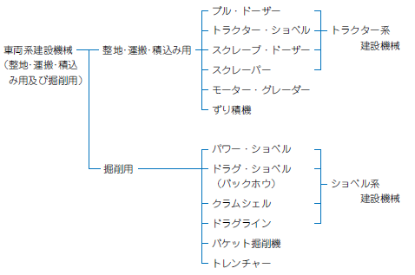
Types and Models of Vehicle-type Construction Machinery
(Leveling, Transportation, Loading and Excavation)
(Industrial Safety and Health Act Enforcement Ordinance Appendix 7)
Classification of vehicle-type construction machinery
Vehicle-type construction machinery (leveling, transportation, loading and excavation
Bulldozer
Tractor construction machinery
Leveling, Transportation, Loading
Tractor shovel (SHOBERU)
Scrape dozer
Scraper
Motor grader
Muck loader
Power shovel (SHOBERU)
Excavation
Drag shovel (SHOBERU) (backhoe)
Shovel (SHOBERU) construction machinery
Clamshell
Dragline
Bucket excavator
Trencher
Page 2 of textbook / Page 5 of auxiliary text

Slide 4
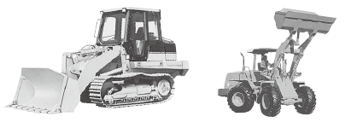
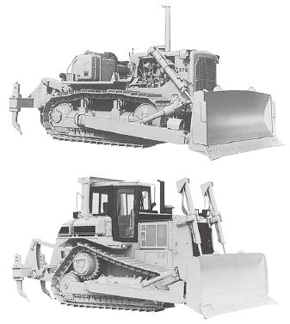
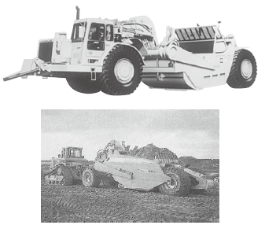
Leveling, Transportation, Loading Machinery
Tractor shovel (SHOBERU) examples
Bulldozer example
Scraper example
Page 2 of textbook / Page 5 of auxiliary text

Slide 5
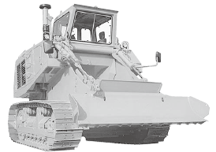
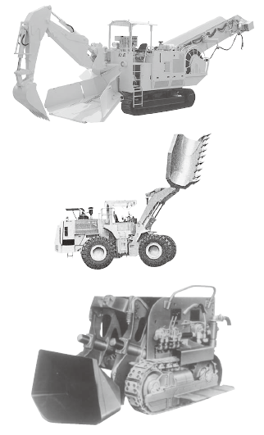
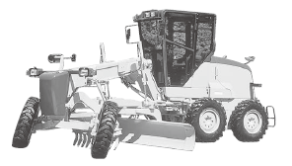
Leveling, Transportation, Loading Machinery
Scrape dozer example
Motor grader example
Muck loader examples
Page 5 of textbook / Page 6 of auxiliary text

Slide 6
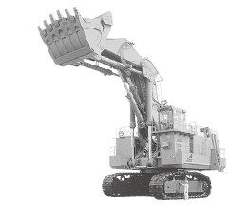
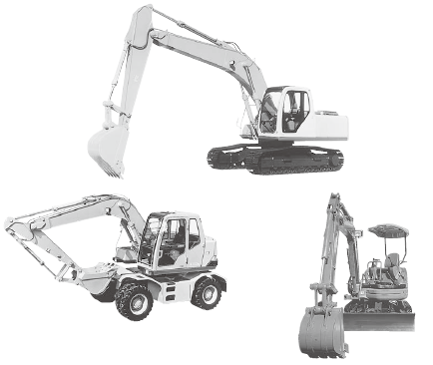
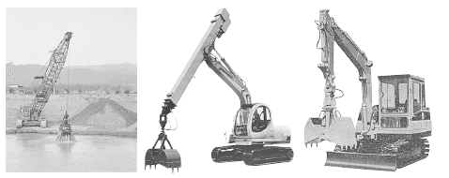
Excavation Machinery
Power shovel (SHOBERU) example
Drag shovel (SHOBERU) examples
Clamshell examples
Page 7 of textbook / Page 8 of auxiliary text

Slide 7
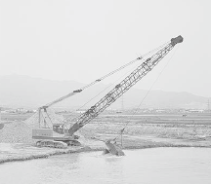
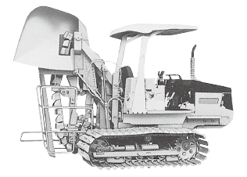
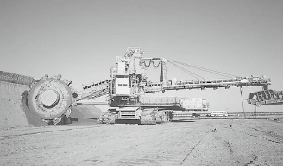
Excavation Machinery
Dragline example
Trencher example
Bucket excavator example
Page 9 of textbook / Page 9 of auxiliary text

Slide 8
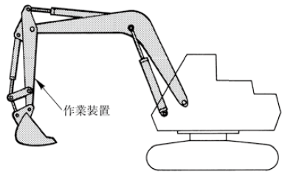
Terminology for Vehicle-type Construction Machinery
1・・・Work Device
Work Device
Page 10 of textbook / Page 10 of auxiliary text

Slide 9
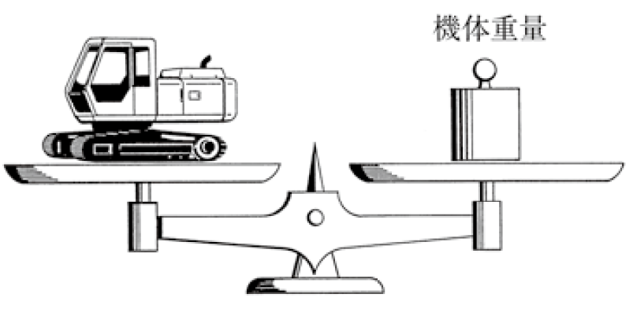
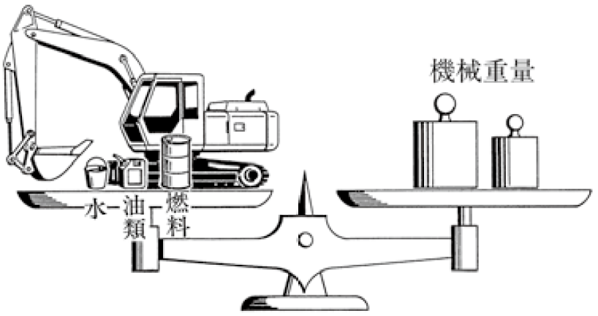
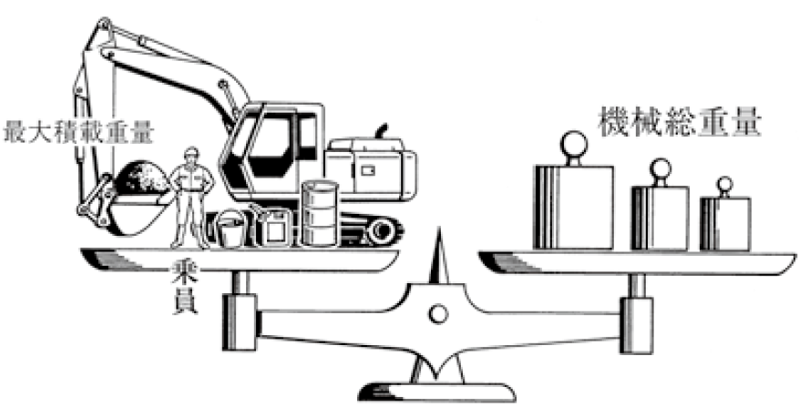
Terminology for Vehicle-type Construction Machine
車両系建設機械に関する用語2・・・Machine body weight
車両系建設機械に関する用語3・・・Machine weight
車両系建設機械に関する用語4・・・Total machine weight
Machine body weight
Machine body weight
Machine weight
Total machine weight
Maximum loading weight
水
油類
Oils
Fuel
Oils
Water
Water
Fuel
Worker
Machine weight
Gross Vehicle Weight
Page 11 of textbook / Page 10 of auxiliary text

Slide 10
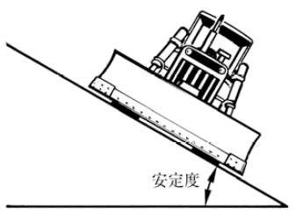
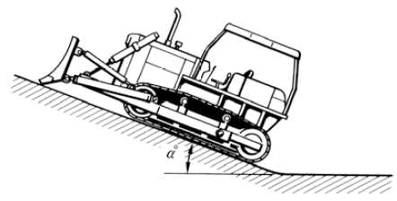
Terminology for Vehicle-type Construction Machiney
5・・・Stability 6・・・Gradeability
Stability
Stability
Gradeability
Page 12 of textbook / Page 11 of auxiliary text

Slide 11
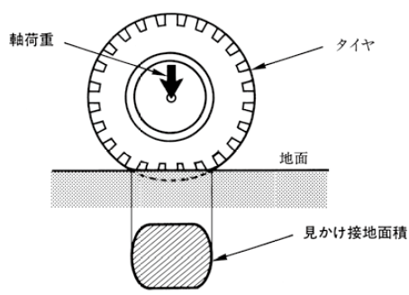
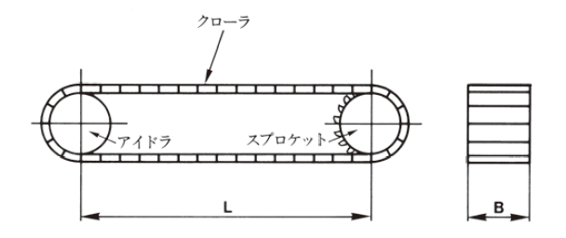


Terminology for Vehicle-type Construction Machiney
7・・・Average contact pressure
① Crawler type
② Wheel type
$$平均接地圧=\frac{Ｗ×9.8}{Ｓ}=\frac{Ｗ×9.8}{2Ｂ×Ｌ}（kPa）$$
Axial load
Average contact pressure
$$平均接地圧=\frac{軸荷重×9.8}{見かけ接地面積}（kPa）$$
Average contact pressure
Apparent ground contact area
Ｗ：Total machine weight（ｔ）
Ｓ：Total contact area＝2Ｂ×Ｌ（㎡）
Ｌ：Center distance（ｍ）between Idler （idle wheel）and sprocket（sprocket wheel）under total weight state.
Ｂ：Crawler width（ｍ）
Axial
load
Tire
Crawler
Idler
Sprocket
Ground
Apparent
ground
contact area
Page 13 of textbook / Page 11 of auxiliary text

Slide 12
Chapter 2 Motors and hydraulic systems for vehicle-type construction machinery

Slide 13
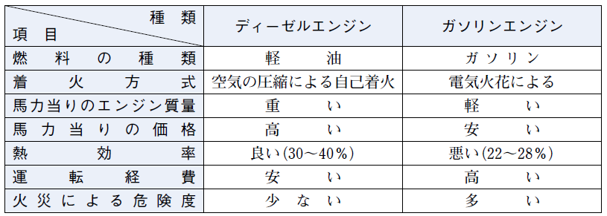
Motor
Comparison between diesel engine and gasoline engine
Type Item | Diesel Engine | Gasoline Engine
Fuel type | Diesel Fuel | Gasoline
Ignition Method | Self-Ignition by compression of air | By electric spark
Engine mass per horsepower | Heavy | Light
Price per horsepower | High | Cheap
Thermal efficiency | Good (30~40%) | Bad (22~28%)
Operating expenses | Low | High
Risk of fire | Low | High
Page 16 of textbook / Page 12 of auxiliary text

Slide 14
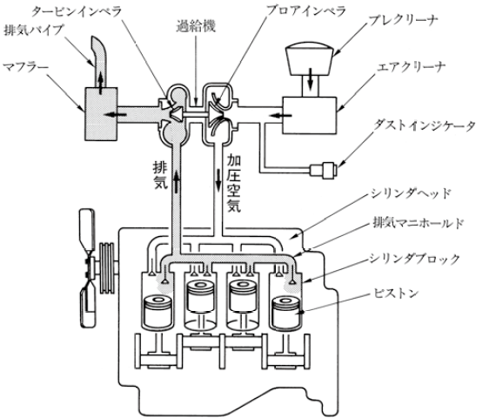
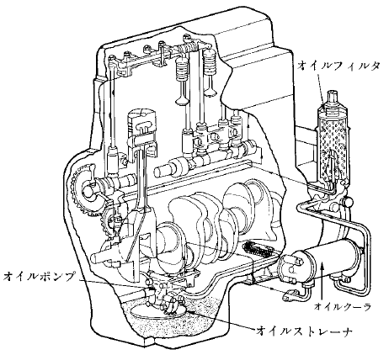
Diesel Engine Structure
Turbine impeller
Supercharger
Proa impeller
Pre cleaner
Exhaust pipe
Muffler
Air cleaner
Oil filter
Dust indicator
Exhaust
Pressurized air
Cylinder head
Exhaust manifold
Cylinder block
Piston
Oil
pump
Oil cooler
Oil strainer
Intake/ exhaust device example
Lubrication system example
吸・排気装置の例
潤滑装置系統の例
Page 18 of textbook / Page 12 of auxiliary text

Slide 15
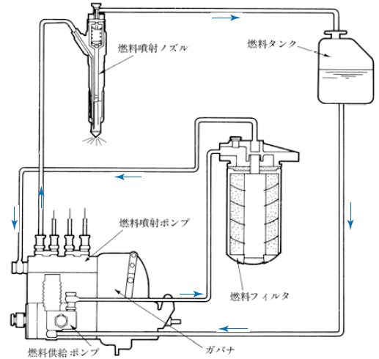
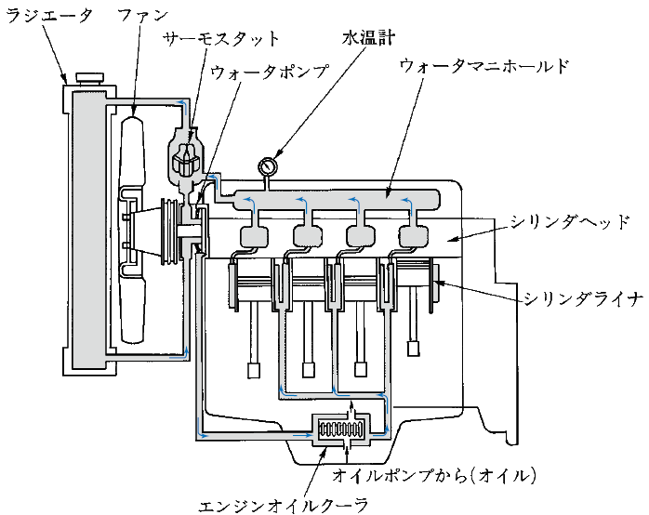
Diesel Engine Structure
Coolant temperature gauge
Fuel injection
nozzle
Radiator
Fan
Thermostat
Fuel tank
Water pump
Water manifold
Cylinder head
Fuel injection
pump
Cylinder liner
Fuel filter
From the oil pump (oil)
Governor
Engine oil cooler
Fuel supply
pump
Fuel System Example
Water-cooled Engine Example
Page 19 of textbook / Page 13 of auxiliary text

Slide 16
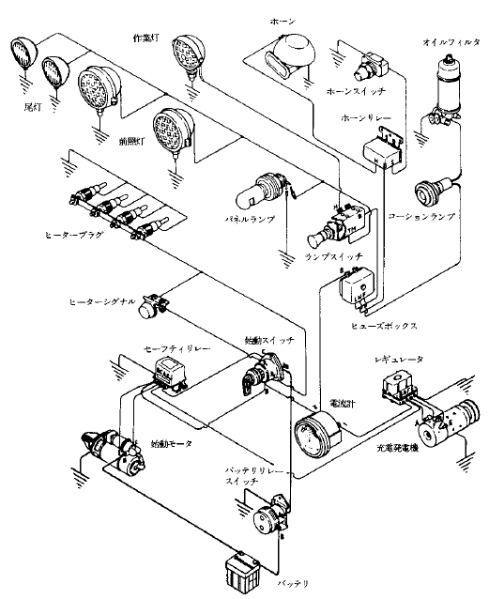
Diesel Engine Structure
Working Lamp
Horn
Oil filter
Tail Lamp
Horn switch
Horn relay
Head Lamp
Heater Plug
Panel Lamp
Caution lamp
Lamp switch
Heater signal
Safe relay
Start Switch
Fuse box
Amperemeter
Regulator
Starting motor
Battery relay switch
Charging Generator
Battery
Electric Circuit Example
Page 20 of textbook / Page 13 of auxiliary text

Slide 17
Fuel / Engine Oil
An engine oil has the following functions:
① Lubrication
② Cooling
③ Sealing
④ Cleaning
⑤ Rust prevention
Although there are many different brands for engine oil, it is necessary to use the standard brand specified in the instruction manual of the construction machine.
Page 22 of textbook / Page 13 of auxiliary text

Slide 18
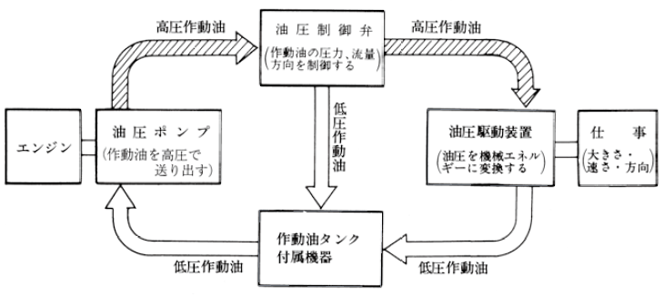
Hydraulic System
High pressure
hydraulic oil
High pressure
hydraulic oil
Hydraulic control valve
(Control hydraulic oil pressure and flow direction)
Hydraulic pump
(Pump out hydraulic oil at high pressure)
Low pressure
hydraulic oil
Hydraulic drive
(Convert oil pressure into mechanical energy )
Work
(Size / Speed/
Direction )
Engine
Hydraulic oil tank
Auxiliary
Low pressure
hydraulic oil
Low pressure
hydraulic oil
Page 24 of textbook / Page 14 of auxiliary text

Slide 19
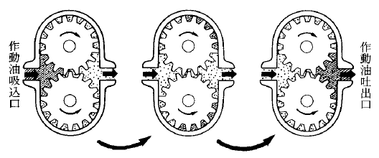
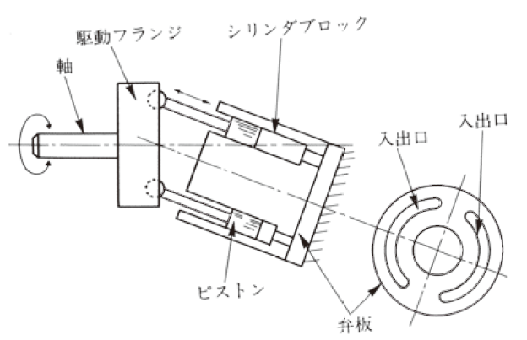
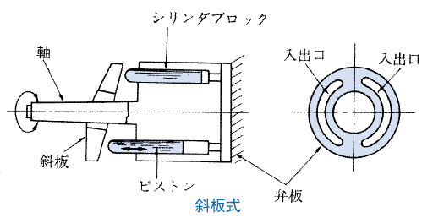
Hydraulic Pump ① Gear Pump ② Piston Pump, Inclined Shaft Type, Swashplate Type
Hydraulic oil
suction
port
Hydraulic oil discharge port
Overview of the gear pump operating principle
Drive flange
Cylinder block
Shaft
Cylinder block
In/
Out port
In/
Out port
In/
Out port
In/
Out port
Axis
Swash plate
Piston
Piston
Valve plate
Valve plate
Inclined Shaft Type Swashplate Type
Page 25 of textbook / Page 14 of auxiliary text

Slide 20
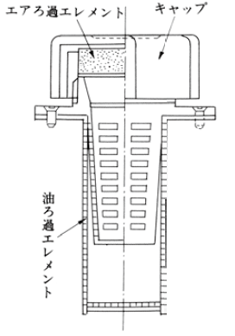
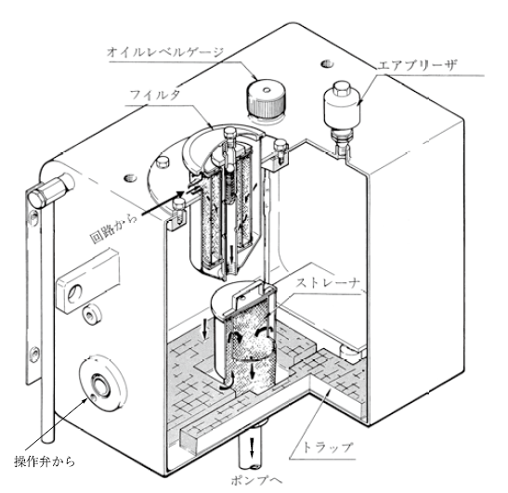
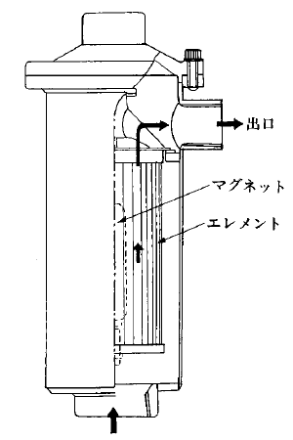
Hydraulic Oil Tank
Combination Air Breather
Air filtration element
Cap
Hydraulic Oil Tank
Oil level gauge
Air breather
Filter
Oil
filtration element
From the circuit
Pipe Line Filter
Strainer
Exit
Magnet
Element
From the operation valve
Trap
To the pump
Page 30 of textbook / Page 14 of auxiliary text

Slide 21
Chapter 3 Equipment Structure Related to Running of the Vehicle-type Construction Machinery

Slide 22
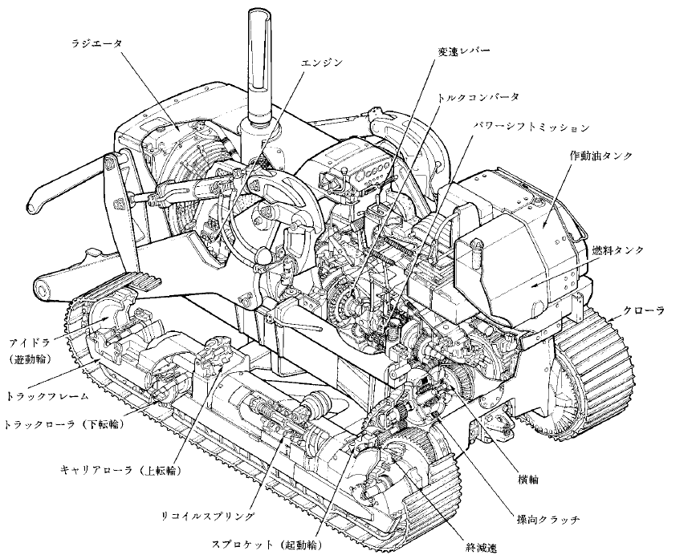
Crawler Tractor
Radiator
Shift lever
Engine
Torque converter
Power shift mission
Hydraulic oil tank
Fuel tank
Idler
(take up tumbler)
Crawler
Truck frame
Track roller
(lower rotary shaft)
Carrier roller
(upper rotary shaft)
Transverse
Recoil spring
Steering clutch
Sprocket (drive sprocket)
Final decelerator
Crawler Type Tractor Structure Example
Page 35 of textbook / Page 15 of auxiliary text

Slide 23
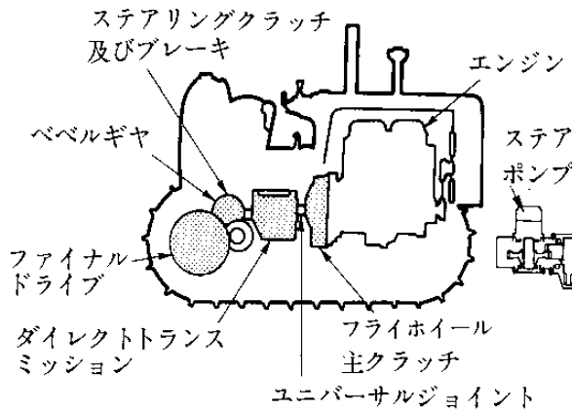
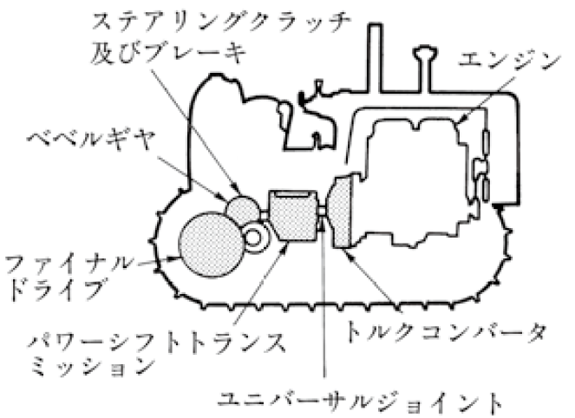
Crawler Tractor
Steering clutch
and brake
Engine
Bevel gear
Final drive
Steering clutch
and brake
Direct transmission
Flywheel main clutch
Engine
Universal joint
Direct Drive Type Power Transmission Device Example
Bevel gear
Final drive
Power shift transmission
Torque converter
Universal joint
Power Shift Type Power Transmission Device Example
Page 35 of textbook / Page 15 of auxiliary text

Slide 24
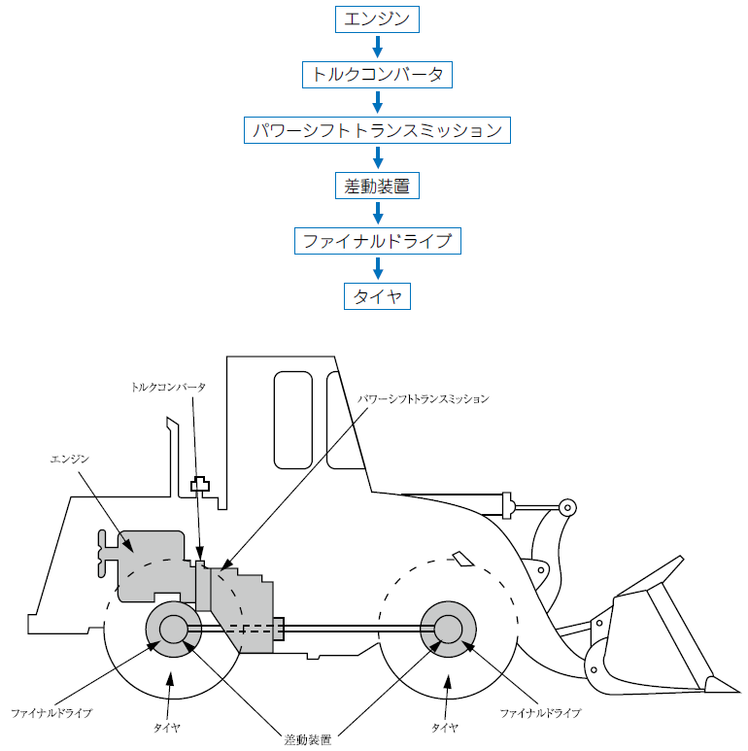
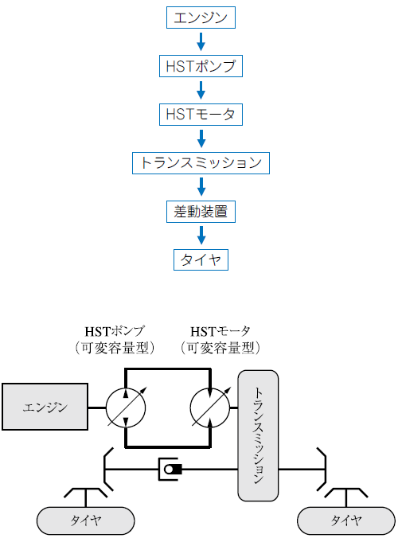
Wheel Tractor
Engine
Engine
Torque converter
HST pump
Power Shift Transmission
HST motor
Differential
Final Drive
Transmission
Tire
Differential
Torque converter
Power shift transmission
Tire
Engine
HST pump
(variable capacity type)
HST motor
(variable capacity type)
Engine
Transmission
Final drive
Tire
Tire
Final drive
Tire
Tire
Differential
Torque Converter Type
Power Transmission Example
HST (Hydro-Static-Transmission) Type
Power Transmission Example
Page 47 of textbook / Page 16 of auxiliary text

Slide 25
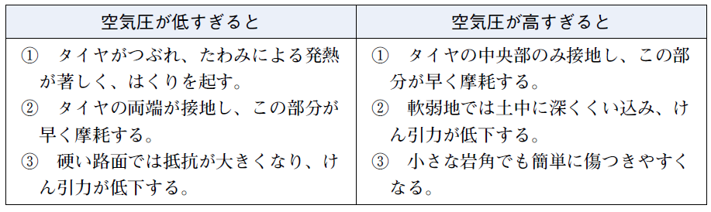
Wheel Type Tractor/ Tire
Tire Air Pressure
When the Air Pressure is Too Low
When the Air Pressure is Too High
Tires are crushed, heat due to deflection is severe, causing peeling.
Both ends of the tire touch the ground and this part wears quickly.
On hard roads, resistance increases and traction decreases.
Only the center part of the tire touches the ground, and this part wears quickly.
In soft areas, the tire digs deep into the soil and reduces traction.
Even small rocks' edges can easily damage the tire.
Page 53 of textbook / Page 17 of auxiliary text

Slide 26
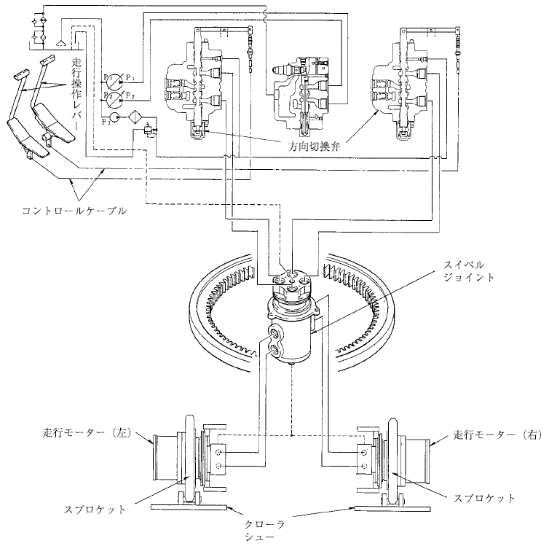
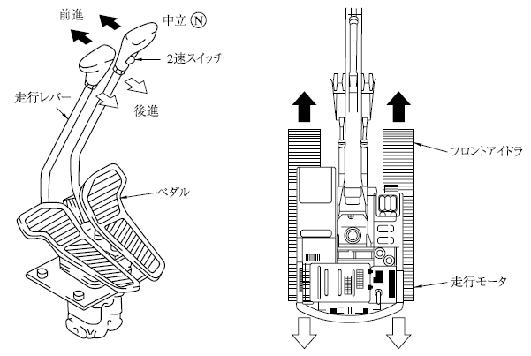
Hydraulic Shovel (SHOBERU) System Construction Machinery
（Crawler Type）
Traveling operation lever
Forward
Neutral (N)
Direction Selection Valve
Traveling lever
2-speed switch
Controller Cable
Backward
Swivel joint
Front Idler
Pedal
Traveling motor
Traveling motor (left)
Traveling motor
Crawler Type Running Operation Device Example
Sprocket
Sprocket
Crawler shoe
Hydraulic Shovel Construction Machinery Hydraulic Circuit Example
Page 57 of textbook / Page 18 of auxiliary text

Slide 27
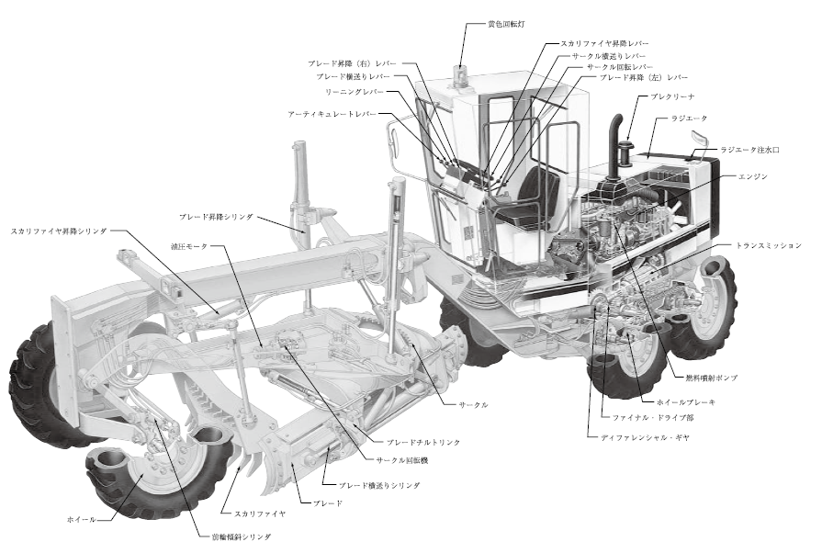
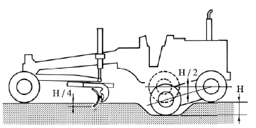
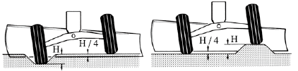
Motor Grader
Motor Grader Structure Example
Yellow revolving lamp
Scarifier elevating lever
Blade elevating (right) lever
Circle traverse feed lever
Blade traverse feed lever
Circle rotation lever
Blade elevating (left) lever
Leaning lever
Pre-cleaner
Articulate lever
Radiator
Radiator water injection port
Blade elevating cylinder
Engine
Scarifier elevating cylinder
Hydraulic motor
Transmission
Fuel Injection Pump
Circle
Wheel Brake
Final Drive Section
Blade tilt link
Differential Gear
Circle rotating machine
Blade traverse feed cylinder
Up And Down Swing Example
Wheel
Scarifier
Blade
Front wheel tilt cylinder
Movement of the Front Axle Example
Page 63 of textbook / Page 19 of auxiliary text

Slide 28
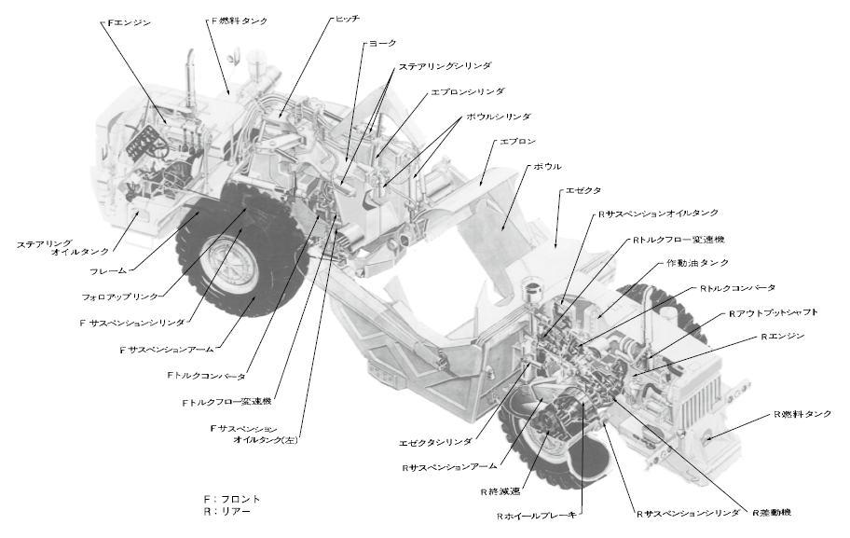
Scraper
Motor Scraper Structure Example
F engine
F fuel tank
Hitch
Yoke
Steering cylinder
Apron cylinder
Bowl cylinder
Apron
Bowl
Ejector
R Suspension oil tank
Steering Oil Tank
R Torque flow transmission
Frame
Hydraulic oil tank
Follow up link
R Torque converter
F Suspension Cylinder
R Output shaft
F Suspension Arm
R Engine
F Torque flow converter
F Torque flow transmission
R Fuel Tank
F Suspension oil tank (left)
Ejector Cylinder
R Suspension Arm
F: Front
R: Rear
R Final decelerator
R Differential gear
R Wheel Brake
R Suspension Cylinder
Page 66 of textbook / Page 20 of auxiliary text

Slide 29
Chapter 4 Handling Equipment Related to Driving Vehicle-type Construction Machinery

Slide 30
Handling the Start of Driving
(1) Before starting the engine
(2) Start the engine
(3) After starting the engine
Page 69 of textbook / Page 21 of auxiliary text

Slide 31
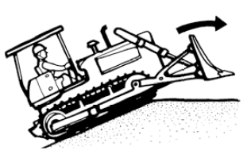
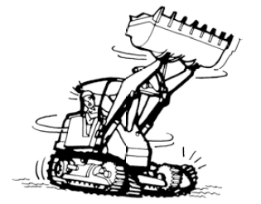
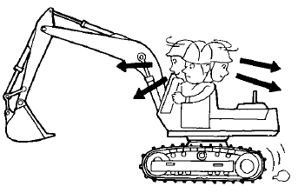
Handling While Driving
(1) Start
(2) Driving
Points to keep in mind when climbing up a hill
Points to keep in mind when turning at high speed
Check the orientation of the machine when moving forward or backward
Page 72 of textbook / Page 23 of auxiliary text

Slide 32
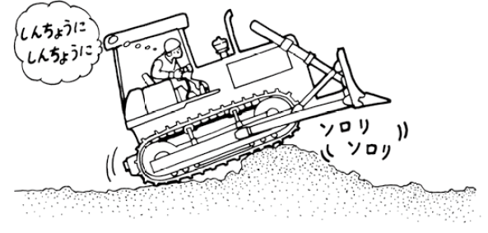



Handling While Driving
(3) Climbing / descending, etc.
(4) Stop running
Careful
Careful
Slowly
Slowly
Points to keep in mind when overcoming obstacles
Using road boards in soft areas example
Stopping on a slope example
Shift lever
Idling around 5 minutes
Clutch
Lever
Brake pedal Lock
Stop on a slope example
Page 74 of textbook / Page 25 of auxiliary text

Slide 33

Handling of Parking (Parking a Machine)
Points to keep in mind when parking
Grease, oil, etc.
1・・・Grease
2・・・Antifreeze
3・・・Oil
Page 76 of textbook / Page 27 of auxiliary text

Slide 34
Chapter 5 Structure and Type of Equipment Related to the Work of Vehicle-type Construction Machinery

Slide 35




Structure and Type of Work Equipment for Tractor-type Construction Machinery
Dump (DANPU) cylinder
Side frame
Tilt rod
Lift shilling
Lift arm
Bucket
Hydraulic Operation of Crawler Type
Tractor Shovel (SHOBERU) Example
Angle Dozer Example
Straight Dozer Example
Rake Dozer Example
Page 79 of textbook / Page 29 of auxiliary text

Slide 36






Structure and Type of Work Equipment for Tractor-type Construction Machinery
U Dozer Example
Trimming Dozer Example
Ripper Example
Wetland Bulldozer Example
Push Dozer Example
Tractor Shovel (SHOBERU) Example
Page 82 of textbook / Page 31 of auxiliary text

Slide 37


Safety Devices, etc.
1・・・Headlight
2・・・Alarm device
3・・・Head guard and fall protection device (ROPS)
Fall Protection Device
Example
Lift Arm Safety Pins, etc
Example
転倒時保護装置の例
リフトアームの安全ピン等の例
Page 85 of textbook / Page 33 of auxiliary text

Slide 38



Structure and Type of Work Equipment for Shovel-type (SHOBERU) Construction Machinery
Arm cylinder
Arm
Arm cylinder
アームシリンダ
アーム
アームシリンダ
Arm
アーム
Boom
Bucket cylinder
Bucket cylinder
ブーム
バケットシリンダ
Boom
バケットシリンダ
ブーム
Boom cylinder
Boom cylinder
ストラップ
Strap
ブームシリンダ
Strap
ブームシリンダ
ストラップ
Strap rod
ストラップロッド
ドラグショベル用バケット
Bucket for drag shovel
Strap rod
ストラップロッド
Drag shovel (SHOBERU)
Power shovel (SHOBERU)
ドラグ・ショベル
Bucket for power shovel (SHOBERU)
パワーショベル用バケット
Work Equipment For Hydraulic Shovels (SHOBERU) Example
Bed
Support rope
支持ロープ
開閉ロープ
Arm
Opening and closing rope
Tag line
rope
Opening and
closing rope
Shell
タグライン
Shaft
main
Tag line
Counter
weight
爪
Nail
Mechanical Clamshell Work Equipment Example
Page 86 of textbook / Page 35 of auxiliary text

Slide 39




Safety Devices, etc.
When getting on
and off
(lock operation)
When working (unlocking)
Turning lever
Switch
Timer
Solenoid valve
Standard
position
Battery
Turning motor
Control pump
Engine
Hydraulic oil tank
Lock
Free
Lock Lever Example
Swivel Parking Brake Example
Off place
Boom hoisting
position
Back
stop
A frame
Stop bolt
Boom
Boom
Bolt length
Operation
accuracy
adjustment
80°
Boom Fall Prevention Device Example
Boom Undulation Stop Device Example
Page 90 of textbook / Page 36 of auxiliary text

Slide 40



Motor Grader
Rotating gear chamber
Lifting arm
Blade rotation
Leaning
Blade up and down (right)
Spheric Joint
Lifting link
Traverse feed gear chamber
Drawbar
Circle
Blade
Blade tilt link
Blade Device Example
Blade up and down (right)
Drawer horizontal feed
Scarifier Device Example
Operation Of Motor Grader Work Equipment Example
Page 92 of textbook / Page 38 of auxiliary text

Slide 41


Scraper
Muck Loader
Ejector
Apron arm
Cylinder
Boom
Conveyor
Yoke
Arm
Bowl
bucket
Turning frame
Cutting
Edge
Bowl cylinder
Apron
Scraper Work Equipment Example
Work Equipment For Transfering Loader Example
Page 94 of textbook / Page 39 of auxiliary text

Slide 42
Chapter 6 Handling Equipment Related to the Work of Vehicle-type Construction Machinery, etc.

Slide 43


Bulldozer 1・・・Basic Operation
Clutch pedal
Decelerator Pedal
Brake pedal
Float
Lower (SAGE)
Reverse (acceleration)
Forward (acceleration)
Left tilt
Right tilt
Left steering
Right steering
Driving
seat
(Steering lever)
Shift lever
forward/
backward
Raise (AGE)
(Work lever)
Bulldozer Operating Device Example
Bulldozer Standard Operation Method
Page 97 of textbook / Page 41 of auxiliary text

Slide 44


Bulldozer 1・・・Basic Operation
Angle amount
Straight dozer
Angle dozer
Angling Example
PAT Vehicle Angle Posture
Page 99 of textbook / Page 42 of auxiliary text

Slide 45



Bulldozer １・・・Basic Operation
Brace
Tilt amount
Tilting
Tilting Example
PAT Vehicle Tilt Posture
Brace
Cutting Edge Angle Adjustment
Textbook page 100/ Auxiliary textbook page 42

Slide 46


Bulldozer 2・・・Basic Operation
Driving on a Slope Example
Blade Operation Example
Page 101 of textbook / Page 43 of auxiliary text

Slide 47



Excavation Work
①
②
③
Side cut work example (a)
①
②
③
Slot dosing example
④
⑤
⑥
Blade height
40～50cm
Ditch Excavation Example
W: Water
Side cut work example (b)
W
W
①
②
W
W
W
③
④
Slope Drainage Example (NORI MEN HAISUI)
Side cut work example (c)
Side Cut Work Example
Page 103 of textbook / Page 44 of auxiliary text

Slide 48




Dozing (OSHIDO) Operation
Double push!
Double Push Example
Relay Pushing Work Example
溝掘削作業の例
Parallel Soil Pressing Work Example
Spreading Work Example
Page 105 of textbook / Page 46 of auxiliary text

Slide 49


Embankment (MORIDO) Operation
(Can be compacted)
(Cannot be compacted)
(Can be compacted)
(Cannot be compacted)
Compacting Embankment Work Example
Embankment (MORIDO) Work Example
Page 107 of textbook / Page 47 of auxiliary text

Slide 50



Finishing Operation
Lower the blade on a surface level
Operate the blade up and down
Fine finish work is
done with a motor grader
¼ of blade width
Finishing Operation Example
Rough Finishing Work Example
Blade Control Device Example
Page 109 of textbook / Page 48 of auxiliary text

Slide 51






Applied Work
Cut down with a chainsaw in advance
Rooting And Weeding Work Example
For bamboo and bushes, set the depth to 20 to 30 cm.
Cutting Roots of Bamboo and Bushes Example
Rake Dozer
Soft Stone Removal Work Example
Pavement Removal Work Example
Backfilling (UMEMODOSHI) Work Example
Page 109 of textbook / Page 50 of auxiliary text

Slide 52






Ripper Operation
(1) Rock mass ripping
(2) Interlocked Grain (SAKAME) ripping
Single Shank Clipper And Multi Shank Clipper
Ripper Work In Case Of Rock Mass And Interlocked Grain (SAKAME)
Ripper Work
Passing Through Soft Ground Example
Downhill Slope And Cross Ripping
Soft Ground Shoe Example
Page 112 of textbook / Page 52 of auxiliary text

Slide 53

Tractor Shovel (SHOBERU)
Electronic monitoring system
Direction indicator
Parking brake switch
Up and down
shift switch
Work equipment lock switch
Work equipment control lever
Brake pedal
Accelerator pedal
Tractor Shovel (SHOBERU) Operating Device Example
Page 115 of textbook / Page 56 of auxiliary text

Slide 54


Tractor Shovel (SHOBERU)
Lift Arm And Bucket Operation Example
Bucket Height When Driving Example
Page 116 of textbook / Page 56 of auxiliary text

Slide 55




Excavation Work
Excavation Work Example (1)
Excavation Work Example (2)
Under-mine digging is dangerous
Excavation Work Example (3)
Excavation Work Example (4)
Page 118 of textbook / Page 57 of auxiliary text

Slide 56



Loading and Transporting Work
Hinge pin height
Start loading
Finish
Loading and Transporting
Work Example
Loading Conditions Example (1)
Stable
One-sided load
Unstable one-sided load
Unstable
Loading Conditions Example (2)
Page 119 of textbook / Page 58 of auxiliary text

Slide 57



Loading and Transporting Work
V type (V shift) Work object
Ｉ type (cross shift) Work object
Low and Carry Method Example
Turning on an even bench
Although the ground is even, it is prohibited to turn it without considering the place.
In general, the turning place on a flat bench should be near the face when loading, and in principle, turn near the loading port when heading for the face after loading.
Return (forward)
(Inlet)
Transport (forward)
Feed
(Face)
Turn
L type (L shift) Work object
T type (T shift) Work object
Loading
Turning on a bench with upward slope
The bench is usually transported backward to prevent spillage on benches with upslope toward the face (downslope toward the inlet.
Select an even place as much as possible for the turning place, and depending on the bench's condition, it is often the case that the turning place is near the inlet).
Turn
Return (forward)
(Face)
(Inlet)
Transport (backward)
Feed
Cross section
Note) The movement of the tractor / shovel
Loading and Transporting Work Example V Shift Etc.
Turning on a bench with downward slope
On a bench with a downward slope toward the face (upward slope toward the inlet), turns near the face during transportation, and when returning, turns by selecting an even place in the area depending on the presence or absence of spillage.
Even if the distance between the slot and the face is short, turn as described above.
Loading operation disassembly example
At maximum clearance
掘削作業の例（２）
Return (backward)
(Face)
(Inlet)
Transport (forward)
20 cm from eye position
Inlet
Feed
Gradient 0%
10%
Loading
Cross section
Throwing Work Example
Page 121 of textbook / Page 59 of auxiliary text

Slide 58


Hydraulic Shovel (SHOBERU) (backhoe)
Operation lever
Arm push
Boom Down
Bucket
Excavation
Bucket Dump
Left turn
Right turn
Arm pull
Boom Up
(Right lever)
(Left lever)
Hydraulic Shovel (SHOBERU) Operating Device Example
Left operation lever
Travelling lever (pedal)
Right operation lever
Forward
Backward
Arm push
Left Travelling
lever (pedal)
Right Travelling
lever (pedal)
Boom Down
Left turn
Arm pull
Right turn
For 2 Lever (pedal) crawler type
Bucket
Excavation
Boom Up
Bucket
Dump
Driver seat
JIS Standard Operation Method
Page 123 of textbook / Page 62 of auxiliary text

Slide 59


Hydraulic Shovel (SHOBERU) (backhoe)
(a) Ditch, foundation excavation for buildings
(b) Shallow excavation of the ground surface
(c) Cut-out finish of slope (NORIMEN)
(d) Groove excavation
(a) Climbing Points
Basic Work With A Hydraulic Shovel (Backhoe) Example
Return
Drop the bucket as much as possible
Return at this point
Raise the bucket at this point
Return at this point
(b) Downhill Points
Climb down without changing the bucket position
Raise the bucket at this point
Return the bucket
Climbing and Descending Points
Page 123 of textbook / Page 63 of auxiliary text

Slide 60



Excavation Work
Arm
Bucket cylinder
Arm cylinder
Bucket cylinder
Link
Cutting edge angle
Basic Work With A Hydraulic Shovel (SHOBERU) (Backhoe) Example
Orientation Of Crawlers When Excavating On The Shoulder
Most Efficient Drilling Range With Arms
Page 126 of textbook / Page 65 of auxiliary text

Slide 61







Loading Work
Dump
Loading Work Example (1)
Loading Work Example (2)
Reduce the
Turning angle
Loading Work Example (4)
Telescoping Example
Keep this gap
Loading Work Example (3)
Loading Work Example (5)
Long Arm Example
Page 128 of textbook / Page 66 of auxiliary text

Slide 62




Hydraulic Shovel (SHOBERU) (loading shovel)
Excavation surface
Slope width
Appointed under surfacec
Predetermined surface
Under surface
Slope
Upper Excavation Work Considering
Drainage Example
Lower Excavation Work Example
Make the turn angle as small as possible
Coming
Leaving
Straight Excavation Work Example
Translation Excavation Work Example
Page 131 of textbook / Page 69 of auxiliary text

Slide 63


Hydraulic Shovel (SHOBERU) (loading shovel (SHOBERU))
Side Hill Bench Cut Method Example
Box Type Bench Cut Method Example
Page 133 of textbook / Page 71 of auxiliary text

Slide 64


Hydraulic Shovel (SHOBERU) (loading shovel (SHOBERU))
a) Large cutting angle
b) Small cutting angle
Bucket Cutting Angle
a) Dump (DANPU) on the same ground
b) Loading into a car in a high position
c) Throw the removed soil on top of the dump (DAMPU) pile
d) Loading with belt conveyor
e) Sideways or rear soil dumping (DANPU SURU)
Loading Soil With A Loading Shovel Example
Page 133 of textbook / Page 72 of auxiliary text

Slide 65

Clamshell
a) Root cutting of construction site
b) Stockpile
c) Loading into a dump (DANPU) truck
d) Loading into a container that is in a high place
Working With Clamshells Example
Page 136 of textbook / Page 74 of auxiliary text

Slide 66


Dragline
(a) Underground slope excavation
Usually, 30 °
or more
(b) Root cutting of building foundation colecting aggegate
(e) Waterways, ditches, dredging
Boom Limit angle
(d) Loading on the same surface on the ground
(e) Loading below the work area
Excavating and Loading Work By Dragline Example
(e) Loading into the hopper
Page 137 of textbook / Page 76 of auxiliary text

Slide 67




Motor Grader 1・・・Basic Operation
Soil Quality and Angle
Scarifier lift
Articulate
Soil
Quality
Angle degree (θ）
Angle degree
Pull
Push
Hard soil
Push
Pull
Soft soil
Circle sideways feed
Leaning
Soil ​gathering
Push
Pull
Push
Pull
Finishing
Circle rotation
Plaid seideways feed
Pull
Push
Pull
Cutting angle adjustment mounting bolt
Push
Plaid up and down (left)
Plaid up and down (right)
Plaid
Pull
Pull
Push
Push
Plaid blade edge angle
Cutting angle
Motor Grader Operating Device Example
Blade Edge Angle
Scarifier Cutting Angle
Page 140 of textbook / Page 77 of auxiliary text

Slide 68



Motor grader 2・・・Basic Operation
Direction of travel
due to load
Straight
Direction of travel
By leaning
Turn left
Windrow
Tire leaning direction
Leaning Operation
Tire Leaning For Left Turn
(b) Rear wheel and plaid, plaid and frame contact
(c) Blade and scarifire
contact
(a) Contact between front wheel and plate
Blade Contact Example
Page 142 of textbook / Page 79 of auxiliary text

Slide 69






Adaptation Work
Snowplow
Bank Cut Position Example
Working With Snow Plows Example
Shoulder Reach Posture Example
Offset amount
Cutting angle
Offset posture using articulate
Scarifier Cutting Angle
U-turn At Articulate
Offset Traveling
Page 144 of textbook / Page 79 of auxiliary text

Slide 70






Scraper (Motor Scraper)
Brake pedal
Accel pedal
Shifting lever
Bowl operation lever
Apron operation lever
Ejector operation lever
Be careful not to raise the bowl too much
Be careful of derailing due to centrifugal force
Hold pedal
Differential lock pedal
Scraper Operating Device Example
Average excavation depth
Start loading
Average excavation depth
Start loading
End of Loading
End of Loading
Excavation Sequence Example
Average excavation depth
Bowl too high
Too much soil in front of the apron
Excavation depth is not fixed
Bowl lowering width
Bowl raising width
Bowl operation time
Apron operation
Bowl lowering time is too early
Do it through
Bowl raising time is too late
Bowl is too wide
Soil Removal Work Example
Basic Excavation Work Example
Page 147 of textbook / Page 82 of auxiliary text

Slide 71


Scraper (Towed Scraper)
In terms of driving, the basic operation is the same as the bulldozer in 6.1.1.
Bulldozer Operating Device Example
Working Status of Towed Scraper
Page 150 of textbook / Page 85 of auxiliary text

Slide 72

Crawler Type Muck loader Machine
The crawler type muck loader mainly includes a large tractor shovel 6.1.2. and a scraping type loader. This page will describe the scraping type loader.
Arm and turning operation
Crawler (left) operation
Crawler (right) operation
Boom and bucket operation
Bucket setting and up and down conveyor operation
Driving seat
Conveyor driving operation
Hydraulic interlock
Operation Device For Scraping Loader Example
Page 154 of textbook / Page 86 of auxiliary text

Slide 73






Transfer of Vehicle-type Construction Machinery
Trailer back
Claw Climbing Equipment Example
Climbing equipment
Relationship between the weight of the loading machine and the climbing equipment example
Mass of loading
machine (t)
Number of climbing tools
Shape dimensions
Length x height x width
15° or less
Material
Number
Use Of Climbing Equipment Example
Aluminum alloy
Aluminum alloy
Vehicle loading platform and loading machine’s center line
Vehicle loading
platform
Center of the pitch and center of the crawler
Aluminum alloy
Oil pressure hose
Climbing equipment
Crawler
Loading Position
Stop
Drag
Wire
robe
Pad (packing material)
Drag
Lever
block
Wooden block
Wire
robe
Foot stall
Blade
U frame
Wire robe
Drag
Pad (packing material)
Lever block
Wire robe
Fixed To Trailer Example
Use Of Foot Stall Example
Page 157 of textbook / Page 88 of auxiliary text

Slide 74
Chapter 7 Inspection and Maintenance for Vehicle-type Construction Machine

Slide 75



Related Laws, General Precautions
Related Laws
Inspection Classification | Article | Enforcer・Qualifications | Inspection Table Retention Period
Inspection before starting operation | Industrial Safety and Health Act (ISHA) Art. 170 Art. 171 | Driver/ Operator | *As long as machine is in production
Regular Independent Inspection (Once per month) | ISHA Art. 168, 169 ,171 | Person instructed by Business Operator (Safety Manager) | 3 years retention
Specific Independent Inspection (Once per month) | ISHA Art. 167, 169, 169 Par. 2, 171 | In-company inspector Inspection Company | 3 years retention (with inspected mark)
*It is not stated in the law but it is best to store the inspection result as long as machine is in use.
Restricted Area during inspection
(Unified safety sign for construction disaster prevention-Example of foreign language display-)
Points to remember when inspecting, etc.
Page 163 of textbook / Page 92 of auxiliary text

Slide 76




Daily Maintenance Points Before Starting Engine
How to Discern Hydraulic Oil
Appearance | Smell | Cause
Change to Opaque White | Good | Contamination with other fluids
Change to Dark Brown | Pungent | Deterioration
Has small black dots | Good | Contamination of foreign materials
Bubbling/ Foaming | --------- | Contaminated with grease
Boom
Arm
Examples of orientation during refilling or inspection
Tire Inspection
When adjusting the electrical system, remove the minus (－) terminal of the battery.
Page 164 of textbook / Page 94 of auxiliary text

Slide 77




Daily Inspection Points After Starting the Engine
Emission Color and Criteria
Emmision Color | Criteria for Inspection
Black | Concentrated vapor, Defective combustion
Faint Yellow | Thin vapor
White/ Blue | Burnt oil, faulty timing
Ash Gray | Concetrated vapor and Burnt oil
No Color | Adequate Vapor, Full combustion
A: Height of Pedal attachment
B: Floor board gap
C: Backlash
A-B-C: Step on it
Clutch Adjustment
Operation Inspection
Points during Storing
Page 170 of textbook / Page 94 of auxiliary text

Slide 78
Inspection Points When Malfunctions Detected During Operations
If during the operation the construction machine feels that it may have a trouble,
it is necessary to immediately stop the machine on a flat place,
report the faulty area to the responsible officer,
repair the part before going back to operation.
Page 172 of textbook / Page 98 of auxiliary text

Slide 79
Chapter 8 Safety Driving Guidelines, Cue Signs, and Guiding

Slide 80


Safety Driving Guidelines
Turn off engine when leaving the vehicle
Check the situation of inspection
Page 175 of textbook / Page 99 of auxiliary text

Slide 81

Signals and Guiding Points
<Signal with Whistle> <Signal using Voice>
• Safe：2 Short blows repeatedly • Safe：All right, All right (ORAI, ORAI)
• Stop：Long whistle blow • Stop：STOP (SUTOPPU)
The inductor must wear clothes that is visible and stand in a location where the driver of machinery can see at ease.
Page 179 of textbook / Page 101 of auxiliary text

Slide 82
Chapter 9 Force and Electricity Knowledge

Slide 83


Moment of Force
Moment of Force
Fulcrum
Length until Bucket l₁
Body Mass W₀
Moment of Fall
Page 181 of textbook / Page 102 of auxiliary text

Slide 84


Mass and Specific Gravity
Volume Formula Chart
Object Mass＝ Volume × Specific Gravity
Object Unit Weight
Material type
Mass per 1m³ (t)
Material type
Mass per 1m³ (t)
Lead
Copper
Steel
Cast Iron
Aluminum
Sand
Coal (powder)
Cokes
Oak
Pine
Cedar
Cypress
Paulownia
Concrete
Soil
Gravel
*Wood mass is dry mass. Soil, gravel, sand, lime and cork are appearance unit weight.
Page 188 of textbook / Page 103 of auxiliary text

Slide 85



Center of Gravity, Object Stability（Suwari）
How to find Center of Gravity
Center of gravity right on top of the object thus stable
Derived from center of gravity right
Derived and loose thus dangerous
Stable
Center
Unstable
Stable
Stable
Object Stability
Center of gravity
Page 189 of textbook / Page 104 of auxiliary text

Slide 86





Object Movement
Non-constant velocity movement
Constant velocity movement
Centripetal
Object A
Centrifugal
Center (Hand)
Velocity and Acceleration
Centrifugal Force /Centripetal Force (a)
Centrifugal Force /Centripetal Force (b)
Falling through Centrifugal Force
Static Friction
Page 194 of textbook / Page 105 of auxiliary text

Slide 87

Electrical Knowledge
Reaction when electric current passes human body Unit mA (Milliampere)
Shock Effect | Alternate Current (AC) |  | Direct Current (DC)
 | Male | Female | Male | Female
1.Tingling Sensation | 1.1 | 0.7 | 5.2 | 3.5
2. Shock with pain (but still able to move muscles) | 9.0 | 6.0 | 62.0 | 41.0
3. Shock with pain (with muscle stiffness, and shortness of breath) | 23.0 | 15.0 | 90.0 | 60.0
4. Often causes death instantly | 100 |  | 100
Note) 1 mA is equal to 1/1000 A (Ampere)
Page 202 of textbook / Page 109 of auxiliary text

Slide 88

Electrical Knowledge
Offest Distance from Power Transmission and Distribution Wire
(Power Line)
(Power Line)
Overhead ground wire
Transmission line
High voltage power line
Safety
Extra high voltage
High voltage reduction wires
(Be careful with high voltage wire when reaching transformer )
Safety
Safety
Safety
Safety
Low voltage wires
Safety
Safety
Pole Transformer
Safety
Attention
Housing side
Vehicle road
Most of the transmission lines are steel towers but there also cases where it is using poles; thus, caution is needed.
Offset distance
Page 203 of textbook / Page 109 of auxiliary text

Slide 89
Chapter 10 Topography and Construction Knowledge

Slide 90



Rock Chemistry, Soil
Classification of Rock Hardness
Classification | Compression Rate (N/mm²) | Elastic Wave Velocity(km/s) | Rock Type Examples
Soft-rock | 10 | Below 1.5 | Tertiary Pelitic Rock, Partial Sandstone
Medium-hard rock | 10~50 | 1.5~3.0 | Majority of Tertiary Sedimentary Rock
Hard rock | 50~150 | 3.0~5.0 | Mesozoic/Paleozoic era Pelitic Rock
Superhard rock | 150 and up | 5.0 and above | Chert, Hard sandstone, Gabbro, Igneous rock like Diabase, Gneiss, Quartz Schist, Hornfels
Load weight
Particle Diameter
Load weight
Fine Sand
Coarse Sand
Fine Gravel
Medium Gravel
Coarse Gravel
Compacted
Clay
Silt
Sand
Gravel
Water and Air
Water and Air
Particle Diameter Classifications and Terms
Natural soil
Compacted finished
Compact Land Composition
Page 207 of textbook / Page 111 of auxiliary text

Slide 91

Land Composition
Solid (Soil Particles)
Gap (Gas,
Liquid)
Full Land Mass
Soil Particle Mass
Air
Water Mass
Water
Air Mass(=0)
Full Land Volume
Soil Particle Volume
Soil Particle
Water Volume
Air Volume
Land Gap Volume
Land Composition
Page 212 of textbook / Page 112 of auxiliary text

Slide 92

Foothold Hardness
Cone Index
Machine Type
Cone Index (N/mm²)
Ground Pressure (N/mm²)
Medium size swamp bulldozer
Above
Medium size bulldozer
Large size bulldozer
Scrapedozer
(Bog-type)
(Load Capacity)
Carryall Scraper
Motor Scraper
Dumptruck
Note）Numbers may change depending on soil texture
Page 215 of textbook / Page 113 of auxiliary text

Slide 93


Soil Volume Changes
Rate of Change of Soil Volume
Name
Hard Rock
Rock and Stone
Medium-hard Rock
Soft Rock
Rock Lump/Precious Stone
Gravel
Natural ground
Sand mixed with gravel
Hard Soil
Soil volume
Unraveled soil volume
Compacted soil volume
Hardened Hard Soil
Sand
Sand
Rock Lump/Sand mixed with precious stone
Sandy Soil
Soil Volume Changes
Common Soil
Rock Lump/Sandy soil mixed with precious stone
Viscous soil
Viscous Soil, etc.
Viscous soil mixed with gravel
Rock Lump/Viscous soil mixed with precious stone
Page 216 of textbook / Page 114 of auxiliary text

Slide 94

Signs and Causes of Sand Erosion
Reclaimed Slope Surface and Height Basis
Soil Type
Excavated surface’s height ・Slope
Ground made of bedrock or hard clay
Less
Over
under
under
Other type ground
Less
Over
Less
under
under
under
Ground made of sand
Or
Less
Over
Ground that easily collapse due to blast, etc.
Or
Less
Over
Page 218 of textbook / Page 115 of auxiliary text

Slide 95



Signs and Causes of Sand Erosion, Land Strength, Signs of Landslides
Slope Landslide Examples
Rock mass falls in the range of one or several rock (rockfall type) Type I
Rock Collapse Pattern
Soil Collapse Pattern
Granite soil
Weathered residual rock lump
Rock with lot of crack
Rock hardness alternating layer
Cliff cone deposit
(cliff cone type)
Terrace gravel layer
(Conglomerate type)
Weathered granites
(layered structure like an onion)
Examples of Landslide on Upright Slope
Fragmented rock type rockfall (abrasion type)
Boulder type rockfall (falling type)
It is a type in which the rock mass separated by the crack is flaked along the crack.
If the filling inside the gravel layer (matrix) is made of a material with a low degree of solidification, such as rock mass or boulder, weathered and eroded, the boulder will float and lose its balance. It's a type that collapse.
Surface collapse is shallow, small-scale collapse (detachment type/breakdown type) Type II
Permeable layer
Soft rock or soil
Spring water
Impermeable layer
Colluvium or topsoil
Rock with lot of crack
Hardness alternating layer
Rocks with columnar joints
Unconsolidated soil
Presence of impermeable layer
Debris flow
Rock separation/break down type collapse
Soil shedding, breakdown type collapse
It's a medium-scale collapse that collapses along the rock joints. Excavation can open potential cracks, where rainwater, etc., percolate and weaken the ground, and often collapse along a straight line on the slide surface.
Stress is released by the excavation of soil and earthen ground, and weathering progresses, and it absorbs water and collapses due to subsequent rainfall, etc., and is the most common type of ground collapse.
Signs of Landslide
Collapse surface is deep or widespread Type III
Bedding, slide plane
Fault fracture zone or surface of separation
Joint dip slope
Collapsed soil avalanche
Dislocation, dike
Stratum, joint dip slope
Large scale collapse (rockslide)
It is a type of collapse caused by the development of an extremely low-strength weak line in the bedrock, and the soil layer slips down along that line. The avalanche scale depends on the relationship between the slope and the weak line, inclination, etc. The scale of collapse is determined by the relationship between the slope and the weak line, the inclination angle, and so on. Also, the tip may protrude out.
Viscous soil arc slide
Clay layer
Composite slide
Large scale collapse (land slide type)
Page 218 of textbook / Page 116 of auxiliary text

Slide 96


Excavation Methods
Top of slope
Drain Gutter
Slope curing
Berm
Sandbag
Toe of slope
Slope inclination
Excavation bottom surface
Drain Gutter
Open Cut Grading Works Example
Waling
Earth retaining wall
Strut
Island Construction Method
Page 224 of textbook / Page 119 of auxiliary text

Slide 97

Excavation Methods
Construction
Anchor
Tie rod
Earth retaining wall
Embedment part
Tie rod method
Steel rod or PC steel wire
Self sustaining method
Mortar
(c) Earth anchor method
Timbering
Waling
Strut
Strut
Bracket
Middle block
Earth retaining wall
Middle block
Open Cut Binder Construction Method Example
Page 226 of textbook / Page 119 of auxiliary text

Slide 98


Excavation Methods
Trenchcut Construction Method Example
Earth surface
First
Earth retaining wall
2nd
3rd
Inverted Lining Example
Page 227 of textbook / Page 120 of auxiliary text

Slide 99
Chapter 11 Accident Case

Slide 100

Casualties Disaster in the Construction Industry
Changes in the construction industry’s fatal accidents with four or more of business closure as shown by figure 11-1
図１１－１ 建設業における休業４日以上の死傷災害の推移
(Excludes those directly caused by the Great East Japan Earthquake)
In addition to the fatal accidents that occurred in 2017 caused by construction machinery, about 56% is caused by leveling, transportation, loading, and excavation machinery, and 15% is caused by demolition machinery.
(Reference) Occupational Accident Occurrence Status, Workplace Safety Site: Analysis of Occupational Accident Cause Factors (2017, Construction Industry) by The Ministry of Health, Labor and Welfare.
Case number (person)
Page 121 of auxiliary text

Slide 101




E.g., 1．
The construction worker was caught between drag shovel (SHOBERU) counterweights
E.g., 2．
While leveling the soil with the drag shovel (SHOBERU), the operator was caught between strut and lever.
E.g., 3． Blocks from the drag shovel (SHOBERU) bucket fell on a worker.
E.g., 4． The drag shovel (SHOBERU) was overturned on a slope and crushed the guide beneath it.
Page 230 of textbook / Page 122 of auxiliary text

Slide 102




E.g., 5 A worker was hit by a turning bucket when he was walking in front of a drag shovel (SHOBERU).
E.g., 6 After finishing the inspection of the bulldozer, while installing the cover, the worker lost his balance and his foot got caught.
E.g., 7 The buldozer fell down the slop and the driver was squashed by the buldozer.
E.g., 8 A marking worker was caught up by the crawler while the buldozer moving backward.
Page 234 of textbook / Page 126 of auxiliary text

Slide 103




E.g., 9 While hanging a load using a tractor shovel (SHOBERU), it crashed into a worker.
E.g., 10 At a mine, a guide was caught in the bucket of the showel tractor.
E.g., 11 A construction worker was run over by a moving backward motor grader.
E.g., 12 A scraper fell on a sloping ground and the driver was crushed beneath it.
Page 238 of textbook / Page 130 of auxiliary text

Slide 104
Legal system for worker safety and health
There are several laws regarding to worker safety and health, including the industrial safety and health law. In particular, the industrial safety and health act stipulates matters that must be observed for the purpose of ensuring the safety and health of the workers and promoting the formation of a comfortable working environment. Specific matters associated with the enforcement of the law are indicated in the government ordinances, ministerial ordinances, notifications, etc.
The legal system for worker safety and health are as follows:
LAW
CABINET ORDER
MINISTERIAL ORDINANCE
PUBLIC NOTICE/NOTIFICATION
Industrial Safety and Health Act (Safety Act)
Industrial Safety and Health Act Enforcement Ordinance (Safety Ordinance)
Industrial Safety and Health Act Enforcement Regulation (Safety Regulations)
Vehicle type consruction machine standard
Vehicle type construction machine (leveling, transport, loading and excavation) driving skill training rules.
Safety and health special education regulation
Figure 9-1 Vehicle type construction machine (leveling, transport, loading and excavation) legal system for driving skill.
（Reference) Ministry of Health, Labor, and Welfare. Risk assessment for building maintenance industry manual
Page 134 of auxiliary text

Slide 105
Industrial Safety and Health System（Extract）（１）
Chapter 1 General Rule
Article 3 (Responsibility of Business)
Business operators must not only comply with the minimum standards for the prevention of occupational accidents stipulated by this law, but also to ensure the safety and health of workers in the workplace. In addition, business operators must cooperate with the government's measure to to prevent occupational accidents.
2. Anyone who designs and manufactures machine, appliances, and other equipments, or importers, anyone who manufactures raw materials, or importer, or anyone who contsructs or designs the building must endeavour to the prevention of occupational accidents due to the use of these items when designing, manufacturing, importing, or constructing these items.
3. Anyone who orders a construction work, anyone who takes over a work to other party, must follow the construction methods and periods, etc. in order not to impose conditions that may impair the execution of a safe and hygienic work.
Article 4 Workers must comply with necessary matters to prevent occupational accidents and endeavour to cooperate with the measures to prevent occupational accidents implemented by business operators and other related parties.
Page 243 of textbook / Page 134 of auxiliary text

Slide 106
Industrial Safety and Health Act（Extract）（２）
Chapter 5 Regulations on machinery, etc, hazardous substances
Article 45 (Periodic self inspection)
Business operators must comply with the regulations by the Ordinance of Ministry of Health, Labor and Welfare by carrying out periodic self inspection of boilers and other machinery, etc. specified by the Cabinet order and record the result.
2 When business operator conducts the self-inspection as specified by the Ordinance of Ministry of Health, Labor and Welfare (hereinafter referred to as "specific self-inspection") among the self-inspections under the regulation of the same paragraph for machinery, etc. as specified by the Cabinet Order in the preceding paragraph, workers who use it are those who have the qualifications specified by the Ordinance of the Ministry of Health, Labor and Welfare, or those who have the registration as prescribed in paragraph 1 of Article 54-3. At the request of others, the person who conducts a specific self-inspection of the machine (hereinafter referred to as "operator") must also perform this regulation.
3 The Minister of Health, Labor and Welfare shall publish guidelines necessary for proper and effective implementation of self-inspection in pursuant to the regulation in paragraph 1.
4 Omitted
Table 5-1 related to Laws and Regulations
Inspection Classification | Provision | Implementor /Qualification | Storage Period of inspection table
Inspection Before starting work | Safety Regulations Article 170 171 | Driver | Checklist while the machine is running
Periodic Self-Inspection (Once a month) | Safety Regulations Article 168 169 171 | A person designated by Business operator (Safety Manager) | Inspection table for 3 years
Specific Self-Inspection (Once a year) | Safety Regulations Article 167 169, 169 par 2 171 | In-house inspector Inspection Company Inspector | Inspection table for 3 years (Attach the inspection mark)
Page 248 of textbook / Page 135 of auxiliary text

Slide 107


Industrial Safety and Health Act（Extract）（３）
Chapter 6 Measures of Workers Employment
Article 61 <Employment Restriction>
Business operators shall operate crane and other operations as specified by the Cabinet Order, i.e., shall only be operated by a person who has obtained a license from the prefectural labor bureau director for the relevant work, or a person who has been registered by the prefectural labor director. Only those who have completed the skill training and those with qualifications specified by the Ordinance of the Ministry of Health, Labor and Welfare shall be allowed to engage in the relevant work.
2 According to the provision of the preceding paragraph, other than the person who can do the appropriate operation, no one shall engage in the appropriate operation.
3 According to the provisions of paragraph 1, when the operator who can engage in the appropriate operation is engaging in the appropriate operation, the operator must carry an appropriate driver’s license or other qualification
4 Omitted
Qualifications required for machinery operator Qualifications required for workers
Page 250 of textbook / Page 136 of auxiliary text

Slide 108

Industrial Safety and Health Act Enforcement （Extract）
Article 20 (Business with Employment restriction)
The business specified by the Cabinet Order under Article 61 as follows.
1~11 Omitted
12 Work operation of construction with machine body mass of 3 tons or more as listed on the attached table 7 No.1, No.2, No.3, or No.6 can use power and can self-propel in unspecified places
13 below omitted
Page 251 of textbook / Page 136 of auxiliary text

Slide 109
Ordinance on Industrial Safety and Health (Extract) (1)
Part 1 General Rules
Chapter 7 License, etc.
Section 3 Skills Training Course
Article 82 <Reissuance, etc., of the Skill Training Course Completion Certificate>
A person who has received a skill training course completion certificate and been actually engaging or intends to engage in the work pertaining to the said skill training shall, in the case of loss or damage of the certificate excluding a case prescribed by paragraph (3) below, submit an application document for the reissuance of the skill training course completion certificate (Form No.18) to the registered training institution that issued the certificate, and thereby reacquire the skill training course completion certificate.
2 A person prescribed by the preceding paragraph shall, when having changed the name or, submit an application document for change of the skill training course completion certificate (Form No.18) to the registered training institution that issued the certificate, and thereby revise the certificate excluding a case prescribed by paragraph (3).
3 Omitted below
Page 256 of textbook / Page 138 of auxiliary text

Slide 110
Ordinance on Industrial Safety and Health (Extract) (2)
Part 2 Safety Standards
Chapter 2 Construction Machine, etc
Section 1 Vehicle Type Construction Machine
Subsection 1 Structure
Article 152 < Providing of Front Lamp >
The employer shall provide a vehicle type construction machine with a front lamp. However, this shall not apply to a vehicle type construction machine used at a place maintaining necessary illumination for carrying out the work safely.
Article 153 < Head Guard>
The employer shall, when using a vehicle type construction machine (limited to a bulldozer, a tractor shovel (SHOBERU), a muck loader, a power shovel (SHOBERU), a drag shovel (SHOBERU) and a breaker) in ※1 a place where it is liable to cause dangers to workers due to falling of rocks, etc., provide the said vehicle type construction machine with ※2 a sound head guards.
Note 1) "A place where there is a risk of falling rocks, etc...." are places where Open-cut excavating work, excavating work for quarrying, construction work of a road, etc. is performed using the machine, and the work by the machine causes the falling of rocks, etc.
Note 2) Regarding the head guard, the structural standard is indicated by Circular No. 559 of 1975.9.26
Subsection 2 Prevention of Dangers Pertaining to the Use of a Vehicle Type Construction Machine
Article 154 <Investigation and Record>
The employer shall, when carrying out the work using a vehicle type construction machine, investigate in advance the landform and condition of the nature of the soil, etc., of the place pertaining to the said work in order to prevent workers from dangers due to falling of the said machine, collapse of natural ground, etc., and record the result of the investigation.
Page 261 of textbook / Page 138 of auxiliary text

Slide 111
Ordinance on Industrial Safety and Health (Extract) (3)
Article 155 <Work Plan>
The employer shall, when carrying out the work using a vehicle type construction machine, establish in advance a work plan in conformity with what is known by the investigation pursuant to the provision of preceding Article, and carry out the work by the said work plan.
2 The work plan set forth in the preceding paragraph shall be the one describing the following matters:
1 The type and capability of the vehicle type construction machine to be used.
2 The travelling route of the vehicle type construction machine.
3 The work method by the vehicle type construction machine.
3 The employer shall, when having established the work plan set forth in paragraph (1), make the matters set forth in item (2) and (3) of the preceding paragraph known to the workers concerned.
Article 156 <Speed Limit>
The employer shall, when carrying out the work using a vehicle type construction machine (excluding the one having maximum speed of10 km/h or less), in advance, set the appropriate speed limit for the vehicle type construction machine corresponding to ※the landform and conditions of nature of the soil, etc., of the place pertaining to the said work and carry out the work by the set speed limit.
2 The operator of the vehicle type construction machine set forth in the preceding paragraph shall not operate the vehicle type construction machine at speeds exceeding the speed limit set forth in the same paragraph.
Note) "Etc. " in " the landform and conditions of nature of the soil, etc. " includes the case where other machinery and equipment are installed.
Page 262 of textbook / Page 139 of auxiliary text

Slide 112
Ordinance on Industrial Safety and Health (Extract) (4)
Article 157 < Prevention of Falling, etc.>
The employer shall, when carrying out the work using a vehicle type construction machine, take necessary measures for the travelling route of the said machine etc., such as preventing collapse of shoulder and uneven settling of the ground and maintaining the※1 necessary width etc., in order to prevent workers from dangers due to overturning or falling of the said machine.
2 The employer shall, in the case where the work using a vehicle type construction machine is carried out at road shoulder, inclined place, etc., and when it is liable to cause dangers to workers due to overturning or falling of the said machine, ※2 arrange a guide, and have the said person guide the said machine.
3 The operator of a vehicle type construction machine set forth in the preceding paragraph shall follow the instructions given by the guide set forth in the same paragraph.
Note 1) "Etc. “ in "necessary width etc." includes installation of guardrails, setting of signs, etc.
Note 2) If guardrails are installed and signs are set properly so that there is no risk of falling or falling, it is not necessary to arrange a guide in Paragraph 2.
Article 157-2
The employer shall, must use a vehicle type construction machine are equipped with seat belts and workers must use seat belts, at road shoulder, inclined place, etc., when it is liable to cause dangers to workers due to overturning or falling of the said machine.
Page 262 of textbook / Page 140 of auxiliary text

Slide 113
Ordinance on Industrial Safety and Health (Extract) (5)
Article 158 < Prevention of Workers Being Hit>
The employer shall, when carrying out the work using a vehicle type construction machine, not allow a worker to enter ※a place, which is liable to cause dangers to workers due to being hit by the vehicle type construction machine during operation. However, this shall not apply to when arranging a guide and having the said person guide the said machine, etc.
2 The operator of the vehicle type construction machine set forth in the preceding paragraph shall follow the instruction given by guide set forth in the proviso of the same paragraph.
Note ) “A place, which is liable to cause dangers to workers” includes not only the traveling range of the machine but also the operating range of the working device such as an arm and a boom.
Article 159 <Signals>
The employer shall, when placing a guide for operation of a vehicle type construction machine, set fixed signals and have the said guide give the signals.
2 The operator of the vehicle type construction machine set forth in the preceding paragraph shall follow the signals set forth in the same paragraph.
Article 160 < Measures to Be Taken in the Case of Leaving the Operating Station>
The employer shall, when the operator of a vehicle type construction machine leaves the operating station, have the said operator take the following measures:
1 To lower a working device of ※1 a bucket, ripper, etc., on the ground.
2 To stop a prime mover and take measures such as ※2 setting the brake ,etc., in order to prevent a vehicle type construction machine from breaking into a run.
2 The operator set forth in the preceding paragraph shall take measures listed in each item of the same paragraph when leaving the operating station of the vehicle type construction machine.
Note 1) "Etc. “ in " a bucket, ripper, etc. " includes shovel, blade, etc.
Note 2) "Etc. “ in " setting the brake ,etc.“ includes stopping with wedges, stoppers, etc.
Page 263 of textbook / Page 141 of auxiliary text

Slide 114
Ordinance on Industrial Safety and Health (Extract) (6)
Article 161 < Transfer of Vehicle Type Construction Machine >
The employer shall, when using a loading plate, fills, etc., in the case where a vehicle type construction machine is loaded to a truck, etc., or unloaded from a truck, etc., by ※1 self-propelling or towing for transferring the said machine, comply with the following provisions in order to prevent dangers due to overturning, falling, etc. of the said machine:
1 To load or unload at a level and firm place.
When using a loading plate, to use the one with a ※2 sufficient length, width and strength, and fix it securely with ※3 appropriate incline.
When using fills or a temporary stand, etc., to secure a sufficient width, ※4 strength and appropriate incline.
Note 1) "Self-propelling" includes trailer.
Note 2) "Sufficient" of "sufficient length" should be determined according to the weight and size of the vehicle type
construction machine for loading and unloading
Note 3) "Appropriate incline" refers to incline within a safe range in consideration of the performance such as climbing
power of the machine.
Note 4) The “strength of fills“ is secured by striking logs that are difficult to fill and taking measures such as solidifying
them sufficiently.
Article 162 < Restriction of Riding>
The employer shall, when carrying out the work using a vehicle type construction machine, not allow a worker to ride on places other than ※the seat.
Note ) “The seat“ refers to the driver's seat, passenger seat, and other seats for boarding.
Article 163 <Restriction of Use>
The employer shall, when carrying out the work using a vehicle type construction machine, abide stability, the maximum working load, etc., ※ decided on the basis of its structure in order to prevent workers from dangers due to overturning, destruction of working device of an arm or a boom, etc.
Note ) “ Decided on the basis of its structure “ is indicated by the structural standard of vehicle type construction
machine
Page 264 of textbook / Page 142 of auxiliary text

Slide 115
Ordinance on Industrial Safety and Health (Extract) (7)
Article 164 <Restriction on the Use for Other than Main Purpose>
The employer shall not use a vehicle type construction machine for other than its main purpose of lifting a load by a power shovel (SHOBERU), ※1 raising or lowering a worker by a clamshell, etc.
2 The provisions of the preceding paragraph shall not apply to the following cases:
1 The case falling under all of followings, in the case where the ※2 load lifting work is carried out:
a. When it is ※3 unavoidable due to the nature of the work or necessary for the safe implementation of the work.
b. When metal parts of a hook and a shackle or ※4 any other hoisting parts falling under all of following conditions are fitted to work device such as an arm and a bucket:
(1) To have ※5 sufficient strength corresponding to the load to be burdened.
(2) To be unlikely to cause danger of the load falling from the said parts due to the use of a latch, etc.
(3) To being unlikely to cause coming off from the work device. ※6
2 In the case where works other than lifting a load is carried out, and when
it is unlikely to cause dangers to the workers
Note 1) The "etc." of "raising or lowering a worker by a clamshell, etc." includes the use of a boom, arm instead of a ram
Note 2) "Load lifting work" includes turning the boom with the load and running with the load.
Note 3) "When it is unavoidable due to the nature of the work or necessary for the safe implementation of the work “ in order to reduce the risk of sediment collapse as part of excavation work using vehicle type construction machine, when temporarily lifting earth retaining sheet piles, hume pipes, etc., the work area is narrow, It may be considered that the workplace becomes more complicated, and the danger increases if a mobile crane is carried in and the work is performed
Note 4) "When metal parts of hoisting parts are fitted to work device" means that the hook, shackle, wire rope, hanging chain, etc. are attached to the working device so that they will not come off easily and can be used to lift the load. It does not include cases where a wire rope is hung on the claws of the bucket to lift the load, and cases where the wire rope is turned directly on the boom or arm to lift the load.
Note 5) The strength of the lifting equipment should have a safety factor of 5 or more(The value obtained by dividing the value of the cutting load of the lifting equipment by the value of the load in Paragraph 3, No.4)
Note 6) "To being unlikely to cause coming off from the work device" are those with hooks, attached by welding, which are welded so that sufficient penetration, throat thickness, can be obtained, and welded over the entire circumference of the attachment part.
Page 265 of textbook / Page 143 of auxiliary text

Slide 116
Ordinance on Industrial Safety and Health (Extract) (8)
Article 165 < Repair, etc.>
The employer shall, when carrying out the work repairing a vehicle type construction machine, or fitting or removing its attachments, designate a person to direct the said work and have the said person take the following measures:
1 To decide a work procedure, and direct the work.
2 To monitor the use of a safety prop, a safety block, etc., prescribed by paragraph (1) of the next Article.
Article 166 <Prevention of Dangers Due to Lowering of a Boom, etc.>
The employer shall, when carrying out the work repairing, checking, etc., under the raised boom or arm, etc., of a vehicle type construction machine, have the worker engaging in the said work use a safety prop, a safety block, etc., in order to prevent workers from dangers due to unexpected descending of the boom or the arm, etc.
The worker engaging in the work set forth in the preceding paragraph shall use a safety prop, a safety block, etc.※, set forth in the same paragraph.
Note ) The "etc." of the "safety block, etc." includes a stand, etc.
Page 265 of textbook / Page 144 of auxiliary text

Slide 117
Ordinance on Industrial Safety and Health (Extract) (9)
Article 166 -2 <Prevention of Dangers due to Collapse of Attachments, etc.>
The worker engaging in the work must use stand when installing or removing attachments for vehicle type construction machine, to prevent the danger of workers due to the collapse of attachments, etc.
2 The worker engaging in the work set forth in the preceding paragraph must use stand, set forth in the same paragraph.
Article 166 – 3 <Restrictions on Attachment>
The employer shall, not attach attachments to vehicle type construction machine that exceed the structurally specified weight.
Article 166 – 4 <Display of Weight of Attachment, etc.>
The employer must display the weight of the attachment (When a bucket, zipper, etc. is installed, the capacity or maximum load weight of the bucket, zipper, etc. is included. Same in this article below) in a position that is easy for the driver to see when Replaced the attachment of vehicle type construction machine, or equip the document on vehicle type construction machine that driver can easily check the weight of the
Page 268 of textbook / Page 144 of auxiliary text

Slide 118
Ordinance on Industrial Safety and Health (Extract) (10)
Part 4 Special Regulations
Chapter 2 Special Regulations Concerning Machine Lessor, etc.
Article 666 < Measures to Be Taken by Machine Lessor, etc.>
A person prescribed by the preceding Article (hereinafter referred to as “machine lessors etc.”) shall, when they lease machines, etc., take the following measures:
To check ※1 in advance the said machine, etc., and carry out the repair or other necessary maintenance when having found any abnormalities
To deliver the document indicating the following matters to the employers to whom machines, etc., are leased.
a. The capabilities of the said machines, etc. ※2
b. Characteristic of the said machines, etc., and other matters of the machines, etc., such as precautions for use. ※3
2 The provisions of the preceding paragraph shall not apply to the case that the selection of machines, etc., at the time of their purchase and their maintenance work after the lease which should originally be made by the owner are made by the employer to whom the machines, etc., are leased (including the small-scale enterprise facilities leasing business conducted by prefectural facilities leasing agency prescribed by paragraph (6) of Article 2 of the Act of Financial Aid on Facility Introduction for Small Scale Enterprises [Act No.115 of 1956])※4
Note 1) “In advance" does not necessarily mean to inspect the entire loan each time, but it may be limited to the necessary parts depending on the usage situation.
Note 2) “Capacity of the machine, etc.” refers to the capacity that is particularly necessary for use of using vehicle type construction machine, such as stability and bucket capacity.
Note 3) “Other matters of the machines" refers to matters to be noted when using the machine, such as fuel used and adjustment method.
Note 4) The purpose of Paragraph 2 is not applicable to those that take the form of leasing as a financial means from the purpose of this Article.
Page 273 of textbook / Page 145 of auxiliary text

Slide 119
Structural standard of Vehicle Type Construction Machine (Extract)
Article 1 < Strength, etc. >
Article 2 < Stability >
Article 3 (Stability of Piling Machine and Punching Machine)
Article 4 (Rear stability of excavation machines (excluding crawler type) and dismantling machines (excluding crawler type))
Article 5 < Brakes for Driving, etc.>
Article 6 < Brake for Work Equipment >
Article 7 <Operating Parts of Traveling Devices, etc.>
Article 8 (Matters necessary for the operation such as the function of the operation part and the operation method)
Article 9 <Visibility Required for Driving , etc. >
Article 10 < Elevating Equipment >
Article 11 < Danger Prevention Equipment by Raising and Lowering Arms, etc. >
Article 12 < Direction Indicator >
Article 13 < Alarm Device >
Article 13-2 < Automatic Stop Device, etc. when the work range is exceeded >
Article 14 < Safety Valves, etc. >
Article 15 < Display >
Article 16 < Vehicle Type Construction Machine with a Special Structure >
Article 17 < Exclusion from Application >
Page 276 of textbook / Page 146 of auxiliary text

