Slide 1
Qualifications for the Slingers
Type of machinery and equipment | Lifting load or limited load
 | 1 ton and more | Less than 1 ton
Crane Mobile crane Derrick Cargo hoist | Those who have completed the slinging skill training course Those who have completed the special training course^{*1} Those who have approved by the Minister of Health, Labour and Welfare^{*2} | Those who have completed the slinging skill training course Those who have completed the special training course^{*1} Those who have approved by the Minister of Health, Labour and Welfare^{*2} Those who have completed the special education for the sling works
*1: | The training course listed in the column of training courses of Appended Table 4 of the Enforcement Ordinance on the Human Resources Development and Promotion Act
*2: | A person who has completed the training of crane operation course prescribed in the Ordinance on the Human Resources Development and Promotion Act

Slide 2
Qualifications for the Slingers
Lifting load: 1 ton or more
Those who have completed the slinging skill training course
Those who have completed the special education for the sling works
Weight of load: 0.5 ton

Slide 3
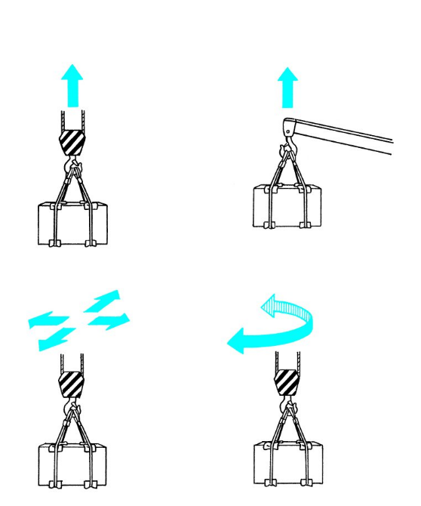
Definition of Cranes
Lift the loads by power
Carry the lifted loads horizontally

Slide 4
Relationship between Magnitude and Arm of Force

Slide 5
Moment of Leverage
Fulcrum

Slide 6
Stationary Pulley
Pull 1 m
It will rise 1 m

Slide 7
Tension of Sling Wire Ropes
m: Weight of the load
Fw: 9.8 x m (kN)
F1, F2: Tensions of sling wire rope
F: Resultant (kN)
F = Fw
P: Force pulling the sling wire ropes inward (kN)
Sling angle
Sling wire rope

Slide 8
Construction of Wire Rope
Core
Strand
Wire

Slide 9
Types of Lays
Ordinary-lay Z (right-hand)
Ordinary-lay S (left-hand)
Lang lay Z (right-hand)
Lang lay S (left-hand)
Ordinary-lay
Lang lay

Slide 10
Measuring Method for Diameter of Wire Rope
Diameter
Wrong
Correct

Slide 11
Number of Ropes and Sling Angle (a = Sling Angle)
Diagonal
Two-rope slinging with two-point
Three-rope slinging with three-point
Four-rope slinging with four-point

Slide 12
Tension Factor and Sling Angle of Wire Rope
Sling angle
Tension Factor

Slide 13
Sling Wire Rope
Eye splices at both ends
Compression joint with thimble and shackle at each end
Compression joints at both ends
Compression joint with thimble and hook at each end
Endless wire rope
Wire rope with ring

Slide 14
Compression Jointing Method
Wire rope
Thimble
Sleeve (special aluminum alloy)
Wire rope

Slide 15
Precautions when Using Sling Wire Rope
Sling angle
Sling angle
Pad
Keep in order
Humidity
Heat
Acid
Dust
Single-rope slinging
Precautions for storage

Slide 16
Types of Chain
Link chain
Nominal diameter
Stud-link chain
Nominal diameter

Slide 17
Chain Sling
Chain with ring
Ring
Chain with hook

Slide 18
Position of Shackles

Slide 19
Example of Using Shackles

Slide 20
Eyebolts

Slide 21
Eyenuts

Slide 22
Example of Using Eyebolts
Use the washer to adjust

Slide 23
Lifting Beam
Lifting beam

Slide 24
Pad
Jute bag
Fabrics
Rubber sheet
Copper or copper alloy
Welded structure
Magnetic pad

Slide 25
Bearer Blocks
Use blocks of equal size.
Hold a block from two sides with both hands.
Hold the left and right side of the block.
The load becomes unstable.
Do not put your hand on its top.

Slide 26
Deformation of Chain
Distorted link
Bent link
Twisted link
Dent
Bend
Twist

Slide 27
Opening and Wear of Hooks

Slide 28
Wear of Shackles

Slide 29
Slinging Outfits

Slide 30
Evacuation Location
2 m or more
Traveling
Evacuation location
45°
Derricking
Slewing
Traversing
2 m or more
Evacuation location
2 m or more
longitudinal length of load
Overhead traveling crane, Bridge crane
Mobile crane, Jib crane

Slide 31
Methods of Hanging on the Hook
Fastening wire ropes by eye

Slide 32
Methods of Hanging on the Hook
Single-turn slinging
Within 60°

Slide 33
Methods of Hanging on the Hook
One-round-turn slinging
Within 60°

Slide 34
Methods of Hanging on the Hook
Blackwall hitch
Within 60°

Slide 35
Methods of Hanging on the Hook
Looping
Looping
Effective rope
Guide rope

Slide 36
Methods of Securing Wire Ropes to Load
Fastening wire ropes by eye
When sling wire ropes are loosened, eyes may be removed.

Slide 37
Methods of Securing Wire Ropes to Load
Single-turn slinging
Sling angle
Sling angle
Two-rope slinging with four-point
Two-rope slinging with four-point

Slide 38
Methods of Securing Wire Ropes to Load
Two-rope slinging with two-point (noosing with shackles)

Slide 39
Methods of Securing Wire Ropes to Load
Two-rope slinging with two-point (fastening by eyes)
Noosing to same direction
Noosing to different directions

Slide 40
Methods of Securing Wire Ropes to Load
How to use shackles (Take attention for bolt position)
The bolt rotates.
The bolt does not rotate.

Slide 41
Methods of Securing Wire Ropes to Load
Fastening wire ropes by eye (Take attention for compression joint position)

Slide 42
Methods of Securing Wire Ropes to Load
One-round-turn slinging with two-rope and four-point

Slide 43
Methods of Securing Wire Ropes to Load
One-round-turn noosing with two-rope and two-point

Slide 44
Methods of Securing Wire Ropes to Load
Bale sling hitch
Single-turn slinging
Fastening wire ropes by eye
Passing doubled over part through eye
Passing eyes through a sling wire rope doubled over
Use endless wire rope

Slide 45
Methods of Securing Wire Ropes to Load
Slinging with single hitch on bottom
Sling angle

Slide 46
Methods of Securing Wire Ropes to Load
Single-rope slinging

Slide 47
Chain with Clamp

Slide 48
Chain with Sling Hook

Slide 49
Endless Chain for Hacker

Slide 50
Chain with Fundry Hook (with Wide Opening)

