Slide 1
For Your Safety and Health at Work
For People Working as Security Guards

Slide 2
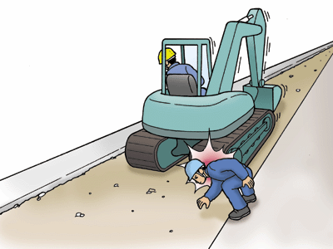
You are surrounded with various types of danger at work
[Workplace accident: Case 1] A worker was run over by a drag shovel while directing vehicles during a road widening project
1 How did the accident occur?
Worker A (second year working with the company) was a security guard
in charge of traffic control at the construction site.
As the driver and project manager on the construction site, Worker B was
using the drag shovel on the day for widening the prefectural road and
performing other roadbed improvement work.
Worker B was driving the drag shovel back and forth to apply pressure to
the powdered stone, when A was hit in the head by the drag shovel.
2 Working unsafely
Worker B reversed the drag shovel without fully checking behind him.
Worker A had moved from his position to the area where the drag shovel was operating
(an area he should not have entered).
The work plan and procedures were not made clear in light of the progress and changes in the work.
No one had been appointed to monitor the overall operation.
3 What should be done for safety in work
Review and clarify work plans and procedures in light of the work progress and changes in site conditions.
Allocate traffic guards to appropriate posts based on their experience and other factors.
Clarify instructions prior to the start of work and adhere to rules in relation to hazardous areas, no-standing zones,
and other relevant areas.

Slide 3
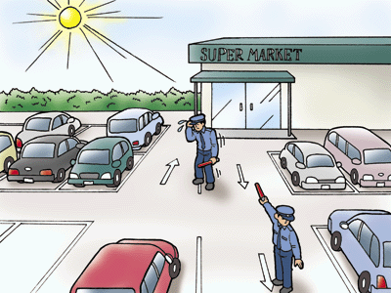
You are surrounded with various types of danger at work
[Workplace Accident: Case 2] A worker suffered heatstroke while directing and organizing vehicles at a rooftop parking lot under the hot sun
1 How did the accident occur?
As a security guard, Worker C was in charge of directing and organizing
vehicles at a rooftop parking lot of a supermarket under the hot sun.
He had been in charge of the same task for three consecutive days at that
point, and although he complained to the site manager on the day that he
didn't feel well, Worker C decided that he was fine and returned to his duties.
The site manager noticed that Worker C looked unwell and ordered him to
take a break, but then the worker was found lying on the ground having
vomited. He died of heatstroke.
2 Working unsafely
His physical condition had deteriorated due to working under the hot sun for consecutive days.
He was performing his tasks without making sure he was having enough breaks.
The site manager as well as Worker C lacked knowledge about heatstroke and failed to take appropriate measures.
3 What should be done for safety in work
Secure enough breaks, rest area, and other relevant conditions in light of workers' health conditions.
Be mindful of water and salt replenishment, clothing, and other relevant aspects that should be considered when
working long hours under the hot sun.
Provide thorough education on heatstroke, including emergency response.

Slide 4
Workplace accidents in the security service sector are on the rise
[Characteristics of accidents in the security service sector]
Trend of workplace accidents in the security service sector
The number of fatalities and injuries resulting in four or more days of absence from work is on the rise
Though with some fluctuation, fatalities are also on the rise.
Fatalities
Fatalities
and injuries
Types of accidents of the affected security guards
Types of accidents resulting in death
FY2018
16 Fatalities
There were many slipping / stumbling and traffic accidents
The majority of fatal accidents were caused by traffic accidents.

Slide 5
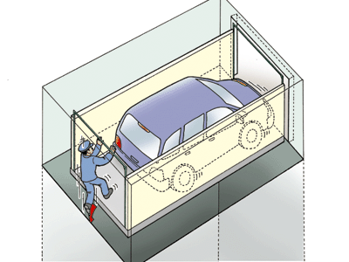
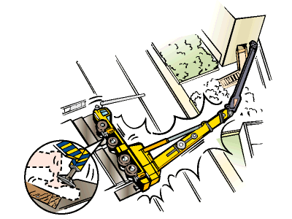
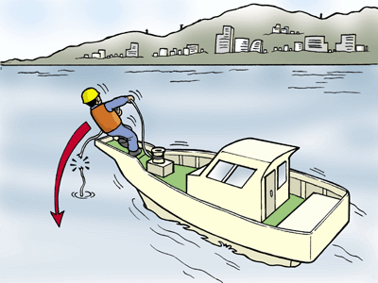
Recognize danger by thinking about the potential of hazards
[Hazardous potential of things]
[Hazardous potential of people]
Things
move;
rotate;
fly apart;
fall;
come off;
catch fire;
come down;
collapse;
explode; or
leak out
People
fall;
suffer lower-back pain;
stumble & fall down;
get stuck;
get caught;
collide;
be hit;
get burnt;
get an electric shock;
MAY
MAY

Slide 6
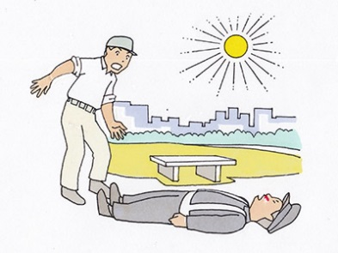
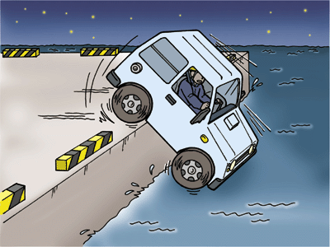
Recognize danger by thinking about the potential of hazards
[Hazardous potential of the environment]
MAY
Temperature is
high (hot)
low (cold)
Surrounding is
dark (hard to see your feet)
too bright (backlighting)
Worksite is
high (risk of falling)
weak (risk of collapse)

Slide 7
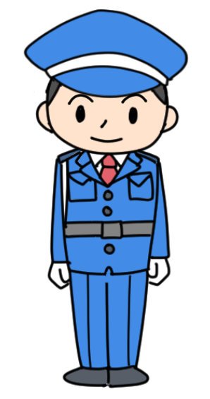
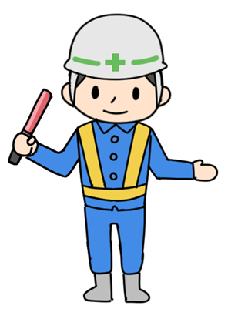
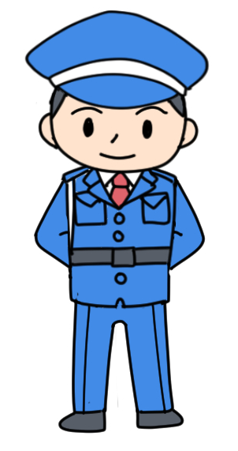
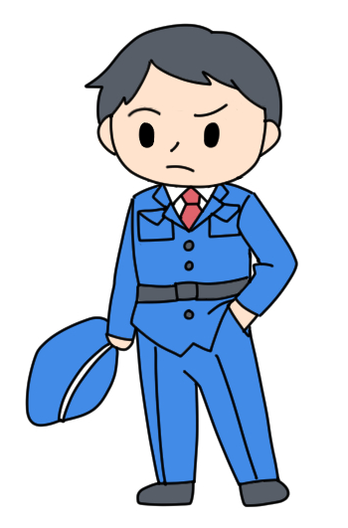
Safety in the workplace starts with appropriate clothing, posture, and "Ho-Ren-So"
Wear the designated clothing and equipment.
To maintain clean and tidy appearance, make sure you look after your work clothes to keep them free of dirt and wrinkles.
Do not bring unnecessary or personal items, and always be mindful of how you appear to others.
Wear your ID, company badge and armband properly.
Security guards in charge of traffic control in particular should wear helmets, reflective vests, and other relevant equipment so that they are visible to drivers and others at night.
〇
×
Lift your chest and straighten your back on your guard duties.
Make sure you have enough time and composure to get into your position.
Maintain correct posture and a wide vision while on duty so that you can see your surroundings fully.
Act briskly and efficiently.
Be careful of putting your hands in your pocket while on duty, since this prevents your hands from reacting quickly, while also leaving a negative impression on others.

Slide 8
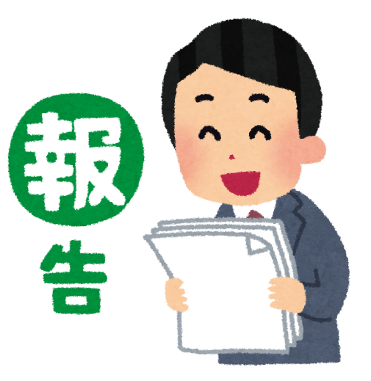
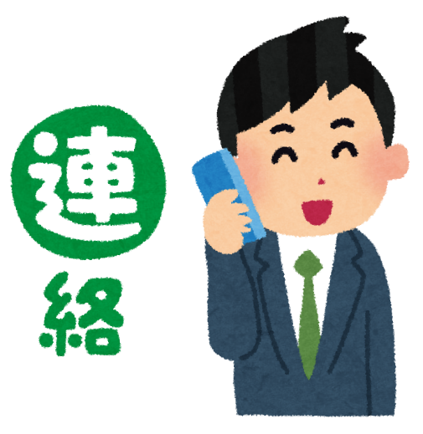
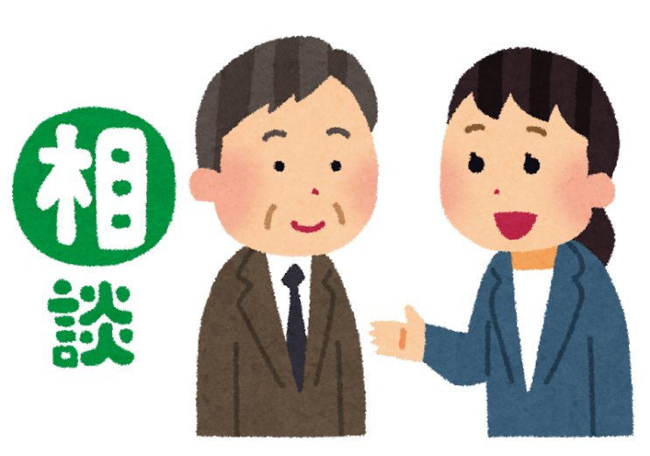
Safety in the workplace starts with appropriate clothing, posture, and "Ho-Ren-So"
What is "Ho-Ren-So"?
Report ( Hokoku )
  It means that the work staff reports to the manager about the work progress and outcome.
Inform ( Renraku )
  This is to inform the relevant parties of the information that should be shared with them, such as that obtained during work.
Consult ( Sodan )
  This is to ask for opinions and advice when you are asked to make a decision, or when you are not sure about your decision, etc.
Report
Inform
Consult
Promptly report any mistakes or problems as well as any abnormalities. This will lead to early resolution.
Keep 5W1H in mind and communicate (convey) information accurately.
If you can't solve the problem by yourself, don't leave it as it is, but consult those around you.
If you sense anything unusual, even if it is trivial, report it to your supervisor, security company, contractor, and other relevant parties.

Slide 9
Review and comply with the Security Directive
Security Plan
  This sets out the details of security operation.
  Security directives (security instructions) are prepared for each security guard based on this security plan regarding execution of security duties.
Security Directive
  This specifies the details and procedures of security tasks, patrol routes, and emergency response methods.
  When carrying out security work, be sure to fully understand the details and precautions described, and ensure compliance with the security instructions.
There have been many cases of people failing to follow the rules and procedures that should have been followed, leading to workplace accidents

Slide 10
Review and comply with the Security Directive
Key Points [Facility Security Guard]
  Make sure you thoroughly understand the details of the security plan and directives, as well as the regulations of the facility.
  Check in advance how to handle and manage equipment such as lifts, fire shutters, and fire doors, as well as electronic locks and keys.
  Check and comply with the relevant laws, regulations, and rules for what you should and should not do for safety.
  Follow the specified routes and rules (such as using a flashlight at night) to patrol safely.
  When you take over duties from your predecessor, ask about safety precautions.
  Never fail to consult a supervisor or a predecessor when you find anything you do not understand.
  Be careful of injuries that arise from getting too accustomed to your work, and avoid careless or unreasonable actions

Slide 11
Review and comply with the Security Directive
Key Points [Traffic Controller]
  Make sure you thoroughly understand the details of the security plan and directives, as well as the regulations of the facility.
  In addition to correctly wearing the designated equipment (e.g. traffic control flags, traffic baton, whistle, walkie-talkies), take extra care to check the battery level of battery-operated equipment and that they are working properly.
  During the night in particular, be sure to wear a vest with high visibility and reflective functions (reflective vest) so that you are visible to drivers and others.
  Comply with security directives and watch out for vehicles not only when setting up but also when removing traffic control materials (traffic cones, etc.).
  Check and comply with the relevant laws, regulations, and rules for what you should and should not do for safety.
  Never fail to consult a supervisor or a predecessor when you find anything you do not understand.
  Be careful of injuries that arise from getting too accustomed to your work, and avoid careless or unreasonable actions

Slide 12
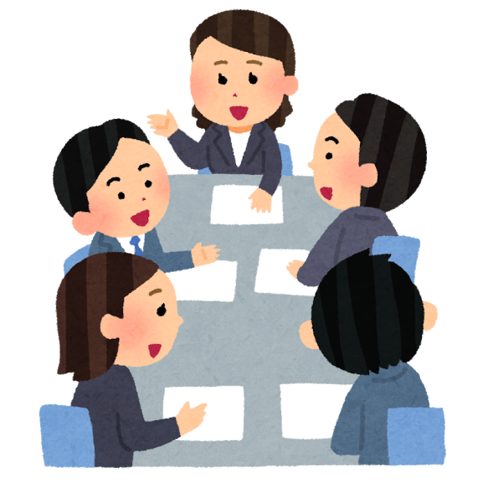
Let's Practice Risk Prediction Activities (KYT).
What is "Risk Prediction Activities (KYT)"?
  Abbreviation of Kiken ("risk") Yochi ("prediction"), and Training.
  Before starting work, those involved should discuss the dangers that lie in that work ("this point is dangerous") and the kind of hazard that may arise from such danger ("this may result in xx"), and identify the risk in advance and consider and put in place countermeasures against said risk.
The floor of the outside passage is made of steel plate, so it might be slippery when it rains.
The stairs here are dark and it's hard to see your feet, so people might trip and fall.
Let's ask them to turn on the lights. We'll need a flashlight.
Then let's get some non-slip shoes. How about putting mats on the passage?
We are going to be working with some heavy equipment today, and with the way things are currently set up, it might collide with the guards.
Let's revise the plan to reflect the positioning of staff.

Slide 13
Let's Practice Risk Prediction Activities (KYT).
KYT Basic 4 Round Method
  This is a basic KYT method in which teams work together on-site or using illustration sheets and actual objects to discover, understand, and resolve dangers hidden in workplaces and tasks.
Rounds | Outline
[1R] Understand the situation | List some of the underlying dangers
[2R] Focus on the essential elements | Narrow down which ones are the most important
[3R] Establish countermeasures | Think about how you could prevent that from happening
[4R] Set targets | Set some action targets to achieve these measures

Slide 14
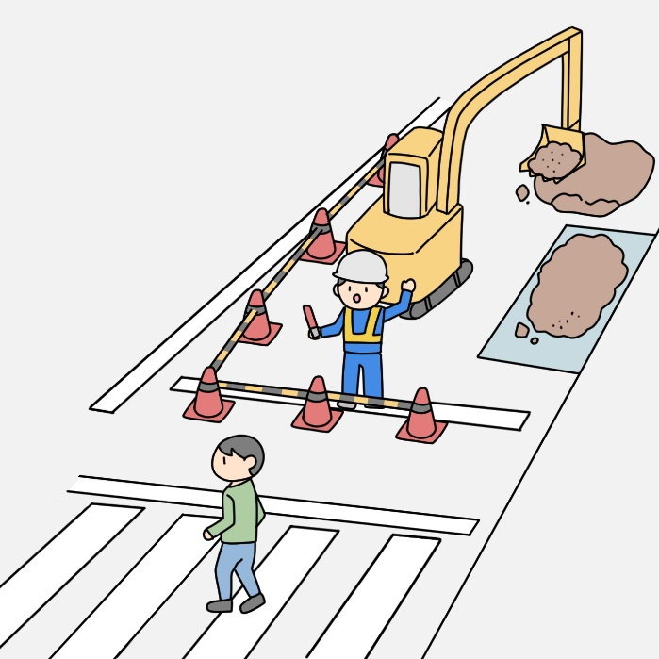
KYT Case Study
Let's practice some KYT using a case where you are directing passersby on a road construction site

Slide 15
KYT Case Study
Let's practice some KYT using a case where you are directing passersby on a road construction site
Rounds | Outline
[1R] Understand the situation
[2R] Focus on the essential elements
[3R] Establish countermeasures
[4R] Set targets

Slide 16
KYT Case Study
Let's practice some KYT using a case where you are directing passersby on a road construction site
Rounds | Outline
[1R] Understand the situation | I may be too focused on the passerby that I might not notice an approaching hydraulic excavator and get run over. I might slip and fall after stepping on the gravel that has spilled from the raised ground. I might get hit by an arm that swiveled suddenly.
[2R] Focus on the essential elements | I may be too focused on the passerby that I might not notice an approaching hydraulic excavator and get run over. I might slip and fall after stepping on the gravel that has spilled from the raised ground. I might get hit by an arm that swiveled suddenly.
[3R] Establish countermeasures | Stand away from the direction that the hydraulic excavator is moving. The driver and the security guard should decide in advance how to signal for when they are going to move the hydraulic excavator.
[4R] Set targets | When moving the hydraulic excavator, the driver should use a walkie-talkie to communicate with the security guard and both parties confirm it is safe before moving it. (If you can't confirm it, don't move it.)

Slide 17
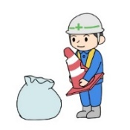
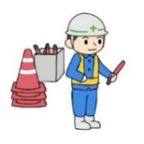
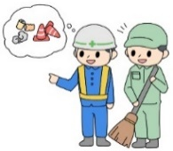
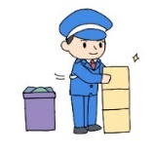
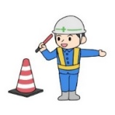
Enhance a safe working environment by practicing the 4S and 5S
Classify (Seiri) | Separate what you need from what you don't need, and get rid of the unnecessary ones. Unnecessary items placed carelessly on passages and other places may cause you to stumble and fall.
Set in order (Seiton) | Place everything you need separately so you can access them easily. You can increase your work efficiency by devising a way to use what you need when you need it. Moreover, be sure to put them away properly and return them to their original position after use (a photo showing their original position will make it easier to keep them tidy).
Clean up (Seiso) | Clean up to remove any debris or dirt. If the floor is cluttered with rubbish and other items, or if the floor surface is wet with water or stained with oil, there is a risk of stumbling or slipping and falling.
Keep clean (Seiketsu) | Maintain a tidy, organized, and clean environment. To maintain a comfortable work environment at all times, repeat the process of tidying, organizing, and cleaning. This is also necessary for maintaining the normal operation of equipment, etc. Cleanliness also helps to prevent infections.
Establish discipline (Shitsuke) | Practice the 4S and make it a habit. Follow the specified rules strictly, and make it a habit by repeating the proper procedures. The 4S must be established as a habit that you practice, and not just understood.

Slide 18
Key points for accident prevention Slipping / Stumbling
Always keep the workspace safe with the 4S: Seiri ("classify"), Seiton ("set in order"), Seiso ("clean up"), and Seiketsu ("keep clean")
  Items and cords cluttering the floor increase the risk of stumbling and falling.
  A floor becomes slippery and increases the risk of slipping and falling when its surface is wet.
Check the conditions of the floors and passages
  The risk of falling increases when there are steps and uneven surfaces on a wet floor, as not only is it easy to slip, but also to trip over.
Make sure the passages are well lit
  The risk of falling increases in dark, poorly lit areas, as you are more likely to stumble over objects or steps that you don't notice.
Use shoes that won't make you slip and stumble easily
  Use non-slip shoes such as those with rubber soles to prevent slipping and stumbling.

Slide 19
Key points for accident prevention Slipping / Stumbling
Main places that are prone to slipping
Main places that are prone to stumbling
Indoors | Outdoors
Floor surface stained with water, oil, etc. Shower room, kitchen and other wet areas Mats and carpets on low-friction floors Stone floors and waxed flooring | Manhole (especially that in a wet condition) Grating (mesh trench covers) Copper plates (metal plates) on stone floors and construction sites Metal surfaces on stairs and passages Frozen surface
Indoors | Outdoors
Floor surface with steps or unevenness Objects placed in passages or on the indoor floor Curled up or warped mats and carpets Legs of tables and partitions Cords placed haphazardly | Roads and passages with steps and uneven surfaces Curbs, curb ramps, and plantation such as roadside trees Stairs, moving walkways and escalators Braille blocks and ramps
[Case Study]
Slipped and fell on the floor when going indoors with wet shoes after patrolling outdoors in the rain.

Slide 20
Key points for accident prevention Traffic Accident
[When getting ready]
Wear the designated equipment
  Make sure to check the battery level of items that operate on batteries, in addition to wearing the designated equipment such as a traffic control flag, traffic baton, whistle, walkie-talkie, protective cap (helmet), and reflective vest.
Stand on the sidewalk as a basic rule
  Sometimes,especially at night or when backlit, it may be difficult for drivers to see the guard even on roads with good visibility, so please stand on the sidewalk unless you have unavoidable reasons for not doing so.
Stand in plain view of the drivers
  If the security guard stands in the driver's blind spot, the driver may start driving without noticing the guard.
Keep an appropriate safety distance from vehicles
  Maintaining an appropriate safety distance allows the guard to have enough time to react to an unexpected sudden departure of a vehicle or in the event that the guard himself slips and falls in bad weather.
Give signals with big, clear movements
  Unclear signals can confuse the driver and result in guiding them improperly
[During traffic control]

Slide 21
Key points for accident prevention Traffic Accident
[During traffic control]
Allow plenty of time to give signals
  To ensure safety, pay attention to the stop distance and other elements, and allow plenty of time to give signals, particularly in bad weather or in winter when the road surface is icy.
Drive safe
  When driving vehicles including security vehicles, it is important to drive safely and to observe driving etiquette to prevent triggering traffic accidents.
[While driving]
[Case Study]
On a day when the roads were icy, the guard gave a stop signal at the same timing as on normal days to a bike rider, who couldn't stop in time and collided with the guard.
[Case Study]
While directing traffic during inclement weather, the batteries in the traffic baton ran out, but the guard continued using it, making it difficult for drivers to see the guard and resulting in collision.

Slide 22
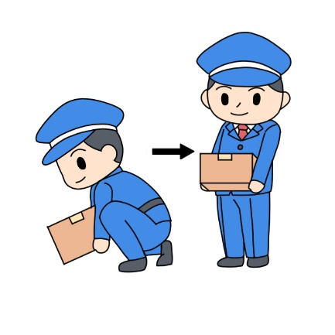
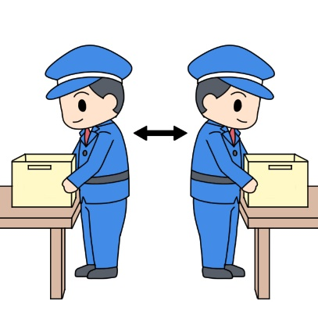
Key points for accident prevention Lower-back pain
Use a dolly to carry heavy items
  Use tools such as dollies and containers to minimize the strain on your lower back when carrying heavy items.
Handle heavy items with proper posture
  If it is not possible to use tools, remove items and cords that are lying around, and bring the heavy item as close to your body as possible in a posture that lowers the center of your gravity.
Lifting heavy items | When changing direction while carrying items
When lifting items from the floor or ground, put one foot slightly in front of the other, bend your knees, and lower your hips enough to carry it. Then, extend your knees and stand up.
When changing direction while carrying items, turn around using your entire body and maintain a comfortable posture.

Slide 23
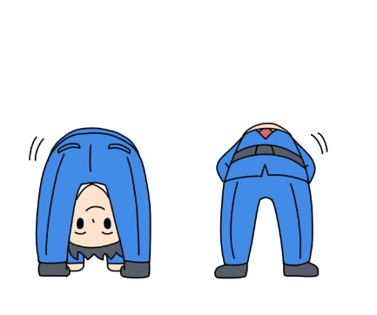
Key points for accident prevention Lower-back pain
Prevent back pain by keeping your body active, such as doing stretches
  You can prevent back pain by stretching on a regular basis, not just before starting work.
Practice stretching
You can prevent back pain by strengthening the muscles that support your lower back, such as your abdominal and back muscles, as well as by keeping your muscles flexible.
[Case Study]
The guard tried to pick up an item on the floor after being on his feet for long periods of time for his security duties, but the item was heavier than expected and his back was not properly bent, causing his back to suddenly hurt and him being unable to move.

Slide 24
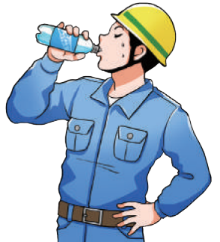
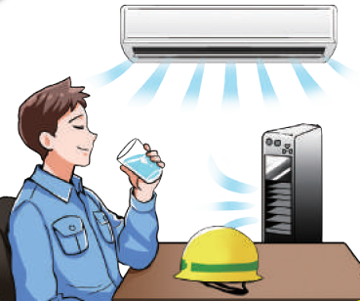
Key points for accident prevention Heatstroke
Regularly replenish water and salt, and take breaks
  Replenish water and salt even before starting work, and take frequent breaks as well as regular sports drinks.
In addition to water, you should also take salt (sodium).
Keep a supply of sports drinks and salt candies handy and available at all times.
Take a break in a cool room.
While on your break, cool your body surface, head and limbs as well as replenish water and salt.

Slide 25
Emergency response in the event of heatstroke
If you suspect that you yourself have heatstroke
  If you are sweating profusely, dizzy, or lightheaded, immediately report to your colleagues or the manager, move to a cool place, replenish water and salt, and take a break.
  If your symptoms persist (or worsen), report it to your colleagues or manager and ask them to contact a medical institution immediately.
  There have been cases of people collapsing on their way home or after returning home even when their symptoms have subsided after a break, so it is advisable to wait after work until your body reaches normal temperature and stabilizes before returning home.
If you suspect that your colleague has heatstroke
  If your colleague looks red, is wobbly, or behaves in an unusual way, immediately call out to them, move them to a cooler place, give them water and salt, and make them take a break (let the other colleagues and manager know too, and don't leave them alone until they recover).
  If they collapse, take measures such as contacting a medical institution, according to the Heatstroke Prevention Leaflet as reference.
  In order to respond to emergencies smoothly, it is important to practice drills on a daily basis so that you can respond to emergencies without delay. Before starting work, make sure you know who to report to, the contact information for medical institutions and other relevant contacts, and the location of rest areas and sports drink storage.

Slide 26
Key points for accident prevention Falling
Check the patrol routes and passages while it is still bright
  Check the location of stairs, steps, slippery areas, etc., while it is still bright, and if there is a risk of falling, share such information with others to eliminate the danger.
Secure the foot of the stepladders
  When using stepladders or other equipment to work at heights, the risk of falling from the stepladders, or the stepladders falling, increases if their feet are not secured.
Do not ride on lifts such as car lifts that are not designed for carrying people
  The lifts are for "cargo only," and you are not allowed to ride them for any reason.
Precautions when using stepladders and stepstools
Stepladders and stepstools should be used on a solid floor, not on a soft floor. The stopper to prevent the stepladder from opening should be properly applied before use. Avoid riding on the top of a stepladder or straddling it. Do not use stepladders that have damages on areas such as the stopper or end caps (ladder feet), or deformed stepstools and other relevant damaged equipment, and replace them accordingly.

Slide 27
Key points for accident prevention Getting Stuck
Stand in plain view of the drivers
  If the security guard stands in the driver's blind spot, the driver may start driving without noticing the guard.
Check the operating ranges of lifts and special vehicles
  Check the movement of special vehicles such as lifts and drag shovels (e.g. up and down movement, shovel swivel range) and maintain a safe distance.
Understand the door's mechanism to avoid getting your hands and fingers stuck
  Understand the direction in which the door opens and closes, the mechanism of automatic doors, etc.
[Case Study]
When the guard tried to go out for patrol, the strong wind suddenly slammed the door shut on him, getting his hand stuck.
[Case Study]
He lowered the lift even though his foot was directly underneath it, causing his foot to be caught by the lift.

Slide 28
Key points for accident prevention Assaults
[Response to suspicious individuals]
Speak to them respectfully and explain politely
  You can avoid conflict by being attentive to the emotions and feelings of the other person.
Keep appropriate space between each other
  To avoid direct harm from suspicious individuals, avoid approaching them unnecessarily.
If there is a suspicious individual, deal with them in a group
  Do not respond to a suspicious individual alone, but form a team of several people
[Dealing with bees]
Avoid approaching or stimulating them unnecessarily
  Ask a specialist to handle it.

Slide 29
Key points when abnormalities occur
Contact law enforcement, etc.
  In addition to calmly assessing the situation, prevent the spread of damage, and provide first aid and guidance to the injured.
Preserve the scene
  There is a lot of evidence left behind that could have been the cause of crimes or accidents.
  Make every effort to preserve the scene in its original state, and cooperate with the police and firefighters in their duties, such as collecting evidence.
Perform emergency resuscitation
Direct people to evacuate
  Since security guards are often assigned the role of directing people to evacuate and extinguishing fire at an early stage, be sure to check the evacuation plan and make preparations for directing people to evacuate.
Extinguish fire at an early stage
  When a fire such as an incipient fire is discovered, it is important to make efforts to extinguish it in its early stages, as well as to direct people to evacuate.
  However, if you feel you are in danger yourself or if the fire has spread to the ceiling, evacuate immediately.

Slide 30
Key points when an accident occurs
The risk of workplace accidents cannot be reduced to zero, even when active health and safety management and actions are taken by security companies, contractors and security guards themselves.
In the unlikely event that a workplace accident occurs at a worksite, take action (such as first aid) to attend to the victims.
Accident
First, keep calm
Never rush to the site, or you may suffer a secondary accident.
Action on the site
Relieve victims
Contact site/security managers
Take victims to a hospital

Slide 31
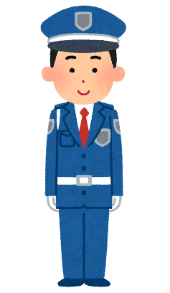
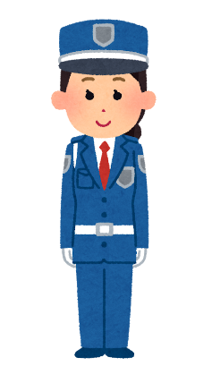
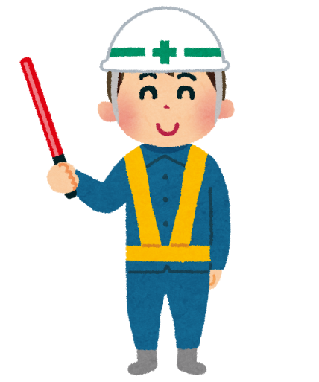
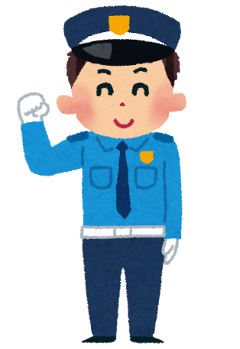
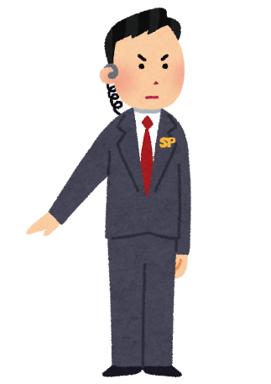
Thank you

